Slide 1
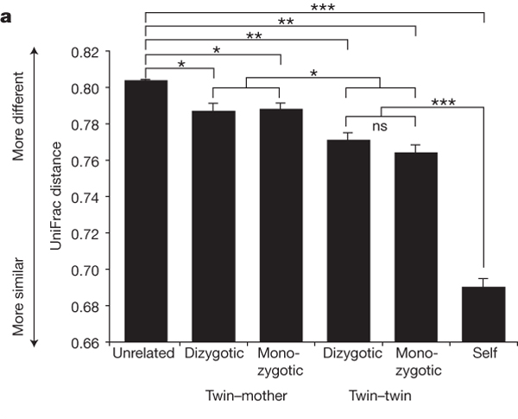

16S rRNA gene surveys reveal familial similarity and
reduced diversity of the gut microbiota in obese individuals.
PJ Turnbaugh et al. Nature 000, 1-5 (2008) doi:10.1038/nature07540

