Slide 1
Classification models for the diagnosis of breast cancer
Megan Hoeksema
Capstone Mid-Term Project
25 JAN 2023

Slide 2
Research question and Purpose
Project Purpose:
To understand the performance of Decision Trees, Random Forest, KNN, SVM and Naïve Bayes in predicting the diagnosis of breast tissue masses as malignant or benign.
Research Question:
Of the following algorithms, KNN, SVM, Decision Trees, Random Forest and Naïve Bayes, which will produce a better model for predicting the diagnosis of breast tissue masses as benign or malignant?

Slide 3
Introduction to the Dataset
Breast Cancer Wisconsin (Diagnostic) Data Set
https://www.kaggle.com/datasets/uciml/breast-cancer-wisconsin-data
569 Total Patients – 357 Benign, 212 Malignant
30 descriptive features computed from a digitalized image of a fine needle aspirate acquired from patient breast masses.
These features describe the nuclei of the cells contained within the tissue sample using the mean, SE and “worst”.
These features contain:
radius (mean of distances from center to points on the perimeter)
texture (standard deviation of gray-scale values)
perimeter
area
smoothness (local variation in radius lengths)
compactness (perimeter^2 / area - 1.0)
concavity (severity of concave portions of the contour)
concave points (number of concave portions of the contour)
symmetry
fractal dimension ("coastline approximation" - 1)

Slide 4
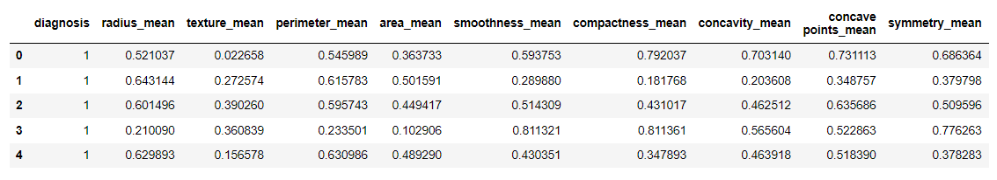
Data Pre-Processing
Removed 2 columns:
Column 32 contained all NaN values
Column 1 contained the patient identifier
Checked for null values in the entire dataset – dataset was clean with 0 NaN
Converted target variable from categorical to numerical (0 – Benign, 1 - Malignant)
Continuous data was scaled using a MinMaxScaler then split into training and test sets at a 70/30.

Slide 5
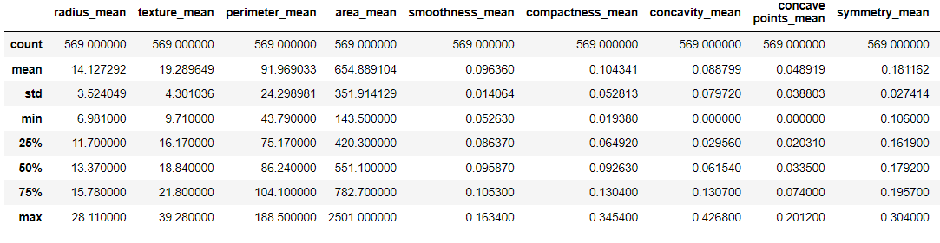
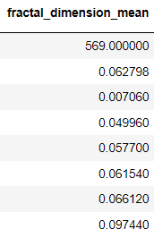
Data Exploration
Descriptive statistics for the first 10 features

Slide 6
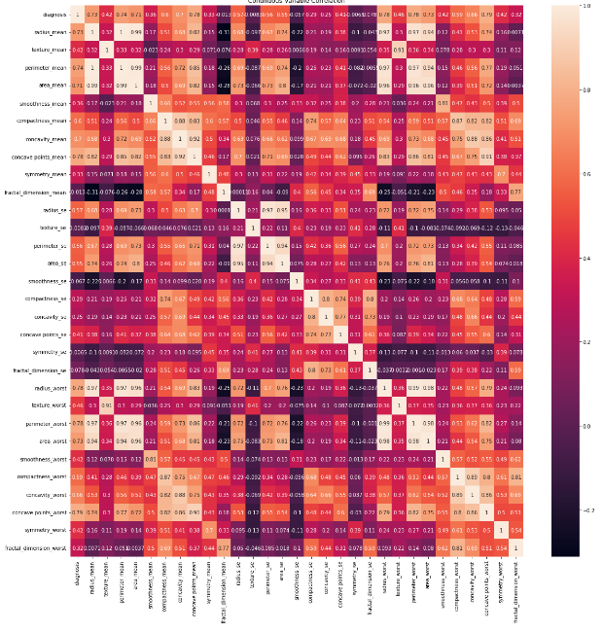
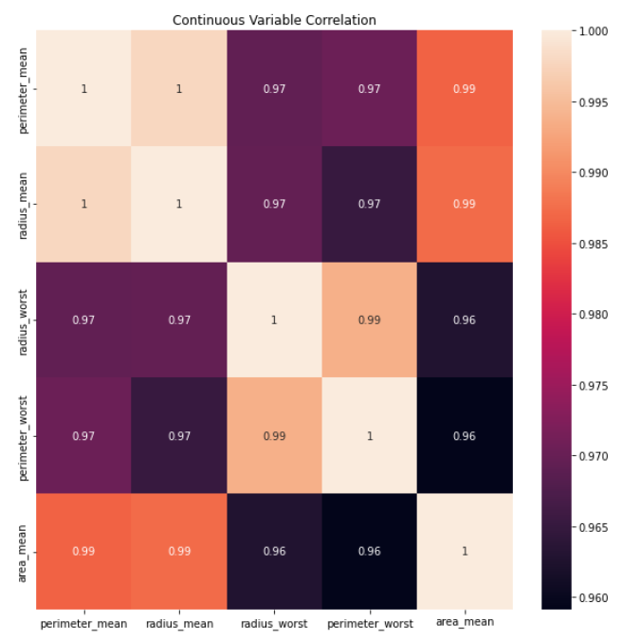
Data exploration
Top 5 Highly Correlated Features

Slide 7
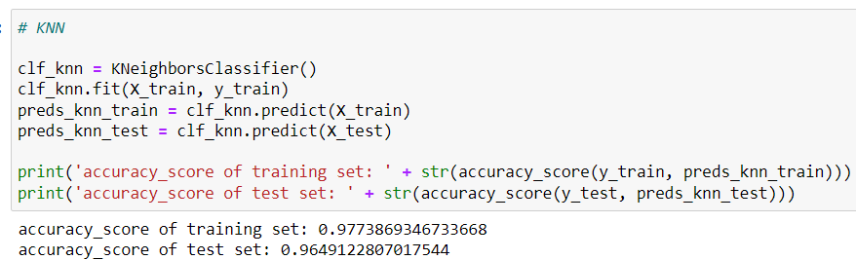
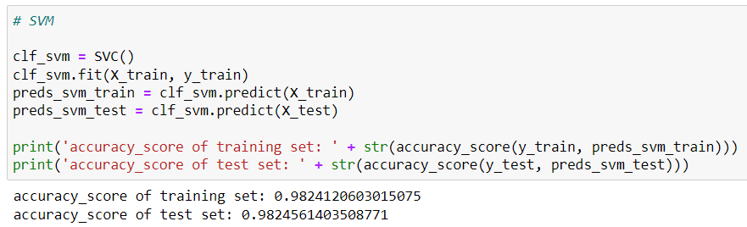
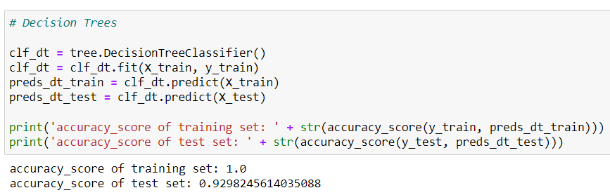
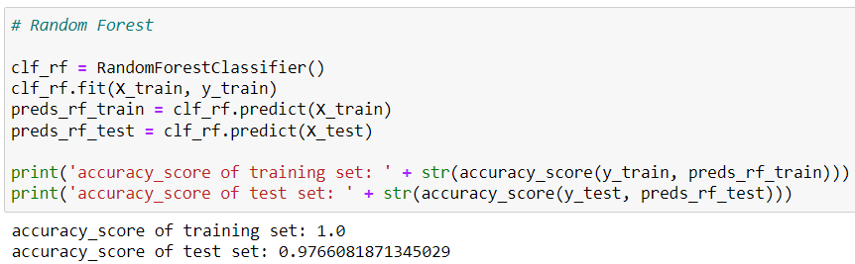
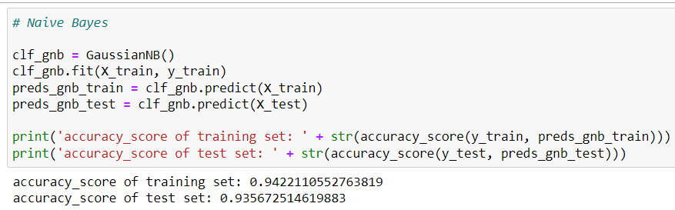
Data Analysis
All models were first performed without any feature selection or hyperparameter tuning
Based on the accuracy scores of the test set, SVM performs the best with an accuracy score of 0.982. Decision Trees performs the worst of the 5 models with an accuracy score or 0.929.

Slide 8
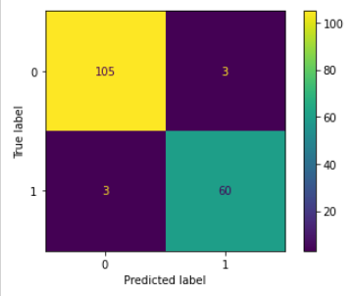
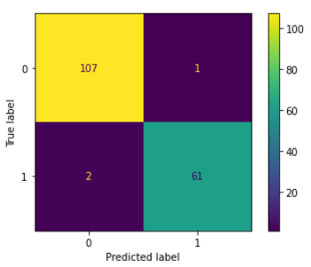
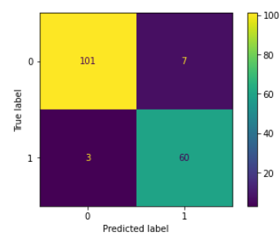
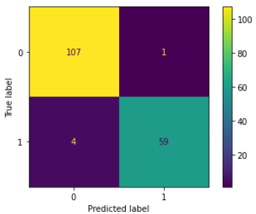

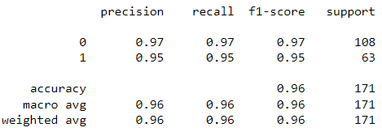
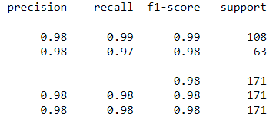
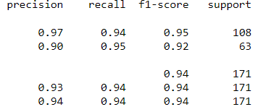
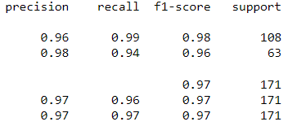
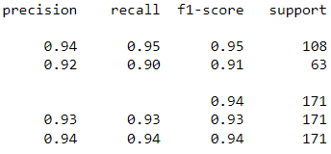
Data Analysis
KNN
SVM
Decision Tree
Random Forest
GNB

Slide 9
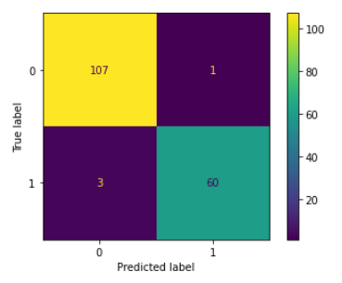
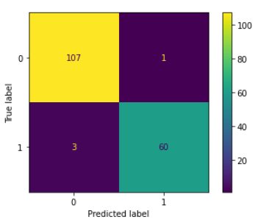
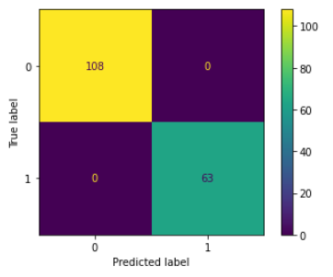

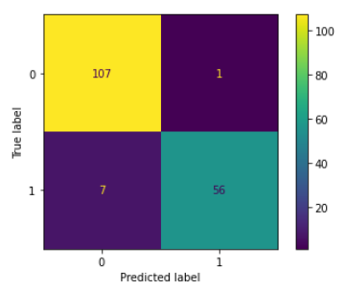

Data analysis- hyperparameter tuning
KNN
SVM
Decision Tree
Random Forest
Gaussian Bayes

Slide 10
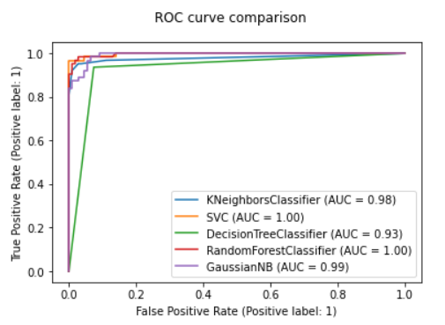
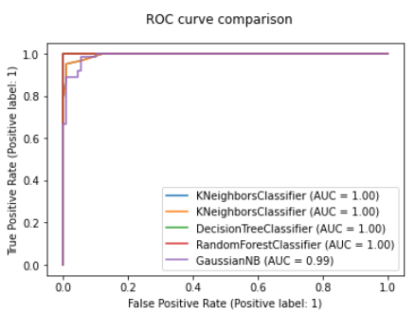
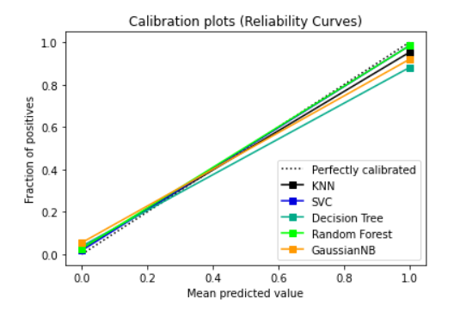
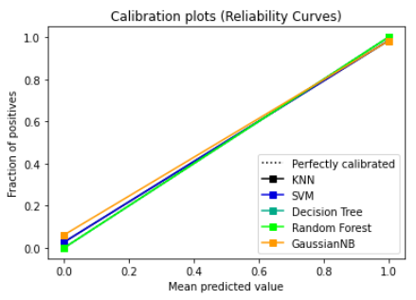
Data Visualization
Tuning Hyperparameters

Slide 11
Conclusions
Top 5 highly correlated variables:
Perimeter Mean, Perimeter Worst, Radius Mean, Radius Worst and Area Mean
All 5 models performed very well prior to hyperparameter tuning, however, the best performing based on accuracy score in the test set was SVM. The lowest performing model based on accuracy score was Gaussian Naïve Bayes
After hyperparameter tuning:
KNN and SVM did not improved. Accuracy scores remained at 0.98
Decision Tree improved the most with an accuracy score of 1.0 up from 0.92.
Random Forest also improved from 0.98 to 1.0
Gaussian Naïve Bayes improved but still remained the lowest performing model with an accuracy score of 0.95.
Time Devoted:
Data Preparation/Exploration: 20%
Model Building: 40%
Model Evaluation/Visualization: 40%

