Slide 1
Group 1 – Team 3 Issue Tracker
Iteration 2
April 1, 2015

Slide 2
Table of Contents
Summary
Requirement Analysis
Design
Architecture
Implementation
Testing
Management

Slide 3
Summary
Bug fixes and visual improvements to the platform was focus of this iteration
Functional Testing
REST implementation
Pre-Production Deployment
Production Deployment & Integration Preparation

Slide 4
Requirement Analysis
Focus on solidifying and expanding the core user stories.
Dashboard
Create Issue
View Issue
Edit Issue
Moving to a client accessible environment
Deploy to server environment

Slide 5
Design
Interface
The team worked on improving the content
A clean-up of bootstrap and keeping the core behavior intact is on-going
Web application Design
Organizing the files to utilize Django’s strengths
Static file organization
Testing App
MTV utilization – URL Resolution, View processing, Template Logic, Static Resources
Demo!

Slide 6
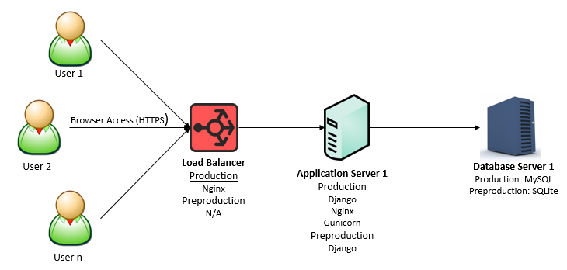
Architecture
3-layer
OS: centos

Slide 7
Implementation
Implementation points this iteration
Solidifying the user experience from a visual and functional standpoint
Utilizing a REST architecture
Stabilizing code-base through a staging to production team VCS system
Preparing for deployment in a Server Environment
Preparing for unification across groups (Production server setup underway)

Slide 8
Testing
Functional Testing based on user stories completed
Create Issue
Search Issue
View Issues (Dashboard)
Edit Issue
Demo!

Slide 9
Management
Iteration
Existing Feature/Functionality Expansion, team was focused on stability of the platform and deployment
More team members feel comfortable with the platform, we expect, to complete all user stories by the next iteration
Issues
Django capability of all team members and completion risk – progressing
Cross-team component objects (projects, user authentication) – will be included in the integration phase
What’s Next?
Integration of code base across the 3 groups underway and preparation for a full platform deployment
Completion of all user stories
Additional Test Coverage (FTs, Unit Tests, Code Coverage)

