Slide 1
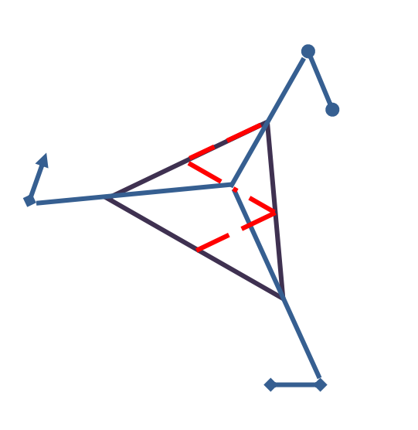


Issue Tracker Group 1 Team 3
Week of 2/4 – 2/11

Slide 2
Requirement Analysis
Bugzilla
Mantis
Lighthouse
JIRA
Github
Trak
Bugify
Redmine
Basecamp
We split the job of reviewing 9 different existing issue trackers to get a better understanding of what features we need to include in our product. After compiling a general report our Requirements lead was able to put together an outline that the rest of the team could then comment on and revise.

Slide 3
Requirements – Essential Features
Functional Requirements -All members from the project can file a defect report. -Issues are analyzed based on several features, such as severity, importance, type, priority. -Time Tracking -Status and resolution tracking -Support for MySQL databases
Nonfunctional Requirements -Security -color coding

Slide 4
Requirements - Desirable Features
-email reports and notifications -search functionality -built in wiki -calendar -tasks tracking -issue creation via email -project forums -Milestone setting
-Additional database support

Slide 5
Onboarding
Between Git and Python/Django almost everyone on our team had some homework to do when getting up to speed with these tools.
To iron out any wrinkles we met Saturday to cover our individual tasks, and then followed up by working together online over the next few days to accomplish basic tasks and instruction, like setting up a git repo, pushing and pulling branches, etc.
Also working on a very trendy team logo!

Slide 6
Tools
Version Control: Git
Issue Tracker TBD
Python/Django (Beautiful Soup)

