Slide 1
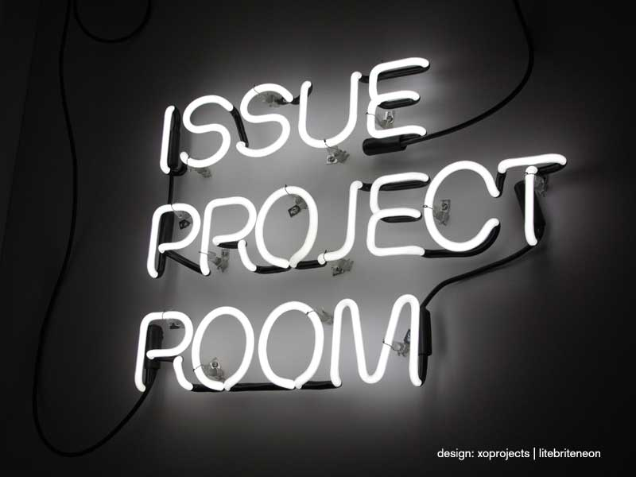
Group 1
Team 3 – Issue Tracker

Slide 2
Table of Contents
Project Management
Overview
Requirements
Process
UX Design
Mockups Sample
Final Product Sample
Software Design
MVC Pattern
Package Diagram
Class Diagrams
Sequence Diagram
Environment
Architecture (3-Tier)
Deployment
DevOps Documentation
Development Environment
Future Improvements
Implementation
Testing
Use Demo!

Slide 3
1. Project Management – Overview
Goals
Complete a client side product and integrate with other team members
Status: OK
Team members to contribute and use their strengths
Status: OK
Lessons Learned
Team members did not feel comfortable with Pivotal Tracker - was important
Iteration process (weekly sprints into the course iteration) was great for the team.

Slide 4
1. Project Management - Requirements
Goal: Create an issue tracker application much like the GitHub Issue Module
Requirements
Create Issue
Edit Issue
Assign Issue
Verify Issue
Comment on Issue
Bonus
Sort by Issue Attributes
Show Issue counts for “One Look Status Views”

Slide 5
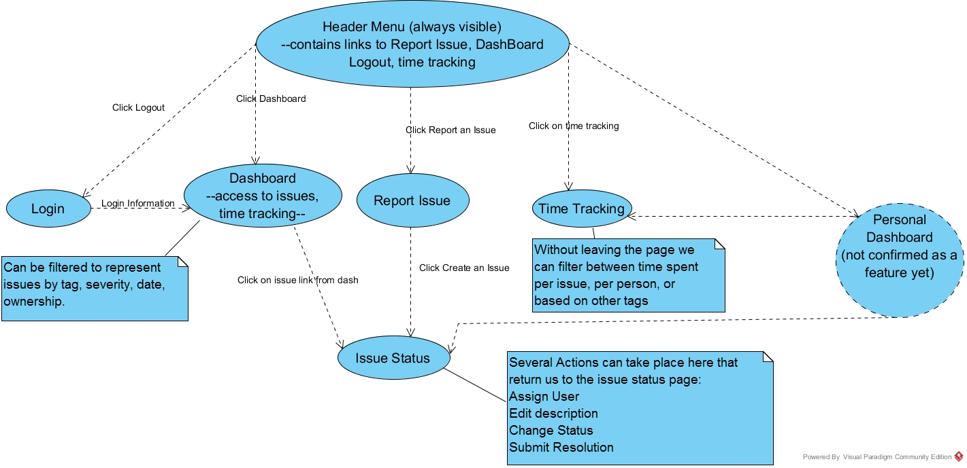
1. Project Management - Requirements

Slide 6
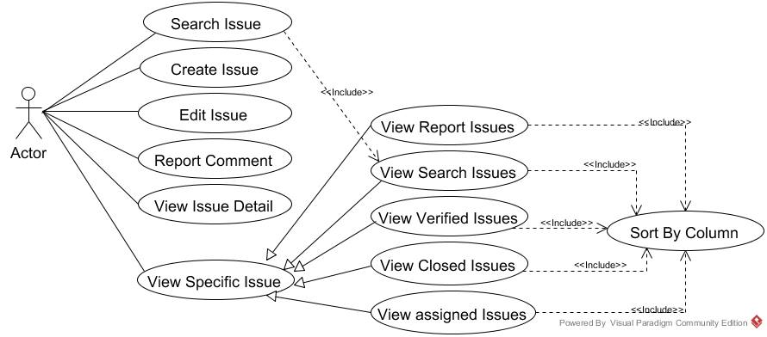
1. Project Management - Requirements

Slide 7
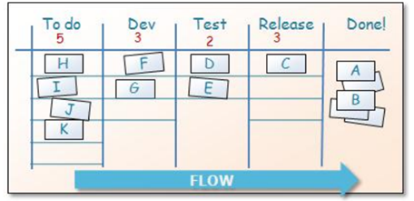
1. Project Management – Process
Weekly Meeting
Nightly after course discussion
Tasks are assigned – Track Management by Team Lead
Tasks are assigned – Team Track Management by Group Leader
Task Management
Weekly Sprints in each iteration (4 sprints)
Quality Management
Acceptance/End-User/Functional Testing Assurance Process
“Test-Driven Development with Python by
Harry Percival (O’Reilly). Copyright 2014 Harry Percival, 978-1-449-36482-3.”

Slide 8
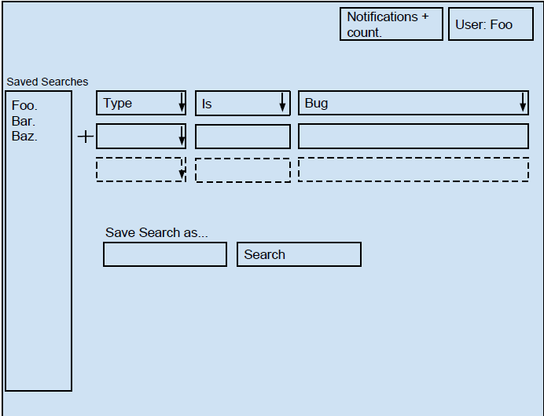
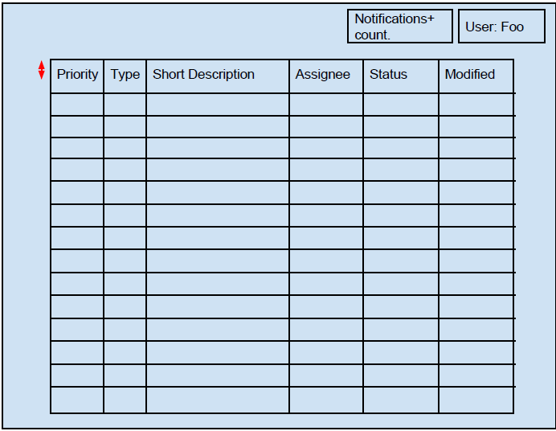
2. UX Design – Mockups Sample
Below are 2 samples of our Search and Multiple Issue Page
Other Mockups (View Issue, Create Issue…)
Search Page
Multiple Issue Page

Slide 9
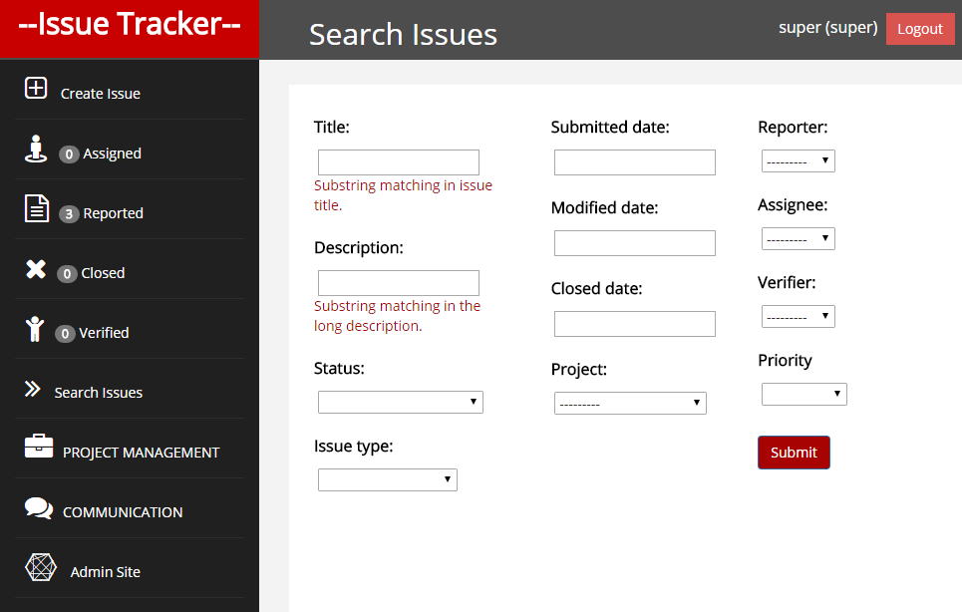
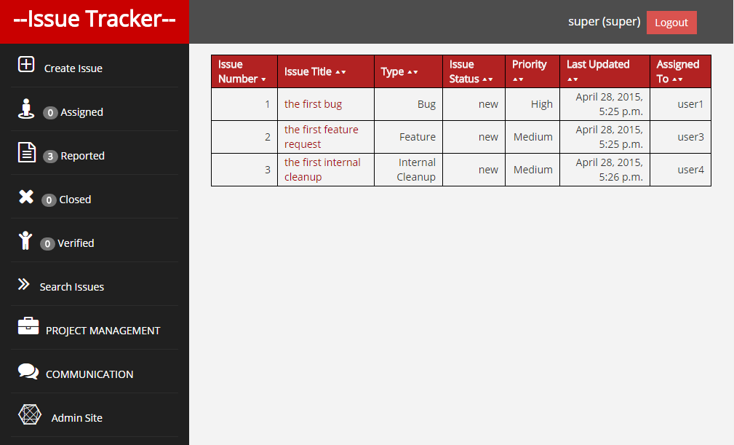
2. UX Design – Final Product Sample
Below are 2 Final Products of our Search and Multiple Issue Page
Search Page
Multiple Issue Page

Slide 10
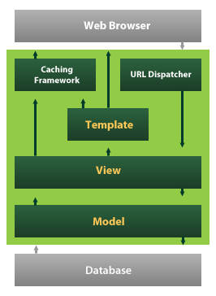
3. Software Design – MVC Pattern
Django “MVC Like” Architecture
Model View Template (Variation of the classic MVC architecture)
Models
Data Entities and records
Django ORM
View (Templates in Django)
Templates
Django Template Language
Forms
Interface with templates, models and used in the views.
Controller (Views in Django)
View – Act more like controllers
Application Logic/Application Logic Calls

Slide 11
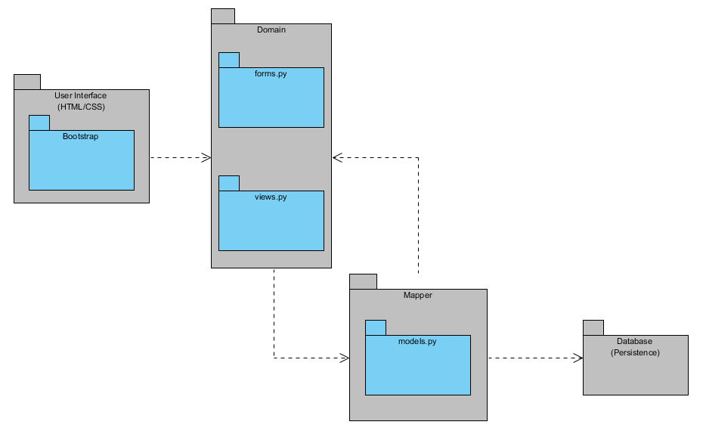
3. Software Design – Package Diagram
MVT
User Interface
Templates (Views)
Domain (Application)
Forms
Form Validation
Views
Control Flow (Controller)
Mapper
Data Model
Entities and Records
Database
Persistence

Slide 12
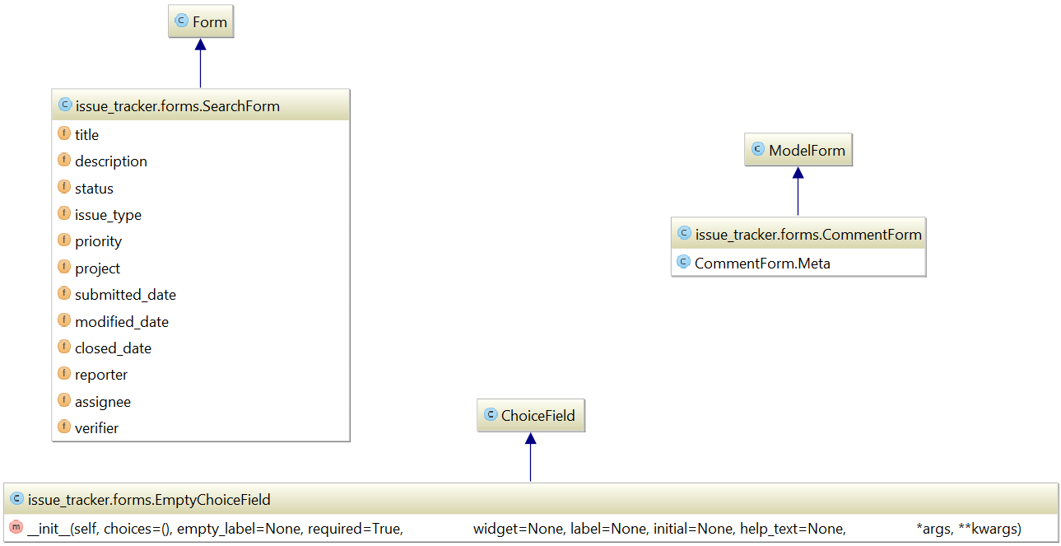
3. Software Design – Class Diagram I
DOMAIN -FORMS
Inherit from the Django Form and Model Form classes
Interface with Templates, Views and Models
Data Validation
Data input

Slide 13
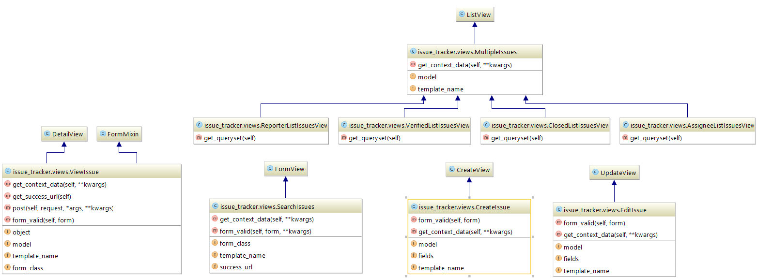
3. Software Design – Class Diagram II
DOMAIN -VIEWS
Inherit from the Django Views and reverse link via the Models Class Meta classes
Utilize form validation
Query sets and Models
Hold the application logic
Search Issue
Create Issue
Edit Issue

Slide 14
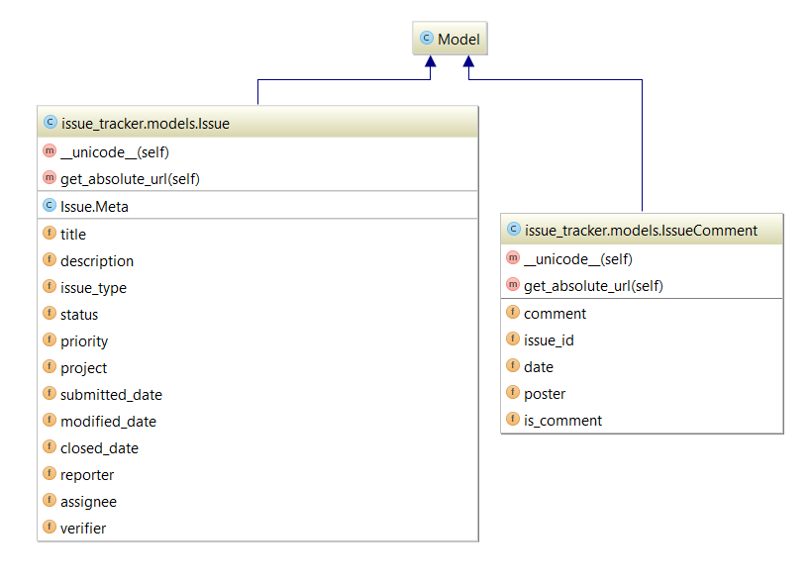
3. Software Design – Class Diagram III
MAPPER - MODELS
Models inherit from the Django Model class
Issue Model
Issue attributes
Title, Description…
Relations to User & Project
Comment Model
Comment Attributes
Comment, Date
Relations to User & Issue

Slide 15
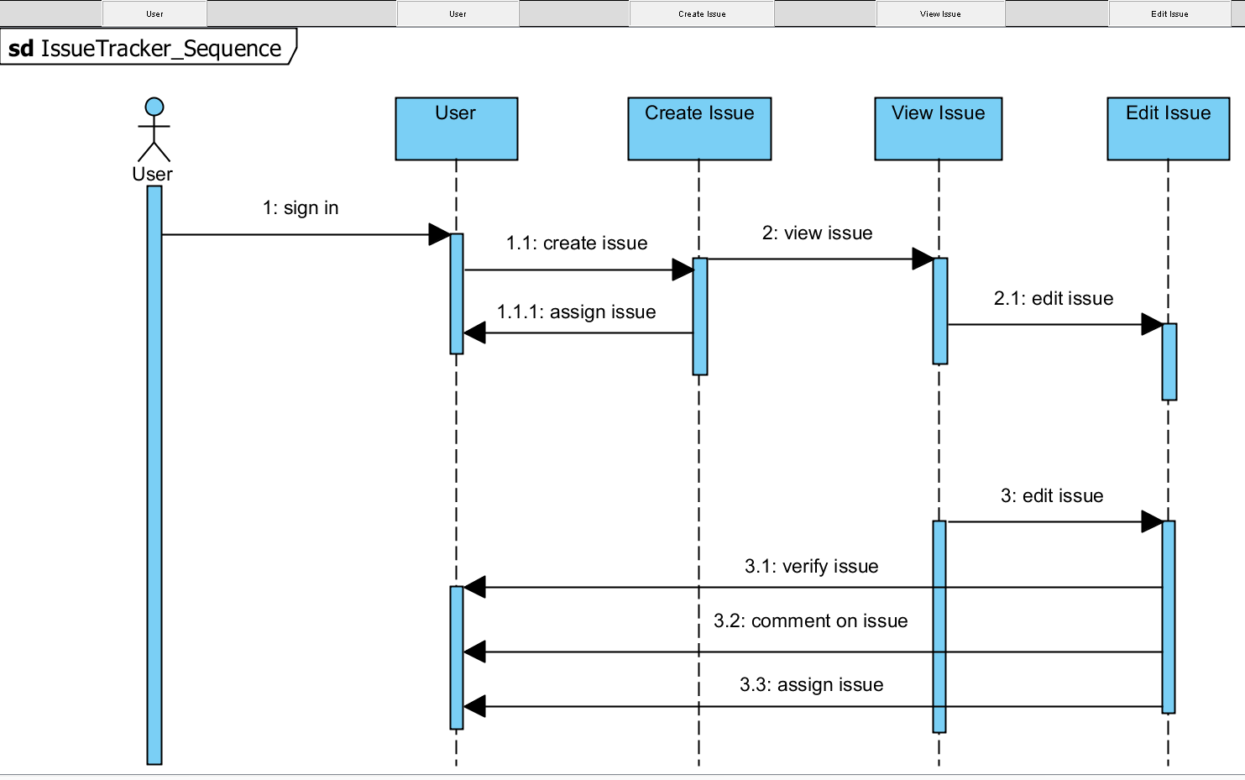
3. Software Design – Sequence Diagram
Issue Tracker Sequence
User Signs in
User Creates issue
User Assigns Issue
User Views issue
User Edits Issue
User Edits Issue
User verify issue
User comment on issue
User assign issue

Slide 16





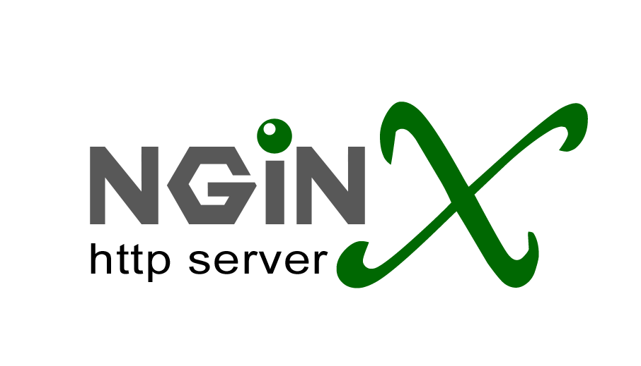
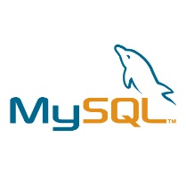


4. Environment – Architecture (3-Tier)
OS: Ubuntu
User 1
Browser Access (HTTP)
User 2
Web server
Http/Proxy service
Static file service
Application server
Python web service
Worker(s) Process Automation
Rest framework
Database server
Persistence Storage
User 3

Slide 17
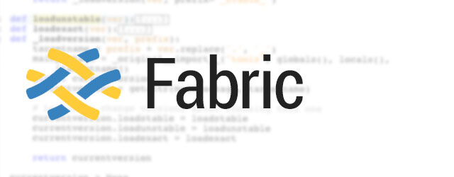
4. Environment – Deployment
Environments
Dev: dev.3blueprints.com
Pre: pre.3blueprints.com
Pro: www.3blueprints.com
VPS
Digital Ocean VPS instances
System Run Time
Services
Ubuntu Upstart Manager
Node.JS (Identifiable app service)
Gunicorn (Identifiable app service)
Init Run Level and Startup command Script
Nginx (General Service)
Fabric Script
Clones project from git hub directory
Resets source to latest master commit
Collects static files into single directory for caching
Secures Django access hosts and debug
Initiates and deploys database

Slide 18
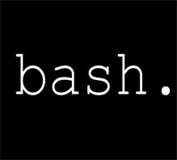
4. Environment – DevOps Documentation
GitHub Open project
https://github.com/CS673S15-Group1/Final_Project
Documentation included in the git hub project
Server Build Installation shell script
Fabric deployment Script
Project Local and Server Installation Steps in project README

Slide 19
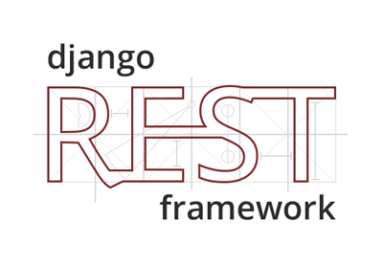

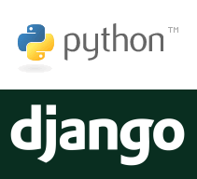


4. Environment – Development Environment
Python Tools
Django Rest Framework
Iron Python
Readline
Requests
Django Cors
Django filters
JavaScript Tools
Node.JS

Slide 20
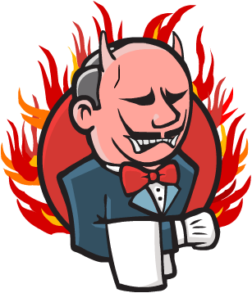
4. Environment – Future Improvements
Multiple Application Servers and Load Balancing
Operating System Service Users Set-up
Nginx
Gunicorn
Node.JS
Node.JS relative paths
Penetration and Load Testing
Jenkins Automated Build Process

Slide 21
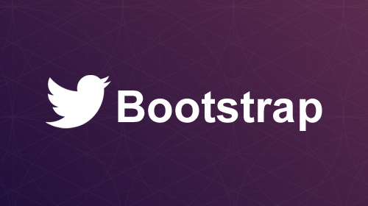
5. Implementation
Development Tools
CSS : Bootstrap
Django: Web Framework
Git: Version Control
Version control
Git (Git Hub)
Team Project
Staging → Master
Group Project
Branching Process
Team3 Pre →Team3 Pro → Master
Challenges
Team members had experience deficiencies in many tools across the board
Django, Git, Python, Bootstrap, Linux

Slide 22
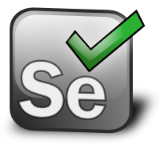
6. Testing
Functional Testing (Selenium Python)
Incorporate page object Design
Unit Testing
Manual Unit Testing
Maintenance & Integration with Source update process
Individual testing before pushes to staging
Staging tested before pushing to Master
Master only receives working code
Demo!

Slide 23

7. Use Demo!

Slide 24
Thank You

