Slide 1

SQL PROJECT LOAN_ANALYSIS

Slide 2
Introduction
My name is Beble Harshada Dinesh. In this project I have utilized SQL Queries to solve questions that where related with Loan Data Analysis.
Performed tasks like data retrieval, aggregation, grouping, and trend analysis.
Extracted actionable insights from loan dataset for better decision-making.

Slide 3
Questions
Retrieve all records from the dataset.
Show only id, loan_amnt, and int_rate
Get all loans with a term of 36 months
Find unique loan grades
Count total number of loans
Average loan amount
Maximum interest rate for grade A
Loans funded with Cash disbursement method
Average installment per grade
Top 5 largest loan amounts
Average interest rate by grade & sub_grade
Percentage of loans fully paid vs charged-off
Borrowers with highest total loan amount (top 10)
Avg loan amount & interest rate for 36-month loans (per grade)

Slide 4
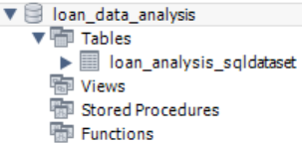
Creating Database And Importing Dataset

Slide 5

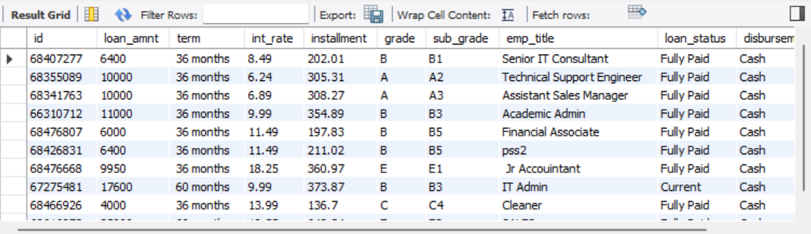
Retrieve all records from the dataset.

Slide 6

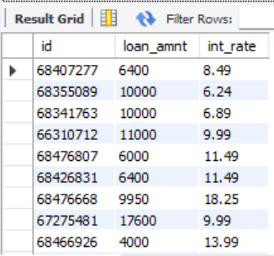
Show only id, loan_amnt, and int_rate

Slide 7

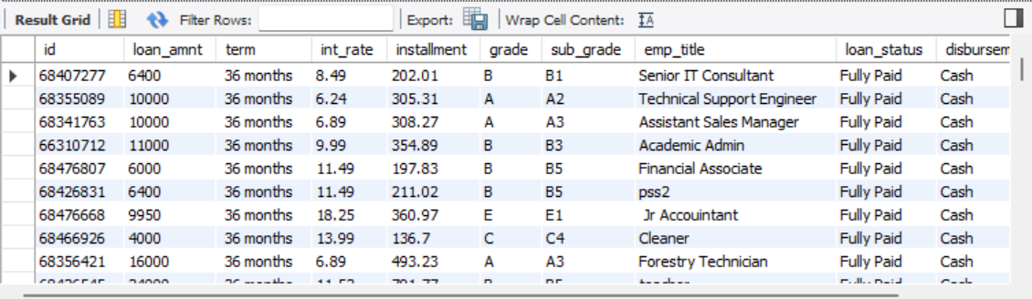
Get all loans with a term of 36 months

Slide 8

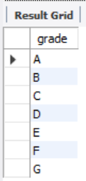
Find unique loan grades

Slide 9


Count total number of loans

Slide 10


Average loan amount

Slide 11


Maximum interest rate for grade A

Slide 12

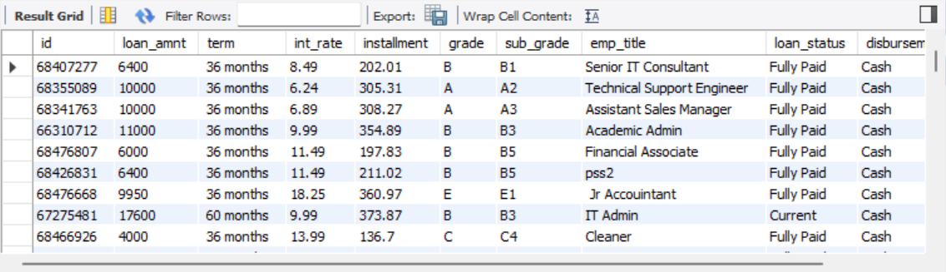
Loans funded with Cash disbursement method

Slide 13

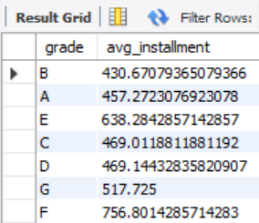
Average installment per grade

Slide 14
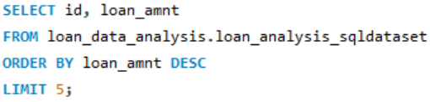
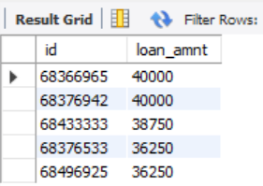
Top 5 largest loan amounts

Slide 15
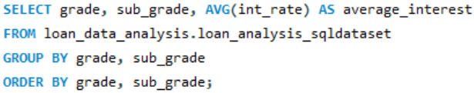
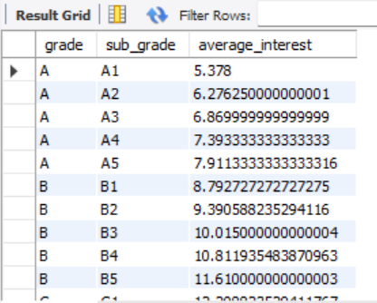
Average interest rate by grade & sub_grade

Slide 16
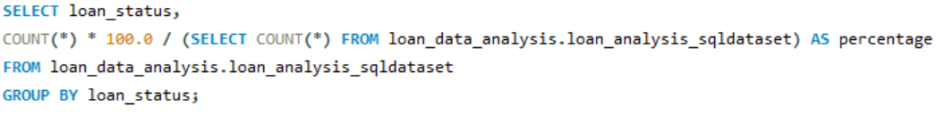
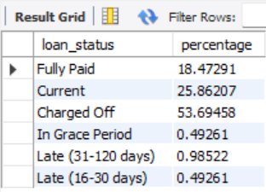
Percentage of loans fully paid vs charged-off

Slide 17

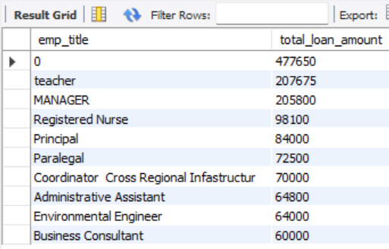
Borrowers with highest total loan amount (top 10)

Slide 18
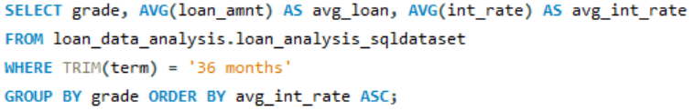
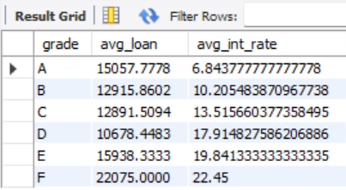
Avg loan amount & interest rate for 36-month loans (per grade)

