Slide 1

SDLCAI
13 OCTOBER 2026 / MARSIO
WELCOME TO
SDLCAI
AI meets the software development lifecycle.
One day. Industry and academia. One conversation.
AI MEETS SDLC
1 / 12
Notes:
Source: SDLCAI opening slides
https://sdlcai.org/slides/opening/#welcome
Local source: site/layouts/slide-opening.html
Original speaker photographs and sponsor logos from assets/.
The opening film is separate preroll media and precedes this welcome slide.

Slide 2

SDLCAI
13 OCTOBER 2026 / MARSIO
200
SOLD OUT
Thank you
for being here.
attendees (approx.)
AI MEETS SDLC
2 / 12
Notes:
Source: SDLCAI opening slides
https://sdlcai.org/slides/opening/#sold-out
Local source: site/layouts/slide-opening.html
Original speaker photographs and sponsor logos from assets/.

Slide 3

SDLCAI
13 OCTOBER 2026 / MARSIO
TODAY’S THEMES
AI IN REAL ENGINEERING PIPELINES
01
QUALITY, TESTING & REVIEW UNDER
02
AUTOMATION
LEADERSHIP & GOVERNANCE FOR AI
03
ADOPTION
AI MEETS SDLC
3 / 12
Notes:
Source: SDLCAI opening slides
https://sdlcai.org/slides/opening/#themes
Local source: site/layouts/slide-opening.html
Original speaker photographs and sponsor logos from assets/.

Slide 4
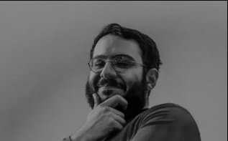
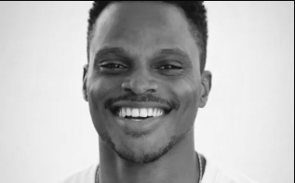
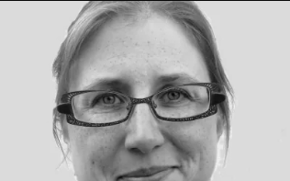
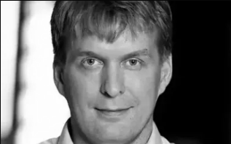
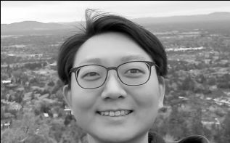
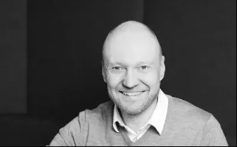
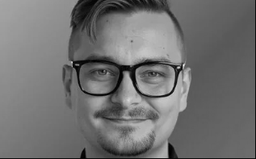
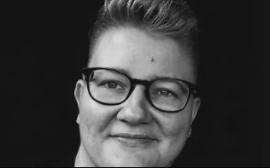
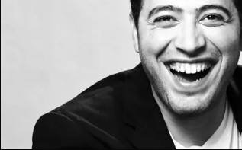
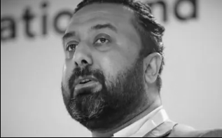
SDLCAI
13 OCTOBER 2026 / MARSIO
TODAY’S SPEAKERS
Mo Khazali
Ohans Emmanuel
Jenni Kylmäkoski
Tapio Pitkäranta
Joongi Shin
Jussi Hacklin
Viljami Kuosmanen
Sini Tistelgrén
Zak Allal
Dr Muhammad
Waseem
AI MEETS SDLC
4 / 12
Notes:
Source: SDLCAI opening slides
https://sdlcai.org/slides/opening/#speakers
Local source: site/layouts/slide-opening.html
Original speaker photographs and sponsor logos from assets/.

Slide 5

SDLCAI
13 OCTOBER 2026 / MARSIO
THE DAY AHEAD
09:00-10:30
Industry perspectives
13:30-15:00
Views from industry
10:30-11:00
Break
15:00-15:30
Afternoon break
11:00-12:30
Views from academia
15:30-17:00
Academia
12:30-13:30
Lunch and posters
17:00-17:15
Wrap-up
17:15-21:00
Afterparty
Full programme at sdlcai.org/schedule
AI MEETS SDLC
5 / 12
Notes:
Source: SDLCAI opening slides
https://sdlcai.org/slides/opening/#schedule
Local source: site/layouts/slide-opening.html
Original speaker photographs and sponsor logos from assets/.

Slide 6
SDLCAI
13 OCTOBER 2026 / MARSIO
17:15-21:00
AFTERPARTY
Right here at Marsio.
Food, conversation & time to catch up.
AI MEETS SDLC
6 / 12
Notes:
Source: SDLCAI opening slides
https://sdlcai.org/slides/opening/#afterparty
Local source: site/layouts/slide-opening.html
Original speaker photographs and sponsor logos from assets/.

Slide 7
SDLCAI
13 OCTOBER 2026 / MARSIO
HALLWAY
The conversations
between the talks.
TRACK
Meet someone new.
Compare notes. Visit the posters.
AI MEETS SDLC
7 / 12
Notes:
Source: SDLCAI opening slides
https://sdlcai.org/slides/opening/#hallway-track
Local source: site/layouts/slide-opening.html
Original speaker photographs and sponsor logos from assets/.

Slide 8

SDLCAI
13 OCTOBER 2026 / MARSIO
THE PACMAN
RULE
Leave a gap
in your circle.
Make it easy for someone
new to join the conversation.
AI MEETS SDLC
8 / 12
Notes:
Source: SDLCAI opening slides
https://sdlcai.org/slides/opening/#pacman-rule
Local source: site/layouts/slide-opening.html
Original speaker photographs and sponsor logos from assets/.

Slide 9
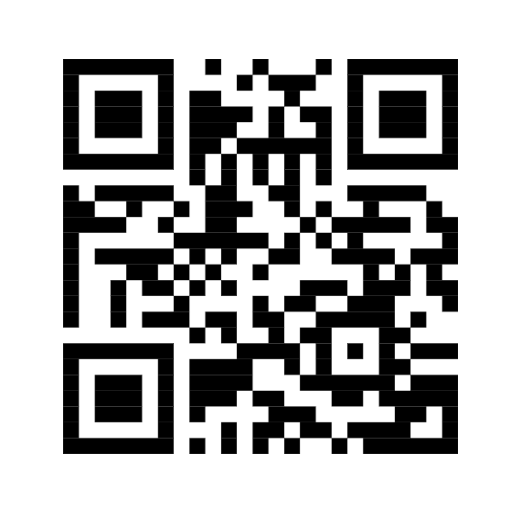
SDLCAI
13 OCTOBER 2026 / MARSIO
QUESTIONS?
Ask questions.
Vote for the ones you want answered.
sdlcai.org/qa
AI MEETS SDLC
9 / 12
Notes:
Source: SDLCAI opening slides
https://sdlcai.org/slides/opening/#questions
Local source: site/layouts/slide-opening.html
Original speaker photographs and sponsor logos from assets/.

Slide 10








SDLCAI
13 OCTOBER 2026 / MARSIO
THANK YOU, SPONSORS
EPIC SPONSOR
TECH SPONSORS
BRAND SPONSOR
LOCATION SPONSOR
AI MEETS SDLC
10 / 12
Notes:
Source: SDLCAI opening slides
https://sdlcai.org/slides/opening/#sponsors
Local source: site/layouts/slide-opening.html
Original speaker photographs and sponsor logos from assets/.

Slide 11
SDLCAI
13 OCTOBER 2026 / MARSIO
BERLIN
CODE OF CONDUCT
Respect each other.
Help make this a welcoming space.
A concern or something wrong? Please talk to an organizer.
berlincodeofconduct.org/en
AI MEETS SDLC
11 / 12
Notes:
Source: SDLCAI opening slides
https://sdlcai.org/slides/opening/#code-of-conduct
Local source: site/layouts/slide-opening.html
Original speaker photographs and sponsor logos from assets/.

Slide 12
SDLCAI
13 OCTOBER 2026 / MARSIO
SHARE YOUR DAY
#sdlcai
Ideas. Conversations. New connections.
AI MEETS SDLC
12 / 12
Notes:
Source: SDLCAI opening slides
https://sdlcai.org/slides/opening/#sdlcai
Local source: site/layouts/slide-opening.html
Original speaker photographs and sponsor logos from assets/.

