Slide 1

SDLCAI
13 OCTOBER 2026 / MARSIO
TODAY AT SDLCAI
AI IN REAL ENGINEERING PIPELINES
01
QUALITY, TESTING & REVIEW UNDER
02
AUTOMATION
LEADERSHIP & GOVERNANCE FOR AI
03
ADOPTION
Industry & academia. Talks, posters & hallway conversations.
AI MEETS SDLC
1 / 8
Notes:
Source: SDLCAI closing slides
https://sdlcai.org/slides/closing/#recap
Local source: site/layouts/slide-closing.html
Original speaker photographs and sponsor logos from assets/.

Slide 2

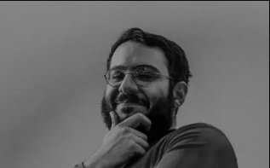
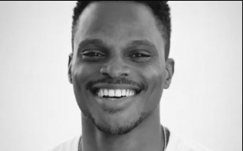
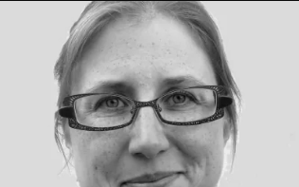
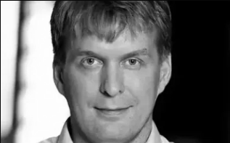
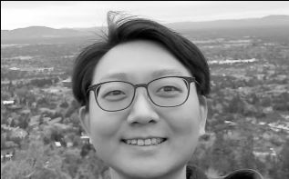
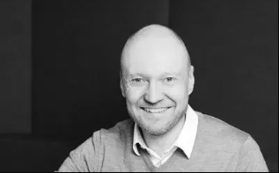
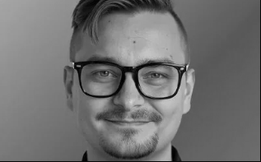
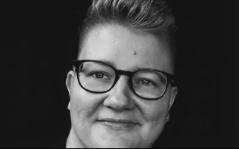
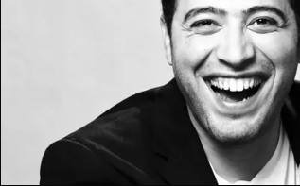
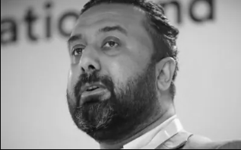
SDLCAI
13 OCTOBER 2026 / MARSIO
THANK YOU, SPEAKERS
Mo Khazali
Ohans Emmanuel
Jenni Kylmäkoski
Tapio Pitkäranta
Joongi Shin
Jussi Hacklin
Viljami Kuosmanen
Sini Tistelgrén
Zak Allal
Dr Muhammad
Waseem
AI MEETS SDLC
2 / 8
Notes:
Source: SDLCAI closing slides
https://sdlcai.org/slides/closing/#speakers
Local source: site/layouts/slide-closing.html
Original speaker photographs and sponsor logos from assets/.

Slide 3








SDLCAI
13 OCTOBER 2026 / MARSIO
THANK YOU, SPONSORS
EPIC SPONSOR
TECH SPONSORS
BRAND SPONSOR
LOCATION SPONSOR
AI MEETS SDLC
3 / 8
Notes:
Source: SDLCAI closing slides
https://sdlcai.org/slides/closing/#sponsors
Local source: site/layouts/slide-closing.html
Original speaker photographs and sponsor logos from assets/.

Slide 4
SDLCAI
13 OCTOBER 2026 / MARSIO
BEHIND THE SCENES
THANK YOU,
ORGANIZERS
Our volunteers & the Marsio team.
For making the day possible.
AI MEETS SDLC
4 / 8
Notes:
Source: SDLCAI closing slides
https://sdlcai.org/slides/closing/#crew
Local source: site/layouts/slide-closing.html
Original speaker photographs and sponsor logos from assets/.

Slide 5
SDLCAI
13 OCTOBER 2026 / MARSIO
TO EVERYONE WHO JOINED US
THANK YOU
FOR BEING HERE.
For your questions, posters & conversations.
AI MEETS SDLC
5 / 8
Notes:
Source: SDLCAI closing slides
https://sdlcai.org/slides/closing/#attendees
Local source: site/layouts/slide-closing.html
Original speaker photographs and sponsor logos from assets/.

Slide 6

SDLCAI
13 OCTOBER 2026 / MARSIO
GROUP PHOTO
AI MEETS SDLC
6 / 8
Notes:
Source: SDLCAI closing slides
https://sdlcai.org/slides/closing/#group-photo
Local source: site/layouts/slide-closing.html
Original speaker photographs and sponsor logos from assets/.

Slide 7


Notes:
Source: SDLCAI closing slides
https://sdlcai.org/slides/closing/#logo
Local source: site/layouts/slide-closing.html
Original speaker photographs and sponsor logos from assets/.

Slide 8

SDLCAI
13 OCTOBER 2026 / MARSIO
AFTERPARTY
Right here at Marsio.
17:15-21:00
AI MEETS SDLC
8 / 8
Notes:
Source: SDLCAI closing slides
https://sdlcai.org/slides/closing/#afterparty
Local source: site/layouts/slide-closing.html
Original speaker photographs and sponsor logos from assets/.

