Slide 1
OPENAI BUILD WEEK 2026 · WORK & PRODUCTIVITY
Kirjolab
An integrated workspace where scholarly evidence becomes traceable prose.
INSPECT THE TRAIL · KEEP THE SOURCE · DECIDE WHAT CHANGES
01 / 08

Slide 2
THE GAP
A citation survives.
Its evidence trail often does not.
Research work crosses tools. Each handoff makes the source passage, reasoning, model context, and human decision harder to reconstruct.
01
SOURCE
02
EVIDENCE
03
REASONING
04
MANUSCRIPT
A paper enters
the library.
The useful passage
stays in a PDF.
Notes and model
context drift away.
Only the citation
reaches the prose.
02 / 08

Slide 3
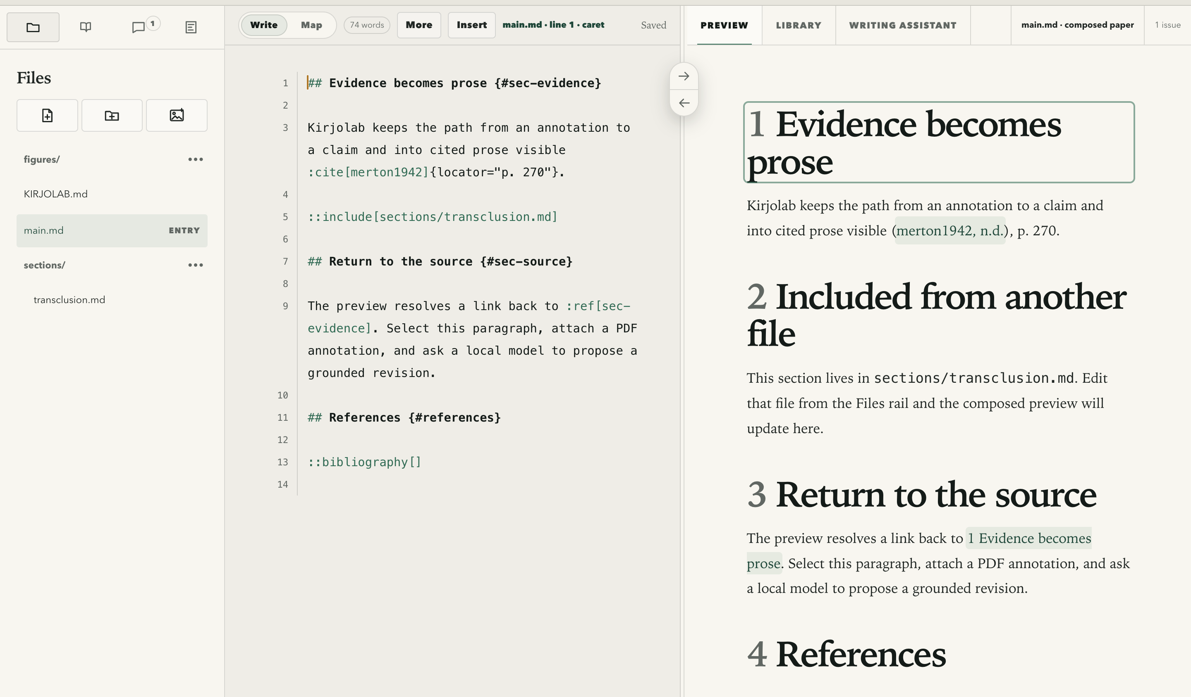
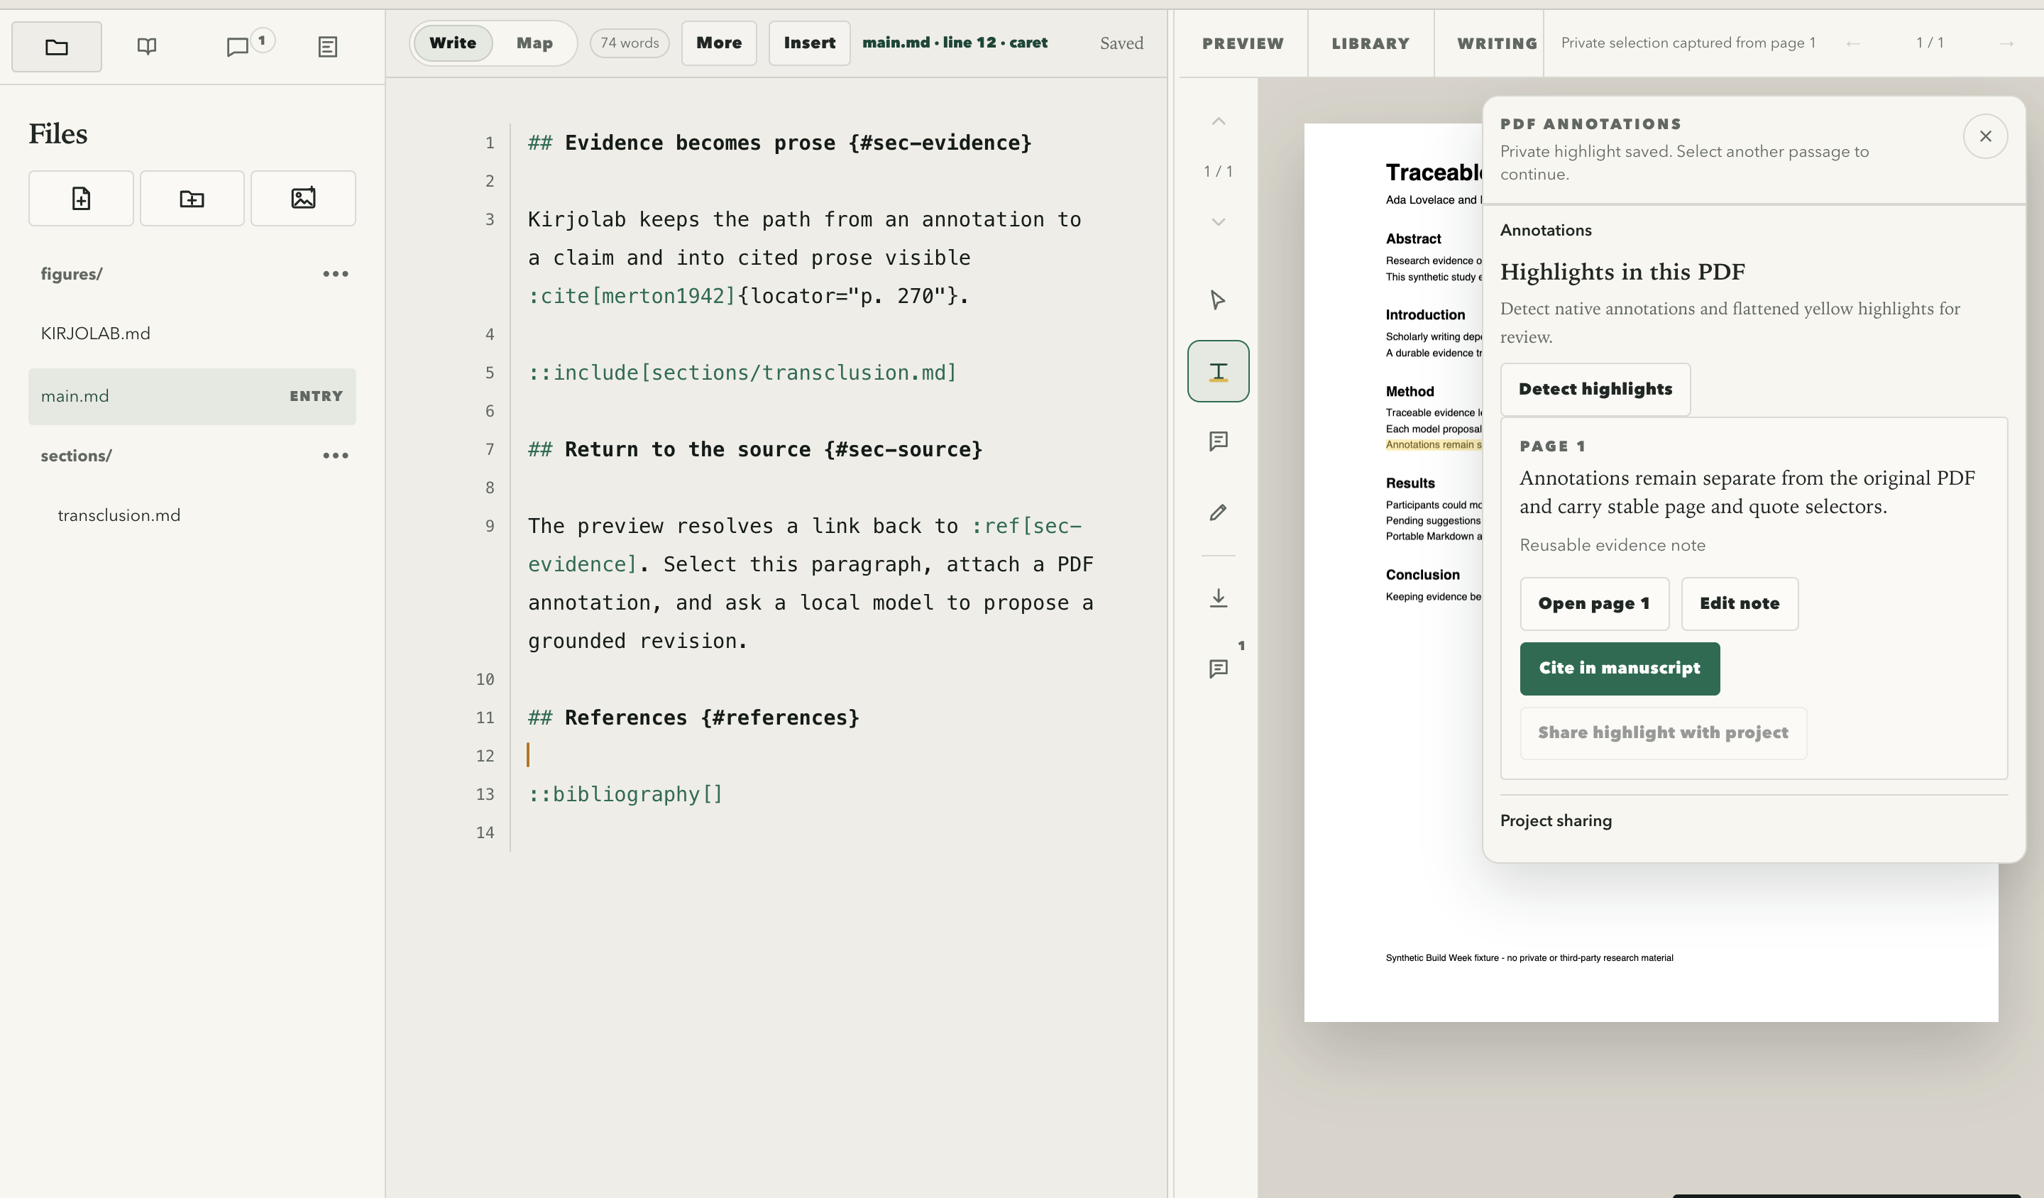
ONE SCHOLARLY WORKSPACE
A highlight becomes a citation.
Select a PDF passage, save the evidence, then insert its source and page at the remembered manuscript caret.
WRITE · CANONICAL MARKDOWN + LIVE PREVIEW
EVIDENCE · HIGHLIGHT + PAGE-AWARE CITATION
03 / 08

Slide 4
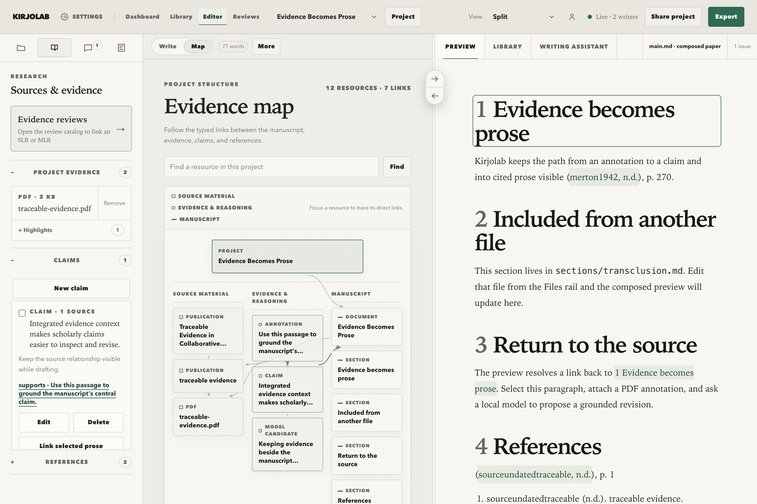
EVIDENCE BECOMES PROSE
The evidence trail stays visible.
Source material
Evidence and reasoning
Manuscript
Typed links keep publications, PDF annotations, claims, model candidates, sections, and documents inspectable as one project structure.
04 / 08

Slide 5
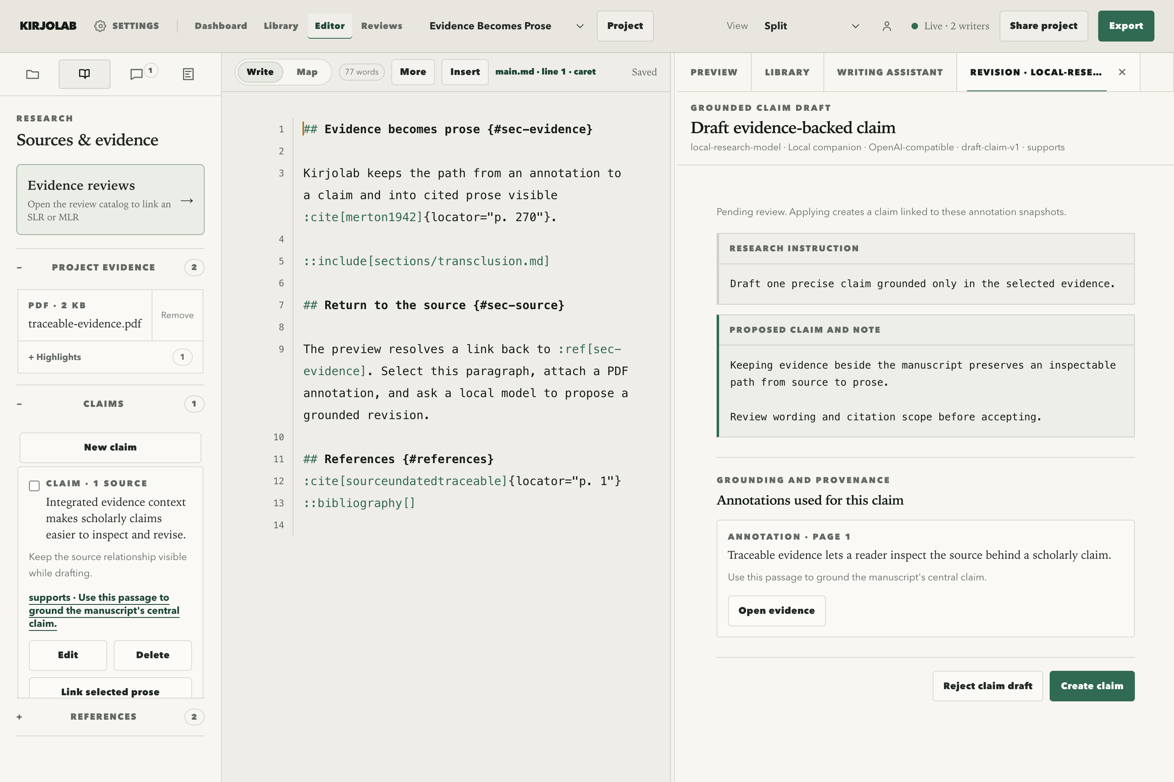
THE MODEL BOUNDARY
AI PROPOSES
The researcher
decides.
- Explicit target and evidence
- Recorded model identity
- Reviewable candidate state
- Accept, edit, or reject
- No silent manuscript mutation
Local-capable. Provider-neutral.
Human-disposed.
05 / 08

Slide 6
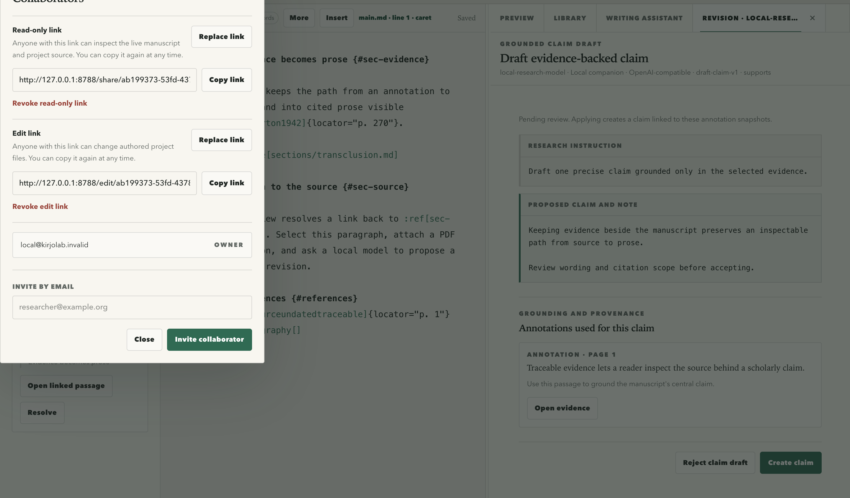
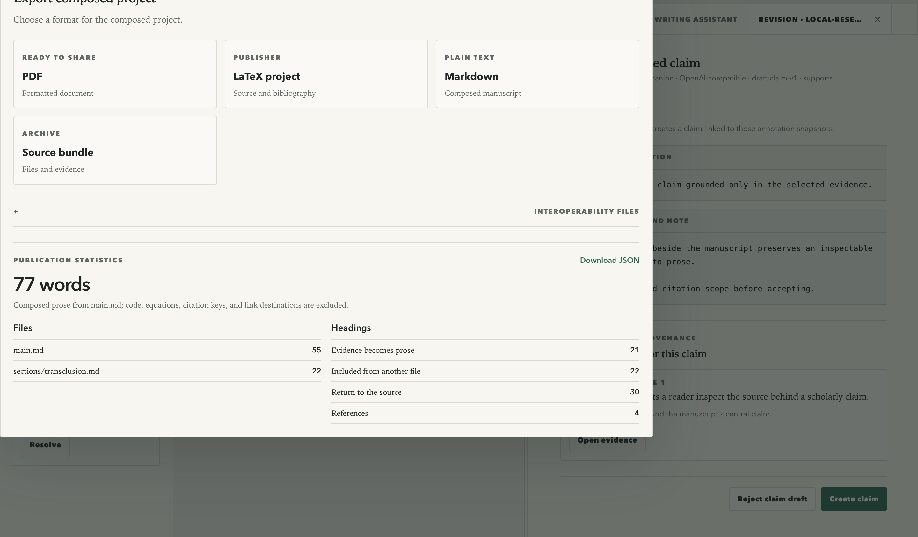
DURABLE BY DESIGN
The work remains yours.
Members can open linked PDFs. Public links cannot; raw bibliography stays behind interoperability.
SHARE · LINKS WITHOUT PRIVATE PDF ACCESS
EXPORT · PRIMARY OUTPUTS, BIBLIOGRAPHY ON DEMAND
06 / 08

Slide 7
SUBMISSION-PERIOD SCOPE
Build Week integrated the product.
The entry shows the complete product while distinguishing pre-period foundations from the submission-period implementation.
FOUNDATION BEFORE JULY 13
FINAL REVIEWED RANGE · JULY 13–19
Portable authoring and collaboration
One inspectable research-to-prose system
- Markdown workspace and scientific preview
- Yjs collaboration and project recovery
- Reference library, PDF reader, and evidence links
- General local-model provider boundary
- Evidence map and independent reviews
- Highlight citation and PDF highlight import
- Member PDF access; never public links
- BibTeX only at interoperability boundaries
CORE PRODUCT RANGE e6a7bdf..c8f0986
808 UNIT | 117 WORKERS RUNTIME | 65 BROWSER TESTS
07 / 08

Slide 8
HOW THE PROJECT WAS BUILT
Codex accelerated the build.
Human judgment set the boundaries.
GPT-5.6 VIA CODEX
Codex inspected the live system, implemented scoped refinements, added tests, and repeated browser reviews through the final snapshot.
gpt-5.6-sol
QUALIFYING /feedback SESSION
019f6472-5ece-7cd3-b66f-ba344ba9e812
The author retained product direction, architecture, provenance rules, the human-disposition boundary, acceptance decisions, and final review.
Open the public snapshot
Open the judge walkthrough
nvm use | npm install | npm run dev
Inspect the trail. Keep the source. Decide what changes.
08 / 08

