Slide 1
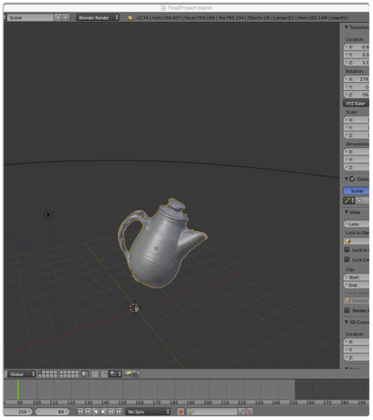
Daniel Diaz
Default Project
Camera_calib -> Generate Reconstructions (diaz_reconstruct.m) -> Generate Meshes (diaz_mesh.m) -> convert meshes to ply (diaz_pipeline.m) -> mesh lab merge/ poisson reconstruction -> Blender
Blender was hard!

