Slide 1

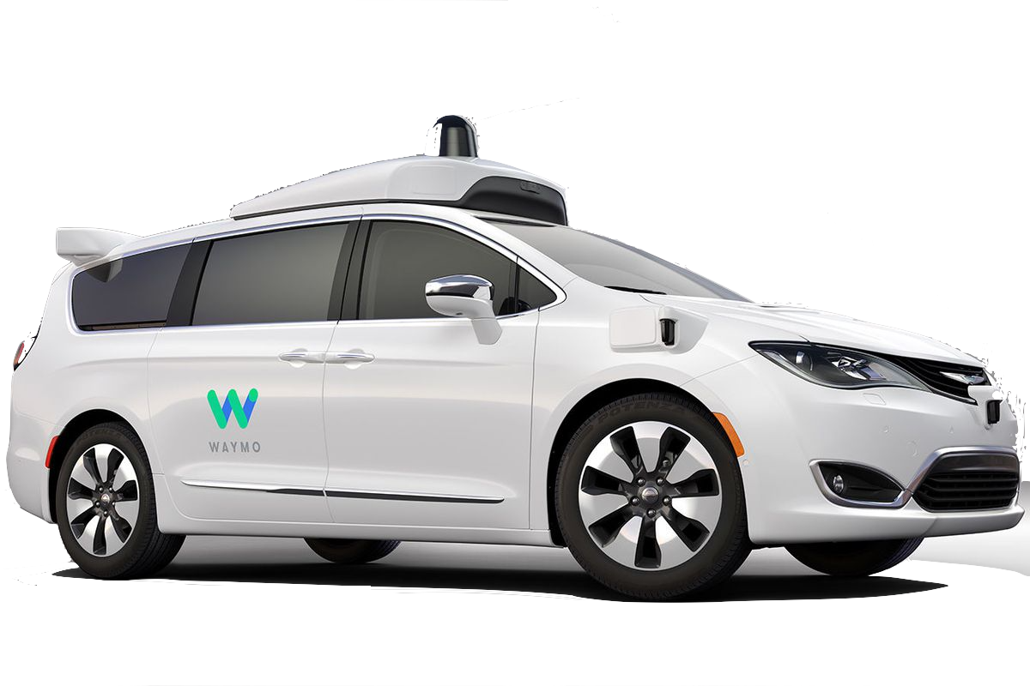
SDN-Controller
SDN-Orchestrator
SDN-Developer
Data Analyst
Network operator
Security Expert
In-network intelligence
ANIMA
© WAYMO
© step2 (push around buggy)

Slide 2







(2) Install network equipment
Controller
Orchestrator
…
(3)
Mgmt
Laptop
Manufacturer
1 MASA
…
Internet
Manufacturer
N MASA
ANI
Registrar
(1)
(4.1)
ani registrar ! [A]
domain-name ani.example.com
Ethernet 0 ! [B]
acp-connect
Register my cert with vendor MASAs ! [C]
(4.2)
(4.3)
“NOC”
Configured equipment
Autonomous network with ANI

Slide 3
Autonomic Network (AN)
Intent and Reporting
Network wide, abstract management
Autonomic Network (AN):
Intent based
network management
Autonomic Function N
ASA N
…
ASA N
Autonomic Function 1
Reporting/
Telemetry /
Analytics
ASA 1
Autonomic Service Agent
Secure GRASP
messages
ASA 1
Autonomic Service Agent
GRASP
Generic Signaling
GRASP
Generic Signaling
Controller
…
EMS
Domain
Certificates
ACP - Autonomic
Control Plane
ACP - Autonomic
Control Plane
Simple, legacy
Management Tools
secure
resilient
zero-touch
hop-by-hop
channels
BRSKI – Secure
Bootstrap
BRSKI – Secure
Bootstrap
MSO OSS
ANI:
Secure, reliable and automatic IPv6 NOC connectivity,
Secure bootstrap, Zero touch service auto configuration
Domain wide (NOC and infrastructure) zero-touch certificates
ANI Autonomic Network
Infrastructure
ANI Autonomic Network
Infrastructure
Domain
Certificate
Domain
Certificate
Network OS
Network OS
NOC – Network Operations Center
OAM – Operation, Administration, Maintenance
Autonomic Network Infrastructure (ANI)
© 2018, Huawei. Used with permission

Slide 4
VENDOR SERVICE
via Internet
ANI DEVICE
Circuit Proxy
ANI
DEVICE
…
ANI
DEVICEs
ANI DEVICE
Registrar
MASA
Manufacturer
Authorized
Signing Authority
PLEDGE
IDevID
Certificate
Domain
Certificate
Domain
Certificate
Domain
Certificate
BRSKI-MASA
BRSKI-EST
TLS connection
Pledge-Registrar
Via Data
Plane
BRSKI-EST
TLS connection
Pledge-Registrar
via
BRSKI
Pledge
Agent
BRSKI
Circuit Proxy
Agent
BRSKI
Domain Registrar
(PKI RA)
ANI Domain
NOC
ACP
GRASP
Agent
ACP
GRASP
Agent
ACP
GRASP
Agent
EST
RFC7030
…
Domain
Root
Certificate
ACP
Autonomic
Control Plane
VRF
Autonomic
Control Plane
VRF
Autonomic
Control Plane
VRF
PKI CA
Certificate
Authority
DULL
GRASP
Agent
DULL
GRASP
Agent
DULL
GRASP
Agent
DULL
GRASP
Agent
ACP capable
And Non-ACP
capable
NOC/OAM
Devices
Data
Plane
Data
Plane
Data
Plane
Data
Plane
optional
…
Autonomic Connect - ACP to NOC
…
ACP channel(s)
ACP channel
ACP channel(s) …
Data Plane IPv6 link-local pledge to proxy
Data Plane IPv4/IPv6
between registrar and CA, registrar and MASA
© 2018, Huawei. Used with permission

Slide 5
BRSKI
Pledge
Agent
BRSKI
Circuit Proxy
Agent
Manufacturer
Trust Anchor MTA
Explanation
DRC
Registrar
Domain Certificate RDC
Domain Root
Certificate DRC
Manufacturer
Certificate MC
Signer
PKI CA
Certificate
Authority
Certificate
DULL
GRASP
Agent
DULL
GRASP
Agent
ACP
GRASP
Agent
Domain Registrar
MASA
ACP GRASP Agent
Announce Registrar to all BRSKI
Circuit Proxy agents via ACP GRASP
MTA
Pledge
IDevID
Certificate
PIC
Pledge powers on / connects to Proxy
Pledge learns Proxy via DULL GRASP
TCP: Pledge <-> Proxy <-> Registrar
TLS: Pledge <--------------> Registrar (BRSKI)
Use
to verify
Voucher
succeeds
RDC
Registrar now trusts PIC
Pledge does not yet trust RDC
MTA
Pledge request voucher to trust RDC
Registrar claim pledge to get voucher from MASA
Voucher: (PIC,RDC) signed by MC
Pledge now trusts RDC
build
(EST) Pledge requests trust anchor
to later authenticate domain peers
Pledge
Domain
Certificate
PDC
DRC
Pledge requests cert parameters
to build its domain certificate
Cert parms: Pledge ACP address, Domain-Name
DRC
(EST) Pledge requests signing of domain cert
PDC
DRC
PDC
Enrolled!
Pledge telemetry: I am enrolled!
© 2018, Huawei. Used with permission

