Slide 1


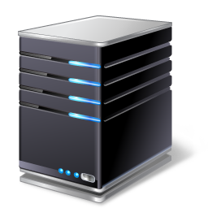




(2) Install network equipment
Controller
Orchestrator
…
(3)
Mgmt
Laptop
Manufacturer
1 MASA
…
Internet
Manufacturer
N MASA
ANI
Registrar
(1)
(4.1)
ani registrar ! [A]
domain-name ani.example.com
Ethernet 0 ! [B]
acp-connect
Register my cert with vendor MASAs ! [C]
(4.2)
(4.3)
“NOC”
Configured equipment
Autonomous network with ANI

