Slide 1

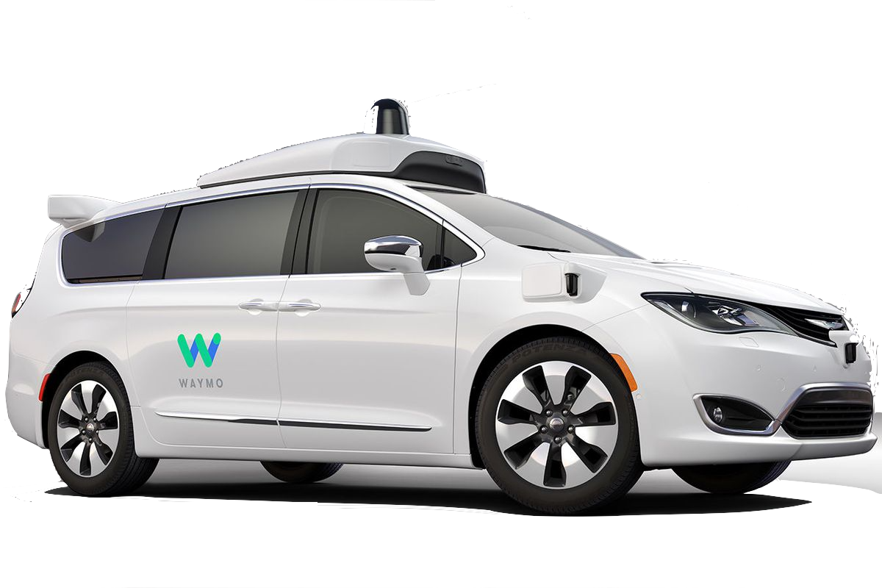
SDN-Controller
SDN-Orchestrator
SDN-Developer
Data Analyst
Network operator
Security Expert
In-network intelligence
ANIMA
© WAYMO
© step2 (push around buggy)

Slide 2
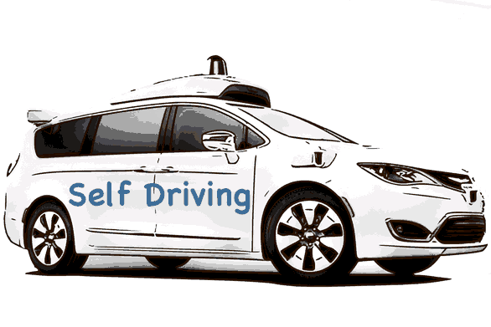
SDN-Controller
SDN-Orchestrator
SDN-Developer
Data Analyst
Network operator
Security Expert
In-network intelligence
ANIMA
“Self Driving”
If networks were cars

Slide 3
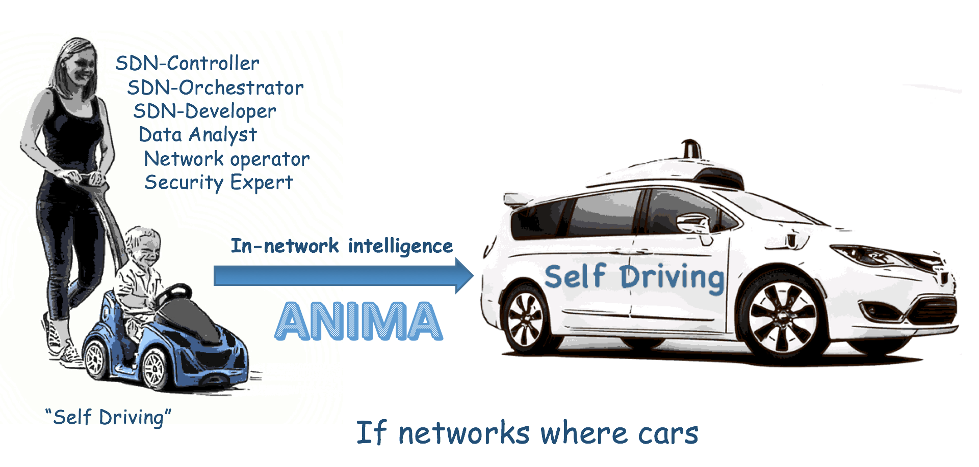
Sometimes powerpoint is bad exporting pictures,
The picture below is png of screendump, so it is 100% correct.
(except the typo in the caption....)

