Slide 1
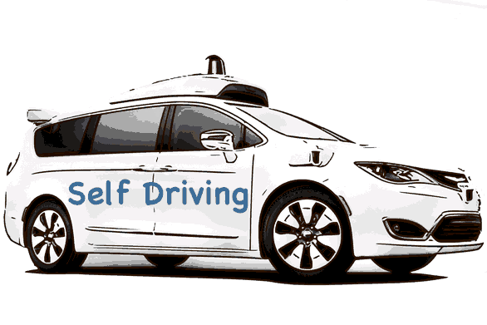
SDN-Controller
SDN-Orchestrator
SDN-Developer
Data Analyst
Network operator
Security Expert
In-network intelligence
ANIMA
“Self Driving”
If networks were cars

