Slide 1








According to Ole/IPJ, prefer to use Cisco brand icon library:
https://www.cisco.com/c/en/us/about/brand-center/network-topology-icons.html
This is now using that library (except for the spy).
(2) Wire up network equipment
Controller
Orchestrator
…
(3)
Mgmt
Laptop
Manufacturer
1 MASA
…
MGMT
ACP
connect
Internet
Manufacturer
N MASA
R
(1)
(4.1)
ANI
Registrar
ani registrar ! [A]
domain-name ani.example.com
ethernet 0 ! [B]
acp-connect
Register my cert with vendor MASAs ! [C]
(4.2)
(4.3)
“NOC”
Configured equipment
Autonomous network with ANI

Slide 2
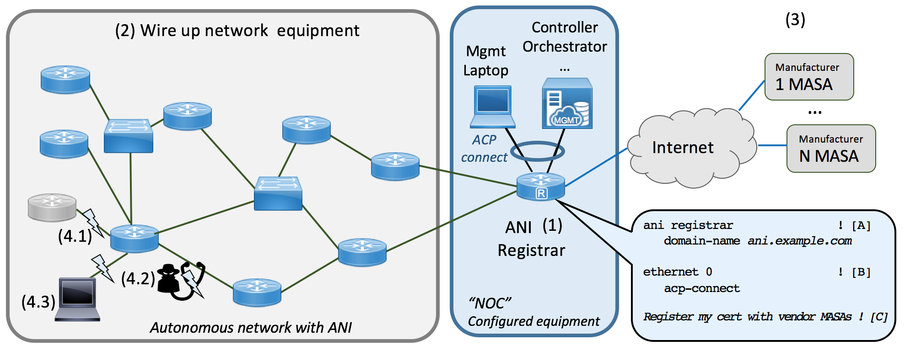
Screendump of picture export as picture, insert into docx.

