Slide 1


Using The Diabetes Dataset To Create Predictive Models to Find Significant Diabetes Predictors, Using Support Vector Machine(SVM) And KNN For Health Surveillances.
Data Science Foundation
Rebecca Agbolade
School of Computing ,Engineering &Digital Technologies
Tees.ac.uk/computing

Slide 2
Compendium
Foreword
Review of Related Literature
Proposed Methodology
Further Measure with Project on Schedule
Rationale of study
Dataset Overview
Scope of study
Analytical Method/Procedures
Purpose of study
Data Pre-Processing Phases
Research questions
Exploratory Data Analysis (EDA)

Slide 3
Justification of study
Explore the increase in cases of diabetes among various demographic groups according to age, gender, and lifestyle parameters.
Determine if there are variations in the prevalence and risk variables of diabetes according to gender.
Study the connections involving levels of glucose in the blood and diabetes with the goal to fully understand the correlation between fluctuations in glucose levels and the existence of diabetes.
Scope of study
This study relies completely on the accuracy of the dataset collected from Kaggle Diabetes dataset.​
Explore the overall incidence of diabetes and its risk factors in relation to several demographic classifications, such as age, gender, and smoking history. ​
Utilizing machine learning approaches with support vector machines, design predictive models to find relevant diabetes predictors in the dataset.
Aims of study
Assess the modifiable risk factors that can be tackled using diabetes prevention techniques, such as smoking and BMI. ​
Investigate variations and patterns in the number of cases of diabetes and all the variables that are related to it in the population under study.​
Offer information-driven recommendations to help shape public health campaigns meant to lessen the impact of diabetes.

Slide 4
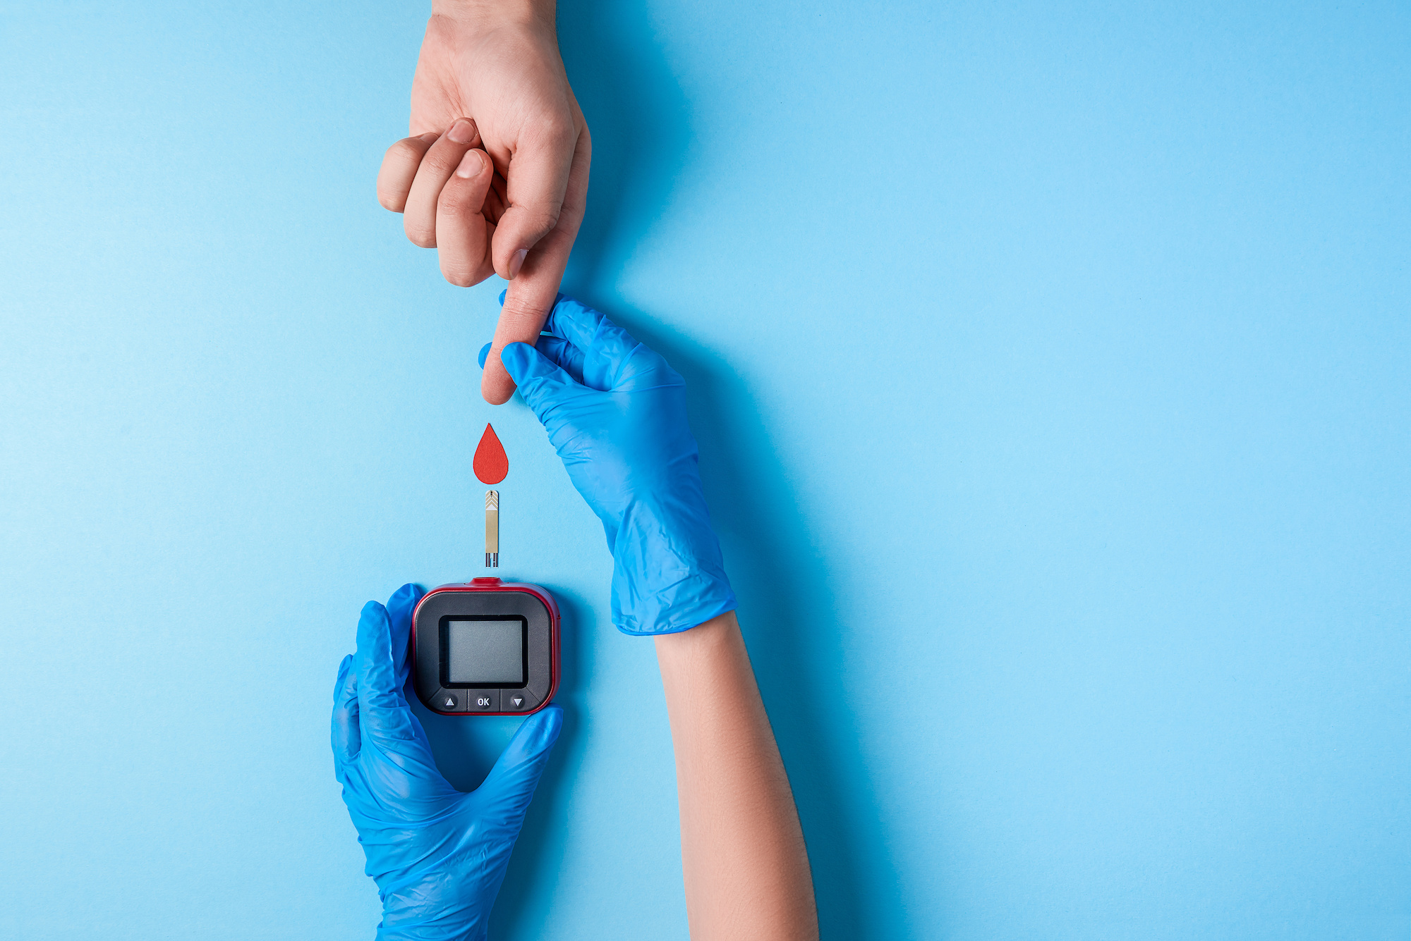
Foreword
One of the primary clues of diabetes, an autoimmune disorder that worsens with time and inhibits the body's ability to produce and utilize insulin, is elevated blood sugar. It may result in serious problems with the kidneys, nerves, eyes, and heart.
Medications, lifestyle changes, and routine monitoring are essential for treating this prevalent worldwide health issue.

Slide 5

Research Questions
What constitutes the demographic group under study's overall diabetes prevalence?
What exactly is the connection with a smoker's past and the development of diabetes?
Is the likelihood of diabetes strongly associated with BMI?
What are the alterations in rates of diabetes with age, and are there age groups that are more susceptible than others?
To what degree are blood glucose levels and the diagnosis of diabetes correlated?
Are individuals suffering from diabetes more inclined to have high blood pressure and heart disease?
Are the levels of and indicators of risk for diabetes different for men and women?

Slide 6

Literature Review
It is now imperative to use cutting edge statistical techniques in the field of diabetes research in order to precisely access and prognosticate diabetes, this literature review explores the merging of machine learning and deep learning approaches in Various studies.
V.Anuja Kumari.et.al(2013)The paper addresses the prevalent of diabetes in the globe and suggests that a Support Vector Machine(SVM) equipped with a Radial Basis function Kernel is a viable classifier for identifying diabetes. The findings from the experiment, which illustrates SVM's potential for precision diabetes diagnosis, demonstrate high accuracy, sensitivity and specificity when using the Pima Indian Diabetes database
H.T Abass.et.al Based on information obtained from an oral glucose tolerance test, the research investigation uses Support Vector Machines (SVM) to foresee Type 2 Diabetes Mellitus. The SVM model outperforms other models by over 12%, with an average accuracy of 96.80%. It is ideal features are plasma glucose concentrations.
Yang, C.H. (2020) et.al This study uses Support Vector Machine (SVM) to estimate the mortality risk in haemodialysis patients. SVM works better than other classifiers, showing higher F1-score and accuracy, especially in diabetes cases. As a result, it is the most accurate predictor of death risk .
Sangh Yuck YOU(2020) et.al.​ With a 70% effectiveness rate, this research uses Support Vector Machine (SVM), Decision Trees, and association analysis to examine key factors that predict diabetes in Pima Indians. The study proposes an effective diagnostic approach to Pima Indians by focusing on age, BMI, and glucose levels. This will assist with earlier detection and prevention, which is especially important in high-risk areas to minimize problems and lower healthcare costs.
Enrique V Carrera(2017)et.al.​ The study proposes a support vector machine (SVM) and retinal image processing-based automated technology diagnosis for early diabetic retinopathy identification. SVM surpasses previous approaches, with 95% sensitivity and 94% predictive capability. For better precision, future studies will focus on texture analysis and soft exudate detection.

Slide 7
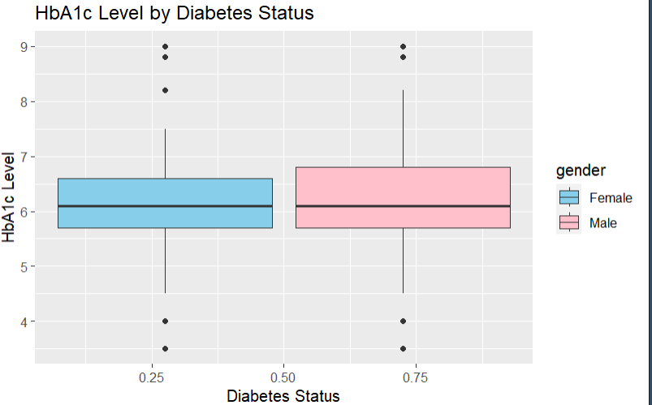
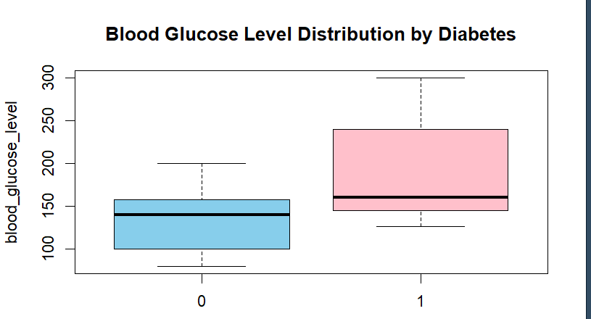
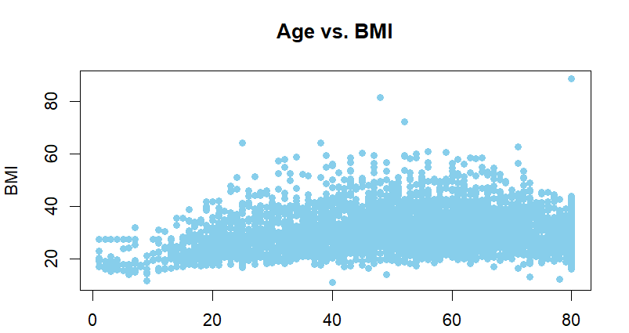
Exploratory Data Analysis

Slide 8
DATASET
This dataset encompasses medical information from diverse patients, indicating the presence or absence of diabetes (0 or 1).
With 100,001 records spread across 9 columns, the dataset provides health-related insights. Gender, age, blood pressure, heart disease, smoking history, BMI, HbA1c level, blood sugar level, and diabetes status are important factors. Numerous analysis can be performed on this dataset, ranging from examining age-related health patterns to figuring out just how prevalent chronic illnesses like heart disease and hypertension are.
The dataset was obtained from Kaggle and the main source was from Electronic Health Records(EHRs)
This is an Annotated(Labelled) data set with the last column being the Target Variable (Diabetes) which makes it a Supervised Learning work used to predict if the patients has diabetes or not. Also, given that SVM is reliable and a flexible algorithm, I selected it for this dataset because it can handle relationship that are non-linear, is robust to anomalies works well in spaces of large dimensions ,emphasizes maximizing margins for better abstraction, and is appropriate for binary classification tasks that are inherent in the diabetes prediction.
Data Pre-processing steps
Data Loading into the data frame
The dataset contained 100,001 rows and 9 columns prior to loading into R. Once I identified that "diabetes" was the target variable, I noticed a class imbalance—there were more 0s than 1s. A sample of 6,774 rows was then selected for analysis.
Removal of redundant variables
Upon inspection, the 'smoking history' column had 1,984 instances of "NO INFO," constituting a significant percentage of the dataset. Despite its prevalence, it was decided not to remove it to avoid potential bias in the analysis, considering it wasn't the target variable.
Data type check
I checked that all the data type were in the right format and also changed the gender and smoking history to numerical data type to help my analysis

Slide 9
S/N | Attribute | Description | Data Type
1 | Gender | Due to biological sex variations, gender affects a person's susceptibility to diabetes and thus their overall health risk. | Categorical (string or Factor)
2 | Age | Age is crucial in diabetes; more common in older adults. Dataset age range: 0-80 reflects diverse demographics. | Integer or Numeric
3 | Hypertension | Hypertension, persistently elevated blood pressure, generally indicated by Hypertension = 0 suggests no hypertension. Hypertension = 1 suggests the presence of hypertension. | Integer (Binary 0 or 1)
4 | Heart disease | Another medical condition that I associated with an increased risk of developing diabetes | Integer (Binary 0 or 1)
5 | Smoking history | Is considered a risk factor for diabetes and can exacerbate the complications associated | Categorical
6 | BMI | BMI(Body Mass Index) is a measure of body fat based on weight and height. Higher BMI value are linked to a higher risk | Numeric(float)
7 | HbA1c_level | Hemoglobin A1c level is a measure of a person’s average blood sugar level over the past 2-3 months | float
8 | Blood glucose level | Refer to the amount of glucose in the blood stream at a given time. High blood glucose level are a key | Numeric(integer
9 | diabetes | Is the target variable being predicted with value of 1 indicating the presence of diabetes and 0 indicating the absence | Integer(binary 0 or 1)
A Table Explaining the Diabetes dataset

Slide 10
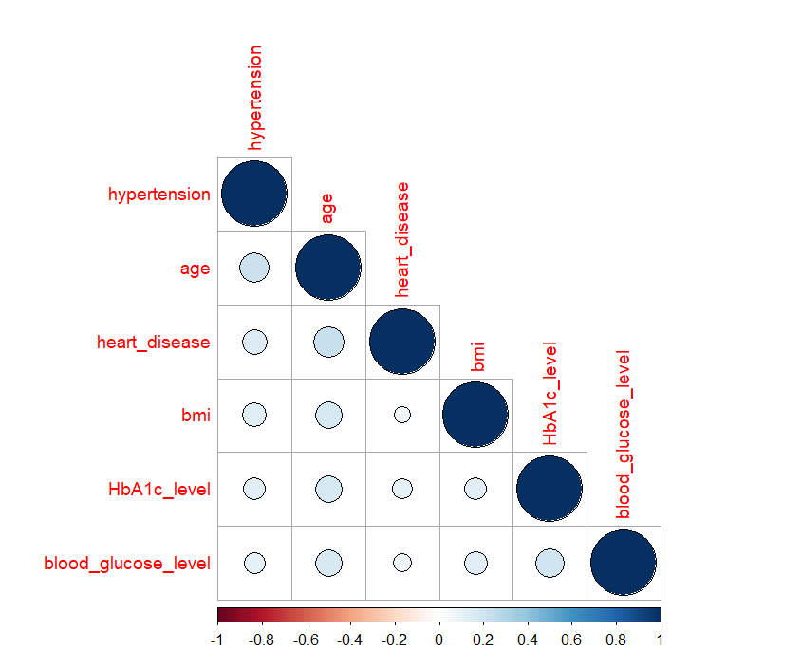
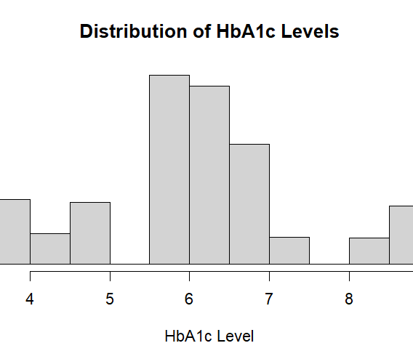

Slide 11
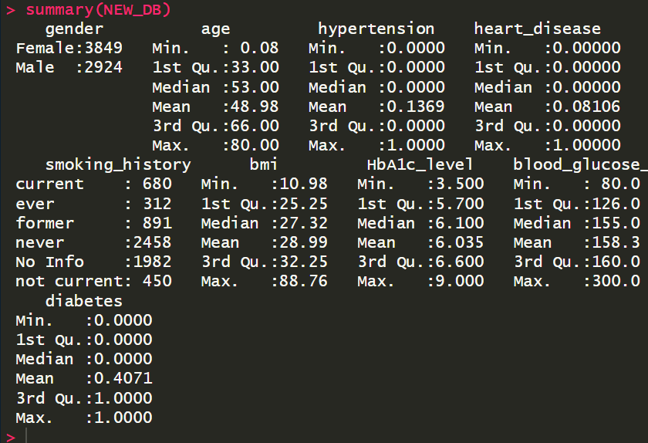
Summary of Snapshot.
Figure 1:A snapshot of the raw dataset showing the statistical parameter and number of NULL value before pre-processing and data cleaning steps.

Slide 12
Proposed data science processes for implementation, outlining steps to harness insights, inform decisions, and drive results.
Data Loading
Data Pre-Processing
Exploratory Data Analysis(EDA)
Testing with ML algorithm
Training with ML algorithm
Data Splicing
Prediction with SVM ML algorithm
Model &Dataset Optimization
Deployment of predicted Model

Slide 13
Data Pre- Processing
Data loading into data frame
Feature
Selection
Data Standardization
Iterative Model
Improvement
Data Cleaning
Exploratory data analysis(EDA)
Data Slicing
Model Training &
Evaluation

Slide 14



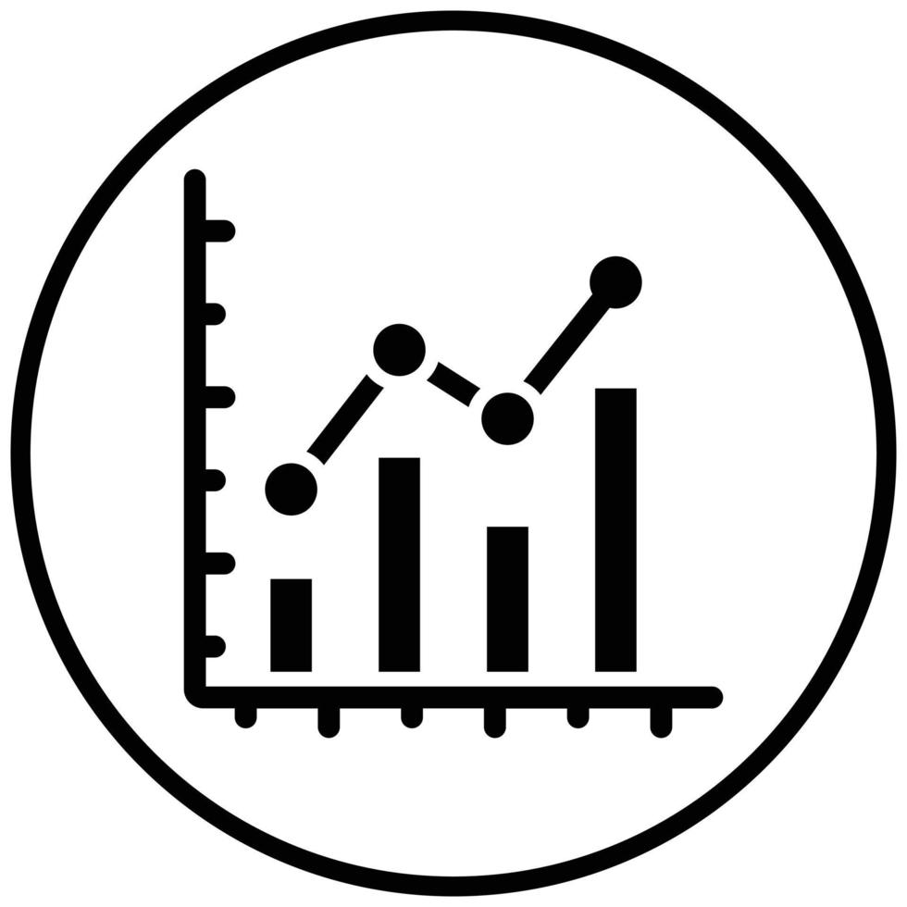

Proposed Next Steps and Project Completion Timeline
The following steps are the proposed next step I intend to take to ring my project into completion
Design Of Machine Learning Model
Training & Testing Model
Evaluation
Model Optimization
Evaluation
6/12/23
8/12/23
11/12/23
15/12/23
18/12/23

Slide 15
]
​ | ​Dataset: https://www.kaggle.com/datasets/iammustafatz/diabetes-prediction-dataset. [Accessed Wednesday November 2023]. [1]E.V Carrera, Automated detection of diabetic retinopathy using SVM,1-4:IEEE,2017. [2]S.YOU, “A study on Methods to prevent Pima Indians Diabetes using SVM, ”Korean journal of Artificial intelligence, pp.7-10,2020. [3]H.T Abbas, ”Predicting long term type 2 diabetes with support vector machine using oral glucose tolerance test,” journal.pone.0219636 [4]V.A Kumari, Classification of Diabetes using Support Vector Machine,797-1801:International Journal of Engineering Research and Applications,2013. [5]C-H.Yang, Prediction of Mortality in the Haemodialysis patient with Diabetes using SVM,219-232:Revista Argentina de Clinica Psicologica,2020.
References

