Slide 1

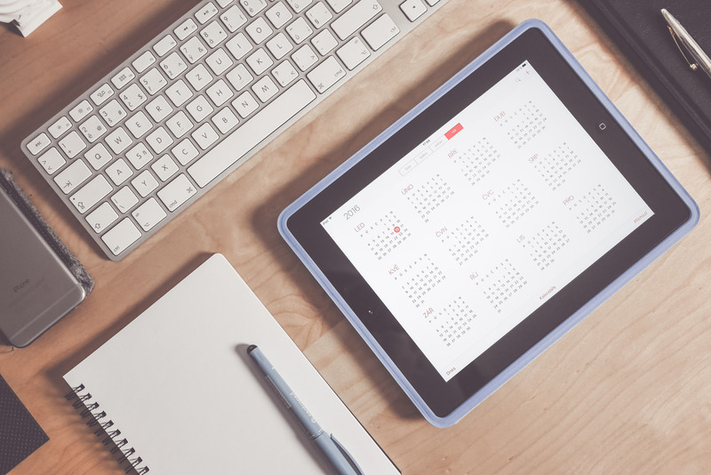
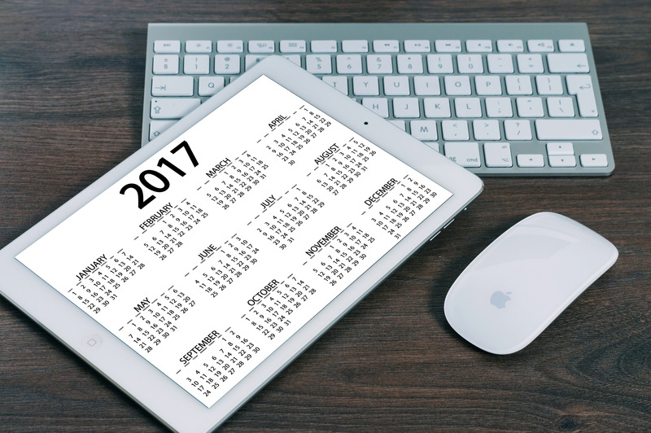
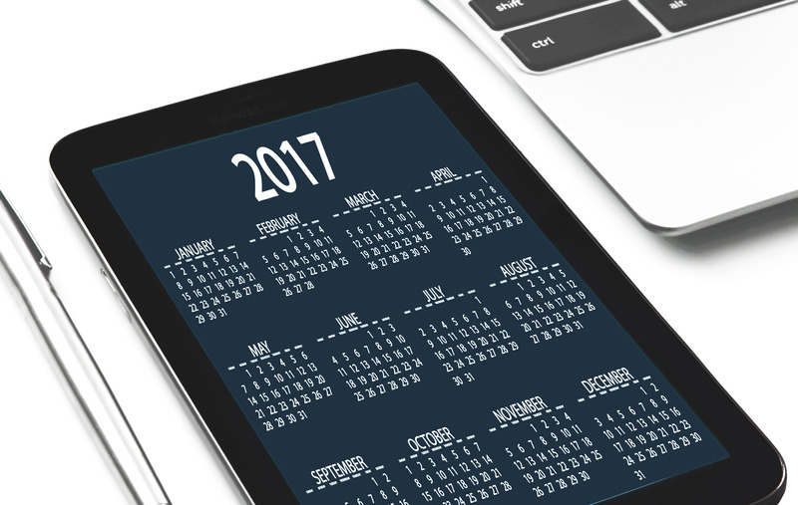

A calendar is essential for day-to-day life so a computer should come with one
Millard Arnold V, Rebecca Morgan

