Slide 1

Learning Choropleths
Outcome of the code as images

Slide 2
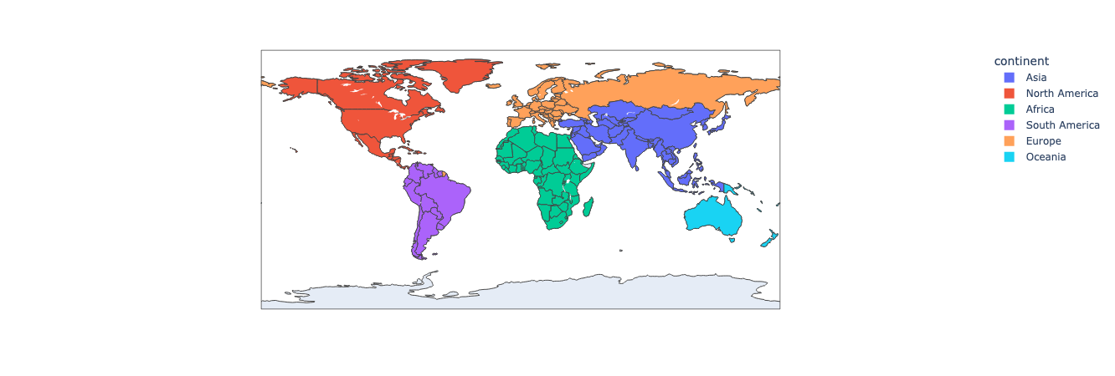
Continents

Slide 3
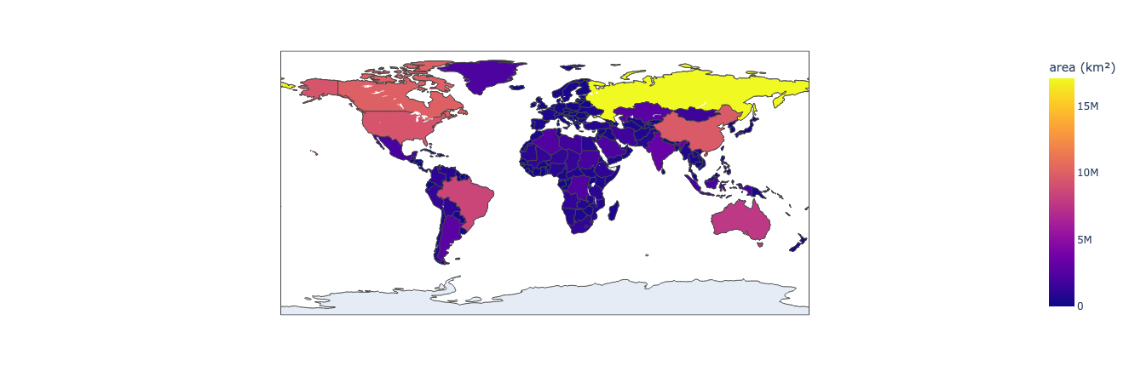
Area

Slide 4
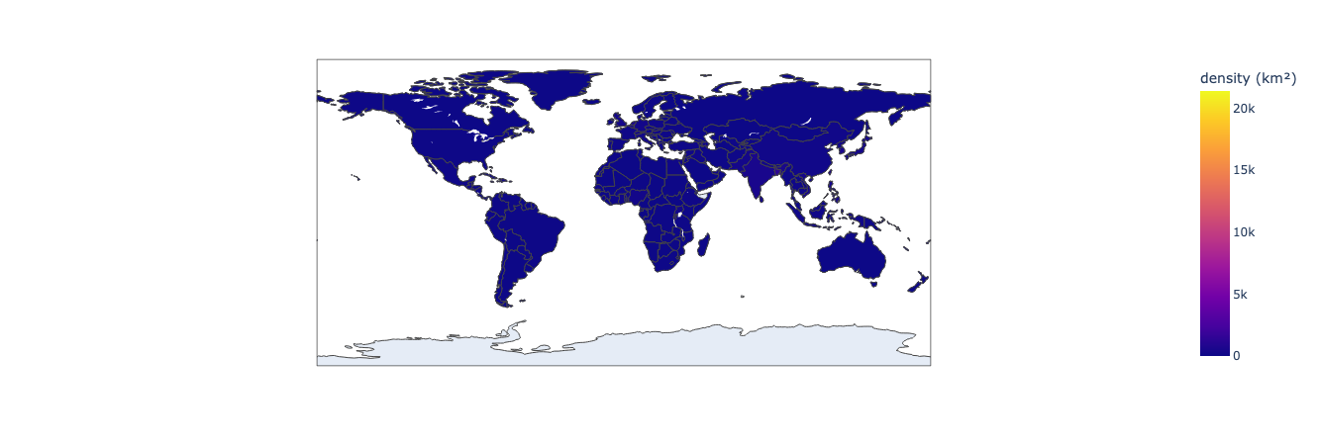
Density

Slide 5
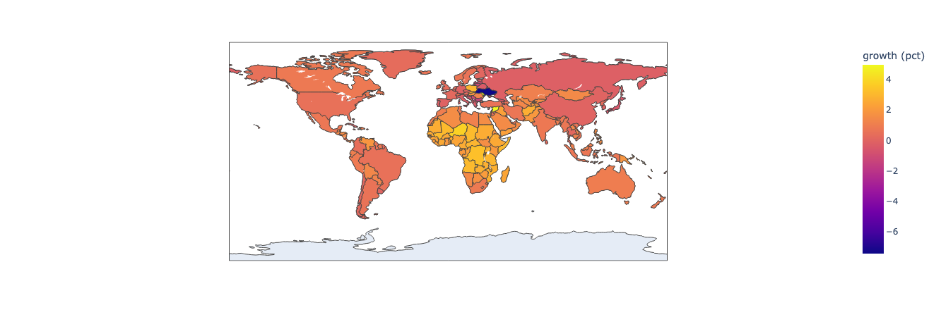
Growth

Slide 6
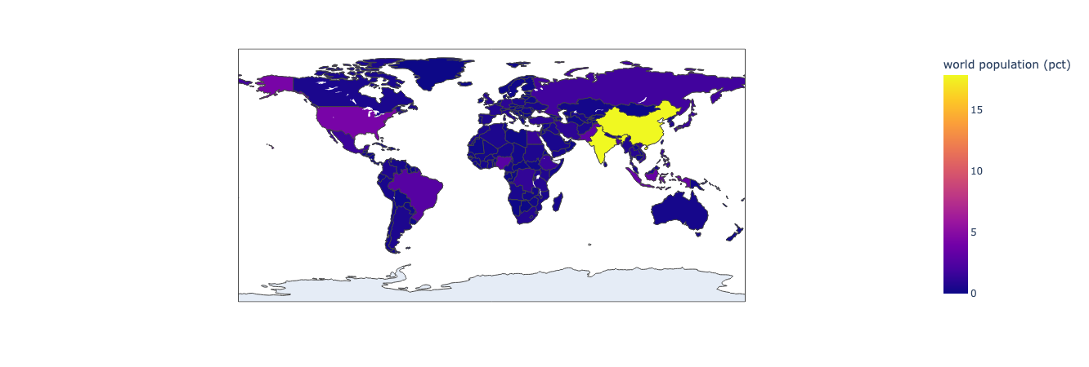
World population percentage

Slide 7
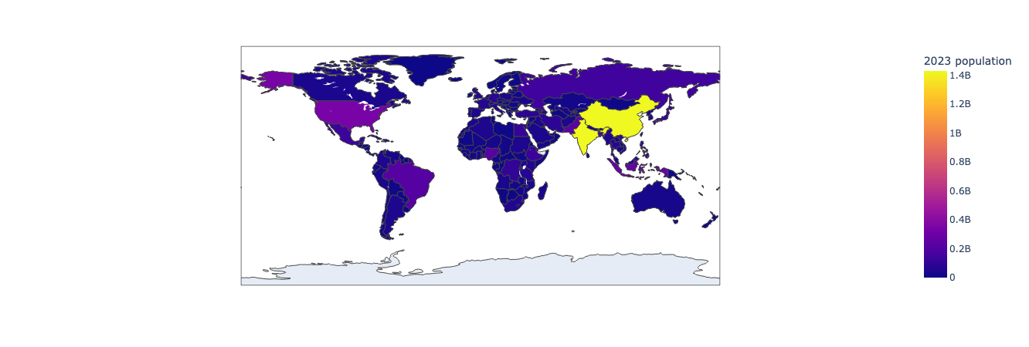
World population 2023

Slide 8

World population 2022

Slide 9

World population 2020

Slide 10
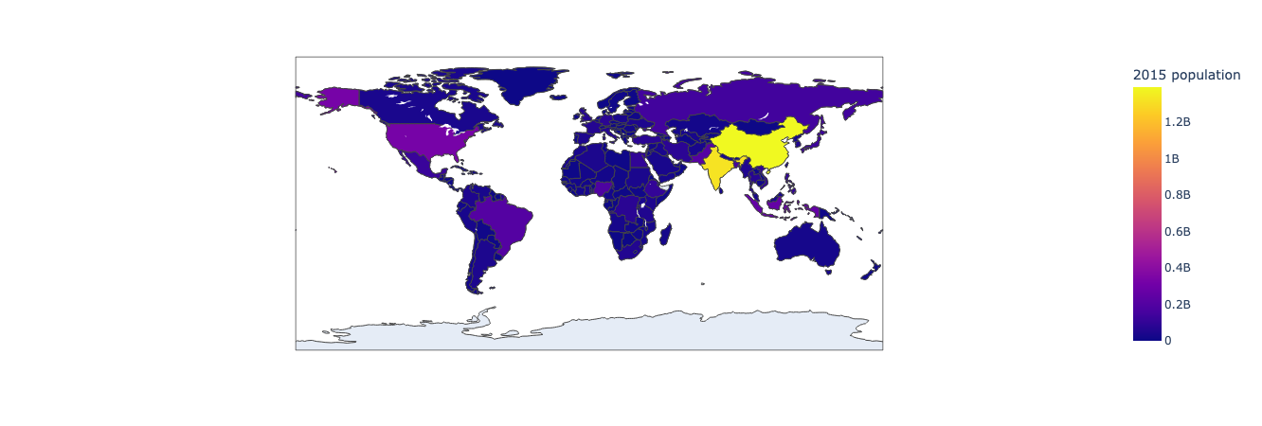
World population 2015

Slide 11

World population 2010

Slide 12

World population 2000

Slide 13

World population 1990

Slide 14

World population 1980

Slide 15
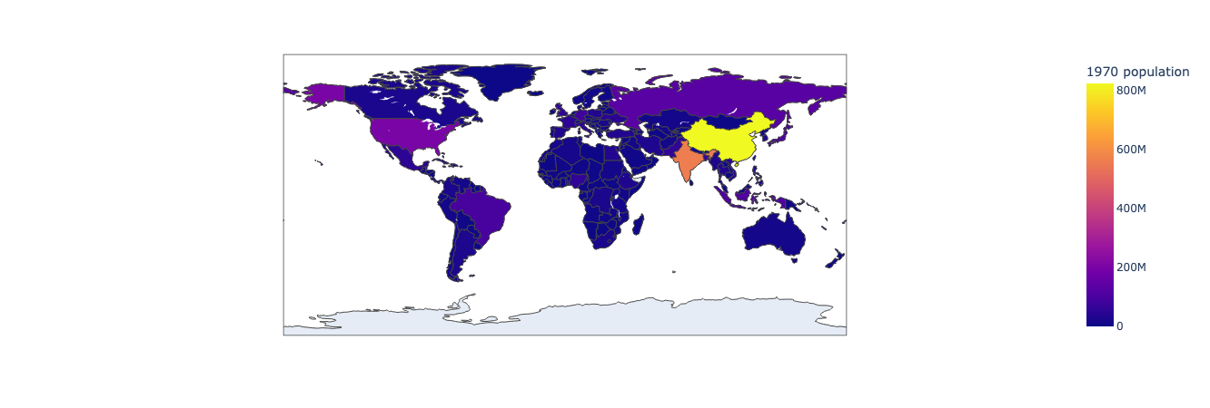
World population 1970

Slide 16
World population 2023 side by side with the world population 1970

