Slide 1
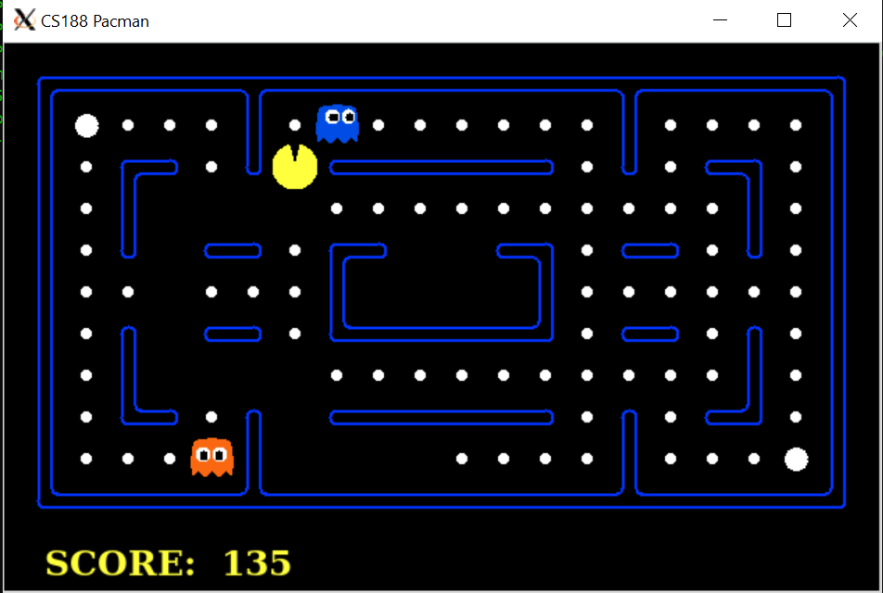
Pacman By: Becca Dura & Joe Vivone
UC Berkeley starter code
Python 2
Searches:
BFS
DFS
Uniform Cost Search
A* Search
Reinforcement Learning:
Value Iteration
Q-Learning

