Slide 1
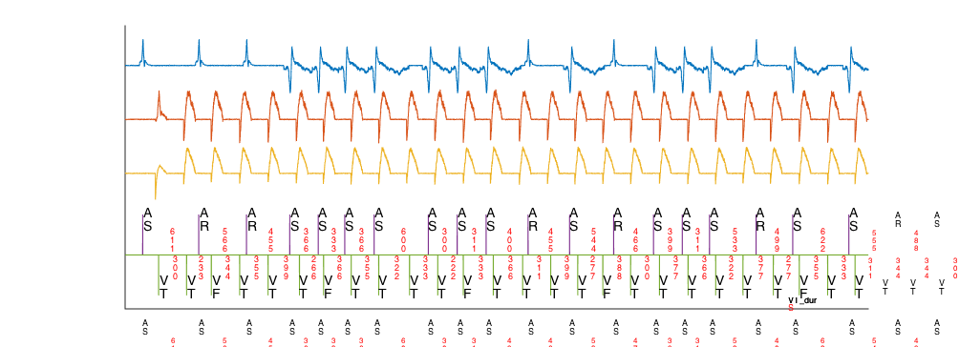
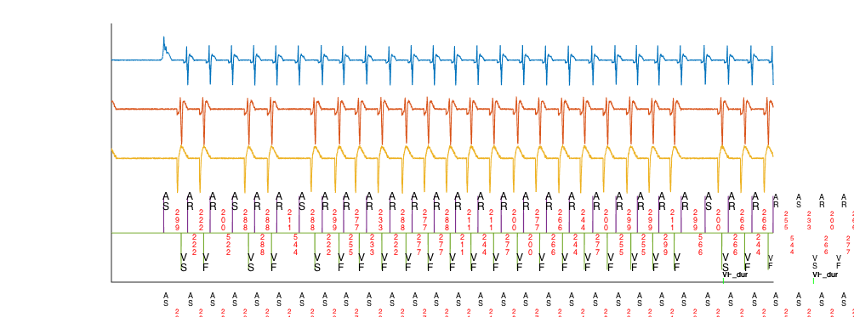
(a)VT
10 beats
Duration
Therapy
Last 10 Ventricular intervals
Initial Detection
A EGM
V EGM
1
V rate>A rate
Therapy
Delivered
8/10 intervals faster
than VT threshold
No
No
8/10 intervals faster
than VF threshold
Shock
Yes
Yes
VT Duration
VF Duration
VT
Marker
RhythmID
(b)SVT
10 beats
Duration
Inhibit
V rate>A rate
by at least 10bpm
No
VTC
Correlated
Yes
A EGM
No
V EGM
Yes
SVT
A Rate>V rate
VTC correlated
Therapy
Inhibited
Shock
VT
No
A-fib Rate=TRUE
& V rate unstable
Yes
Marker

