Slide 1
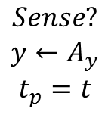
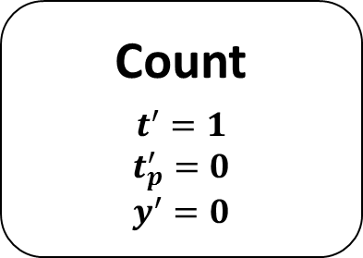
Count
$$t^{′}=1$$
$$t_{p}^{′}=0$$
$$y^{′}=0$$
$$Sense?$$
$$y←A_{y}$$
$$t_{p}=t$$

