Slide 1

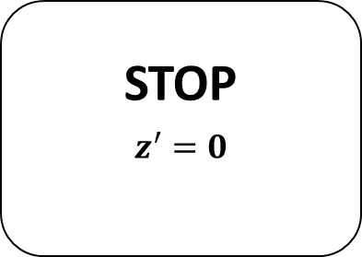

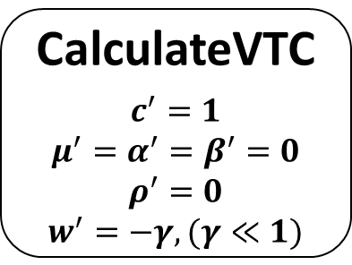
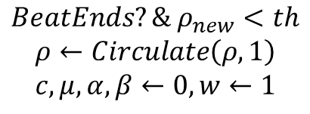
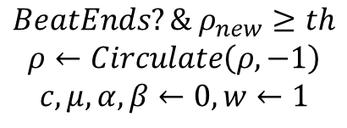
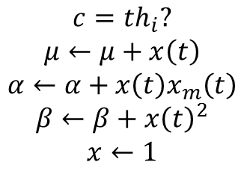
$$BeatEnds?\& ρ_{new}≥th$$
$$ρ←Circulate\left(ρ,−1\right)$$
$$c,μ,α,β←0,w←1$$
$$c=th_{i}?$$
$$μ←μ+x\left(t\right)$$
$$α←α+x\left(t\right)x_{m}\left(t\right)$$
$$β←β+x{\left(t\right)}^{2}$$
$$x←1$$
CalculateVTC
$$c^{′}=1$$
$$μ^{′}=α^{′}=β^{′}=0$$
$$ρ^{′}=0$$
$$w^{′}=−γ,(γ≪1)$$
STOP
$$z^{′}=0$$
$$DurationEnds?$$
$$z←0$$
$$L_{3}≤th$$
$$BeatEnds?\& ρ_{new}<th$$
$$ρ←Circulate\left(ρ,1\right)$$
$$c,μ,α,β←0,w←1$$

