Slide 1
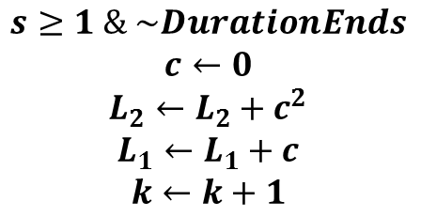
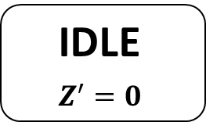
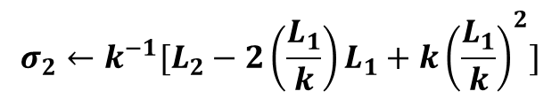
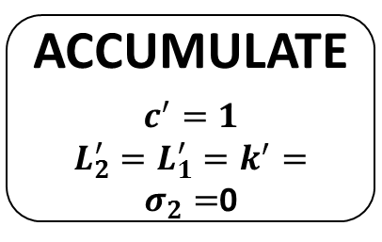


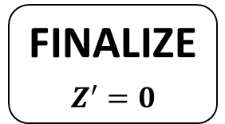
ACCUMULATE
$$c^{′}=1$$
$L_{2}^{′}=L_{1}^{′}=k^{′}=σ_{2}=$0
IDLE
$$Z^{′}=0$$
$$Duration!$$
$$DurationEnds!$$
$$s≥1 \& \sim DurationEnds$$
$$c←0$$
$$L_{2}←L_{2}+c^{2}$$
$$L_{1}←L_{1}+c$$
$$k←k+1$$
$$σ_{2}←k^{−1}[L_{2}−2\left(\frac{L_{1}}{k}\right)L_{1}+k{\left(\frac{L_{1}}{k}\right)}^{2}]$$
FINALIZE
$$Z^{′}=0$$

