Slide 1
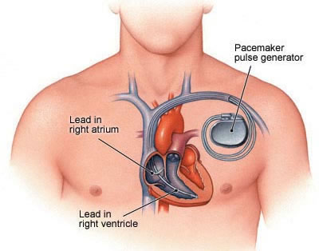
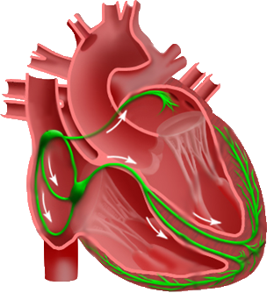
Remove heart from figure
Remove dialog boxes
Add captions later
AS
AP
Events
VS
VP
SA node
A-lead
AV node
V-lead
His-Purkinje System

Slide 2
Figure 2: (models.pdf) Different heart models

Slide 3
Fig 3: Multi-scale

Slide 4
Fig 4 (Table)
Simplify
Images

Slide 5
MBCT Figure

Slide 6
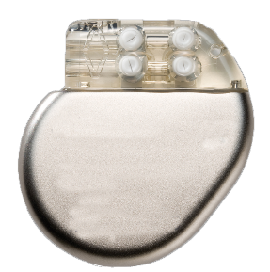
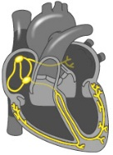


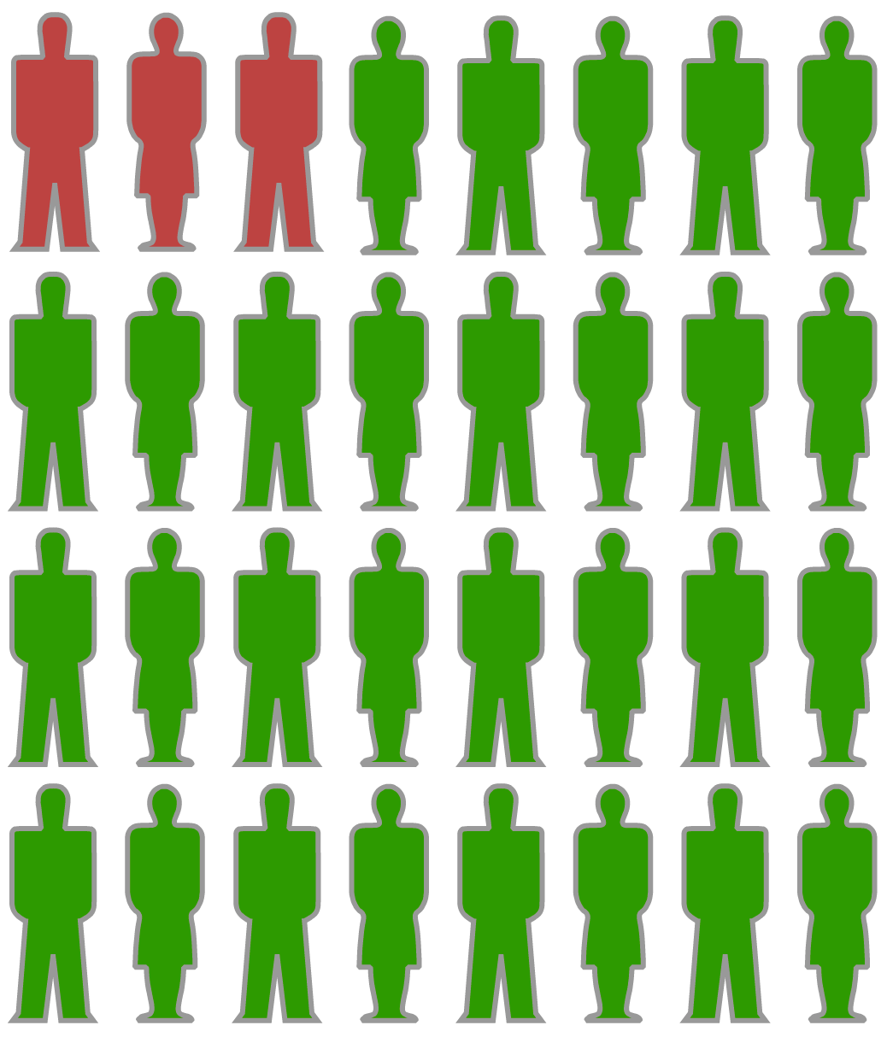
Model-based Clinical Trials
Physiological Monitors for Model Training
2
Timing Constraints for Heart Condition 1
Timing Constraints for Heart Condition 2
Timing Constraints for Heart Condition N
Perturb parameters within constraints
3
1
Real Patient-Specific
Heart Models
Synthetic
Heart Model Library
4
Closed-loop Device Testing
H1 H2 H3
H4’ H5’ H6’ H7’ H8’ Hn-1’ Hn’
Implantable Cardiac Device
Real Patient Heart Models
Generate Synthetic Heart Models
Complete Population/Parameter Analysis

Slide 7
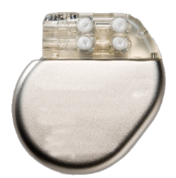
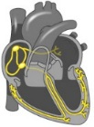

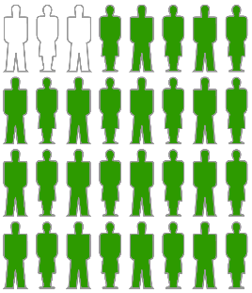
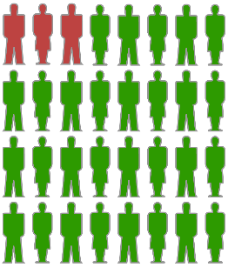
Physiological Monitors for Model Training
2
Timing Constraints for Heart Condition 1
Timing Constraints for Heart Condition 2
Timing Constraints for Heart Condition N
Perturb parameters within constraints
Real Patient-Specific
Heart Models
3
1
Synthetic
Heart Model Library
4
Closed-loop Device Testing
H1 H2 H3 H4’ H5’ H6’ H7’ H8’ HN-1’ HN’
Implantable Cardiac Device
Real Patient Heart Models
Generate Synthetic Heart Models
Complete Population/Parameter Analysis

