Slide 1
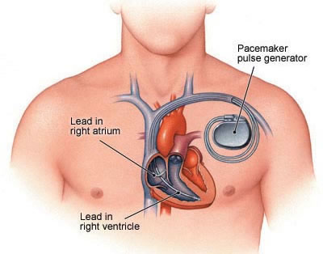

Remove heart from figure
Remove dialog boxes
Add captions later
AS
AP
Events
VS
VP
SA node
A-lead
AV node
V-lead
His-Purkinje System

Slide 2
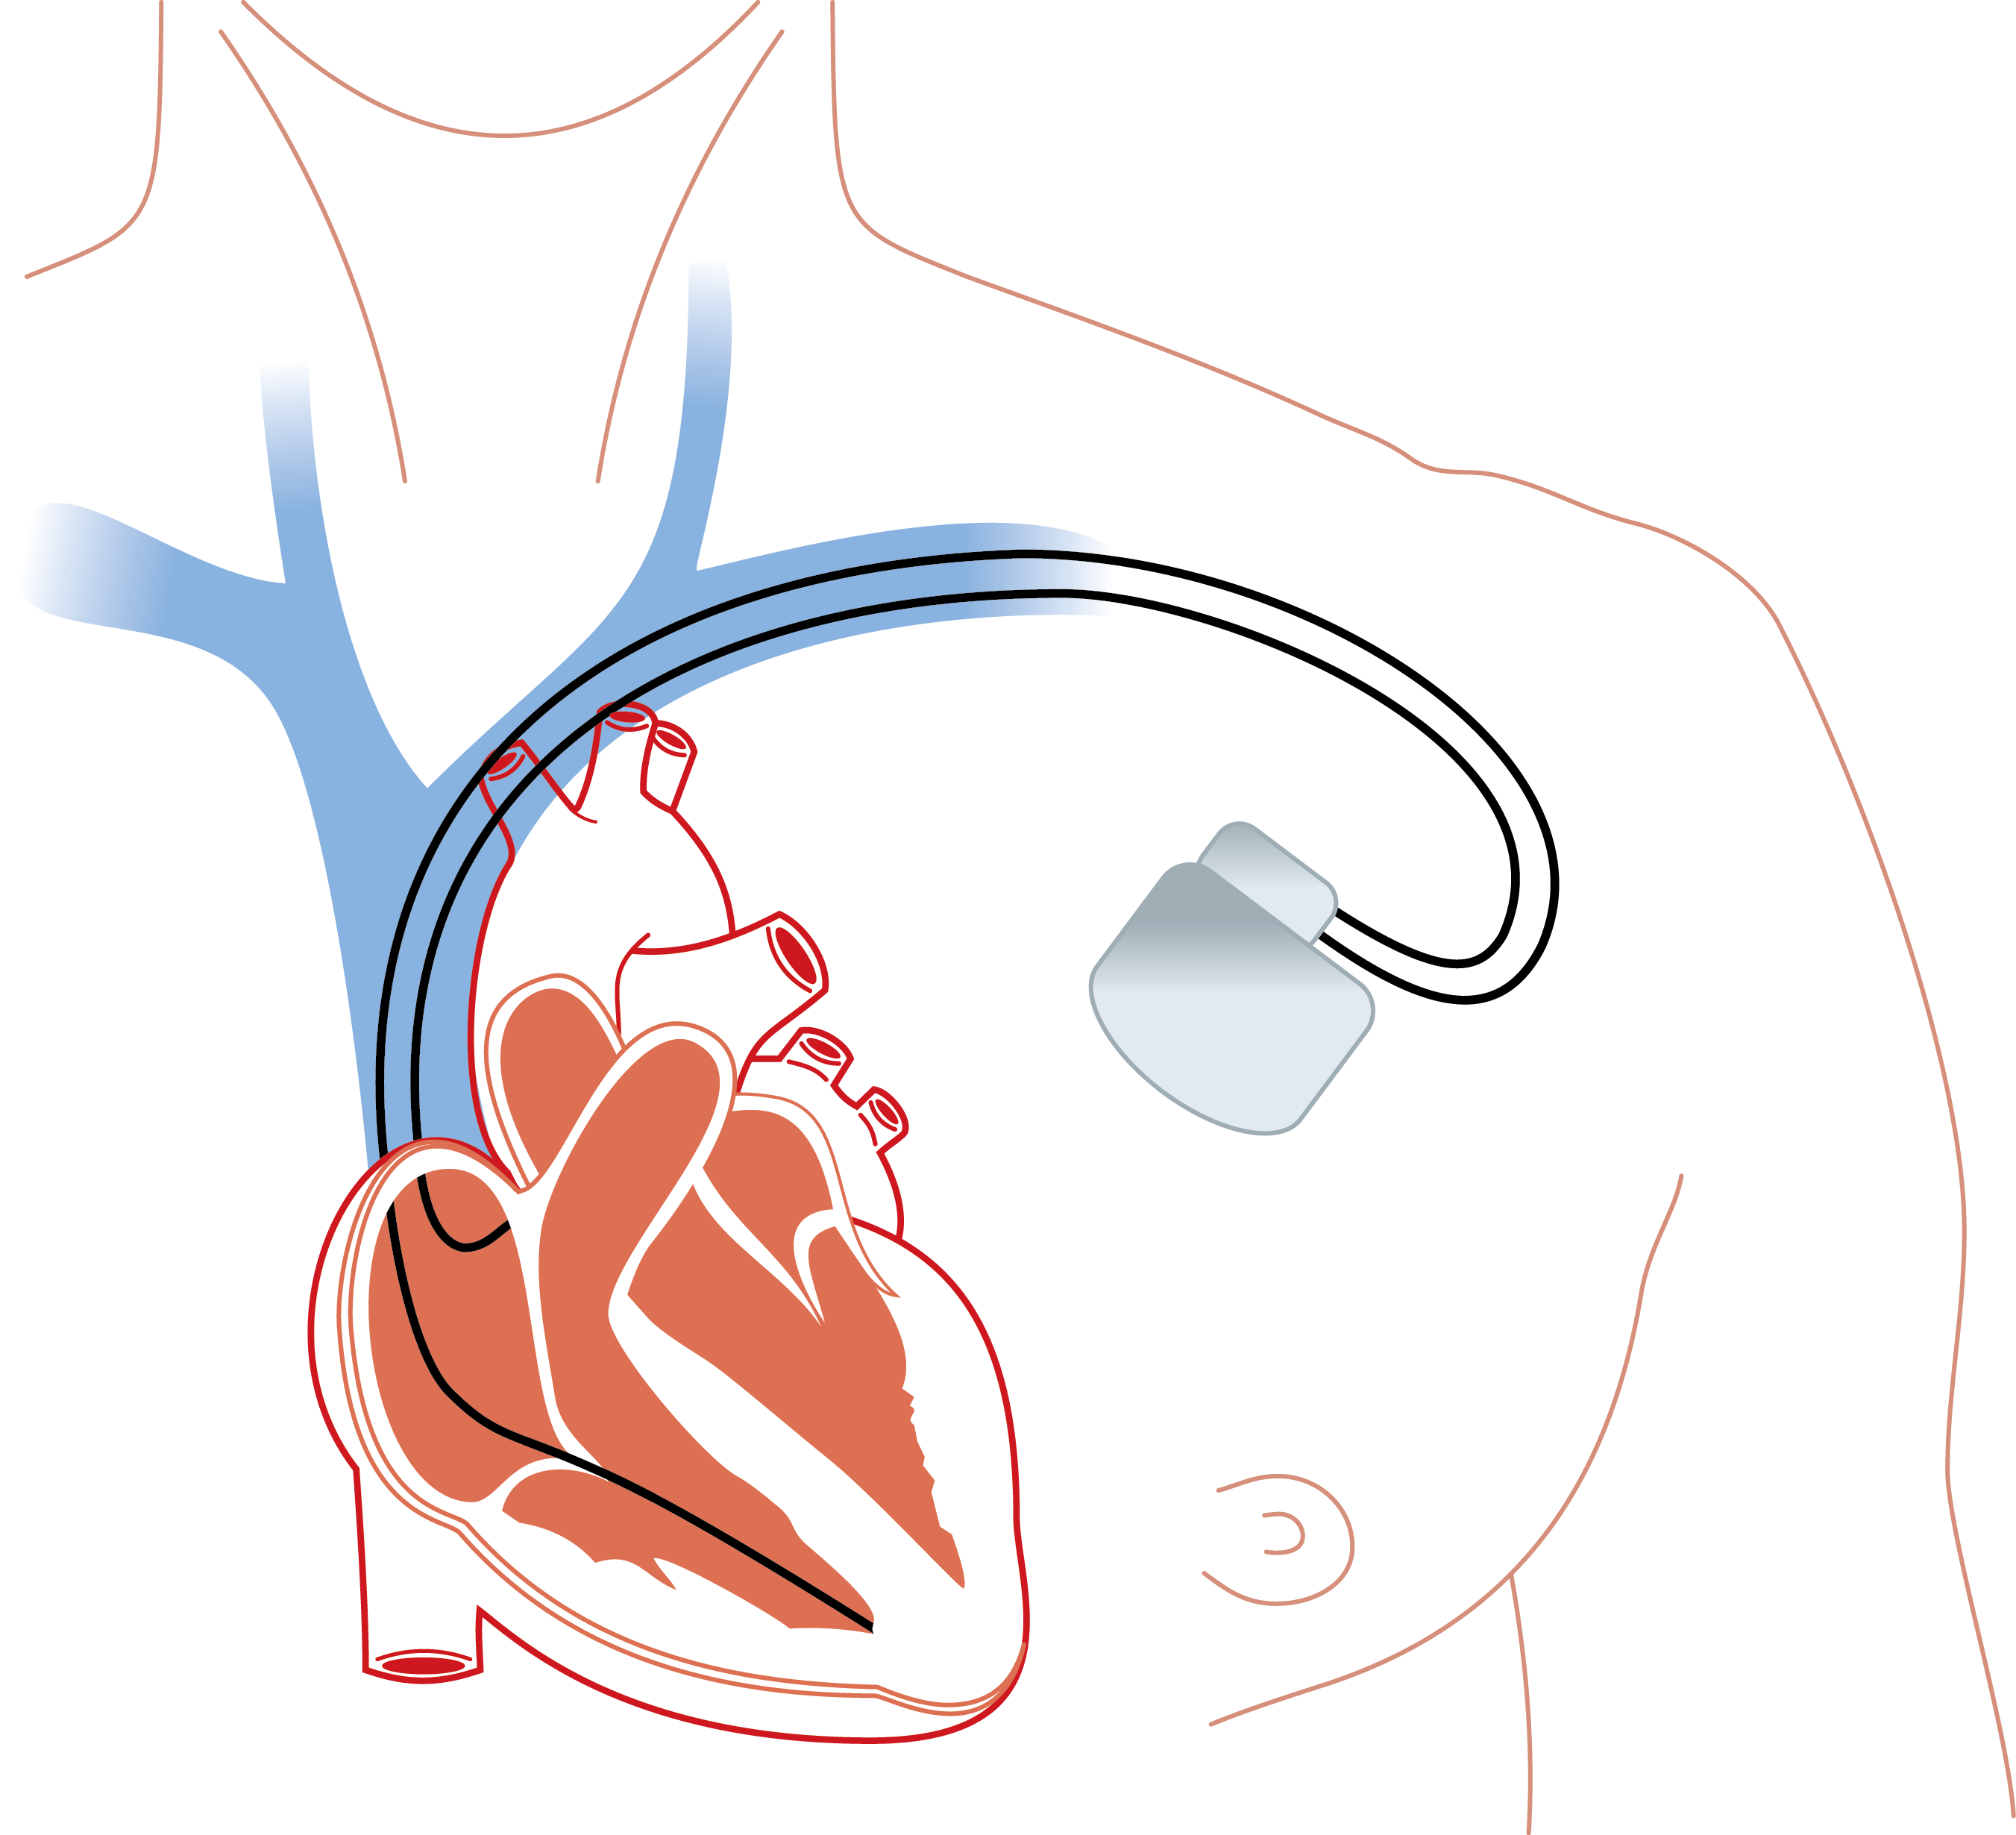
Pacemaker Pulse
Generator
Sensing
AS
AP
Events detected
in pacemaker
Pacing
VS
VS
Atrial
lead signal
Left Atrium
Left Ventricle
Ventricular
lead signal
Right Atrium Lead
Right Atrium
Right Ventricle Lead
Right Ventricle

Slide 3
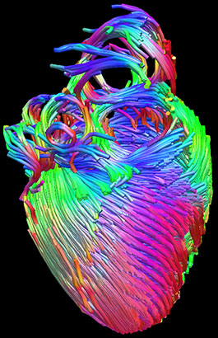
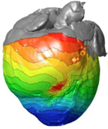
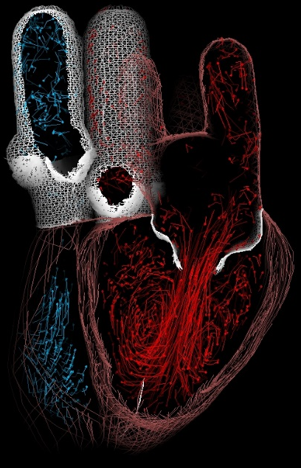
Anatomy Model
Electrophysiology Model
Electro-mechanical Model
Blood Flow Model

Slide 4
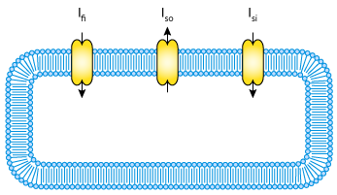
Cellular Model
Electrophysiology Model
Anatomical Model
Electro-mechanical Model

Slide 5
Fig 3: Multi-scale

Slide 6
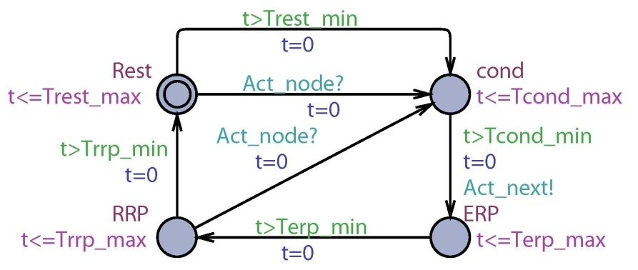
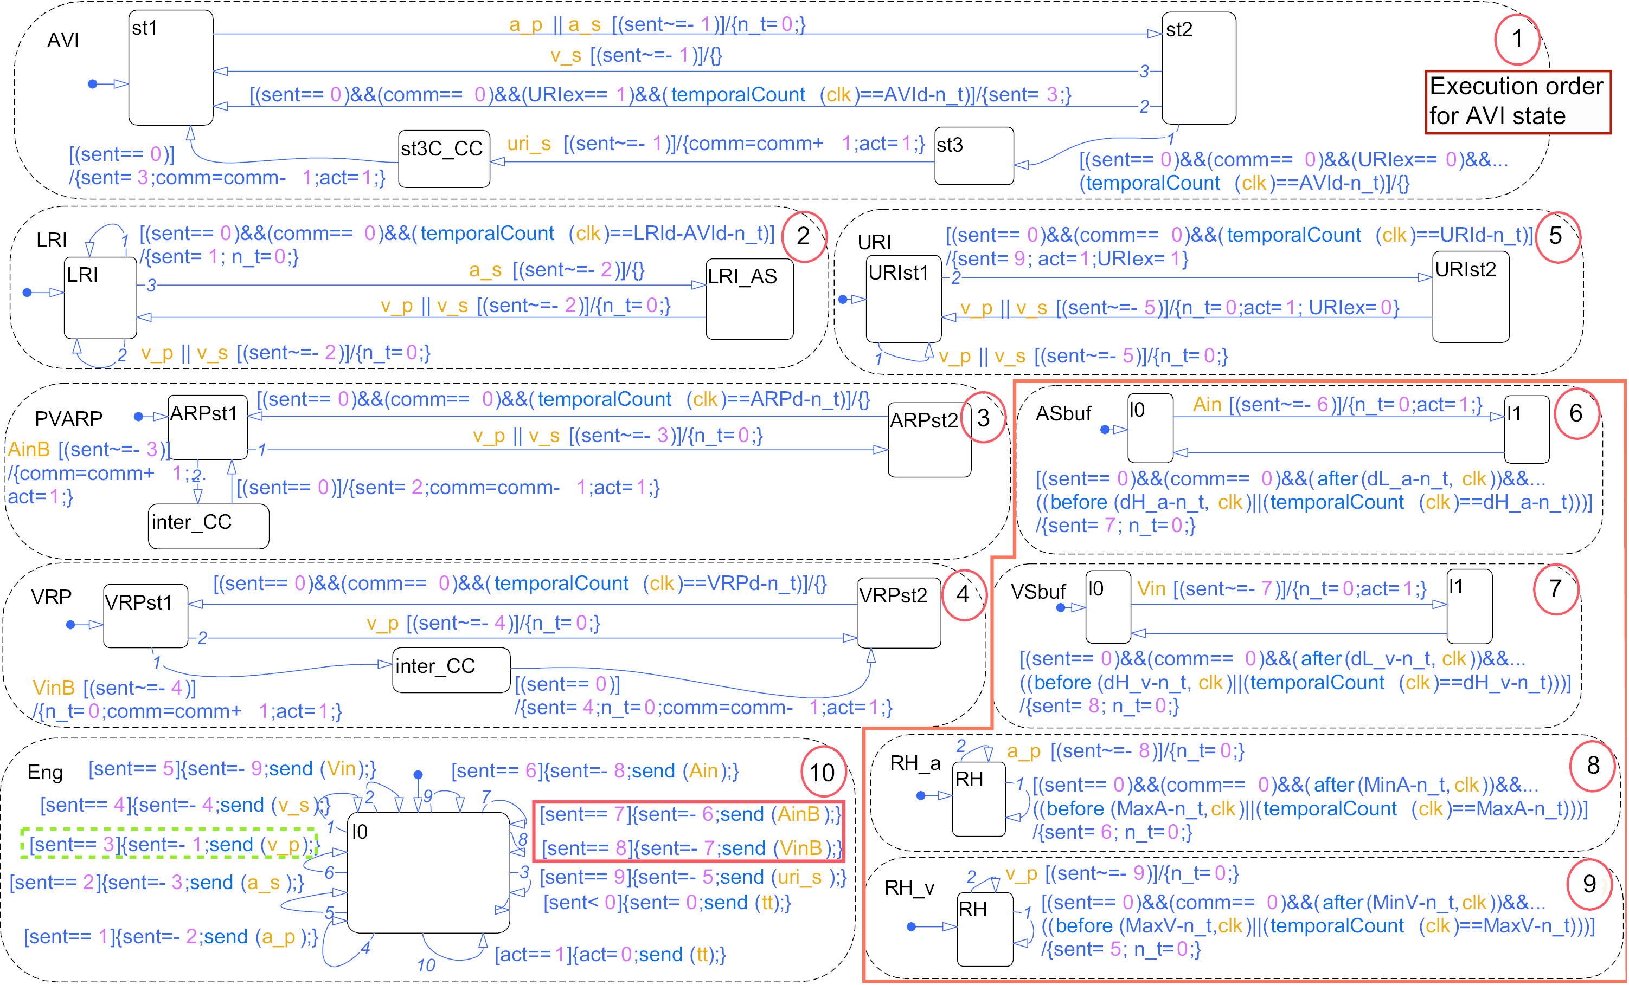
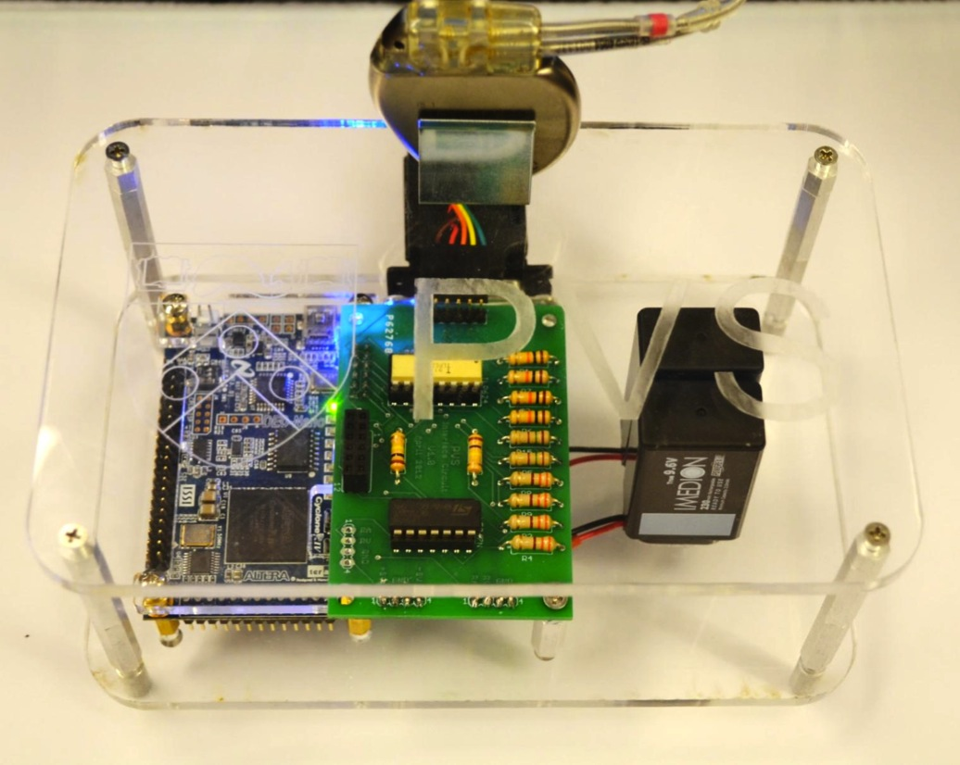
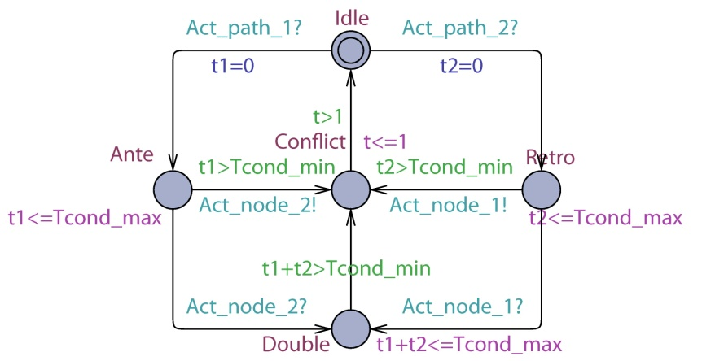
Model Checking
Simulation-based Testing
Platform Testing
Non-deterministic UPAAL Model
Abstract Heart and Device models
Deterministic Simulink Model
Increased complexity and interactions
Hardware implementation of verified models
Heart-on-a-Chip Platform

Slide 7
Model-based Pacemaker Design
Heart
Pacemaker
Non-deterministic
UPPAAL Model
Model Checking
Interpolation
UPP2SF
Model Translation
Deterministic
Stateflow
Chart
Model Simulation
HDL Coder
Simulink Coder
FPGA
implementation
C Code
implementation
Hardware Testing
Notes:
We developed a model based design tool chain for pacemaker software development. At verification level we have a set of non-deterministic heart models which covers different heart conditions. Together with a timed-automata model of the pacemaker the closed-loop system is verified in model checker UPPAAL against safety properties.
Using the tool UPP2SF, which is a matlab script developed by us, the UPPAAL model of the pacemaker can be rigorously translated into stateflow chart. We also have deterministic heart models in Simulink which can perform closed-loop simulation with the pacemaker model.
Using the simulink coder, the stateflow chart of the pacemaker can be translated into C code and implemented on any embedded platform.
Using this automated tool chain, we can rule out discrepancies introduced by manual translations between layers. Together with our heart model implementation, we can ensure all properties satisfied at verification level still holds after implementation.

Slide 8
Heart On A Chip Platform
Notes:
With an analog interface the heart model implementation is able to interact with a real pacemaker. Demonstrations of the platform is shown in the case study section.

Slide 9
AS
AS
SA node
AV node
VS
VS
His-Purkinje System
(a)
(b)
(c)

Slide 10
MBCT Figure

Slide 11
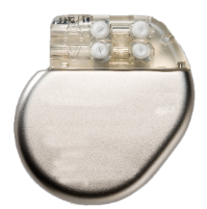




Physiological Monitors for Model Training
2
Timing Constraints for Heart Condition 1
Timing Constraints for Heart Condition 2
Timing Constraints for Heart Condition N
Perturb parameters within constraints
Real Patient-Specific
Heart Models
3
1
Synthetic
Heart Model Library
4
Closed-loop Device Testing
H1 H2 H3 H4’ H5’ H6’ H7’ H8’ HN-1’ HN’
Implantable Cardiac Device
Real Patient Heart Models
Generate Synthetic Heart Models
Complete Population/Parameter Analysis

Slide 12
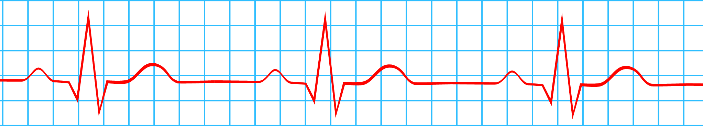
Real Patient
Heart Data
Parameter
Constraints
3
Synthetic
Heart Model Library
Closed-loop
Device Testing
1
2
4
Parameter Constraints for Heart Condition 1
H1
H5
Parameter Constraints for Heart Condition 2
H2
Training
Cohort
Generation
Parameterized
Heart Model
H3
HN
Parameter Constraints for Heart Condition N
Implantable Cardiac Device
H4

Slide 13
Real Patient-Specific
Heart Models
Implantable Cardiac Device

