Slide 1

What Factors Affect Instagram Likes

Slide 2
Acquiring the data
Used Instagram API data
Dataset represents all of the posts on Instagram submitted
during the week of 9/28/14 and 10/4/14
within a 5 kilometer range of Franklin & Marshall College.

Slide 3
Cleaning
Methods Created:
hashtagcounter(caption)
hashtaglist(caption)
dayofweek(date)
created(date,time)
Lambda syntax created binary columns:
‘Filter_Boolean’
‘‘Day_and_Night’
‘High_or_Low’
‘Weekdayend’

Slide 4
Cleaning
Outliers were removed
All posts with a ‘like_count’ greater than 400
The overall dataset (dfn) was then split into two separate groups:
Highlikes – all posts with a’ like_count’ greater than or equal to 100
Lowlikes – all of posts with a ‘like_count’ less than 100 likes.

Slide 5
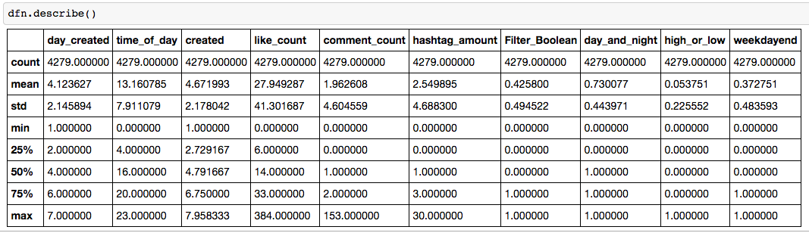
cleaning

Slide 6
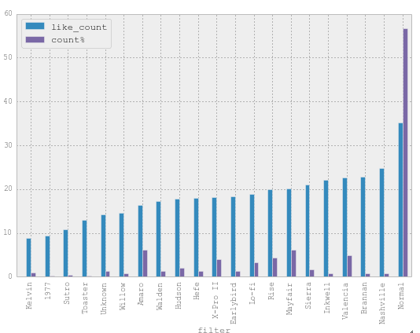
Filters (Images)

Slide 7
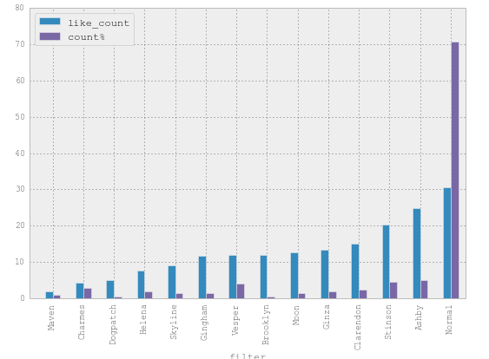
Filters (videos)

Slide 8
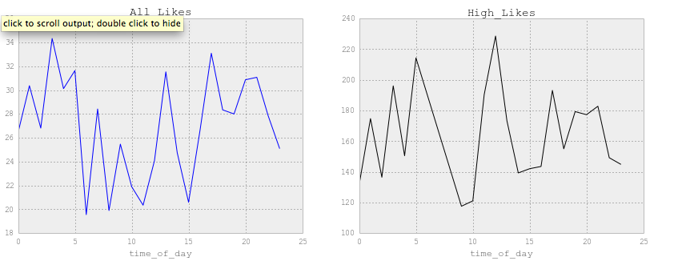
Average amount of likes by hour

Slide 9
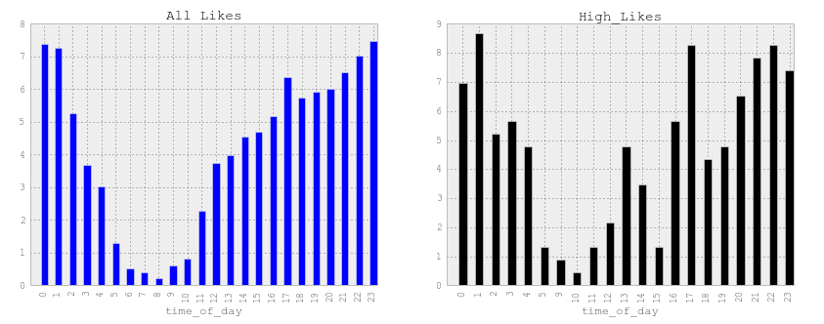
Average amount of Posts per hour of the day

Slide 10
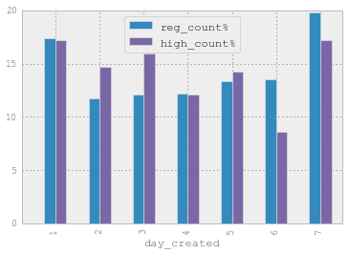
Percentage spread of posts

Slide 11
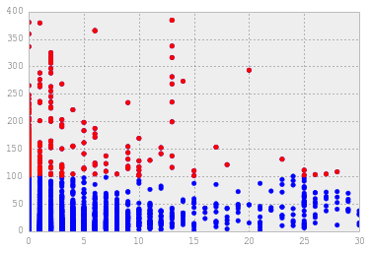
Low_like and high_like usage of hashtags

Slide 12
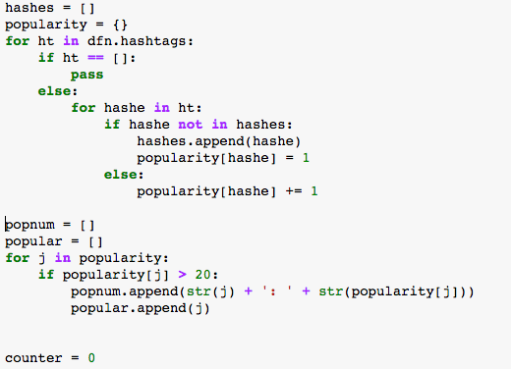
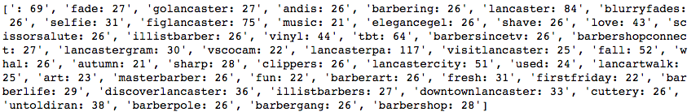
Popular hashtag usage among high_liked posts

Slide 13
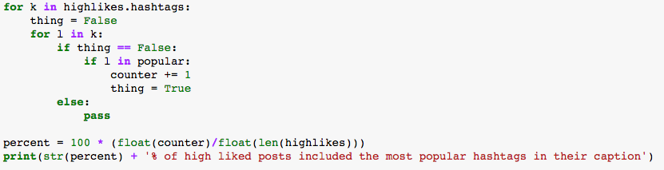
Popular hashtag usage among high_liked posts
14.347826087% of high_liked posts included the hashtags on the most popular list

