Slide 1
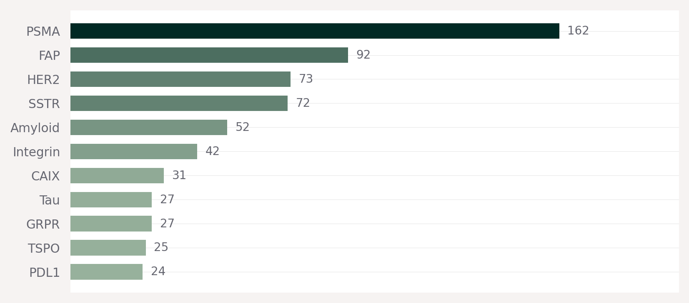
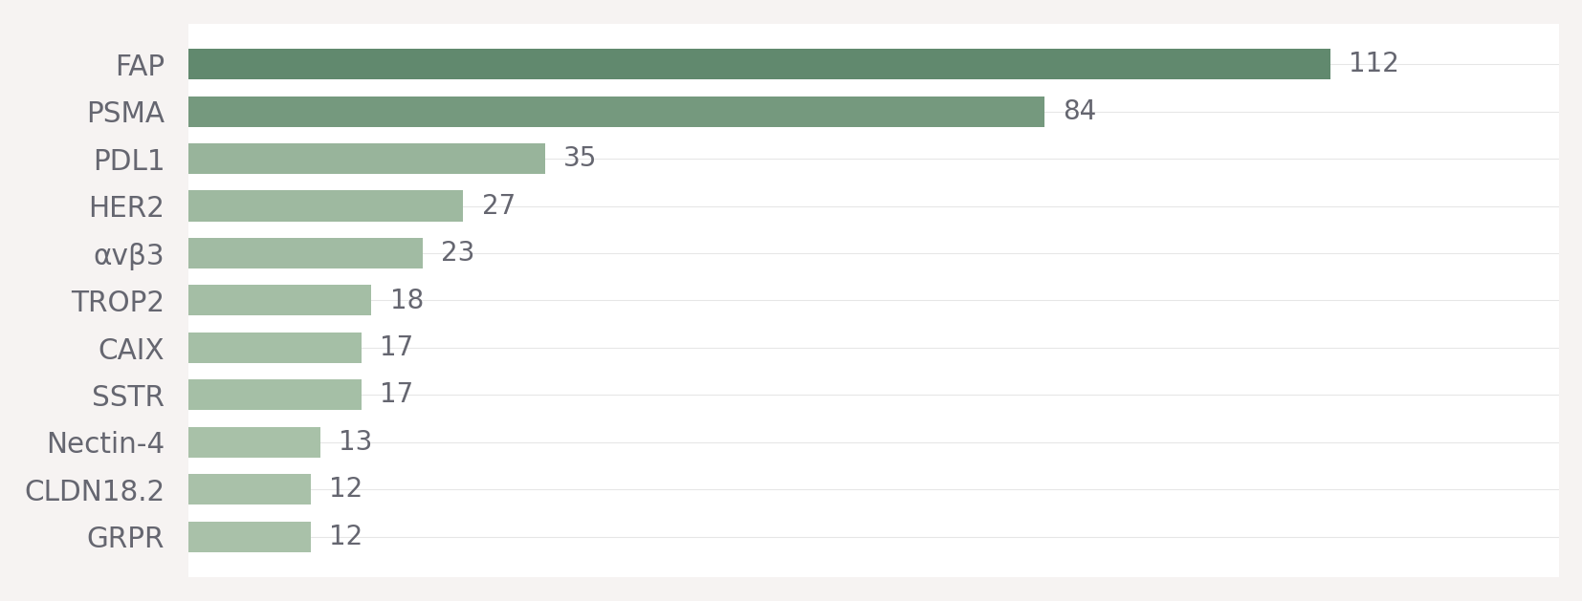
Landscape
Confidential
5
Chinese developers balance validated targets (PSMA, FAP) with first-in-class RLT bets
GLOBAL
China's target strategy
1
Validation through well-understood targets (FAP, PSMA)
2
First-to-market bet on FAP for fibrotic cancers
3
ADC-validated target optionality (HER2, TROP2, etc.)
4
First-in-class RLT bets (Nectin-4, CLDN18.2)
CHINA
Key divergence
FAP #1 in China (vs #2 globally) — massive bet on fibrotic cancers
TROP2, Nectin-4, CLDN18.2 reflect ADC-to-RLT translation strategy unique to China
SSTR drops from #4 globally to #8 in China — less focus on neuroendocrine
Source: NextPharma, Pharmacube (via BFC Group)

