Slide 1
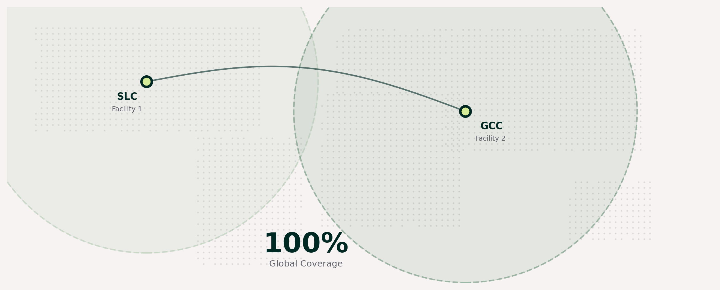
GCC Opportunity
Confidential
8A
Two near-antipodean facilities give Sego same-day dose delivery to any point on Earth
Salt Lake City — Facility 1
GCC — Facility 2
Coverage: North & South America, Western Europe
Key hub: SLC International Airport — direct routes to major US & European destinations
Coverage: GCC & Africa, Asia & Australasia, Eastern Europe
Key hub: GCC Airport — 250+ direct destinations across 5 continents
Exact replica of SLC R&D, development, and commercial production facility — same hot-cell configurations, automated synthesis, QC labs, and GMP-compliant dispensing. Operational from day one.

Slide 2
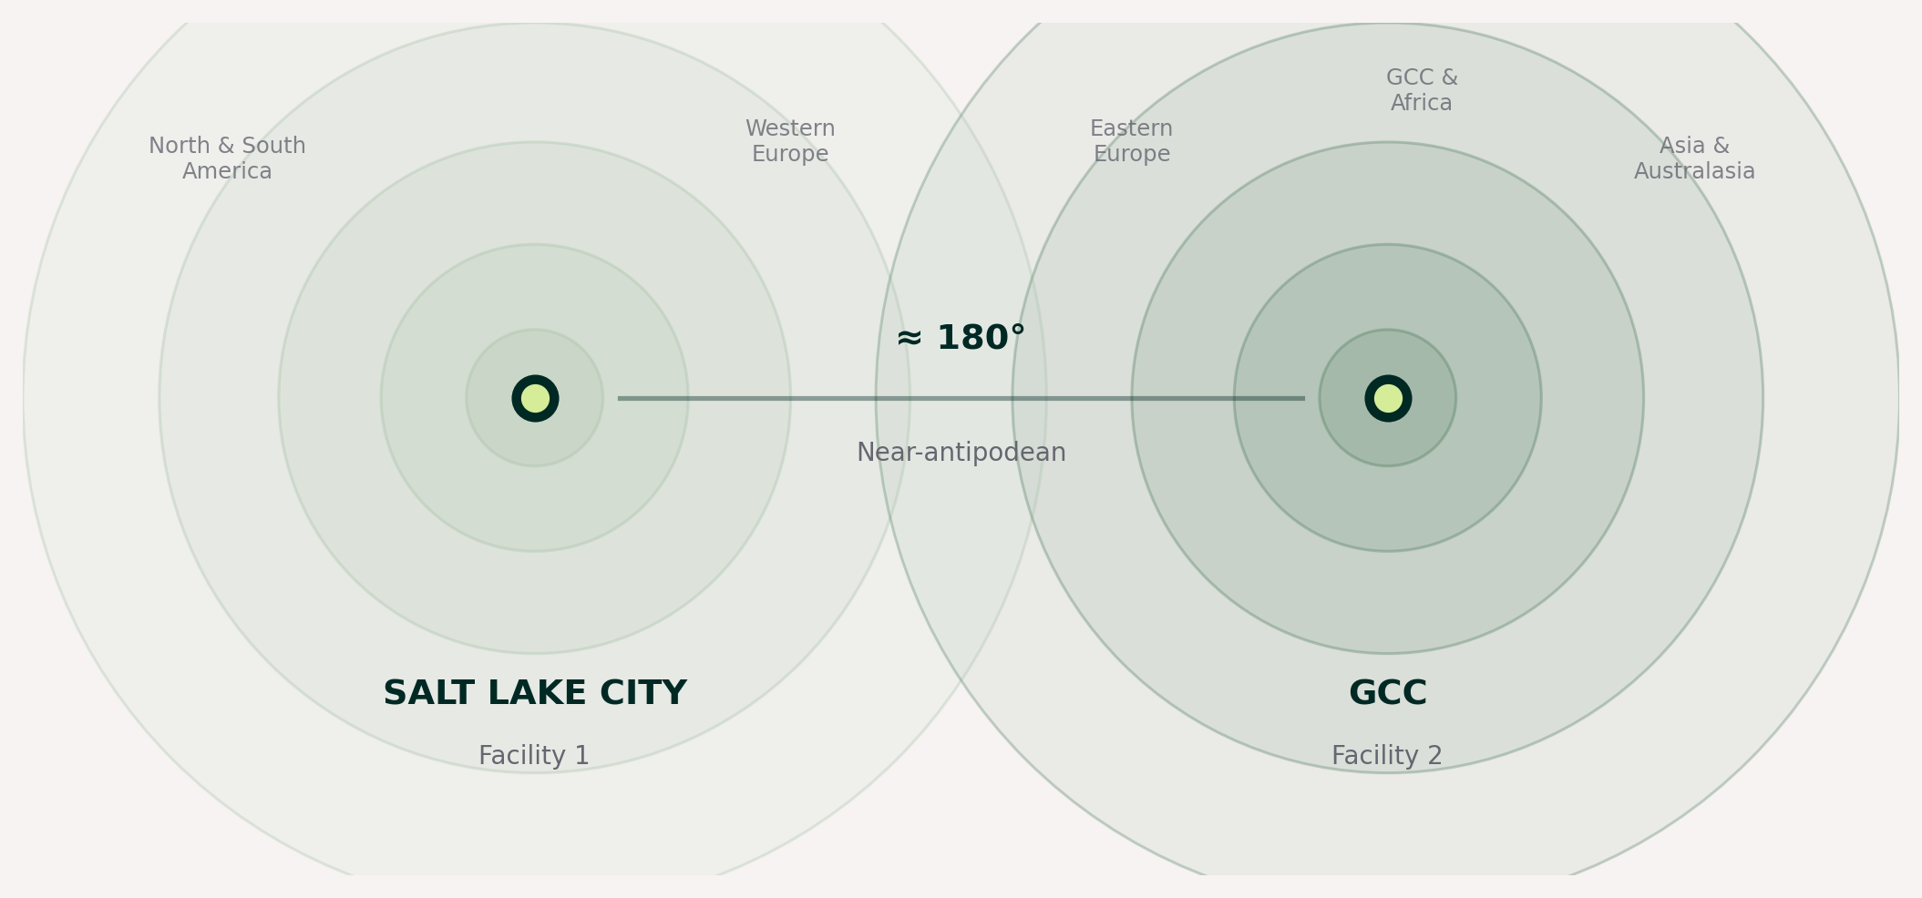
GCC Opportunity
Confidential
8B
Two near-antipodean facilities give Sego same-day dose delivery to any point on Earth
100%
Global Coverage
Salt Lake City — Facility 1
GCC — Facility 2
North & South America, Western Europe
SLC International Airport — direct US & European routes
GCC & Africa, Asia & Australasia, Eastern Europe
GCC Airport — 250+ direct destinations across 5 continents

