Slide 1
Vitaliy Basyuk aka Wolfgang Bas becevka@kucoe.net
Express Nodes on the right Angle

Slide 2

Did you ever have a product idea?

Slide 3

A dream will always triumph over reality, once it is given the chance. Stanislaw Lem

Slide 4
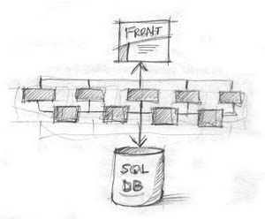
birkey.com

Slide 5

My way on finding technologies which help not to loose excitement of my idea and not let me sink in the sea of boilerplate code.

Slide 6
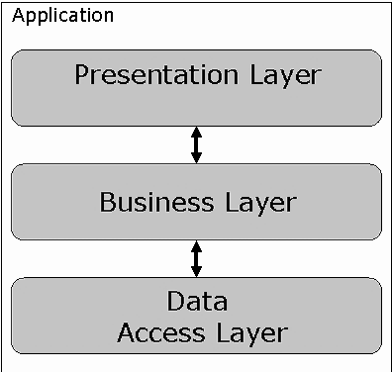

Slide 7
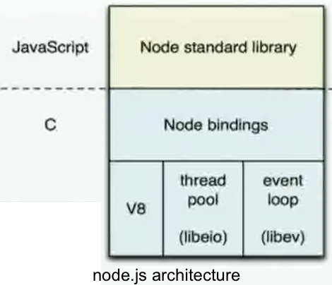
Node.js is a platform built on Chrome's JavaScript runtime for easily building fast, scalable network applications.

Slide 8
The basic philosophy of node.js is
Non-blocking I/O
Every I/O call must take a callback, whether it is to retrieve information from disk, network or another process
Built-in support for the most important protocols
HTTP, DNS, TLS
Low-level
Does not remove functionality present at the POSIX layer. For example, support half-closed TCP connections.
Stream everything
Never force the buffering of data

Slide 9
Code
fs.readFile('/etc/passwd', function(err, data){
console.log(data);
});
var http = require('http');
http.createServer(function (req, res) {
res.writeHead(200, {'Content-Type': 'text/plain'});
res.end('Hello World\n');
}).listen(8081);
console.log('Server running at port 8081');

Slide 10
Server routing
var http = require('http');
http.createServer(function (req, res) {
var path = url.parse(req.url).pathname;
var hello = {message: "Hello, world"};
switch (path) {
case '/json':
res.writeHead(200, {'Content-Type':'application/json; charset=UTF-8'});
res.end(JSON.stringify(hello));
break;
default:
res.writeHead(404, {'Content-Type': 'text/html; charset=UTF-8'});
res.end('Sorry, we cannot find that!');
}
}).listen(8081);

Slide 11
Express
var express = require('express');
var app = express();
app.get('/', function(req, res){
res.send('Hello World');
});
app.listen(8081);
var express = require('express');
var app = express();
var hello = {message: "Hello, world"};
app.get('/json', function(req, res){
res.json(hello);
});
app.all('*', function(req, res){
res.send(404, 'Sorry, we cannot find that!');
});
app.listen(8081);

Slide 12
What Express does?
Processing request parameters and headers
Routing
Rendering response and views support
Application configuration and middleware support
session, CSRF, basicAuth, vhost, static content, custom

Slide 13
Express example
var express = require('express'),
routes = require('./routes'),
api = require('./routes/api');
var app = express();
app.configure(function(){
app.set('views', __dirname + '/views');
app.set('view engine', 'jade');
app.use(express.bodyParser());
app.use(express.methodOverride());
app.use(express.static(__dirname + '/public'));
app.use(app.router);
});
app.configure('development', function(){
app.use(express.errorHandler({ dumpExceptions: true, showStack: true }));
});
app.configure('production', function(){
app.use(express.errorHandler());
});

Slide 14
Express example (continue)
app.get('/', routes.index);
// res.render('index');
app.get('/posts', api.posts);
app.get('/posts/:id', api.post);
//var id = req.params.id;
app.post('/posts', api.addPost);
//res.json(req.body);
app.put('/posts/:id', api.editPost);
app.delete('/posts/:id', api.deletePost);
app.get('*', routes.index);
app.listen(3000, function(){
console.log("Express server listening on port %d in %s mode", app.address().port, app.settings.env);
});

Slide 15
Node.js pros
Known language (JavaScript)
Additional API are documented well and understandable
Effortless building of REST services with Express
No server configuration, easy to install and run
Real-time application support
Quite big community and a lot of tools implemented

Slide 16
Node.js cons
Not mature enough and some API are not stable
Running on production server might differ
Not enough tools and libraries
Not for a CPU consuming routines
Async code looks not so pretty

Slide 17
Further reading
http://nodejs.org/api/ - Node.js official API
http://book.mixu.net/ - Mixu Node book
http://ofps.oreilly.com/titles/9781449398583/index.html - Node Up and Running (has chapter on Express)
http://expressjs.com/api.html - Express API
Useful modules
http://socket.io/ - for realtime apps
https://github.com/visionmedia/jade - Express template engine
http://visionmedia.github.io/mocha/ - test framework
http://chaijs.com/ - BDD/TDD assertion library

Slide 19
MongoDB
Document-Oriented Storage for JSON-style documents with dynamic schemas, full index support and rich document-based queries.
db.articles.find({'comments.0.by':'becevka'})

Slide 20
Mongoskin
var mongo = require('mongoskin');
var db = mongo.db('localhost:27017/test?auto_reconnect');
db.bind('posts', {
removeTagWith : function (tag, fn) {
this.remove({tags:tag},fn);
}
});
db.posts.removeTagWith('delete', function (err, replies){
//do something
});

