Slide 1
NoSQL & SQL
When it comes to choosing a database the biggest decision is picking a relational (SQL) or non-relational (NoSQL) data structure. While both databases are viable options still there are certain key differences between the two that users must keep in mind when making a decision.

Slide 2
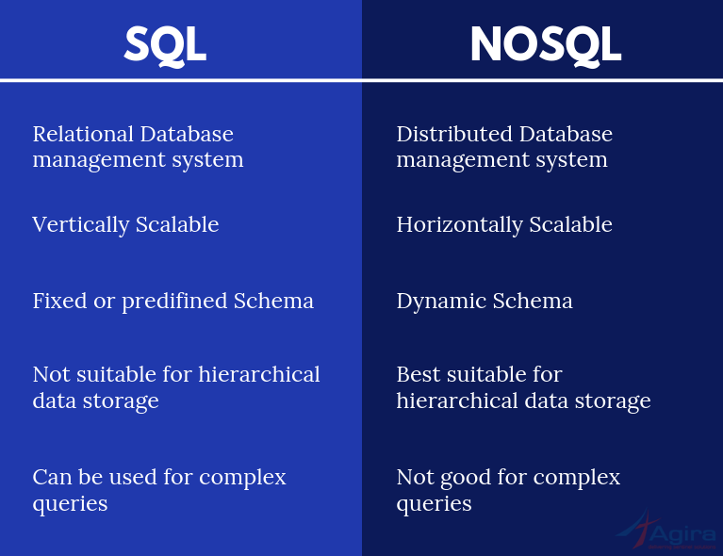

Slide 3
Main differences between NoSQL and SQL:
Type:
SQL databases are primarily called Relational Databases (RDBMS); whereas NoSQL databases are primarily called non-relational or distributed databases.
Language:
SQL databases define and manipulate data-based structured query language (SQL). Seeing from a side this language is extremely powerful. SQL is one of the most versatile and widely-used options available which makes it a safe choice, especially for great complex queries. But from another side, it can be restrictive. SQL requires you to use predefined schemas to determine the structure of your data before you work with it. Also, all of your data must follow the same structure. This can require significant up-front preparation which means that a change in the structure would be both difficult and disruptive to your whole system.

Slide 4
A NoSQL database has a dynamic schema for unstructured data. Data is stored in many ways which means it can be document-oriented, column-oriented, graph-based, or organized as a key-value store. This flexibility means that documents can be created without having a defined structure first. Also, each document can have its own unique structure. The syntax varies from database to database, and you can add fields as you go.

Slide 5
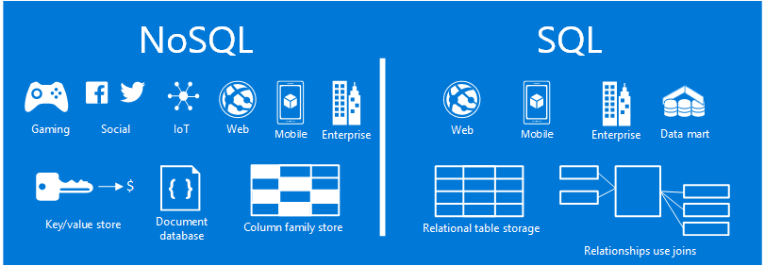

Slide 6
