Slide 1

Refactoring Scientific Software
Anshu Dubey Argonne National Laboratory
Better Scientific Software Tutorial, SC20, November 2020
See slide 2 for license details

Slide 2
License, Citation and Acknowledgements
License and Citation
This work is licensed under a Creative Commons Attribution 4.0 International License (CC BY 4.0).
The requested citation the overall tutorial is: David E. Bernholdt, Anshu Dubey, Patricia A. Grubel, Rinku K. Gupta, Better Scientific Software tutorial, in SC ‘20: International Conference for High Performance Computing, Networking, Storage and Analysis, online, 2020. DOI: 10.6084/m9.figshare.12994376
Individual modules may be cited as Speaker, Module Title, in Better Scientific Software tutorial…
Acknowledgements
Additional contributors include: Mike Heroux, Alicia Klinvex, Mark Miller, Jared O’Neal, Katherine Riley, David Rogers, Deborah Stevens, James Willenbring
This work was supported by the U.S. Department of Energy Office of Science, Office of Advanced Scientific Computing Research (ASCR), and by the Exascale Computing Project (17-SC-20-SC), a collaborative effort of the U.S. Department of Energy Office of Science and the National Nuclear Security Administration.
This work was performed in part at the Argonne National Laboratory, which is managed by UChicago Argonne, LLC for the U.S. Department of Energy under Contract No. DE-AC02-06CH11357.
This work was performed in part at the Oak Ridge National Laboratory, which is managed by UT-Battelle, LLC for the U.S. Department of Energy under Contract No. DE-AC05-00OR22725.
This work was performed in part at the Lawrence Livermore National Laboratory, which is managed by Lawrence Livermore National Security, LLC for the U.S. Department of Energy under Contract No. DE-AC52-07NA27344.
This work was performed in part at the Los Alamos National Laboratory, which is managed by Triad National Security, LLC for the U.S. Department of Energy under Contract No.89233218CNA000001
This work was performed in part at Sandia National Laboratories. Sandia National Laboratories is a multi-mission laboratory managed and operated by National Technology and Engineering Solutions of Sandia, LLC., a wholly owned subsidiary of Honeywell International, Inc., for the U.S. Department of Energy’s National Nuclear Security Administration under contract DE-NA0003525.

Slide 3
What is Refactoring
Definition: Refactoring is a disciplined technique for restructuring an existing body of code, altering its internal structure without changing its external behavior.
Different from development
You have a working code
You know and understand the behavior
You have a baseline that you can use for comparison

Slide 4
What is Refactoring
General motivations
Modularity enhancement
Improve sustainability
Release to outside users
Easier to use and understand
Port to new platforms
Performance portability
Expand capabilities
Structural flexibility
Definition: Refactoring is a disciplined technique for restructuring an existing body of code, altering its internal structure without changing its external behavior.
Different from development
You have a working code
You know and understand the behavior
You have a baseline that you can use for comparison

Slide 5
Refactoring
An example of workflow with testing
Notes:
Tests written before refactoring encapsulate and enforce a contract made at design time. Having them available easily allows us to maintain that any small change does not alter behavior of code being refactored.
Fowler (1999) via Code Complete:
Refactoring is “a change made to the internal structure of the software to make it easier to understand and cheaper to modify without changing its behavior”.

Slide 6
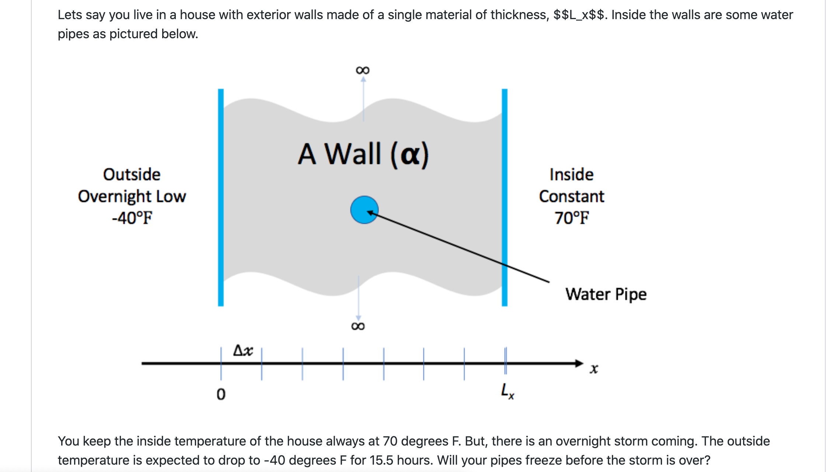
Look at the Running Example
In the repository there are two versions
One is a single file with monolithic code
The other is modularized reusable maintainable code
If we had only the first version, we would be refactoring to get to the second

Slide 7
Considerations for Refactoring
Know why you are refactoring
Is it necessary
Where should the code be after refactoring
In heat example version 1
It is necessary because
It is a monolithic code
No reusability of any part of the code
Devising tests is hard
Limited extensibility
Where do we want to be after refactoring
Closer to the second version
More modular, maintainable and extensible

Slide 8
Considerations for Refactoring
To convert the monolithic code
Separate out utilities, generalize interfaces
Put global definitions in a header file
Create a general build function
No new code or intrusive changes
Know the scope of refactoring
How deep a change
How much code will be affected
In heat example
No capability extension
No performance consideration
Cleaner, more maintainable code

Slide 9
Before Starting
Know your cost estimates
Verification
Check for coverage provided by existing tests
Develop new tests where there are gaps
Make sure tests exist at different granularities
There should be demanding integration and system level tests

Slide 10
Before Starting
Know your cost estimates
Verification
Check for coverage provided by existing tests
Develop new tests where there are gaps
Make sure tests exist at different granularities
There should be demanding integration and system level tests
Know your bounds
on acceptable behavior change
error bounds
bitwise reproduction of results unlikely after transition
Map from here to there
Incorporate testing overheads into refactoring cost estimates

Slide 11
Cost estimation
The biggest potential pitfall
Can be costly itself if the project is large
Most projects do a terrible job of estimation
Insufficient understanding of code complexity
Insufficient provisioning for verification and obstacles
Refactoring often overruns in both time and budget
Factors that can help
Knowing the scope and sticking to it
If there is change in scope estimate again
Plan for all stages of the process with contingency factors built-in
Make provision for developing tests and other forms of verification
Can be nearly as much or more work than the code change
Insufficient verification incurs technical debt

Slide 12
Cost estimation
When development and production co-exist
Potential for branch divergence
Policies for code modification
Estimate the cost of synchronization
Plan synchronization schedule and account for overheads
Anticipate production disruption
From code freeze due to merges
Account for resources for quick resolution of merge issues
This is where buy-in from the stake-holders is critical

Slide 13
Cost estimation
When development and production co-exist
Potential for branch divergence
Policies for code modification
Estimate the cost of synchronization
Plan synchronization schedule and account for overheads
Anticipate production disruption
From code freeze due to merges
Account for resources for quick resolution of merge issues
This is where buy-in from the stake-holders is critical
In the heat example
No more than a few hours of developer time
No disruption
No need for a buy-in

Slide 14
Exercise: Refactoring the Running Example
Convert heatAll.C to the cleaner version with reusable code.
Though a solution is there in the repo, your solution need not be identical
Think about how you want your final product to be and then go through the exercise of refactoring
Here as an example exercise, I am taking the clean solution and generalizing the update_solution interface
Motivation: Do not want to change heat.C for adding another method
For this exercise we will use “ftcs” and “upwind15” as alternative options

Slide 15
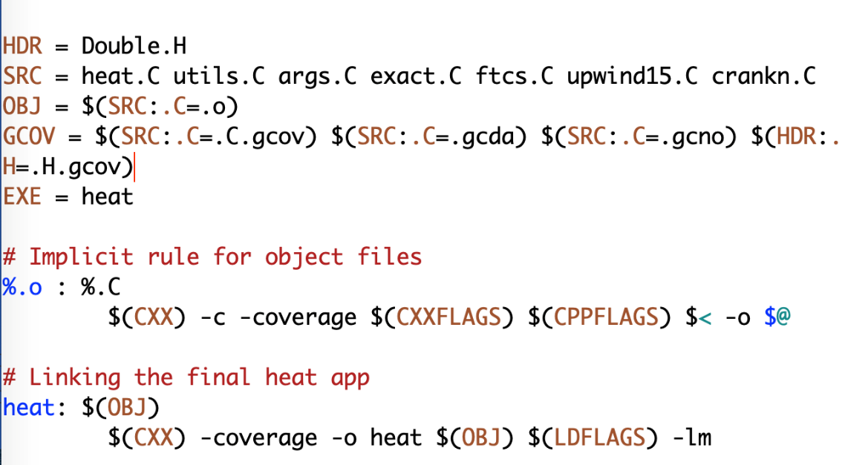
Preparing for Refactoring – check coverage
In your working copy add -coverage as shown below
Run ./heat runame=“ftcs_results”
Run gcov heat.C
Examine heat.C.gcov

Slide 16
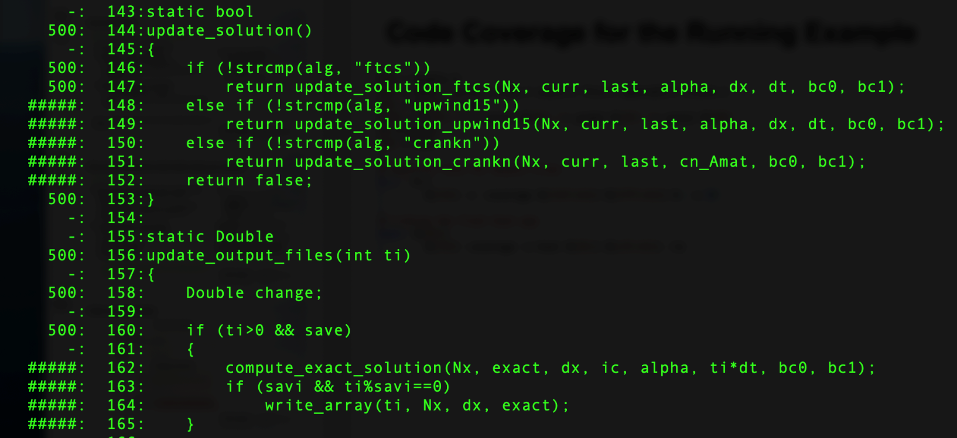
Preparing for Refactoring – check coverage
Run ./heat runame=“ftcs_results”
Run gcov heat.C
Examine heat.C.gcov
A dash indicates non-executable line
A number indicated the times the line was called
##### indicates line wasn’t exercised

Slide 17
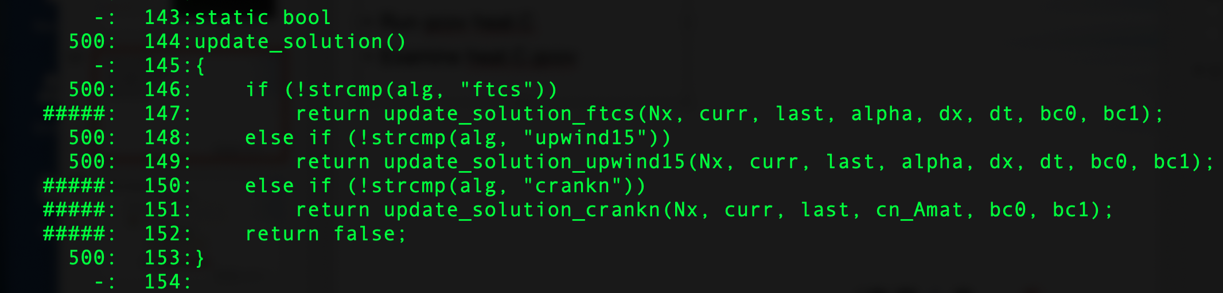
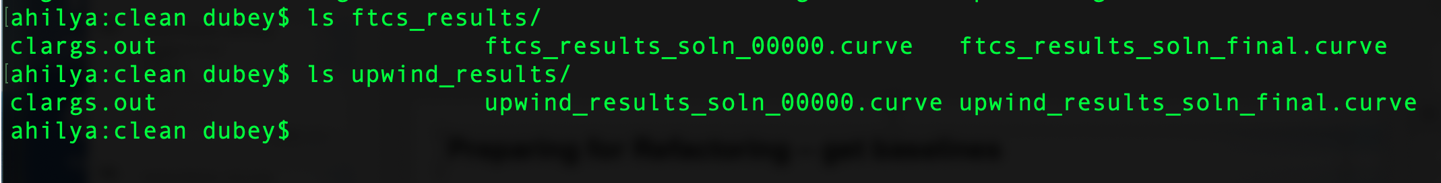
Preparing for Refactoring – get baselines
Call to upwind15 not exercised
Run ./heat alg=“upwind15” runame=“upwind_results
We have baselines for ftcs and upwind

Slide 18
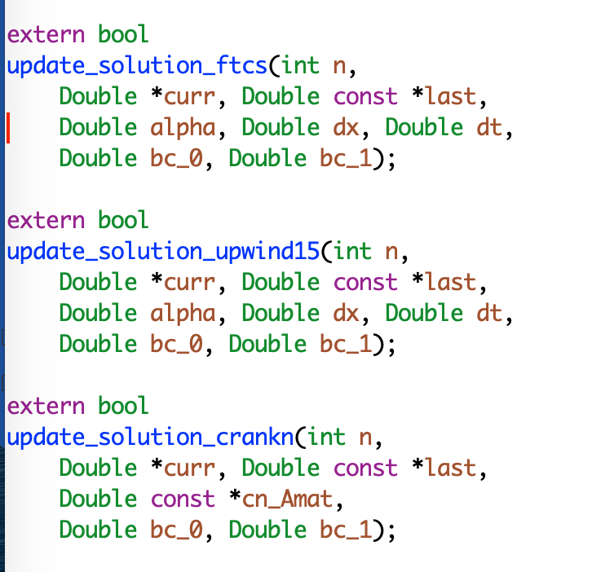
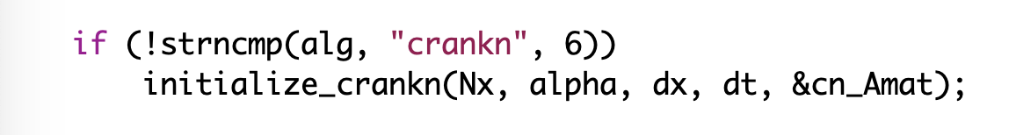
Refactoring – The starting code
Interfaces are not identical
crankn has an extra argument
It also has an extra step in initialization

Slide 19
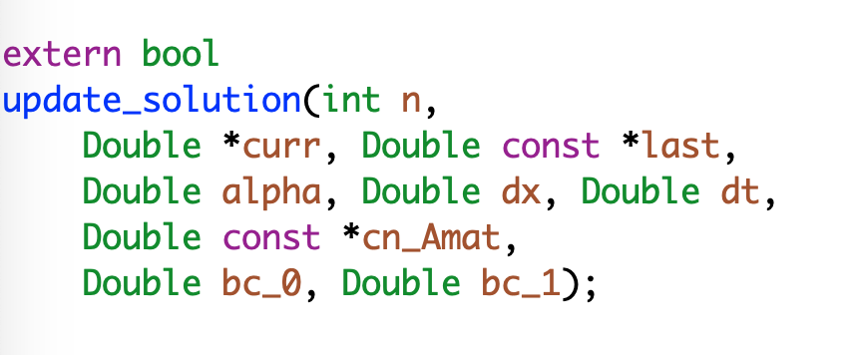
Refactoring
Generalize the interface
Modify the makefile

Slide 20
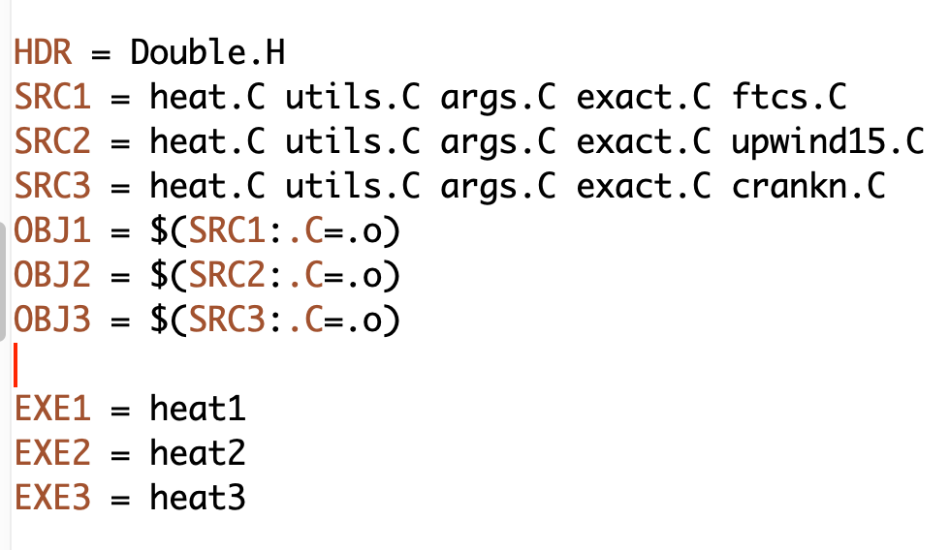
Refactoring
Generalize the interface
Modify the makefile

Slide 21
Refactoring
Generalize the interface
Modify the makefile
Add null implementations of initialize_crank in ftcs and upwind15

Slide 22
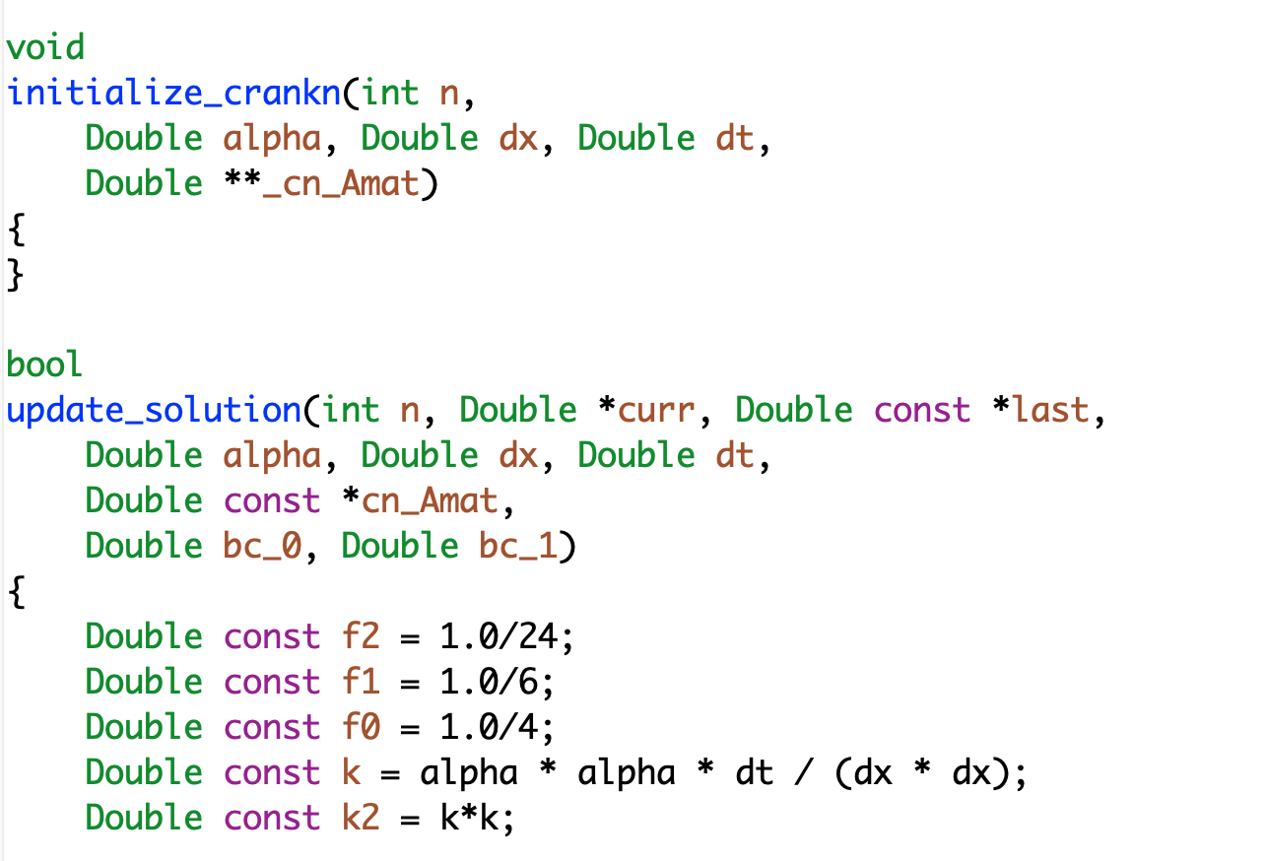
Refactoring
make heat1
Run ./heat runame=“ftcs_results”
Make heat2
Run ./heat runame=“upwind_results”
Verify against baseline

Slide 23
A Real World Example: FLASH
Refactoring for Next Generation Hardware
AMReX - Lawrence Berkeley National Lab
Designed for exascale
Node-level heterogeneity
Smart iterators hide parallelization
Goal: Replace Paramesh with AMReX
Plan: Getting there from here
On ramping
Design
Intermediate steps
Realizing the goal
Notes:
Can point out that this graphic show the need to update the tree - two AMR implementations required a new AMR subfolder.

Slide 24
Considerations
In FLASH
Initial estimate at 6-12 months
Took close to 12 months
Cost estimation
Expected developer time
Extent of disruption in production schedules
Get a buy-in from the stakeholders
That includes the users
For both development time and disruption

Slide 25
Map from Here to There: On ramp plan
Proportionate to the scope
Scattered independent changes - May be OK
All at once
Invasive large-scale change in the code - Bad idea
All at once

Slide 26
On ramp plan
So how should it be done
Incrementally if at all possible
Small components, verified individually
Migrated back, integration tests done
Alternatively migrate them into new infrastructure

Slide 27
Phase 1 - design
Sit, think, hypothesize, & argue
Derive and understand principal definitions & abstractions
Collect & understand Paramesh/AMReX constraints
Generally useful design due to two sets of constraints?
Collect & understand physics unit requirements on Grid unit
Design fundamental data structures & update interface
Notes:
Paramesh/AMReX constraints inform what we can implement and therefore offer clients through the interface.
The coupling to Hydro explains what is needed from Grid and how it must be requested.
The point is that we are looking at both sides of the interface to determine what shape it can tak

Slide 28
Phase 2 - prototyping
Quick, dirty, & light
Implement new data structures
Evolve design/implementation by iterating between Paramesh & AMReX
Explore Grid/physics unit interface
simpleUnsplit Hydro unit
A simplified implementation
No need to be physically correct
Exercise the grid interface identically to the real solver
Discover use patterns of data structures and Grid unit interface
Adjust requirements & interfaces
Notes:
Prototyping is a first level stress testing of our design decisions and interface. To be an effective stress test, we should have likely expanded further out to capture more use cases of our interface. That said, Klaus and Anshu are already aware of these use cases and could have known that the limited scope of this phase was reasonably stressful and therefore informative.
Implementing with Hydro let us discover common usage patterns to build a gut-level understanding of whether or not the interface was a natural fit for the application.

Slide 29
Phase 3 - implementation
Toward quantifiable success & Continuous Integration
Derive & implement lessons learned
Clean code & inline documentation
Update Unsplit Hydro
Intermediate step - Hybrid FLASH
AMReX manages data
Paramesh drives AMR
Fully-functioning simulation with AMReX
Prune old code
Notes:
Point of hybrid method was first and foremost to build a proof of concept that worked on system-level tests. It was also a means to test out the design decisions and the efficiency of the associated implementations at a larger grained level. This is in contrast to the forward engineering being done by me at the level of routines, units, and unittests.
Adding new features or capabilities grew test suite.s

Slide 30
To have good outcome from refactoring
Know why
Know how much
Know the cost
Plan
Have strong testing and verification
Get buy-in from stakeholders

