Slide 1
Better Scientific Software tutorial
David E. Bernholdt, Anshu Dubey, Patricia A. Grubel, Rinku K. Gupta, and Gregory R. Watson
with help from David M. Rogers
SC21
Final slides, hands-on activities, last-minute updates, etc. at: https://bssw-tutorial.github.io/
and click the link for today’s tutorial

Slide 2
License, Citation and Acknowledgements
License and Citation
This work is licensed under a Creative Commons Attribution 4.0 International License (CC BY 4.0).
The requested citation the overall tutorial is: David E. Bernholdt, Anshu Dubey, Patricia A. Grubel, Rinku K. Gupta, and Gregory R. Watson, Better Scientific Software tutorial, in the International Conference for High-Performance Computing, Networking, Storage, and Analysis (SC21), St. Louis, MO, USA and online, 2021. DOI: 10.6084/m9.figshare.16556628
Individual modules may be cited as Speaker, Module Title, in Better Scientific Software tutorial…
Acknowledgements
This work was supported by the U.S. Department of Energy Office of Science, Office of Advanced Scientific Computing Research (ASCR), and by the Exascale Computing Project (17-SC-20-SC), a collaborative effort of the U.S. Department of Energy Office of Science and the National Nuclear Security Administration.
This work was performed in part at the Argonne National Laboratory, which is managed by UChicago Argonne, LLC for the U.S. Department of Energy under Contract No. DE-AC02-06CH11357.
This work was performed in part at the Oak Ridge National Laboratory, which is managed by UT-Battelle, LLC for the U.S. Department of Energy under Contract No. DE-AC05-00OR22725.
This work was performed in part at the Lawrence Livermore National Laboratory, which is managed by Lawrence Livermore National Security, LLC for the U.S. Department of Energy under Contract No. DE-AC52-07NA27344.
This work was performed in part at the Los Alamos National Laboratory, which is managed by Triad National Security, LLC for the U.S. Department of Energy under Contract No.89233218CNA000001
This work was performed in part at Sandia National Laboratories. Sandia National Laboratories is a multi-mission laboratory managed and operated by National Technology and Engineering Solutions of Sandia, LLC., a wholly owned subsidiary of Honeywell International, Inc., for the U.S. Department of Energy’s National Nuclear Security Administration under contract DE-NA0003525.

Slide 3
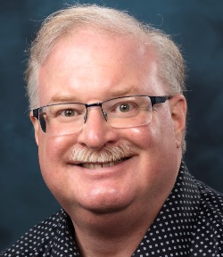
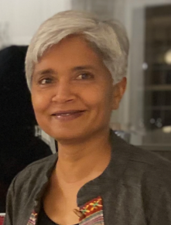
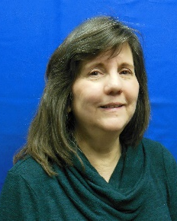
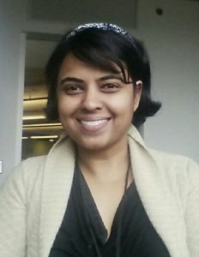
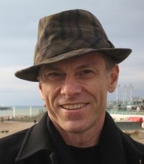
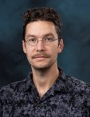
About Us
David Bernholdt, ORNL
Anshu Dubey, ANL
Patricia Grubel, LANL
Rinku Gupta, ANL
Greg Watson, ORNL
David Rogers, ORNL (helper)
Member of the IDEAS Productivity Project: http://ideas-productivity.org
David B
he/him
Anshu
she/her
Patricia
she/her
Rinku
she/her
Greg
he/him
David R
he/him

Slide 4
The IDEAS-ECP team works with the ECP community, and beyond, to improve developer productivity and software sustainability as key aspects of increasing overall scientific productivity
Establish software communities
Determine community policies to improve software quality and compatibility
Create Software Development Kits (SDKs) to facilitate the combined use of complementary libraries and tools
1
Customize and curate methodologies
Target scientific software productivity and sustainability
Use workflow for best practices content development
3
Incrementally and iteratively improve software practices
Determine high-priority topics for improvement and track progress
Productivity and Sustainability Improvement Planning (PSIP)
Engage in community outreach
Broad community partnerships
Collaboration with computing facilities
Webinars, tutorials, events
WhatIs and HowTo docs
Better Scientific Software site (https://bssw.io)
2
4
For more about our work see this report: https://doi.org/10.2172/1606662

Slide 5

Building an Online Community
https://bssw.io
New community-based resource for scientific software improvement
A central hub for sharing information on practices, techniques, experiences, and tools to improve developer productivity and software sustainability for computational science & engineering (CSE)
Goals
Raise awareness of the importance of good software practices to scientific productivity and to the quality and reliability of computationally-based scientific results
Raise awareness of the increasing challenges facing CSE software developers as high-end computing heads to extreme scales
Help CSE researchers increase effectiveness as well as leverage and impact
Facilitate CSE collaboration via software in order to advance scientific discoveries
Site users can…
Find information on scientific software topics
Contribute new resources based on your experiences
Create content tailored to the unique needs and perspectives of a focused scientific domain

Slide 6


Follow IDEAS and BSSw
IDEAS Productivity mailing list: http://eepurl.com/cQCyJ5
Announcements of IDEAS-organized events
Best Practices for HPC Software Developers webinar series
Strategies for Working Remotely panel series
Software-focused events at major scientific meetings (e.g., SIAM, ISC, SC, etc.)
Typically 2-3 messages per month
BSSw Digest: https://bssw.io/pages/receive-our-email-digest
Updates on BSSw content
New blog posts, events, and resources
BSSw Fellowship
Typically 1-2 messages per month
Also: RSS feed: https://bssw.io/items.rss

Slide 7
The Importance of Naming
Computing is rife with terminology that many consider harmful and exclusionary
Examples include: whitelist/blacklist, master/slave, and master (standalone)
We support efforts to replace such language with more inclusive language
In this tutorial, we strive to use inclusive language
Example: we use “main” for the default git branch, even where outside sources we reference may use “master”
We welcome suggestions for further improvements in our tutorial
Additional information:
The Inclusive Naming Initiative
The BSSw.io resource on inclusive naming provides some additional context and links

Slide 8
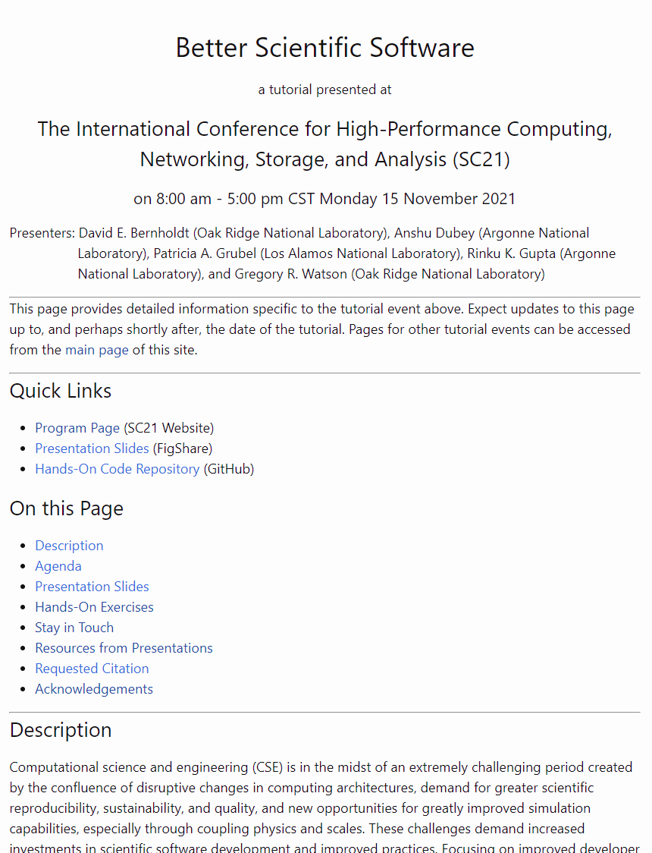
BSSw Tutorial Web Site
https://bssw-tutorial.github.io/ is the one URL you need to find all of the resources for this tutorial
Each tutorial event has its own page
We will backfill tutorials before 2021 as time permits
Each tutorial page is considered archival
All of the materials used in that tutorial (or links to them)
Materials may be updated if we find mistakes

Slide 9
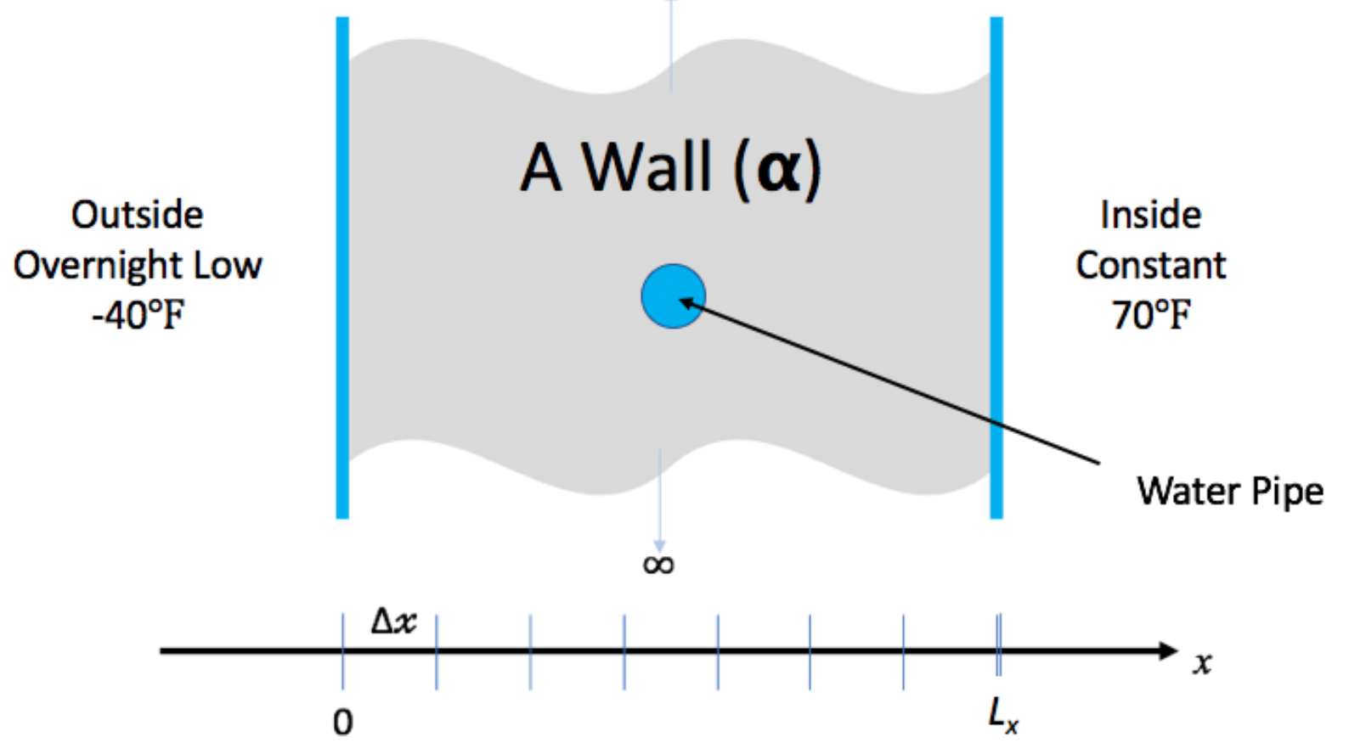
Hands-On Activities
We have created a simple example to give you some (optional) hands-on experience with some of the concepts in this tutorial
You don’t need to understand the math/physics to do the exercises, or to find them useful
We have some time in the agenda for the hands-on activities
But feel free to start early (i.e. during breaks) and continue after the tutorial
We’ll give feedback on pull requests and issues filed (or email us, see next slide).
Instructions on the tutorial web site: https://bssw-tutorial.github.io/ and click the link for today’s tutorial

Slide 10
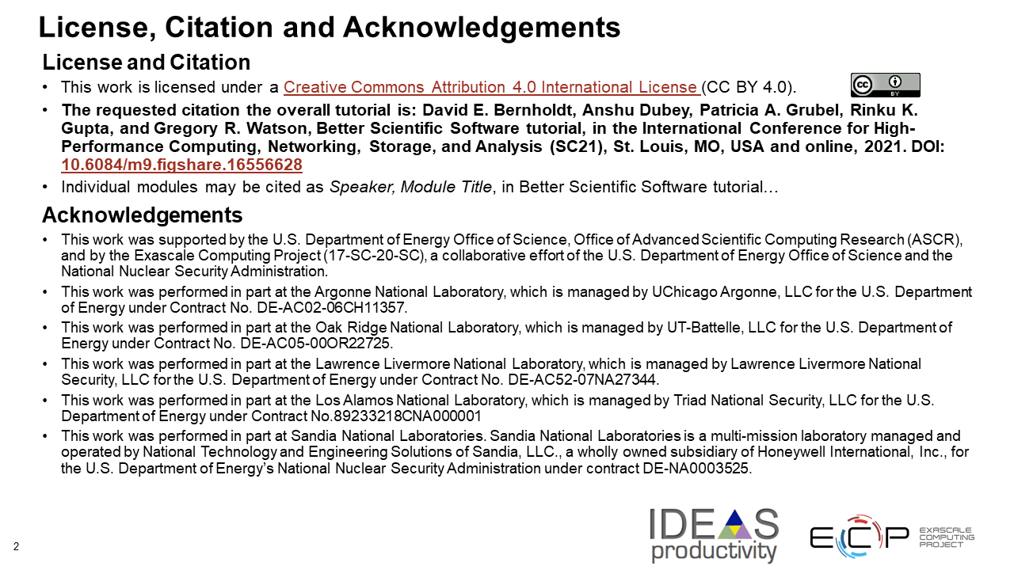
Explaining Slide 2
Slide 2 in all of our presentations contains the license, citation, and acknowledgements for the tutorial
(Software) best practice to make your license and preferred citation(s) easily finable
Sponsor acknowledgements rarely hurt!

Slide 11
We Want to Interact with You!
We find these tutorials most interesting and informative (for everyone) if you ask questions and share experiences!
We learn too!
Please use Zoom chat to ask questions at any time
We will hang around in Zoom during breaks and lunch for live Q&A/discussions with anyone interested
Also during the hands-on session
If you work on the hands-on activities, we’ll be glad to provide feedback
Submit a pull request and we’ll take a look
After the tutorial email us at bssw-tutorial@lists.mcs.anl.gov
With questions or feedback
The list moderator will allow your messages to be posted
Refer to bssw-tutorial.github.io page for all tutorial materials

