Slide 1
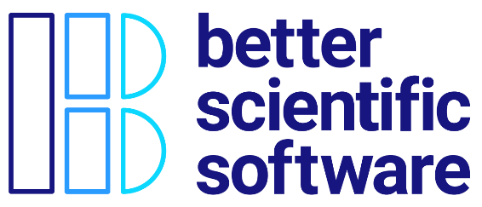
Summary
James M. Willenbring Sandia National Laboratories
David E. Bernholdt, David Rogers Oak Ridge National Laboratory
Developing a Testing and Continuous Integration Strategy for your Team tutorial @ ECP Annual Meeting, April 2021
See slide 2 for license details

Slide 2
License, Citation and Acknowledgements
License and Citation
This work is licensed under a Creative Commons Attribution 4.0 International License (CC BY 4.0).
The requested citation the overall tutorial is: David E. Bernholdt, Patricia A. Grubel, and James M. Willenbring, Developing a Testing and Continuous Integration Strategy for your Team tutorial, in Exascale Computing Project Annual Meeting, online, 2021. DOI: 10.6084/m9.figshare.14376956
Individual modules may be cited as Speaker, Module Title, in Better Scientific Software tutorial…
Acknowledgements
Additional contributors include: David E. Bernholdt, Anshu Dubey, Rinku K. Gupta, Mike Heroux, Alicia Klinvex, Mark Miller, Jared O’Neal, Katherine Riley, David Rogers, Deborah Stevens, James Willenbring
This work was supported by the U.S. Department of Energy Office of Science, Office of Advanced Scientific Computing Research (ASCR), and by the Exascale Computing Project (17-SC-20-SC), a collaborative effort of the U.S. Department of Energy Office of Science and the National Nuclear Security Administration.
This work was performed in part at the Argonne National Laboratory, which is managed by UChicago Argonne, LLC for the U.S. Department of Energy under Contract No. DE-AC02-06CH11357.
This work was performed in part at the Oak Ridge National Laboratory, which is managed by UT-Battelle, LLC for the U.S. Department of Energy under Contract No. DE-AC05-00OR22725.
This work was performed in part at the Lawrence Livermore National Laboratory, which is managed by Lawrence Livermore National Security, LLC for the U.S. Department of Energy under Contract No. DE-AC52-07NA27344.
This work was performed in part at the Los Alamos National Laboratory, which is managed by Triad National Security, LLC for the U.S. Department of Energy under Contract No.89233218CNA000001
This work was performed in part at Sandia National Laboratories. Sandia National Laboratories is a multi-mission laboratory managed and operated by National Technology and Engineering Solutions of Sandia, LLC., a wholly owned subsidiary of Honeywell International, Inc., for the U.S. Department of Energy’s National Nuclear Security Administration under contract DE-NA0003525.

Slide 3
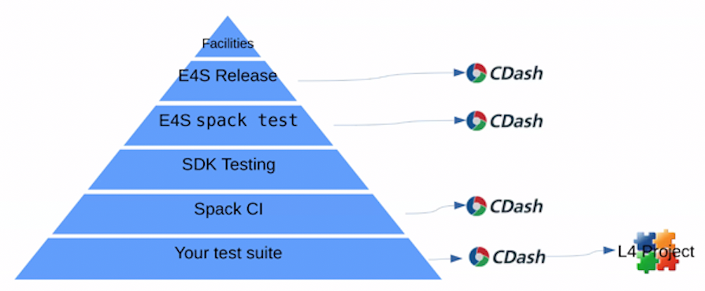
Testing Matters (Maybe even more than you think)
Individual project test suites are the basis for many layers of testing
Well constructed tests add to confidence in and stability of code
Fragile or insufficient test suites lead to errors and frustration

Slide 4
We Covered Software Engineering Topics Focused on Testing…
Testing strategies for complex software systems
Continuous integration testing

Slide 5
And there are Many More Topics We Didn’t Have Time For
Documentation
Licensing
Packaging and distribution
Issue tracking
Configuration and build
Debugging strategies
Building and sustaining communities around software
Software publication and citation
Requirements gathering
Understanding and debugging floating-point math
Performance and performance portability
Project management
Collaboration around software development
Designing software for flexibility and extensibility
Systematic refactoring of large, complex software systems
Reproducibility
Also important topics, but…
Less distinction between research software and other software
More informational resources available
Next-level concerns for starting researchers
Very limited time!

Slide 6
But you’re a researcher. You can’t afford to spend “all” of your time on software engineering.

Slide 7

A Final Recommendation: Continual, Incremental Software Process Improvement
Target: your project should include “just enough” software engineering so that you can meet your short-term and longer-term scientific goals effectively
Identify your team’s “pain points” in your software development processes
Set a goal for something to improve
Target processes and behaviors, not just tasks
Pick something that you can address in a few months that will give you a noticeable benefit
Agree on a plan to address it, identify markers of progress and what is “done”
Write them down
Work your plan, track your progress
When you are done, celebrate…
…then pick a new pain point to address
Old Process
New Process
Cost
Start
Progress
Finish
The new process costs something to implement, but it pays off over time
Productivity and Sustainability Improvement Planning
https://bssw.io/psip
A goal of BSSw.io is to provide resources for improving your software processes. If you find useful resources that aren’t on BSSw.io, consider contributing. Its easy and quick.

Slide 8

Thanks, and Keep in Touch!
Email comments and questions to bssw-tutorial@lists.mcs.anl.gov
Follow us:
IDEAS Productivity project
Website: https://ideas-productivity.org/
Announcement list: http://eepurl.com/cQCyJ5
Better Scientific Software
Resources: https://bssw.io/
Monthly digest: https://bssw.io/pages/receive-our-email-digest
RSS feed: https://bssw.io/items.rss

Slide 9
Related Events at the ECP Annual Meeting (all times Eastern)
IDEAS Desk – informal conversations about developer productivity and software sustainability
Room 125 in the Gather.Town Side Meetings area
12:30pm-2:00pm Monday through Friday
Validation, Verification and Performance Suites, Proxy Apps, and Continuous Integration for Exascale Supercomputers
10:00am-11:30am Wednesday
Advancing Scientific Productivity through Better Scientific Software
11:30am-12:30am Wednesday
Hands-on with Progress Tracking Cards: A Lightweight Method for Improving Your Software Practices
1:00pm-3:30pm Wednesday
Benefiting from ECP CI
2:30pm-3:30pm Wednesday
ECP CI Startup Tutorial
2:30pm-6:00pm Friday

