Slide 1

Welcome to…
Check this web site for the latest updates for this tutorial!
David E. Bernholdt, Anshu Dubey, Rinku Gupta, David Rogers
1:00-4:00pm MDT Thursday 25 March 2021
Last-minute updates, final slides, etc. at: https://bssw-tutorial.github.io/
See slide 2 for license details and requested citation

Slide 2
License, Citation and Acknowledgements
License and Citation
This work is licensed under a Creative Commons Attribution 4.0 International License (CC BY 4.0).
The requested citation the overall tutorial is: David E. Bernholdt, Anshu Dubey, Rinku K. Gupta, and David M. Rogers, Better Scientific Software tutorial, in Improving Scientific Software conference, online, 2021. DOI: 10.6084/m9.figshare.14256257
Individual modules may be cited as Speaker, Module Title, in Better Scientific Software tutorial…
Acknowledgements
Additional contributors include: Mike Heroux, Alicia Klinvex, Mark Miller, Jared O’Neal, Katherine Riley, David Rogers, Deborah Stevens, James Willenbring
This work was supported by the U.S. Department of Energy Office of Science, Office of Advanced Scientific Computing Research (ASCR), and by the Exascale Computing Project (17-SC-20-SC), a collaborative effort of the U.S. Department of Energy Office of Science and the National Nuclear Security Administration.
This work was performed in part at the Argonne National Laboratory, which is managed by UChicago Argonne, LLC for the U.S. Department of Energy under Contract No. DE-AC02-06CH11357.
This work was performed in part at the Oak Ridge National Laboratory, which is managed by UT-Battelle, LLC for the U.S. Department of Energy under Contract No. DE-AC05-00OR22725.
This work was performed in part at the Lawrence Livermore National Laboratory, which is managed by Lawrence Livermore National Security, LLC for the U.S. Department of Energy under Contract No. DE-AC52-07NA27344.
This work was performed in part at the Los Alamos National Laboratory, which is managed by Triad National Security, LLC for the U.S. Department of Energy under Contract No.89233218CNA000001
This work was performed in part at Sandia National Laboratories. Sandia National Laboratories is a multi-mission laboratory managed and operated by National Technology and Engineering Solutions of Sandia, LLC., a wholly owned subsidiary of Honeywell International, Inc., for the U.S. Department of Energy’s National Nuclear Security Administration under contract DE-NA0003525.

Slide 3
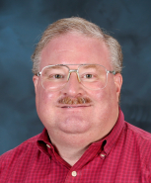
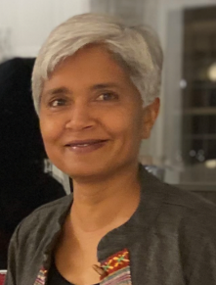
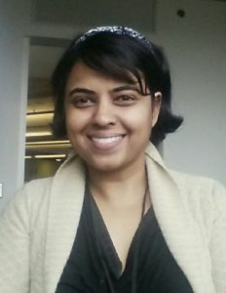
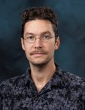
About Us
David Bernholdt, ORNL
Anshu Dubey, ANL
Rinku Gupta, ANL
David Rogers, ORNL
Member of the IDEAS Productivity Project: http://ideas-productivity.org
Focus: Increasing CSE software productivity, quality, and sustainability
David B
Anshu
Rinku
David R

Slide 4
The IDEAS-ECP team works with the ECP community to improve developer productivity and software sustainability as key aspects of increasing overall scientific productivity
Establish software communities
Determine community policies to improve software quality and compatibility
Create Software Development Kits (SDKs) to facilitate the combined use of complementary libraries and tools
1
Customize and curate methodologies
Target scientific software productivity and sustainability
Use workflow for best practices content development
3
Incrementally and iteratively improve software practices
Determine high-priority topics for improvement and track progress
Productivity and Sustainability Improvement Planning (PSIP)
Engage in community outreach
Broad community partnerships
Collaboration with computing facilities
Webinars, tutorials, events
WhatIs and HowTo docs
Better Scientific Software site (https://bssw.io)
2
4
For more about our work see this report: https://doi.org/10.2172/1606662

Slide 5

Building an Online Community
https://bssw.io
New community-based resource for scientific software improvement
A central hub for sharing information on practices, techniques, experiences, and tools to improve developer productivity and software sustainability for computational science & engineering (CSE)
Goals
Raise awareness of the importance of good software practices to scientific productivity and to the quality and reliability of computationally-based scientific results
Raise awareness of the increasing challenges facing CSE software developers as high-end computing heads to extreme scales
Help CSE researchers increase effectiveness as well as leverage and impact
Facilitate CSE collaboration via software in order to advance scientific discoveries
Site users can…
Find information on scientific software topics
Contribute new resources based on your experiences
Create content tailored to the unique needs and perspectives of a focused scientific domain

Slide 6


Follow IDEAS and BSSw
IDEAS Productivity mailing list: http://eepurl.com/cQCyJ5
Announcements of IDEAS-organized events
Best Practices for HPC Software Developers webinar series
Strategies for Working Remotely panel series
Software-focused events at major scientific meetings (e.g., SIAM, ISC, SC, etc.)
Typically 2-3 messages per month
BSSw Digest: https://bssw.io/pages/receive-our-email-digest
Updates on BSSw content
New blog posts, events, and resources
BSSw Fellowship
Typically 1-2 messages per month
Also: RSS feed: https://bssw.io/items.rss

Slide 7
Tutorial Objectives
Overview of best practices in software engineering explicitly tailored for CSE
Why: Increase CSE software quality, sustainability, productivity
Better CSE software > better CSE research > broader CSE impact
Who: Practices relevant for projects of all sizes
emphasis on small teams, e.g., a faculty member and collaborating students
Approach:
Useful information, examples, exercises, pointers to other resources
Not to prescribe any particular practices as “must use”
Be informative about practices that have worked for some projects
Recommend a series of small, incremental improvements
Emphasize adoption of practices that help productivity rather than put unsustainable burden
Customize as needed for each project
Remember: your code will live longer than you expect. Prepare for it!
Old Process
New Process
Cost
Start
Progress
Finish

Slide 8
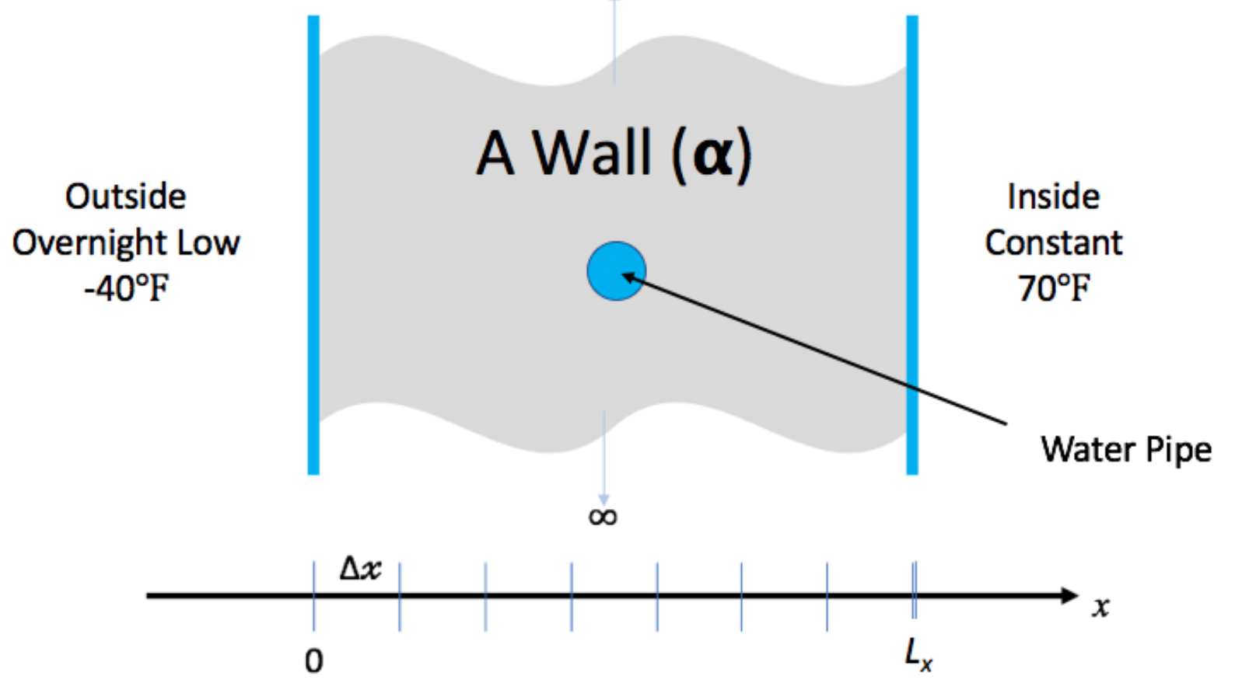
Hands-On Activities
We have created a simple example to give you some (optional) hands-on experience with some of the concepts in this tutorial
You don’t need to understand the math/physics to do the exercises, or find them useful
Because of the limited time for this tutorial, the exercises will be “homework”, but we’ll be happy to give you feedback on your work
Instructions on the tutorial web site: https://bssw-tutorial.github.io/

Slide 9
We Want to Interact with You!
We find these tutorials most interesting and informative (for everyone) if you ask questions and share experiences!
We learn too
Please use chat to ask questions at any time
We will answer in in the chat or verbally
We will answer as many as we can
If we don’t get to your question, follow up with us afterwards
If you work on the hands-on activities, we’ll be glad to provide feedback
Submit a pull request and we’ll take a look
After the tutorial email us at bssw-tutorial@lists.mcs.anl.gov
With questions or feedback
The list moderator will allow your messages to be posted

