Slide 1
What is a Git Workflow?
A Git workflow consists of the structure of the branches and policies
Designated lifetime branches
main, production, pre-production, development
Feature Branches
New features, bug fixes etc.
Schedules for releases (if applicable)
Testing
Branch Protections

Slide 2
Why use a Git Workflow?
Provides collaboration in a consistent and productive manner
Team members are on the same page for development
Policies make it clear
How to use the branching structure
What branches are protected
What is tested and when
What branches are stable
Helps team members understand the current state of the code

Slide 3
Commonly Known Git Workflows
Git Flow
GitHub Flow
GitLab Flow
Extra Slides show real Git Workflows of some CSE projects
Add Resource from David
Notes:
Going to cover this quickly, but want you to have the resources, there are also extra slides can help you see what might be useful for your Scientific projects
May want to add when and why to use them

Slide 4
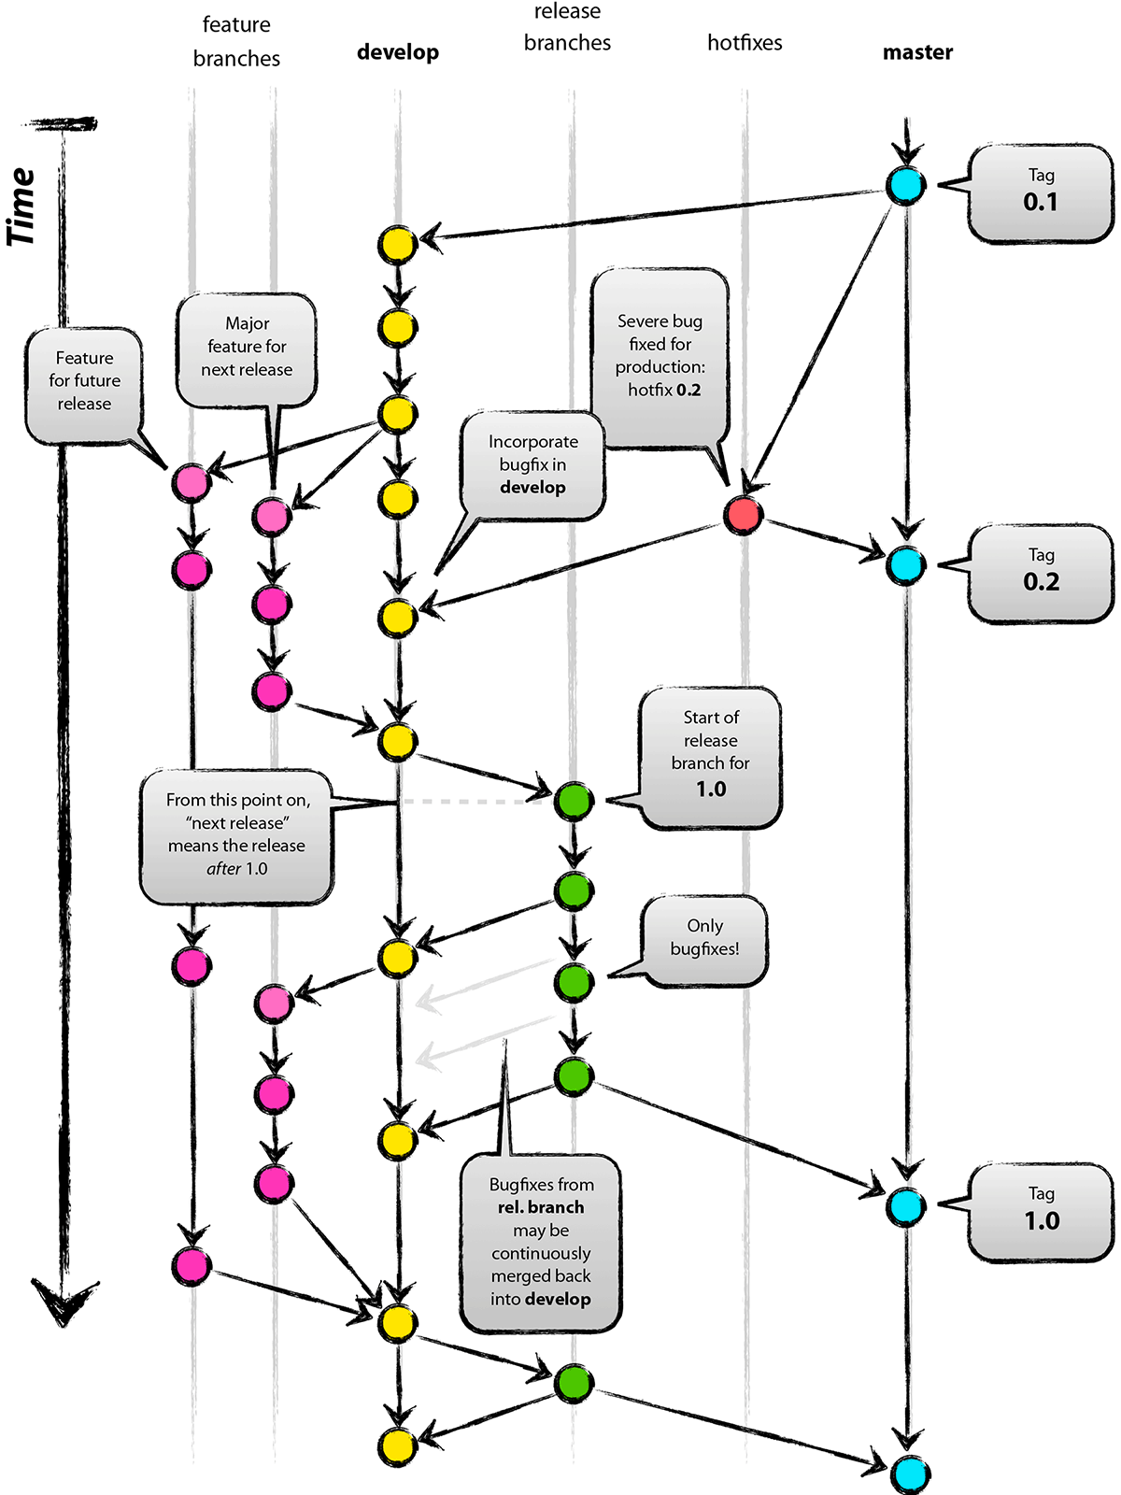

Git Flow
Full-featured workflow
Increased complexity
Designed for SW with official releases
Feature branches based off of develop
Git extensions to enforce policy
How are develop and main synchronized?
Where do merge conflicts occur and how are they resolved?
main
Author: Vincent Driessen
Original Blog: https://nvie.com/posts/a-successful-git-branching-model/
License: Creative Commons
Notes:
Go through quickly shows complexity and designed for SW with official releases add why use this

Slide 5
GitHub Flow
http://scottchacon.com/2011/08/31/github-flow.html
Published as viable alternative to Git Flow
No structured release schedule
Continuous deployment & continuous integration allows for simpler workflow
Key Ideas
All commits in the main branch are deployable
Base feature branches off of main
Push local repository to remote constantly
Open Pull Requests early to start dialogue
Merge into main after Pull Request review
Notes:
Go through quickly – point out No structured release schedule, continuous integration, simpler add why use this

Slide 6
GitLab Flow
https://docs.gitlab.com/ee/workflow/gitlab_flow.html
Published as viable alternative to Git Flow & GitHub Flow
Semi-structured release schedule
Workflow that simplifies difficulties and common failures in synchronizing infinite lifetime branches
Key Ideas
Main branch is staging area
Mature code in main flows downstream into pre-production & production infinite lifetime branches
Allow for release branches with downstream flow
Fixes made upstream & merged into main.
Fixes cherry picked into release branch
Notes:
Go through quickly Use this if the release schedule is not as structured

Slide 7
Guidelines for establishing a Git Workflow
Communicating this to your collaborators
Include workflow in Contributing Guide
Establish conventions for branch naming (issues, major/minor versions)
Enforce workflow
Branch protections
Limiting who can push/merge
Testing & review requirements
Adopt what is good for your team
Consider team culture and project challenges
Assess what is and isn’t feasible/acceptable
Start with simplest and add complexity where and when necessary
Notes:
Emphasis on Adopt what is good for your team

Slide 8
Working Slide Continued
Project Management or Agile Software Development
Understand the principles of agile software development
Be able to setup and use a simple kanban board for status tracking
Understand the principles of agile software development
Be able to setup and use a simple Kanban board for status tracking

Slide 9
Working Slides cont.
Code Review
Understanding the value of code reviews
Know the best practices for code review

Slide 10
Software Licensing
External resources: Introduction to Software Licensing from Best Practices for HPC Software Developers webinar series

Slide 11
Real Git Workflows of CSE projects
Trilinos Workflow
Open MPI Workflow
Flecsi Workflow

Slide 12
Current Trilinos Workflow
https://trilinos.github.io/
Test-driven workflow
Feature branches start and end with develop
All changes to develop must come from GitHub pull requests
Feature branches are merged into develop only after passing pull request test suite
Change sets from develop are tested daily for integration into main
Workflow designed so that
All commits in main are in develop
Merge conflicts exposed when integrating into develop
Merge conflicts never occur when promoting to main
main
develop
develop -> main testing
Pull request testing
Issue 1
Issue 2
Notes:
From the website: The Trilinos Project is a community of developers, users and user-developers focused on collaborative creation of algorithms and enabling technologies within an object-oriented software framework for the solution of large-scale, complex multi-physics engineering and scientific problems on new and emerging high-performance computing (HPC) architectures.
Trilinos is also a collection of reusable scientific software libraries, known in particular for linear solvers, non-linear solvers, transient solvers, optimization solvers, and uncertainty quantification (UQ) solvers.

Slide 13
Current Open MPI Workflow
Workflow designed so that
Support two most recent releases
Issues are addressed on all applicable branches
All PR’s reviewed by at least one core developer
Main and supported branches work at all times
Developers work on main or feature branches depending on complexity of the changes
Testing
CI testing on PR’s for any branch using Jenkins (limited set of compilers, hardware, tests)
Nightly testing on all branches using community-built MTT framework (more complex set of compilers, hardware, tests)
Additional testing for release candidates
https://www.open-mpi.org
Versioning:
Major versions - break compatibility
Minor versions – visible
Releases correct issues
main
Upcoming release (if exists)
Latest supported release
Previous supported release
Issue 1
Issue 2
Notes:
A High Performance Message Passing Library

Slide 14
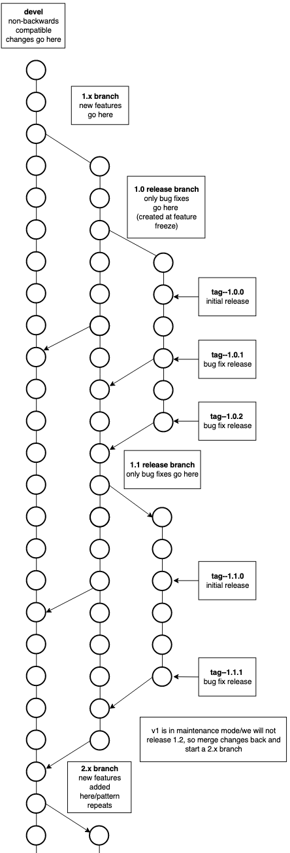
Current FleCSI Workflow
https://flecsi.github.io/flecsi
Versioning:
Incompatible - devel branch breaks compatibility with previous versions
Feature (1, 2 …) named for major version
Release - (1.x, 2.x …) named for major.minor version, correct issues, tags used for bug fixes.
Workflow designed so that
All supported branches work at all times
Merge Requests are tested and reviewed
Testing
Customized unit-testing framework based on Google Test
Special gitlab-ci branch - images and configuration files
Notes:
FleCSI is a compile-time configurable framework designed to support multi-physics application development for current and emerging HPC systems.
In the diagram there is a 1.x branch only for new releases, an initial 1.0 release branch with tag 1.0.0 as the initial release and tags 1.0.1, 1.0.2 for bug fixes, when 1.1 feature is release again an initial tag 1.1.0, then bug fix release tags 1.1.1 & 1.1.2 etc. Once a major version goes into maintenance mode and a new major feature branch begins; in this case 2.x and like branches and tags are created for 2.x

