Slide 1
Software Testing and Verification
Anshu Dubey (she/her)
Argonne National Laboratory
Software Productivity and Sustainability track @ Argonne Training Program on Extreme-Scale Computing summer school
Contributors: Anshu Dubey (ANL), Patricia Grubel (LANL), Rinku Gupta (ANL), Alicia Klinvex (SNL), Mark C. Miller (LLNL), Jared O’Neal (ANL), David M. Rogers (ORNL), Gregory R. Watson (ORNL)
Notes:
Hello, everyone. I'm _from. ___. In this module I’m going to be talking about software testing and how it is used in the development process for scientific computing.

Slide 2
License, Citation and Acknowledgements
License and Citation
This work is licensed under a Creative Commons Attribution 4.0 International License (CC BY 4.0).
The requested citation the overall tutorial is: David E. Bernholdt, Anshu Dubey, Todd Gamblin, Jared O’Neal, and Boyana R. Norris, Software Productivity and Sustainability track, in Argonne Training Program on Extreme-Scale Computing, St. Charles, Illinois, 2022. DOI: 10.6084/m9.figshare.20416215.
Individual modules may be cited as Speaker, Module Title, in Better Scientific Software tutorial, ISC, 2022 …
Acknowledgements
This work was supported by the U.S. Department of Energy Office of Science, Office of Advanced Scientific Computing Research (ASCR), and by the Exascale Computing Project (17-SC-20-SC), a collaborative effort of the U.S. Department of Energy Office of Science and the National Nuclear Security Administration.
This work was performed in part at the Argonne National Laboratory, which is managed by UChicago Argonne, LLC for the U.S. Department of Energy under Contract No. DE-AC02-06CH11357.
This work was performed in part at the Lawrence Livermore National Laboratory, which is managed by Lawrence Livermore National Security, LLC for the U.S. Department of Energy under Contract No. DE-AC52-07NA27344.
This work was performed in part at the Los Alamos National Laboratory, which is managed by Triad National Security, LLC for the U.S. Department of Energy under Contract No.89233218CNA000001
This work was performed in part at the Oak Ridge National Laboratory, which is managed by UT-Battelle, LLC for the U.S. Department of Energy under Contract No. DE-AC05-00OR22725.
This work was performed in part at Sandia National Laboratories. Sandia National Laboratories is a multi-mission laboratory managed and operated by National Technology and Engineering Solutions of Sandia, LLC., a wholly owned subsidiary of Honeywell International, Inc., for the U.S. Department of Energy’s National Nuclear Security Administration under contract DE-NA0003525.
This work was performed in part at University of Oregon through a subcontract with Argonne National Laboratory.

Slide 3


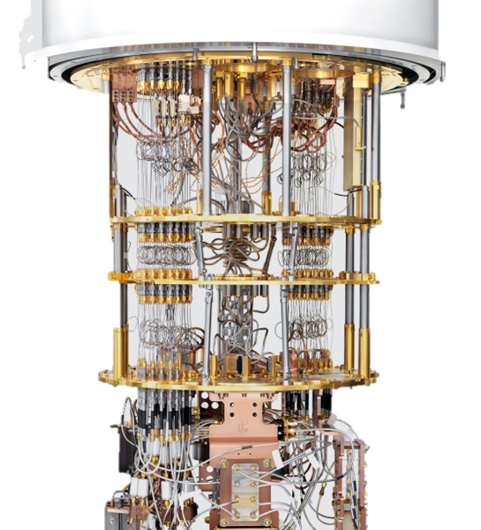
Motivation – Testing Practices
Supercomputer Cycles are Scarce Resources
Goal = capture QA details during science runs
Many people need to have confidence
in your results:
You
Your project lead or boss
Your sponsor
Your reviewers or referees
Your readers
Testing helps build credibility without repeating runs.
Notes:
Slides from reproducibility talk

Slide 4
What about Verification and Validation?
Scientific computing and software engineering use different definitions
 | Scientific computing | Software engineering
Verification | Confirms the mathematical accuracy and stability of a numerical solution in addition to specifications. | Confirms that the software conforms to its specifications (i.e. requirements.)
Validation | Confirms the physical accuracy of a given model by comparing against experimental data. | Confirms that the software actually meets the customer’s needs.
Validation in scientific computing requires a comparison to the experimental data, whereas in software engineering it is based on customer needs
Also, for a real problem, there is typically no way to check for correct output given some inputs. Validation is still required however, so an indirect method must be used.
Notes:
So how does testing relate to verification and validation? Unfortunately the terminology is different if you’re talking about scientific computing or software engineering. Software verification is checking that the software conforms to the requirements and design. Software verification is not just testing, but testing plays a role in the verification process to check that each aspect of the software is working the way it is supposed to. For scientific computing, verification aims to ensure that the code is a correct representation of an underlying mathematical model. Thus verification will involve comparing model solutions to reference solutions, checking for convergence, etc. The aim of software validation is to determine if the code meets the customer’s needs, so requires system-level or acceptance testing to be performed. Validation in scientific computing is more complex. It involves determining the accuracy of the model by comparing outputs with experimental results. It may also involve using the computational model to make predictions that can be verified.

Slide 5
Testing within the software development lifecycle
When should functional tests be provided?
Ideally before the code is written
Also known as test driven development (TDD)
Tests then become the specification for the program
This approach also ensures that thought is given to what it means for the program to be correct, rather than just what the program should do
Requires:
Care in writing tests
Frequent running of tests (see our Continuous Integration module)
Wide adoption by development team
Notes:
Testing is required at many points during the software development lifecycle. But when do you actually write tests? Often testing is left until last. The code is written and then tests are added either to meet requirements, or to address deficiencies, or perhaps a bug has been encountered and the vendor requires tests the demonstrate the issue. However rather than adding tests as an afterthought, best practice in software engineering encourages tests to be written before the code. This is known as test driven development. One of the advantages of this approach is that developers think about what it means for the program to be correct, not just what it should do. Another advantage is that the tests become the specification. There are some challenges to this approach however...

Slide 6
Steps for test driven development
Write a single test¹ describing an aspect of the program
Run the test, which should fail because the feature does not exist
Write just enough code to make the test pass
Refactor the code
Repeat, creating new tests as new functionality is added
¹In numerical methods there are times when a single test may not suffice
Notes:
This methodology has been found to be successful broadly across the software engineering community. First a test describing an aspect of the program is written. The tests a run, and this new test will fail because the feature doesn't exist. Just enough code to make the test pass is then written. We do this to ensure that we're not implementing more functionality than the test will be able to check. The tests are re-run and additional code changes made until the test passes. Once the test passes, the code is refactored to tidy it up, remove any redundant code, and make sure it conforms to any project requirements.

Slide 7
Testing within the software development lifecycle
Testing within the software development lifecycle
Notes:
Scientific software development is a complex process, involving expertise in many different subject areas. Domain experts have a set of models in mind, and will propose equations required to solve the problem. They should also have considered validation checks arising from physical and mathematical properties of their models: like conserved quantities and analytical solutions. Applied mathematicians work with solvers and discretizations. They should contribute a good understanding of function spaces and convergence criteria - which address model fidelity, accuracy, and stability. Computer scientists map problem details into programming languages. They contribute extensible and interoperable frameworks that maximize both productivity and performance.
For the project team to work together effectively, they need to iterate on features that move toward their science objectives. Testing happens at many points in this process, and is essential for ensuring that the desired outcomes are achieved.

Slide 8
Developing Tests
We verify correct behavior
How ?

Slide 9
Developing Tests
We verify correct behavior
We think of ways in which we can tell whether the code is doing what it is supposed to do
How ?

Slide 10
Developing Tests
Compare against a known analytical solution
Compare against a manufactured solution
We verify correct behavior
We think of ways in which we can tell whether the code is doing what it is supposed to do
How ?

Slide 11
Developing Tests
Compare against a known analytical solution
Compare against a manufactured solution
Right there are all the ingredients for building tests
All that is needed is automating directly or indirectly
We verify correct behavior
We think of ways in which we can tell whether the code is doing what it is supposed to do
How ?

Slide 12
Developing Tests
Compare against a known analytical solution
Compare against a manufactured solution
Right there are all the ingredients for building tests
All that is needed is automating directly or indirectly
We verify correct behavior
We think of ways in which we can tell whether the code is doing what it is supposed to do
How ?
Visualize and inspect output

Slide 13
Developing Tests
Compare against a known analytical solution
Compare against a manufactured solution
Right there are all the ingredients for building tests
All that is needed is automating directly or indirectly
We verify correct behavior
We think of ways in which we can tell whether the code is doing what it is supposed to do
How ?
Visualize and inspect output
Develop diagnostics
(indirect ways of verification)

Slide 14
Developing Tests
Compare against a known analytical solution
Compare against a manufactured solution
Right there are all the ingredients for building tests
All that is needed is automating directly or indirectly
We verify correct behavior
We think of ways in which we can tell whether the code is doing what it is supposed to do
How ?
Including these through automation is equally important
Comparison utility
Conserved quantities
Error bars
Statistical analysis
Visualize and inspect output
Develop diagnostics
(indirect ways of verification)

Slide 15
Test Development For a New Code
Simple functions: relation between input and output => unit test
Other functions: build scaffolding
For every new functionality being added, think about its verification
If it has limited dependencies, manufacturing input for known output will give you a self test
If manufacturing input is too difficult, again apply scaffolding

Slide 16
Test Development For a New Code
Simple functions: relation between input and output => unit test
For every new functionality being added, think about its verification
If it has limited dependencies, manufacturing input for known output will give you a self test

Slide 17
Example – Shock Hydrodynamics with Adaptive Mesh Refinement
Components needed
Mesh
Hydrodynamics solver
Equation of state
Parallelization
Strategy for development
Think of an application with analytical solution
Notes:
Once those basic unit tests are done, we can create a unit test at the next level. Here, the Sedov blast wave is simulated using the cell grid and equation of state previously tested. The Sedov wave has a known analytical solution, which provides an error estimate for the implementation. Out-of-tolerance errors at this stage indicate a problem specific to hydrodynamics, since the cells and equation of state are already tested. In addition, plotting errors vs. space and time helps to train graduate students.

Slide 18
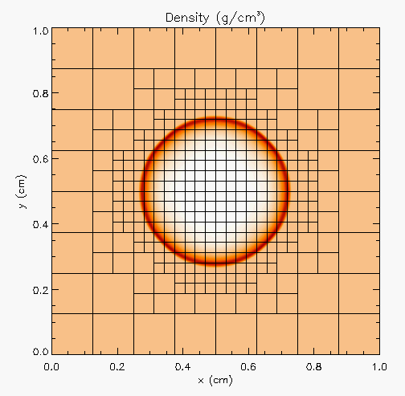
Example – Shock Hydrodynamics with Adaptive Mesh Refinement
Components needed
Mesh
Hydrodynamics solver
Equation of state
Parallelization
Sedov blast wave
High pressure at the center
Shock moves out in a circle
Analytical solution for how far the shock has travelled
Strategy for development
Think of an application with analytical solution

Slide 19
Step 1 – Equation of State
Initialize density and internal energy with known values
Compute pressure and temperature using EOS
Next use density and computed pressure as input and compute internal energy and temperature using EOS
Compare computed values against initialized values
Notes:
.

Slide 20
Step 1 – Equation of State
Initialize density and internal energy with known values
Compute pressure and temperature using EOS
Next use density and computed pressure as input and compute internal energy and temperature using EOS
Compare computed values against initialized values
We have a unit test
Notes:
.

Slide 21
Step 2 – Mesh
Start with uniform grid
Domain decomposition for parallelization
Halo fill operation
Initialize the interior (red) with a known function
Apply halo fill
Compute values for the halo using the known function
Compare against filled values
rank 1
rank 2
halo cells
Notes:
.

Slide 22
Step 2 – Mesh
Start with uniform grid
Domain decomposition for parallelization
Halo fill operation
Initialize the interior (red) with a known function
Apply halo fill
Compute values for the halo using the known function
Compare against filled values
rank 1
rank 2
halo cells
We have another unit test
Notes:
.

Slide 23
Step 3 – Hydrodynamics
Apply initial conditions to the mesh
zeroes everywhere except at the center
Write code for the analytical expression of the distance traveled by the shock
Do time integration
At time T compare evolved solution against analytical solution
If both mesh and EOS unit test pass, then any failure is in Hydrodynamics
This is the idea behind scaffolding
Notes:
.

Slide 24
Step 4: AMR
The same halo fill unit test for mesh also works for AMR
Additional functionalities to test are:
Fine-coarse boundary resolution
Regridding
Steps in testing
Run Sedov with UG
Run Sedov with AMR, but no dynamic refinement
If failed fault is in flux correction
Run Sedov with AMR and dynamic refinement
If failed fault is in regridding

Slide 25
Step 4: AMR
The same halo fill unit test for mesh also works for AMR
Additional functionalities to test are:
Fine-coarse boundary resolution
Regridding
Steps in testing
Run Sedov with UG
Run Sedov with AMR, but no dynamic refinement
If failed fault is in flux correction
Run Sedov with AMR and dynamic refinement
If failed fault is in regridding
We have continued to build scaffolding and are able to pinpoint cause of error
Notes:
.

Slide 26
Test Development For a Legacy Code
There may not be existing tests
Isolate a small area of the code
Dump a useful state snapshot
Build a test driver
Start with only the files in the area
Link in dependencies
Copy if any customizations needed
Read in the state snapshot
Restart from the saved state
Verify correctness
Always inject errors to verify that the test is working
state
driver
Notes:
Here's an example from the E3SM code, the Exascale Earth System Model. Although advanced now, it originated in a combination of Fortran codes dealing with various aspects of climate modeling. The project came together from a collection of independent projects and development practices. They imposed structure on the code through the use of Fortran modules. However, the focus was on running whole models, so their architecture and testing strategies evolved to work with that goal. That led to an unforeseen difficulty. For several sections of the code, even the simplest modification would take running the entire model to test. This meant enqueuing the job in a batch queue that would take non-trivial amount of time to run. What was missing was granular testing. And it wasn’t easy to separate out code sections for testing independently because one Fortran module gets data from another, that in turn gets data from yet another and so on … This is an example of a methodology used to generate an independent test for a code section.
Review the dependencies. Here the model needs to be at a certain ”state” to invoke the target code.
Look for dependencies on Fortran data modules that are outside the sub-tree containing the source code for this section
For each of the data modules determine where the dependencies can be pruned.
d) Run the full model and capture the “state” just before the invocation of the target section.
e) Create a separate working directory for the test
f) In this working area create soft links to the files that have dependencies
g) Where the dependence is to be pruned create a copy of the corresponding file in the working area and modify it as needed.
e) Create a test driver to load the state and exercise the unit.
d) If extra functions from the code were accessed, these were sym-linked into the test directory. Here, the branch at the right represents some helper functions that can be imported easily.
e) That doesn't always work. The red dot represents a module with lots of dependencies - not needed for this test. In these cases, the module was modified to remove unnecessary dependencies.
f) With all the code dependencies sorted out, the test driver itself becomes an isolated unit. For this example, the original test took hours to run through the batch queue of a cluster. The new unit test ran in 20 seconds on a developer's laptop.

Slide 27
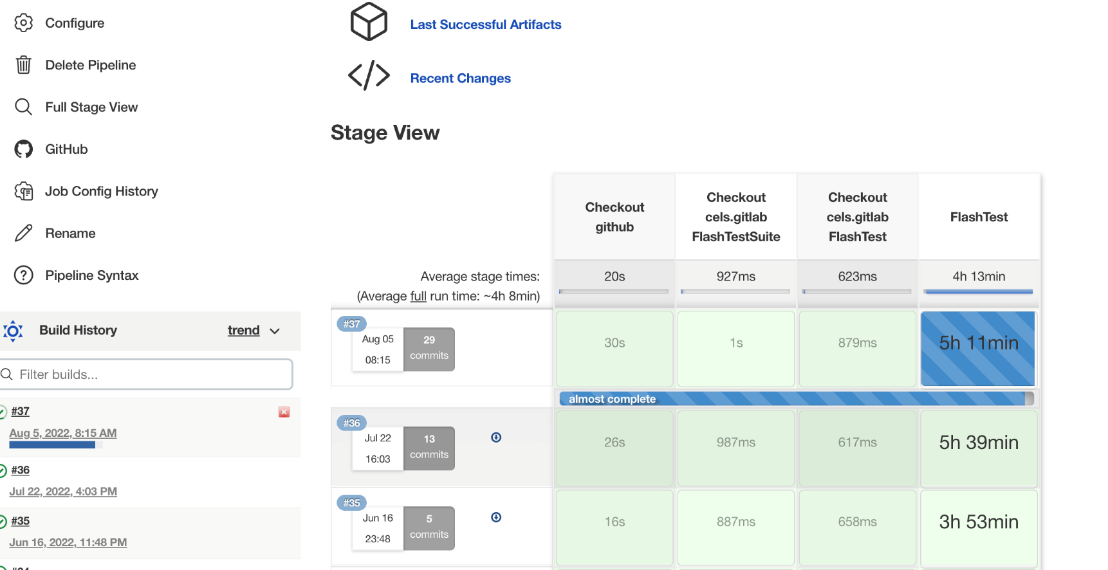
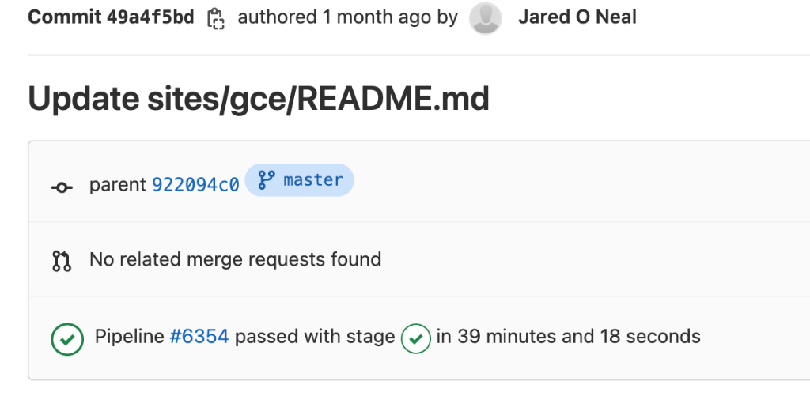
How to build your test suite?
Two “levels”
Automated / scheduled testing
May be long running
Provide comprehensive coverage
Continuous integration
Quick diagnosis of error
Notes:
Let's think about this problem as "selecting the right tests." Taking a step back, there are two 'levels' of tests (regression testing and CI-type tests), and there are multiple 'granularities' of tests (from unit to integration). Computer scientists tend to gravitate towards tests that run quickly and check data structures, types, definitions, syntax, and error reporting. These quick tests are great for a continuous integration suite. Domain scientists tend to think of ways to compare program outputs to external measures - like known solutions and example run cases. These tests can be long-running, and need interpretation to understand what's going on. Such tests are often better suited for scheduled testing - which can be set up to run on dedicated servers on a nightly or weekly schedule. And there is a range of intermediate levels of testing pertaining to interoperability in component-based software systems, verification of non-trivial functionality such as transparent restart from a checkpoint etc. Since testing is so broad, individual tests can also vary in complexity. As a rule of thumb, complicated tests get -100 points. Tests should be as simple as possible, and always provide information on what went wrong. If a test can't help to diagnose an error condition, it's not a useful test.

Slide 28
How to build your test suite?
A mix of different granularities works well
Unit tests for isolating component or sub-component level faults
Integration tests with simple to complex configuration and system level
Restart tests
Rules of thumb
Simple
Enable quick pin-pointing
Useful resources https://ideas productivity.org/resources/howtos/
Notes:
Let's think about this problem as "selecting the right tests." Taking a step back, there are two 'levels' of tests (regression testing and CI-type tests), and there are multiple 'granularities' of tests (from unit to integration). Computer scientists tend to gravitate towards tests that run quickly and check data structures, types, definitions, syntax, and error reporting. These quick tests are great for a continuous integration suite. Domain scientists tend to think of ways to compare program outputs to external measures - like known solutions and example run cases. These tests can be long-running, and need interpretation to understand what's going on. Such tests are often better suited for scheduled testing - which can be set up to run on dedicated servers on a nightly or weekly schedule. And there is a range of intermediate levels of testing pertaining to interoperability in component-based software systems, verification of non-trivial functionality such as transparent restart from a checkpoint etc. Since testing is so broad, individual tests can also vary in complexity. As a rule of thumb, complicated tests get -100 points. Tests should be as simple as possible, and always provide information on what went wrong. If a test can't help to diagnose an error condition, it's not a useful test.

Slide 29
How do we determine what tests are needed?
Code coverage tools
Expose parts of the code that aren’t being tested
gcov - standard utility with the GNU compiler collection suite (we will use it in the next few slides)
Compile/link with –coverage & turn off optimization
Counts the number of times each statement is executed
Necessary for testing, but not sufficient
gcov also works for C and Fortran
Other tools exist for other languages
JCov for Java
Coverage.py for python
Devel::Cover for perl
profile for MATLAB
Lcov
a graphical front-end for gcov
available at http://ltp.sourceforge.net/coverage/lcov.php
Codecov.io in CI module
Hosted servers (e.g. coveralls, codecov)
graphical visualization of results
push results to server through continuous integration server
Notes:
Even if you follow the TDD methodology, it is useful to know how much code is actually being tested.

Slide 30
Building Test-suite
First line of defense – code coverage tools
Code coverage tools necessary but not sufficient
Do not give any information about interoperability
Map your tests and examples – what do they do?
Follow the order
All unit tests – including full module tests (e.g. CL)
Tests sensitive to perturbations (e.g. SV)
Most stringent tests for solvers (e.g. WD, PT)
Least complex test to cover remaining spots (Aha!)
Notes:
This final example shows a graphical way to "map" areas of your code for testing. The x-axis has physical capabiliies. The y-axis has infrastructure and generic solvers. List out all test and mark the corresponding squares in the matrix if the two corresponding features are exercised together in the test. For example here SV stands for the Sedov test run with Uniform grid and includes tracer particles. Similarly the celluar test (CL) runs with AMR and also includes nuclear burning and particles in addition to Hydro and EOS. The idea is to know which of these squares need to be marked to have sufficient amount of interoperability coverage needed by the code. Not every square needs to be covered, though. It also helps document areas of your code that are needed for each science scenario.
This type of map is complementary to code coverage. If your program is well-structured, there should be some correspondence between this map and the files that coverage shows as "tested".
The Order described here gives guidelines for how to select the tests to maximize the needed coverage while minimizing the cost. It is always desirable to run the fastest and most lightweight tests that can pinpoint the error.

Slide 31
Good Rules of Thumb
Test your tests!
Make sure tests fail when they’re supposed to!
Add “regression tests”
Ensure that bugs aren’t creeping in
Test regularly
Critical when teams are adding code regularly
To identify and document where changes to the underlying platform change code behavior/results
Automate regular testing
Inculcate the discipline of monitoring the outcome of regular testing
Exercise third-party dependencies
Physics/math based strategies
Conserved quantities, symmetries, synthetic operators
Eliminate complete dependence on bitwise reproducibility
Notes:
Slides from reproducibility talk

Slide 32
Summary
A testing strategy is essential for producing reliable trustworthy software
Invest the time needed to thoroughly test your software at all levels
Use automation whenever possible
Different challenges are associated with exploratory, legacy, and composable codes
Adapt your strategy to fit your situation.
Eventually you will want to be able to verify all components in a code release.
Don’t get distracted by all the technologies out there – focus on exercising your code.
Scaffolding projects can help with mechanics.

Slide 33
Resources
Oberkampf, W., & Roy, C. (2010). Verification and Validation in Scientific Computing. Cambridge: Cambridge University Press. doi:10.1017/CBO9780511760396
Michael Feathers. 2004. Working Effectively with Legacy Code. Prentice Hall PTR, USA. ISBN: 9780131177055
A Dubey, K Weide, D Lee, J Bachan, C Daley, S Olofin… - Ongoing Verification of a Multiphysics Community Code. Software: Practice and Experience, 2015 https://doi.org/10.1002/spe.2220

