Slide 1
Scientific Software Design
Anshu Dubey (she/her) Argonne National Laboratory
Better Scientific Software tutorial @ SC22
Contributors: Anshu Dubey (ANL), Mark C. Miller (LLNL), David Bernholdt (ORNL)

Slide 2
License, Citation and Acknowledgements
License and Citation
This work is licensed under a Creative Commons Attribution 4.0 International License (CC BY 4.0).
The requested citation the overall tutorial is: David E. Bernholdt, Anshu Dubey, and Patricia A. Grubel, Better Scientific Software tutorial, in The International Conference for High-Performance Computing, Networking, Storage, and Analysis (SC22), Dallas, Texas, 2022. DOI: 10.6084/m9.figshare.21384057.
Individual modules may be cited as Speaker, Module Title, in Better Scientific Software tutorial, …
Acknowledgements
This work was supported by the U.S. Department of Energy Office of Science, Office of Advanced Scientific Computing Research (ASCR), and by the Exascale Computing Project (17-SC-20-SC), a collaborative effort of the U.S. Department of Energy Office of Science and the National Nuclear Security Administration.
This work was performed in part at the Argonne National Laboratory, which is managed by UChicago Argonne, LLC for the U.S. Department of Energy under Contract No. DE-AC02-06CH11357.
This work was performed in part at the Lawrence Livermore National Laboratory, which is managed by Lawrence Livermore National Security, LLC for the U.S. Department of Energy under Contract No. DE-AC52-07NA27344.
This work was performed in part at the Los Alamos National Laboratory, which is managed by Triad National Security, LLC for the U.S. Department of Energy under Contract No.89233218CNA000001
This work was performed in part at the Oak Ridge National Laboratory, which is managed by UT-Battelle, LLC for the U.S. Department of Energy under Contract No. DE-AC05-00OR22725.
This work was performed in part at Sandia National Laboratories. Sandia National Laboratories is a multi-mission laboratory managed and operated by National Technology and Engineering Solutions of Sandia, LLC., a wholly owned subsidiary of Honeywell International, Inc., for the U.S. Department of Energy’s National Nuclear Security Administration under contract DE-NA0003525.

Slide 3
HPC Computational Science Use-case
More Scientific Understanding
More Hardware
Resources
Higher Fidelity
Model
More Diverse
Solvers

Slide 4
HPC Computational Science Use-case
More Scientific Understanding
Heterogeneous
models
Software complexity
More Hardware
Resources
Higher Fidelity
Model
Distributed
memory
model
More Diverse
Solvers
Platform complexity

Slide 5
HPC Computational Science Use-case
More Scientific Understanding
Many components may be under research
Software continuously evolves
All use cases are different and unique
Heterogeneous
models
Software complexity
More Hardware
Resources
Higher Fidelity
Model
Distributed
memory
model
More Diverse
Solvers
Platform complexity

Slide 6
General Design Principles for HPC Scientific Software
Considerations
Multidisciplinary teams
Many facets of knowledge
To know everything is not feasible
Two types of code components
Infrastructure (mesh/IO/runtime …)
Science models (numerical methods)
Codes grow
New ideas => new features
Code reuse by others
Design Implications
Separation of Concerns
Shield developers from unnecessary complexities
Work with different lifecycles
Long-lasting vs quick changing
Logically vs mathematically complex
Extensibility built in
Ease of adding new capabilities
Customizing existing capabilities

Slide 7
General Design Principles for HPC Scientific Software
Subject of research
Model
Numerics
Client Code
Mathematically complex
logically separable functional units of computation
Encode into framework
Treat differently and & encapsulate to plug and play
Applies to both kind
Differentiate between private and public
More Stable
Discretization
I/O
Runtime Parameters
Infrastructure
Data structures and movement
Define interfaces
Design first, then apply programming model to the design instead of taking a programming model and fitting your design to it.

Slide 8
A Design Model for Separation of Concerns
Infrastructure
Capabilities
Requirements
Model
Software Architecture API Design
API
Implement
Design
Develop
Test
Validate
Maintain
Augment
Integrate

Slide 9
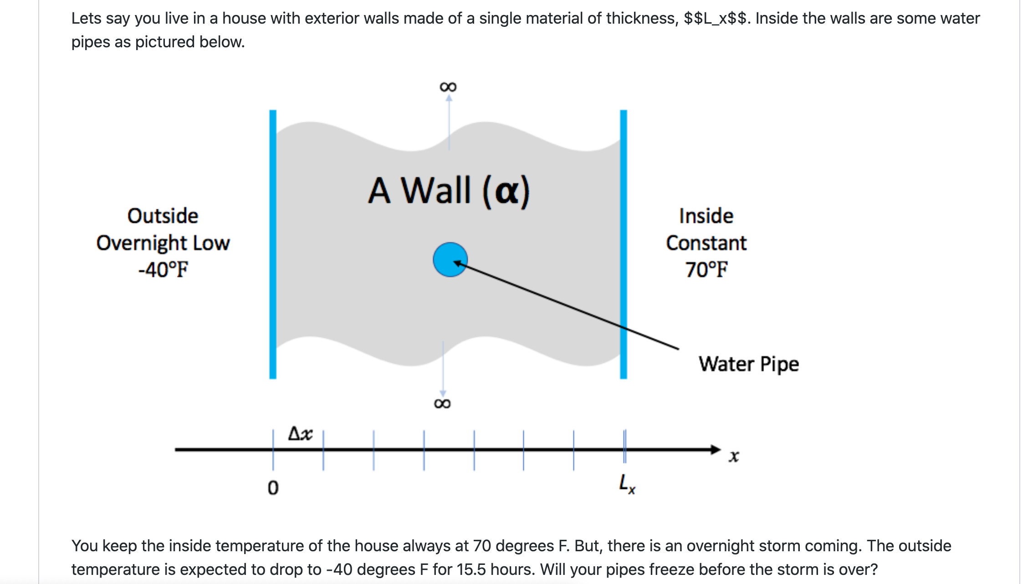
The Running Example

Slide 10
Problem Specification - Design Considerations
Specification
Solve heat equation with some initial and boundary conditions
Apply different integration methods
What is infrastructure here?
Discretization/ State
Verification
I/O
Application of initial conditions
Runtime parameters
Comparison
What is model here?
Initial conditions
Boundary conditions
Integration
Notes:
This is where one can switch to white board and ask questions.

Slide 11
Infrastructure API
process_args(int argc, char **argv)
static void initialize(void)
void copy(int n, double *dst, double const *src)
void write_array(int t, int n, double dx, double const *a)
void set_initial_condition(int n, double *a, double dx, char const *ic)

Slide 12
Numerics API
double l2_norm(int n, double const *a, double const *b)
bool update_solution_crankn(int n, double *curr, double const *last, double const *cn_Amat, double bc_0, double bc_1)
bool update_solution_upwind15(int n, double *curr, double const *last, double alpha, double dx, double dt, double bc_0, double bc_1)
bool update_solution_ftcs( int n, double *uk1, double const *uk0, double alpha, double dx, double dt, double bc0, double bc1)
void compute_exact_solution(int n, double *a, double dx, char const *ic, double alpha, double t, double bc0, double bc1)

Slide 13
Example: Architecting Multiphysics PDEs
Virtual view of functionalities
Decomposition into units and definition of interfaces
Spatial
decomposition
Virtual view :
domain sections
as stand-alone
computation unit
Parallelization
and scaling
optimization
Real view : A
whole domain
with many
operators
Functional
decomposition
Virtual view
collection of
components
Memory
access and
compute
optimization
Notes:
Example of changing the block size to adjust to the cache memory
And point-to-point Vs collectives depending upon the scale of the problem

Slide 14
Example: Multiphysics PDEs for Distributed Memory Parallelism
Virtual view of functionalities
Decomposition into units and definition of interfaces
Spatial
decomposition
Virtual view :
domain sections
as stand-alone
computation unit
Parallelization
and scaling
optimization
Implemented by
domain experts
and applied
mathematicians
Implemented by
software and
performance
engineers
Real view : A
whole domain
with many
operators
Functional
decomposition
Virtual view
collection of
components
Memory
access and
compute
optimization
Notes:
Example of changing the block size to adjust to the cache memory
And point-to-point Vs collectives depending upon the scale of the problem

Slide 15
Example: Design for Extensibility from FLASH, Now Flash-X
Assumed that capabilities will be added for better models
Assembly from components
Decentralized maintenance of metadata
Python tool to parse and configure
OOP implemented through Unix directory structure and configuration tool
Key idea is distributed intelligence

Slide 16
Takeaways Until Now
Differentiate between slow changing and fast changing components of your code
Understand the requirements of your infrastructure
Implement separation of concerns
Design with portability, extensibility, reproducibility and maintainability in mind
Do not design with a specific programming model in mind
Software complexity
Distributed
memory
model
Platform complexity

Slide 17
A New Paradigm Because of Platform Heterogeneity
Question - do the design principles change?
Heterogeneous
models
Software complexity
Platform complexity

Slide 18
A New Paradigm Because of Platform Heterogeneity
Question - do the design principles change?
The answer is – not really
The details get more involved
Heterogeneous
models
Software complexity
Platform complexity

Slide 19
A Design Model for Separation of Concerns
Infrastructure
Capabilities
Requirements
Model
Software Architecture API Design
API
Implement
Design
Develop
Test
Validate
This is where maximum
change is likely
Maintain
Augment
Integrate

Slide 20
Design Guidance For Performance Portability
Design for Hierarchical parallelism
Design towards several thousand threads
Design for a hierarchical memory space
Design patterns that count, allocate, and reuse memory
Avoid exposing/using non-portable vendor-specific options

Slide 21
Features and Abstractions that must Come in
Framework
Real view : A
whole domain
with many
operators
Spatial
Decomposition
Blocks/tiles
Virtual view :
domain sections
as stand-alone
computation unit
Load Distribution
Offloading
and scaling
optimization
Runtime
management
Functional
decomposition
Virtual view
collection of
components
Abstraction at
solver level
code
transformation
Memory
access and
compute
optimization

Slide 22
Features and Abstractions that must Come in
How do abstraction layers work
Infer the structure of the code
Infer the map between algorithms and devices
Infer the data movements
Map computations to devices
These are specified either through constructs or pragmas
Performance depends upon how well the mapping is done.
Framework
Real view : A
whole domain
with many
operators
Spatial
Decomposition
Blocks/tiles
Virtual view :
domain sections
as stand-alone
computation unit
Load Distribution
Offloading
and scaling
optimization
Runtime
management
Functional
decomposition
Virtual view
collection of
components
Abstraction at
solver level
code
transformation
Memory
access and
compute
optimization

Slide 23
Underlying Ideas
Make the same code work on different devices
A way to let compiler know that ”this” expression can be specialized in many ways
Definition of specializations
Template meta-programming in abstraction layers

Slide 24
Underlying Ideas
Make the same code work on different devices
A way to let compiler know that ”this” expression can be specialized in many ways
Definition of specializations
Template meta-programming in abstraction layers
Assigning work within the node
“Parallel For” or directives with unified memory
Directives or specific programming model for explicit data movement
More complex data orchestration system for asynchronous computation

Slide 25
Underlying Ideas
Make the same code work on different devices
A way to let compiler know that ”this” expression can be specialized in many ways
Definition of specializations
Template meta-programming in abstraction layers
Assigning work within the node
“Parallel For” or directives with unified memory
Directives or specific programming model for explicit data movement
More complex data orchestration system for asynchronous computation
Look at what is needed, design for commonalities.

Slide 26
Underlying Ideas
Make the same code work on different devices
A way to let compiler know that ”this” expression can be specialized in many ways
Definition of specializations
Template meta-programming in abstraction layers
Assigning work within the node
“Parallel For” or directives with unified memory
Directives or specific programming model for explicit data movement
More complex data orchestration system for asynchronous computation
Look at what is needed, design for commonalities.
Even when using third party abstraction tools understanding the code’s structure and needs is critical for performance portability

Slide 27
Underlying Ideas
Make the same code work on different devices
A way to let compiler know that ”this” expression can be specialized in many ways
Definition of specializations
Template meta-programming in abstraction layers
Assigning work within the node
“Parallel For” or directives with unified memory
Directives or specific programming model for explicit data movement
More complex data orchestration system for asynchronous computation
Look at what is needed, design for commonalities.
Even when using third party abstraction tools understanding the code’s structure and needs is critical for performance portability
… that translates to investing in design

Slide 28
Final takeaways
The key to both performance portability and longevity is careful software design
Extensibility should be built into the design
Design should be independent of any specific programming model
Composability and flexibility help with performance portability
Resources:
https://www.exascaleproject.org/
https://doi.org/10.6084/m9.figshare.13283714.v1
https://bssw.io/blog_posts/performance-portability-and-the-exascale-computing-project
https://www.exascaleproject.org/event/kokkos-class-series
A Design Proposal for a Next Generation Scientific Software Framework
Software Design for Longevity with Performance Portability

