Slide 1
Summary
David M. Rogers (he/him) Oak Ridge National Laboratory
Developing a Testing and Continuous Integration Strategy for your Team tutorial @ Exascale Computing Project Annual Meeting
Contributors: David E. Bernholdt (ORNL), Anshu Dubey (ANL), David M. Rogers (ORNL), James M. Willenbring (SNL)

Slide 2
License, Citation and Acknowledgements
License and Citation
This work is licensed under a Creative Commons Attribution 4.0 International License (CC BY 4.0).
The requested citation the overall tutorial is: Gregory R. Watson and David M. Rogers, Developing a Testing and Continuous Integration Strategy for your Team tutorial, in Exascale Computing Project Annual Meeting, online, 2022. DOI: 10.6084/m9.figshare.19608927
Individual modules may be cited as Speaker, Module Title, in Better Scientific Software tutorial…
Acknowledgements
This work was supported by the U.S. Department of Energy Office of Science, Office of Advanced Scientific Computing Research (ASCR), and by the Exascale Computing Project (17-SC-20-SC), a collaborative effort of the U.S. Department of Energy Office of Science and the National Nuclear Security Administration.
This work was performed in part at the Argonne National Laboratory, which is managed by UChicago Argonne, LLC for the U.S. Department of Energy under Contract No. DE-AC02-06CH11357.
This work was performed in part at the Oak Ridge National Laboratory, which is managed by UT-Battelle, LLC for the U.S. Department of Energy under Contract No. DE-AC05-00OR22725.
This work was performed in part at the Lawrence Livermore National Laboratory, which is managed by Lawrence Livermore National Security, LLC for the U.S. Department of Energy under Contract No. DE-AC52-07NA27344.
This work was performed in part at the Los Alamos National Laboratory, which is managed by Triad National Security, LLC for the U.S. Department of Energy under Contract No.89233218CNA000001
This work was performed in part at Sandia National Laboratories. Sandia National Laboratories is a multi-mission laboratory managed and operated by National Technology and Engineering Solutions of Sandia, LLC., a wholly owned subsidiary of Honeywell International, Inc., for the U.S. Department of Energy’s National Nuclear Security Administration under contract DE-NA0003525.

Slide 3
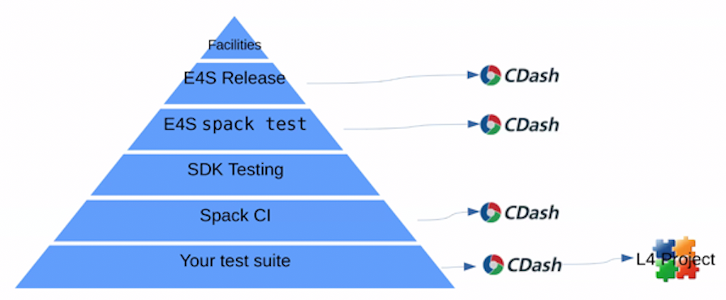
Testing Matters (Maybe even more than you think)
Individual project test suites are the basis for many layers of testing
Well constructed tests add to confidence in and stability of code
Fragile or insufficient test suites lead to errors and frustration

Slide 4
We Covered Software Engineering Topics Focused on Testing…
Testing strategies for complex software systems
Continuous integration testing

Slide 5
And there are Many More Topics We Didn’t Have Time For
Documentation
Licensing
Packaging and distribution
Issue tracking
Configuration and build
Debugging strategies
Building and sustaining communities around software
Software publication and citation
Requirements gathering
Understanding and debugging floating-point math
Performance and performance portability
Project management
Collaboration around software development
Designing software for flexibility and extensibility
Systematic refactoring of large, complex software systems
Reproducibility
Also important topics, but…
Less distinction between research software and other software
More informational resources available
Next-level concerns for starting researchers
Very limited time!

Slide 6
But you’re a researcher. You can’t afford to spend “all” of your time on software engineering.

Slide 7

A Final Recommendation: Continual, Incremental Software Process Improvement
Target: your project should include “just enough” software engineering so that you can meet your short-term and longer-term scientific goals effectively
Identify your team’s “pain points” in your software development processes
Help: RateYourProject assessment tool: https://rateyourproject.org/
Set a goal for something to improve
Target processes and behaviors, not just tasks
Pick something that you can address in a few months that will give you a noticeable benefit
Agree on a plan to address it, identify markers of progress and what is “done”
Write them down
Help: Progress tracking card examples: https://bssw-psip.github.io/ptc-catalog/catalog
Work your plan, track your progress
When you are done, celebrate…
…then pick a new pain point to address
Old Process
New Process
Cost
Start
Progress
Finish
The new process costs something to implement, but it pays off over time
Productivity and Sustainability Improvement Planning
https://bssw.io/psip
A goal of BSSw.io is to provide resources for improving your software processes. If you find useful resources that aren’t on BSSw.io, consider contributing. Its easy and quick.

Slide 8

Thanks, and Keep in Touch!
Email comments and questions to bssw-tutorial@lists.mcs.anl.gov
We’ll provide feedback on pull requests in the hands-on repository
See the tutorial web site for an archive of all the materials from this tutorial
https://bssw-tutorial.github.io/
Follow us:
IDEAS Productivity project
Website: https://ideas-productivity.org/
Announcement list: http://eepurl.com/cQCyJ5
Better Scientific Software
Resources: https://bssw.io/
Monthly digest: https://bssw.io/pages/receive-our-email-digest
RSS feed: https://bssw.io/items.rss

Slide 9
Related Events at the ECP Annual Meeting (all times Eastern)
IDEAS Desk – informal conversations about developer productivity and software sustainability
Room 125 in the Gather.Town Side Meetings area (Whova -> Logistics)
Hours: 12:30pm-1:30pm Monday through Friday
ECP Broader Engagement Initiative
1:00pm-3:00pm Tuesday
Programming Environments Landscape at ASCR Facilities
2:00pm-3:00pm Tuesday
AD, Hardware and Integration, and Facilities Poster Session
4:00pm-6:00pm Tuesday
Best Practices #somycodewillseethefuture Breakout
1:00pm-2:00pm Wednesday
Panel on Sustainability of ECP Software and Applications
1:00pm-3:00pm Wednesday
What Can be Learned from Applying Team of Teams Principles to the ECP Projects PETSc, Trilinos, xSDK, and E4S?
1:00pm-3:00pm Thursday

