Slide 1
Improving Reproducibility through Better Software Practices Particularly for Small Teams
SIAM CSE
Atlanta, GA
February 28, 2017
Michael A. Heroux

Slide 2

Outline
Introduction
Increasing focus on reproducibility.
Role of better software practices.
Practical ideas:
Testing.
Containers.
Other projects.
Notes:
Motivation for verification and testing
Definitions
Best practices
Automated test harnesses

Slide 3
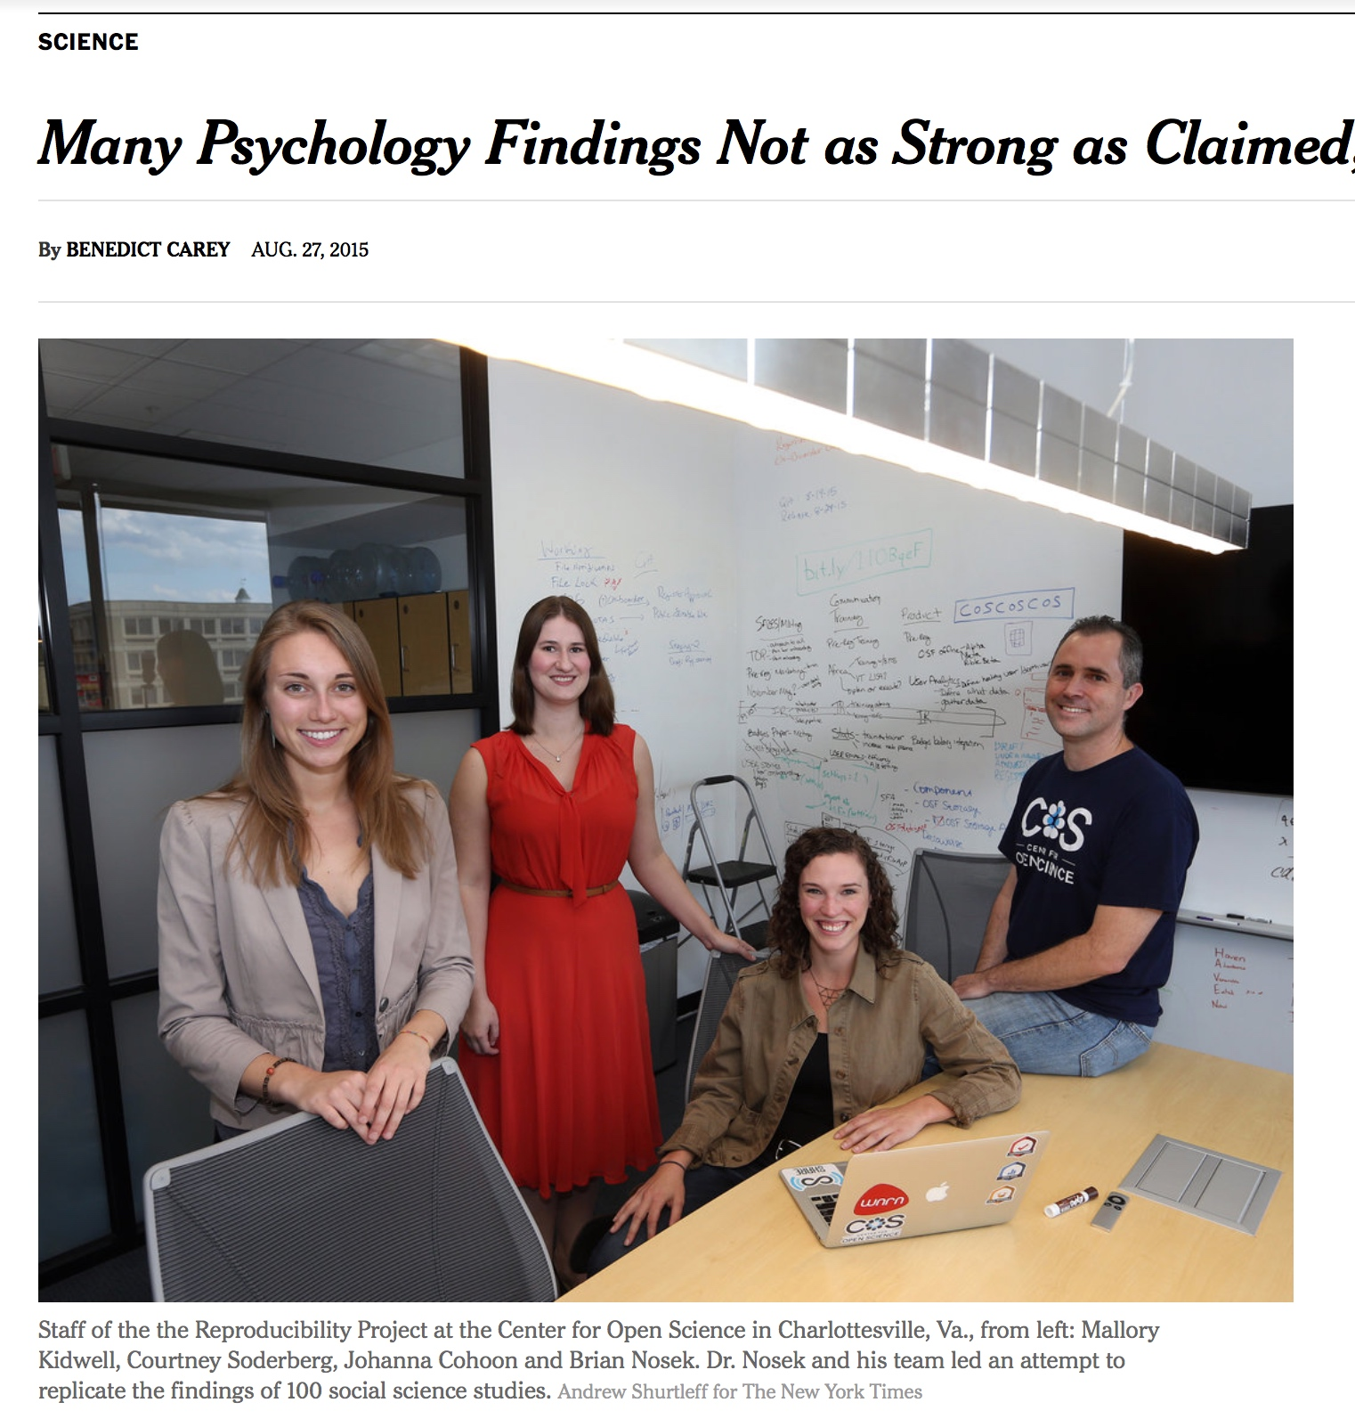
Reproducibility
NY Times highlights “problems”.
Only one of many cited examples.
HPC has been spared this “spotlight” (so far).
Lots of activity:
AAAS, ACM initiatives.
PPoPP, Supercomputing 2016.
But what is reproducibility?
http://www.nytimes.com/2015/08/28/science/many-social-science-findings-not-as-strong-as-claimed-study-says.html?_r=0

Slide 4
Reproducibility Terminology
V. Stodden, D. H. Bailey, J. Borwein, R. J. LeVeque, W. Rider, and W. Stein. 2013. Setting the Default to Reproducible: Reproducibility in Computational and Experimental Mathematics. (2013). http://icerm.brown.edu/html/programs/topical/tw12 5 rcem/icerm report.pdf
Reviewable Research. The descriptions of the research methods can be independently assessed and the results judged credible. (This includes both traditional peer review and community review, and does not necessarily imply reproducibility.)
Replicable Research. Tools are made available that would allow one to duplicate the results of the research, for example by running the authors’ code to produce the plots shown in the publication. (Here tools might be limited in scope, e.g., only essential data or executables, and might only be made available to referees or only upon request.)
Confirmable Research. The main conclusions of the research can be attained independently without the use of software provided by the author. (But using the complete description of algorithms and methodology provided in the publication and any supplementary materials.)
Auditable Research. Sufficient records (including data and software) have been archived so that the research can be defended later if necessary or differences between independent confirmations resolved. The archive might be private, as with traditional laboratory notebooks.
Open or Reproducible Research. Auditable research made openly available. This comprised well-documented and fully open code and data that are publicly available that would allow one to (a) fully audit the computational procedure, (b) replicate and also independently reproduce the results of the research, and (c) extend the results or apply the method to new problems.

Slide 5
ACM TOMS
TOMS RCR Initiative: Referee Data.
Why TOMS? Tradition of real software that others use.
Two categories: Algorithms, Research.
TOMS Algorithms Category:
Software Submitted with manuscript.
Both are thoroughly reviewed.
TOMS Research Category:
Stronger: Previous implicit “real software” requirement is explicit.
New: Special designation for replicated results.
5

Slide 6

ACM TOMS Replicated Computational Results (RCR)
Submission: Optional RCR option.
Standard reviewer assignment: Nothing changes.
RCR reviewer assignment:
Concurrent with standard reviews.
As early as possible in review process.
Known to and works with authors during the RCR process.
RCR process:
Multi-faceted approach, Bottom line: Trust the reviewer.
Publication:
Replicated Computational Results Designation.
The RCR referee acknowledged.
Review report appears with published manuscript.

Slide 7
RCR Process: Two Basic Approaches
TOMS:
First RCR paper in TOMS issue 41:3
Editorial introduction.
van Zee & van de Geijn, BLIS paper.
Referee report.
Second: TOMS 42:1
Hogg & Scott.
Third: TOMS 42:4.
Several others in queue.
TOMACS
Similar.
1. Independent replication (3 options):
Transfer of, or pointer to, author’s software.
Guest account, access to author’s software.
Observation of authors replicating results.
Or (Untested, rare)
2. Review of computational results artifacts:
Results may be from an unavailable system.
Leadership class computing system.
In this situation:
Careful documentation of the process.
Software should have its own substantial V&V process.

Slide 8
Big Picture of ACM RCR
Thank you for taking the time to consider our paper for your journal.
XXX has agreed to undergo the RCR process should the paper proceed far enough in the review process to qualify. To make this easier we have preserved the exact copy of the code used for the results (including additional code for generating detailed statistics that is not in the library version of the code).
Improve science.
Quality of prose: Good.
Quality of data: Poor.
So bad now:
Trust comes from seeing a “cloud” of similar papers with similar results.
Which could still be wrong (built on a common bad piece).
Replicability: First step toward improvement.
Engage a “dark portion” of the R&D community.
Reviewers not among typical reviewer pool.
Practitioners, users. Expert at use of Math SW.

Slide 9
Reproducibility Status & (Some) Futures
TOMACS: Adopted TOMS RCR.
ACM: Completed electronic workflow support, badging.
Conference proceedings:
PPoPP, other conferences, reviewing artifacts.
SC16, 17 and beyond. Progressive increase of results review.
AAAS:
Science paper (from 3rd Arnold Workshop on Reproducibile Science):
The “REP” Standards for Disclosing Computational Methods Victoria Stodden, Marcia McNutt, David H. Bailey, Ewa Deelman, Yolanda Gil, Brooks Hanson, Michael A. Heroux, John P.A. Ioannidis, Michela Taufer, submitted, July 2016.
REP = Reproducibility Enhancement Principles

Slide 10
Incentives To Change
Demand
Reproducibility
SW Quality Requirements
Employer Recognition
Productivity & Sustainability Investments
Enable
Common statement: “I would love to do a better job, but I need to:
Get this paper submitted.
Complete this project task.
Do something my employer values more.
Goal: Change incentives to include value of better software.

Slide 11
SC17 Reproducibility Initiative
Two appendices:
Artifact description (AD).
Blue print for setting up your computational experiment.
Makes it easier to rerun computations in future.
Computational Results Analysis (CRA).
Targets ”boutique” environments.
Improves trustworthiness when re-running hard, impossible.
Details: http://sc17.supercomputing.org/submitters/technical-papers/reproducibility-initiatives-for-technical-papers/

Slide 12
Example: HPCG Benchmark
Exploit two properties:
Operator symmetry:
For any linear operator A, x^{T}Ay = y^{T}A^{T}x.
If A symmetric A = A^{T}, so x^{T}Ay = y^{T}Ax.
And x^{T}Ay - y^{T}A^{T}x = 0.
HPCG computes the above expression for:
User matrix and the preconditioner.
Numerical detail: Need to scale by
Spectral properties of CG: Eigenvalue clustering.

Slide 13
https://github.com/hpcg-benchmark/hpcg/blob/master/src/TestSymmetry.cpp
// Test symmetry of matrix
// First load vectors with random values
FillRandomVector(x_ncol); FillRandomVector(y_ncol);
double xNorm2, yNorm2;
double ANorm = 2 * 26.0;
// Next, compute x'*A*y
ComputeDotProduct(nrow, y_ncol, y_ncol, yNorm2, t4, A.isDotProductOptimized);
int ierr = ComputeSPMV(A, y_ncol, z_ncol); // z_nrow = A*y_overlap
if (ierr) HPCG_fout << "Error in call to SpMV: " << ierr << ".\n" << endl;
double xtAy = 0.0;
ierr = ComputeDotProduct(nrow, x_ncol, z_ncol, xtAy, t4, A.isDotProductOptimized); // x'*A*y
if (ierr) HPCG_fout << "Error in call to dot: " << ierr << ".\n" << endl;
// Next, compute y'*A*x
// …
testsymmetry_data.depsym_spmv = std::fabs((long double) (xtAy - ytAx))/((xNorm2*ANorm*yNorm2 + yNorm2*ANorm*xNorm2) * (DBL_EPSILON));
if (testsymmetry_data.depsym_spmv > 1.0) ++testsymmetry_data.count_fail; // If the difference is > 1, count it wrong
if (A.geom->rank==0) HPCG_fout << "Departure from symmetry (scaled) for SpMV abs(x'*A*y - y'*A*x) = " << testsymmetry_data.depsym_spmv << endl;
// Test symmetry of multi-grid
// Compute x'*Minv*y
// …

Slide 14
https://github.com/hpcg-benchmark/hpcg/blob/master/src/TestCG.cpp
// Modify the matrix diagonal to greatly exaggerate diagonal values.
// CG should converge in about 10 iterations for this problem, regardless of problem size
for (local_int_t i=0; i< A.localNumberOfRows; ++i) {
global_int_t globalRowID = A.localToGlobalMap[i];
if (globalRowID<9) {
double scale = (globalRowID+2)*1.0e6;
ScaleVectorValue(exaggeratedDiagA, i, scale);
ScaleVectorValue(b, i, scale);
} else {
ScaleVectorValue(exaggeratedDiagA, i, 1.0e6);
ScaleVectorValue(b, i, 1.0e6);
}
}
ReplaceMatrixDiagonal(A, exaggeratedDiagA);
// …

Slide 15
Message to This Audience
Be prepared to have someone else replicate your results.
Create, retain artifacts that establish credible results.

Slide 16
Acknowledgments
Sandia National Laboratories is a multi-program laboratory managed and operated by Sandia Corporation, a wholly owned subsidiary of Lockheed Martin Corporation, for the U.S. Department of Energy’s National Nuclear Security Administration under contract DE-AC04-94AL85000. SAND NO. 2016-8466 C.

Slide 17
Other resources
ACM TOMS Editorial
Science Magazine Article
Others

