Slide 1
Testing of HPC scientific software
Testing of HPC Scientific Software
SIAM CSE17
Atlanta, GA
February 28, 2017
Tutorial slides available at: http://bit.ly/siam-cse17-mt3
Anshu Dubey (ANL) and Alicia Klinvex (SNL)

Slide 2
Acknowledgments
Argonne, a U.S. Department of Energy Office of Science laboratory, is operated under Contract No. DE-AC02-06CH11357.
Sandia National Laboratories is a multi-program laboratory managed and operated by Sandia Corporation, a wholly owned subsidiary of Lockheed Martin Corporation, for the U.S. Department of Energy’s National Nuclear Security Administration under contract DE-AC04-94AL85000. SAND NO. 2016-8466 C.

Slide 3


The IDEAS project
A DOE project aimed at increasing software productivity for extreme-scale computational science
IDEAS resources
On various topics in software engineering and productivity, including testing
https://ideas-productivity.org
More info:
See last slide for info on additional software testing resources
CSE Software Forum: https://cse-software.org
Collaborators in IDEAS project:
ANL
LANL
LBNL
LLNL
ORNL
PNNL
SNL
Colorado School of Mines

Slide 4
Outline
Introduction
Scientific software verification
How to evaluate needs of a project and devise a testing regime
Testing during refactoring
Hands on - Code coverage
Demo - Continuous integration
Notes:
Motivation for verification and testing
Definitions
Best practices
Automated test harnesses

Slide 5
Introduction
Why is testing important?
Definitions

Slide 6
Benefits of testing
Promotes high-quality software that delivers correct results and improves confidence
Increases quality and speed of development, reducing development and maintenance costs
Maintains portability to a variety of systems and compilers
Helps in refactoring
Avoid introducing new errors when adding new features
Avoid reintroducing old errors

Slide 7
How common are bugs?
Bugs per 1000 lines of code (KLOC)
Industry average for delivered software
1-25 errors
Microsoft Applications Division
10-20 defects during in-house testing
0.5 in released product
Programs do not acquire bugs as people acquire germs, by hanging around other buggy programs. Programmers must insert them.
- Harlan Mills
Code Complete (Steven McConnell)

Slide 8
Why testing is important: the protein structures of Geoffrey Chang
Some inherited code flipped two columns of data, inverting an electron-density map
Resulted in an incorrect protein structure
Retracted 5 publications
One was cited 364 times
Many papers and grant applications conflicting with his results were rejected

Slide 9
Why testing is important: the 40 second flight of the Ariane 5
Ariane 5: a European orbital launch vehicle meant to lift 20 tons into low Earth orbit
Initial rocket went off course, started to disintegrate, then self-destructed less than a minute after launch
Seven variables were at risk of leading to an Operand Error (due to conversion of floating point to integer)
Four were protected
Investigation concluded insufficient test coverage as one of the causes for this accident
Resulted in a loss of $370,000,000.

Slide 10
Why testing is important: the Therac-25 accidents
Therac-25: a computer-controlled radiation therapy machine
Minimal software testing
Race condition in the code went undetected
Unlucky patients were struck with approximately 100 times the intended dose of radiation, ~ 15,000 rads
Error code indicated that no dose of radiation was given, so operator instructed machine to proceed
Recalled after six accidents resulting in death and serious injuries

Slide 11
Definitions
Unit tests
Test individual functions or classes
Integration tests
Test interaction, build complex hierarchy
System level tests
At the user interaction level

Slide 12
Definitions
Restart tests
Code starts transparently from a checkpoint
Regression (no-change) tests
Compare current observable output to a gold standard
Performance tests
Focus on the runtime and resource utilization

Slide 13
Policies on testing practices
Avoid regression suites consisting of system-level no-change tests
Tests often need to be re-baselined
Often done without verification of new gold-standard
Hard to maintain across multiple platforms
Loose tolerances can allow subtle defects to appear
Notes:
Questions : Why would you rebaseline tests ?
Any experience among audience where tolerances were actually defects ?

Slide 14
Policies on testing practices
Must have consistent policy on dealing with failed tests
Issue tracking
How quickly does it need to be fixed?
Who is responsible for fixing it?
Add regression test afterwards (to avoid reintroducing issue later)
Someone needs to be in charge of watching the test suite

Slide 15
Policies on testing practices
When refactoring or adding new features, run a regression suite before checkin
Be sure to add new regression tests for the new features
Require a code review before releasing test suite
Another person may spot issues you didn’t
Incredibly cost-effective
Notes:
Question – Is it enough to add a new test for every new feature ? If not why not.

Slide 16
Example: Trilinos checkin test script
Detects which packages were modified by your commits
Determines which packages you potentially broke
Configures, builds, and tests those packages
On success, pushes to repo
On failure, reports why it failed
Useful for ensuring your changes don’t break another package
May take a while, but many people run it overnight
Notes:
Question – Maybe ask audience for their experiences before launching into this slide

Slide 17
Maintenance of a test suite
Testing regime is only useful if it is
Maintained
Tests and benchmarks periodically updated
Monitored regularly
Can be automated
Has rapid response to failure
Tests should pass most of the time

Slide 18
Use of test harnesses
Essential for large code
Set up and run tests
Evaluate test results
Easy to execute a logical subset of tests
Pre-push
Nightly
Automation of test harness is critical for
Long-running test suites
Projects that support many platforms
Jenkins
C-dash
Custom
(FlashTest)

Slide 19
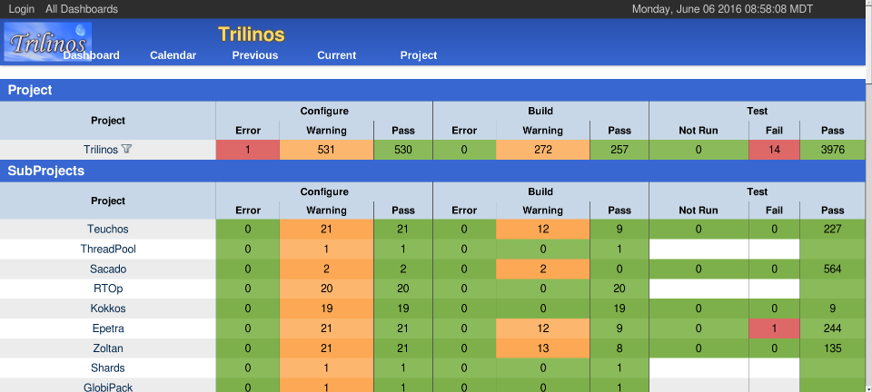
Example: Trilinos automated testing

Slide 20
Scientific Software Verification
Challenges specific to scientific software

Slide 21
Verification
Code verification uses tests
It is much more than a collection of tests
It is the holistic process through which you ensure that
Your implementation shows expected behavior,
Your implementation is consistent with your model,
Science you are trying to do with the code can be done.

Slide 22
Simplified schematic of science through computation
This is for simulations, but the philosophy applies to other computations too.
Physical World
Model
Model
fidelity
Validation
Equations
Many stages in the lifecycle have components that may themselves be under research => need modifications
Model
fidelity
Discretize
Implementation
Difference equations
Verify accuracy
stability
Numerical solvers
Notes:
Why do you suppose there are so many feedback loops ?
Does anyone have an example of when discretization or equation needed to change ?

Slide 23
CSE verification challenges
Floating point issues
Different results
On different platforms and runs
Ill-conditioning can magnify these small differences
Final solution may be different
Number of iterations may be different
Unit testing
Sometimes producing meaningful testable behavior too dependent upon other parts of the code
Definitions don’t always fit
Notes:
1. Unit testing is a contentious issue. Any examples of when building fake inputs isn’t worthwhile ?

Slide 24
CSE verification challenges
Integration testing may have hierarchy too
Particularly true of codes that allow composability in their configuration
Codes may incorporate some legacy components
Its own set of challenges
No existing tests of any granularities
Examples – multiphysics application codes that support multiple domains
Notes:
Why is composability a bigger challenge ?

Slide 25
Stages and types of verification
During initial code development
Accuracy and stability
Matching the algorithm to the model
Interoperability of algorithms
In later stages
While adding new major capabilities or modifying existing capabilities
Ongoing maintenance
Preparing for production
Notes:
What do you think is the biggest difference between initial stages and later stages

Slide 26
Stages and types of verification
If refactoring
Ensuring that behavior remains consistent and expected
All stages have a mix of automation and human-intervention
Note that the stages apply to the whole code as well as its components

Slide 27
How to evaluate project needs
And devise a testing regime

Slide 28
Why not always use the most stringent testing?
Effort spent in devising tests and testing regime are a tax on team resources
When the tax is too high…
Team cannot meet code-use objectives
When is the tax is too low…
Necessary oversight not provided
Defects in code sneak through

Slide 29
Evaluating project needs
Objectives: expected use of the code
Team: size and degree of heterogeneity
Lifecycle stage: new or production or refactoring
Lifetime: one off or ongoing production
Complexity: modules and their interactions

Slide 30
Commonalities
Unit testing is always good
It is unlikely to be sufficient
Verification of expected behavior
Understanding the range of validity and applicability is always important
Especially for individual solvers
Notes:
Earlier we said unit testing is contentious, why these seemingly contradictory statements
What should you know about an algorithm before using a component that implements it

Slide 31
Test Development
Development of tests and diagnostics goes hand-in-hand with code development
Non-trivial to devise good tests, but extremely important
Compare against simpler analytical or semi-analytical solutions
They can also form a basis for unit testing
In addition to testing for “correct” behavior, also test for stability, convergence, or other such desirable characteristics
Many of these tests go into the test-suite
Notes:
Why analytical/semi analytical …
What other kinds of tests exist ?

Slide 32
Example from Flash
Grid ghost cell fill
Use some function to initialize domain
Two variables, in one only interior cells initialized, in the other ghost cells also initialized
Run ghost cell fill on the first variable – now both should be identical within known tolerance
Use redundant mechanisms

Slide 33
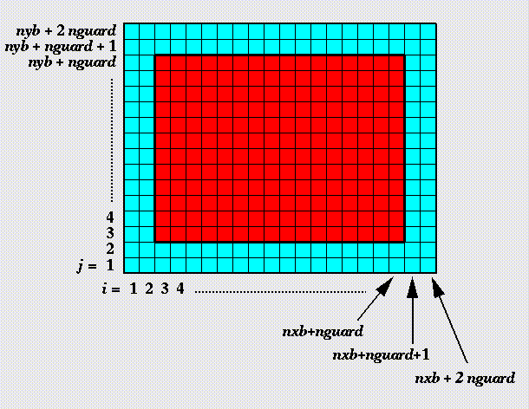
Against manufactured solution
Verification of guard cell fill
Use two variables A & B
Initialize A including guard cells and B excluding them
Apply guard cell fill to B

Slide 34
Example from Flash
Eos
Use initial conditions from a known problem
Apply eos in two different modes – at the end all variables should be consistent within tolerance
Hydrodynamics
Sedov blast problem has a known analytical solution
Runs with UG and AMR

Slide 35
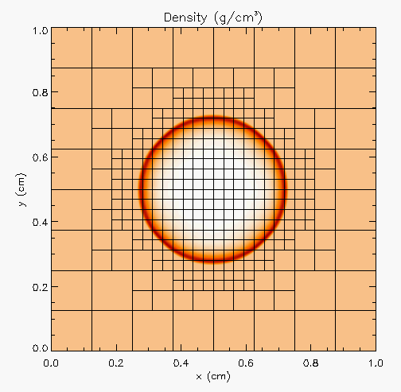
Against analytical solution
Sedov blast wave
High pressure at the center
Shock moves out spherically
FLASH with AMR and hydro
Known analytical solution
Though it exercises both mesh, hydro and eos, if mesh and eos are verified first, then this test verifies hydro

Slide 36
Building confidence
First two unit tests are stand-alone
The third test depends on Grid and Eos
Not all of Grid functionality it uses is unit tested
Flux correction in AMR
If Grid and Eos tests passed and Hydro failed
If UG version failed then fault is in hydro
If UG passed and AMR failed the fault is likely in flux correction

Slide 37
Development phase – adding on
Few more steps when adding new components to existing code
Know the existing components it interacts with
Verify its interoperability with those components
Verify that it does not inadvertently break some unconnected part of the code
May need addition of tests not just for the new component but also for some of the old components
This part is often overlooked to the detriment of the overall verification

Slide 38
Selection of tests
Important to aim for quick diagnosis of error
A mix of different granularities works well
Unit tests for isolating component or sub-component level faults
Integration tests with simple to complex configuration and system level
Restart tests
Rules of thumb
Simple
Enable quick pin-pointing
Full paper Dubey et al 2015

Slide 39
Approach
Build a matrix
Physics along rows
Infrastructure along columns
Alternative implementations, dimensions, geometry
Mark <i,j> if test covers corresponding features
Follow the order
All unit tests – including full module tests
Tests representing ongoing productions
Tests sensitive to perturbations
Most stringent tests for solvers
Least complex test to cover remaining spots

Slide 40
Example
Tests | Symbol
Sedov | SV
Cellular | CL
Poisson | PT
White Dwarf | WD
A test on the same row indicates interoperability between corresponding physics
Similar logic would apply to tests on the same column for infrastructure
More goes on, but this is the primary methodology

Slide 41
Refactoring
Testing needs during code refactor

Slide 42
Considerations
Know why you are refactoring
Know the scope of refactoring
Know bounds on acceptable behavior change
Know your error bounds
Bitwise reproduction of results unlikely after transition
Map from here to there
Check for coverage provided by existing tests
Develop new tests where there are gaps
Incorporate testing overheads into refactor cost estimates

Slide 43
Challenges with legacy codes
Legacy codes can have many gotchas
Dead code
Redundant branches
Interactions between sections of the code may be unknown
Can be difficult to differentiate between just bad code, or bad code for a good reason
Nested conditionals
Code coverage tools are of limited help

Slide 44
Options
Test coverings
Set of tests used to introduce an invariant
Cover a small area of the system
Ascertain correct behavior
Build the invariant, then refactor to make the code clear
Have an on-ramp plan
Notes:
What is an on-ramp plan and why is it critical
Does one have an example ?

Slide 45
Code Coverage

Slide 46
How do we determine what other tests are needed?
Code coverage tools
Expose parts of the code that aren’t being tested
gcov
standard utility with the GNU compiler collection suite
counts the number of times each statement is executed
lcov
a graphical front-end for gcov
available at http://ltp.sourceforge.net/coverage/lcov.php

Slide 47
How to use gcov/lcov
Compile and link your code with --coverage flag
It’s a good idea to disable optimization
Run your test suite
Collect coverage data using gcov/lcov
Optional: generate html output using genhtml

Slide 48
A hands-on gcov tutorial
https://amklinv.github.io/morpheus/index.html

Slide 49
But I don’t use C++!
gcov also works for C and Fortran
Other tools exist for other languages
JCov for Java
Coverage.py for python
Devel::Cover for perl
profile for MATLAB
etc

Slide 50
Continuous integration

Slide 51
Continuous integration (CI): a master branch that always works
Code changes trigger automated builds/tests on target platforms
Builds/tests finish in a reasonable amount of time, providing useful feedback when it’s most needed
Immensely helpful!
Requires some work, though:
A reasonably automated build system
An automated test system with significant test coverage
A set of systems on which tests will be run, and a controller

Slide 52
Continuous integration (CI): a master branch that always works
Has existed for some time
Adoption has been slow
Setting up and maintaining CI systems is difficult, labor-intensive (typically requires a dedicated staff member)
You have to be doing a lot of things right to even consider CI

Slide 53
Cloud-based CI is available as a service on GitHub
Automated builds/tests can be triggered via pull requests
Builds/tests can be run on cloud systems – no server in your closet. Great use of the cloud!
Test results are reported on the pull request page (with links to detailed logs)
Already being used successfully by scientific computing projects, with noticeable benefits to productivity
Not perfect, but far better than not doing CI

Slide 54
Travis CI is a great choice for HPC
Integrates easily with GitHub
Free for Open Source projects
Supports environments with C/C++/Fortran compilers (GNU, Clang, Intel[?])
Linux, Mac platforms available
Relatively simple, reasonably flexible configuration file
Documentation is sparse, but we now have working examples

Slide 55
Travis CI live demo
https://github.com/amklinv/morpheus

Slide 56
Other resources
Software testing levels and definitions:
http://www.tutorialspoint.com/software_testing/software_testing_levels.htm
Working Effectively with Legacy Code, Michael Feathers. The legacy software change algorithm described in this book is very straight-forward and powerful for anyone working on a code that has insufficient testing.
Code Complete, Steve McConnell. Excellent testing advice. His description of Structure Basis Testing is good, and it is a simple concept: Write one test for each logic path through your code.
Organization dedicated to software testing: https://www.associationforsoftwaretesting.org/
Software Carpentry: http://katyhuff.github.io/python-testing/
Tutorial from Udacity: https://www.udacity.com/course/software-testing--cs258
Papers on testing:
http://www.sciencedirect.com/science/article/pii/S0950584914001232
https://www.researchgate.net/publication/264697060_Ongoing_verification_of_a_multiphysics_community_code_FLASH
Resources for Trilinos testing:
Trilinos testing policy: https://github.com/trilinos/Trilinos/wiki/Trilinos-Testing-Policy
Trilinos test harness: https://github.com/trilinos/Trilinos/wiki/Policies--%7C-Testing

Slide 57
Motivating people to write tests
Tests protect YOU from other people from breaking your work
If someone else’s changes break your code, they are responsible for fixing it
Testing is cheaper and easier than debugging
You may already have some tests lying around
Drivers for generating conference or paper results
User submitted bugs
Examples

