Slide 1

Welcome to…
David E. Bernholdt, Anshu Dubey, Michael Heroux, Alicia Klinvex
8:30am-12:00pm, Monday 13 November 2017
Tutorial evaluation form: http://bit.ly/sc17-eval
Final version of tutorial slides: http://bit.ly/bssw-tutorial
Requested citation: David E. Bernholdt, Anshu Dubey, Michael Heroux, and Alicia Klinvex, Better Scientific Software, tutorial, in SC ‘17: International Conference for High Performance Computing, Networking, Storage and Analysis, Denver, Colorado, 2017. DOI: 10.6084/m9.figshare.c.3928039.

Slide 2
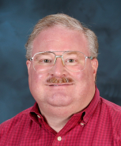
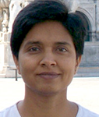
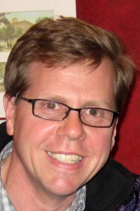
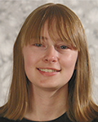



Tutorial Instructors
David Bernholdt, ORNL
Anshu Dubey, ANL
Mike Heroux, SNL
Alicia Klinvex, SNL
Members of the IDEAS Scientific Software Productivity Project: www.ideas-productivity.org
Focus: Increasing CSE software productivity, quality, and sustainability
David
Anshu
Mike
Alicia

Slide 3
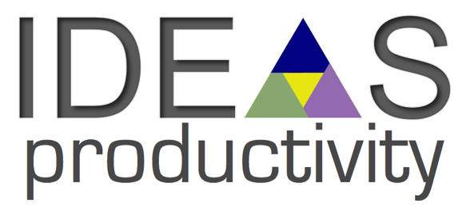
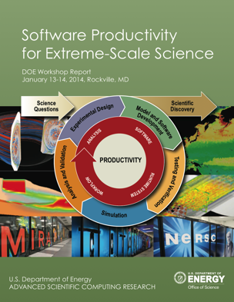
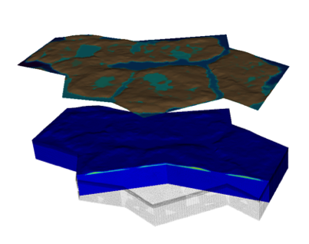


Interoperable Design of Extreme-scale Application Software (IDEAS)
Motivation
Enable increased scientific productivity, realizing the potential of extreme- scale computing, through a new interdisciplinary and agile approach to the scientific software ecosystem.
Project History
IDEAS began in 2014 as a DOE ASRC/BER partnership to improve application software productivity, quality, and sustainability. In 2017, the DOE Exascale Computing Project began supporting IDEAS to help application teams improve developer productivity and software sustainability while making major changes for exascale.
Impact on Applications & Programs
Terrestrial ecosystem use cases tied initial IDEAS activities to programs in DOE Biological and Environmental Research (BER). The Exascale Computing Project (ECP) supports a broad portfolio of applications furthering science, energy, national security, and economic competitiveness.
Objectives
Address confluence of trends in hardware and increasing demands for predictive multiscale, multiphysics simulations.
Respond to trend of continuous refactoring with efficient agile software engineering methodologies & improved software design.
Outreach and Community
Approach
Interdisciplinary multi-institutional team (ANL, LANL, LBNL, LLNL, ORNL, PNNL, SNL, U. Oregon) with broad experience in scientific software development
Close partnerships with applications teams ensures impact on science
Identification, documentation and dissemination of best practices for BER and ECP software teams and the broader community
Catalyzing software process improvements through tailored engagement with individual projects
Working to bend the curve of software development costs downwards
Use Cases: Terrestrial Modeling
Old Process
New Process
Software Productivity for Extreme-Scale Science
Cost
Methodologies for Software
Productivity
Extreme-Scale Scientific Software Development Kit (xSDK)
Start
Progress
Finish
www.ideas-productivity.org
Notes:
Qualitatively new approach based on making productivity the explicit and primary principle guiding our decisions and efforts.
Developing and demonstrating new approaches for producing, using, and supporting scientific software:
- Enhancing interoperability and performance portability of libraries and components
Establishing methodologies that facilitate delivery of software as reusable, interoperable components.
Right: Upper Colorado River System

Slide 4
Tutorial objectives
Overview of best practices in software engineering explicitly tailored for CSE
Why: Increase CSE software quality, sustainability, productivity
Better CSE software > better CSE research > broader CSE impact
Who: Practices relevant for projects of all sizes
emphasis on small teams, e.g., a faculty member and collaborating students
Approach:
Information, examples, exercises, pointers to other resources
Not to prescribe any set of practices as “must use”
Be informative about practices that have worked for some projects
Emphasis on adoption of practices that help productivity rather than put unsustainable burden
Customize as needed for each project

Slide 5
Agenda
Tutorial evaluation form: http://bit.ly/sc17-eval
Time | Topic | Speaker
8:30am-8:45am | Why effective software practices are essential for CSE projects | David E. Bernholdt, ORNL
8:45am-9:15am | Introduction to software licensing | David E. Bernholdt, ORNL
9:15am-9:45am | Better (small) scientific software teams | Michael A. Heroux, SNL
9:45am-10:00am | Improving Reproducibility Through Better Software Practices | Michael A. Heroux, SNL
10:00am-10:30am | Break
10:30am-10:45am | Testing of HPC Scientific Software: Introduction | Alicia M. Klinvex, SNL
10:45am-11:15am | Verification | Anshu Dubey, ANL
11:15am-11:45am | Evaluating project testing needs | Anshu Dubey, ANL
11:45am-12:00pm | Code coverage demo and CI demo | Alicia M. Klinvex, SNL

