Slide 1
Testing of HPC Scientific Software Introduction
Presented at Better Scientific Software tutorial
SC17, Denver, Colorado
Alicia Klinvex Sandia National Laboratory

Slide 2
License, citation and acknowledgements
License and Citation
This work is licensed under a Creative Commons Attribution 4.0 International License (CC BY 4.0).
Requested citation: Alicia Klinvex, Testing of HPC Scientific Software: Introduction, tutorial, in SC ‘17: International Conference for High Performance Computing, Networking, Storage and Analysis, Denver, Colorado, 2017. DOI: 10.6084/m9.figshare.5593342.
Acknowledgements
This work was supported by the U.S. Department of Energy Office of Science, Office of Advanced Scientific Computing Research (ASCR), and by the Exascale Computing Project (17-SC-20-SC), a collaborative effort of the U.S. Department of Energy Office of Science and the National Nuclear Security Administration.
This work was performed in part at Sandia National Laboratories. Sandia National Laboratories is a multi-mission laboratory managed and operated by National Technology and Engineering Solutions of Sandia, LLC., a wholly owned subsidiary of Honeywell International, Inc., for the U.S. Department of Energy’s National Nuclear Security Administration under contract DE-NA0003525. SAND NO SAND2017-5474 PE

Slide 3

Outline
Introduction
Scientific software verification
How to evaluate needs of a project and devise a testing regime
Demo - Code coverage and continuous integration
Notes:
Motivation for verification and testing
Definitions
Best practices
Automated test harnesses

Slide 4
Introduction
Why is testing important?
Definitions

Slide 5
Benefits of testing
Promotes high-quality software that delivers correct results and improves confidence
Increases quality and speed of development, reducing development and maintenance costs
Maintains portability to a variety of systems and compilers
Helps in refactoring
Avoid introducing new errors when adding new features
Avoid reintroducing old errors

Slide 6
How common are bugs?
Programs do not acquire bugs as people acquire germs, by hanging around other buggy programs. Programmers must insert them.
- Harlan Mills
Bugs per 1000 lines of code (KLOC)
Industry average for delivered software
1-25 errors
Microsoft Applications Division
10-20 defects during in-house testing
0.5 in released product
Code Complete (Steven McConnell)

Slide 7
Why testing is important: the protein structures of Geoffrey Chang
Some inherited code flipped two columns of data, inverting an electron-density map
Resulted in an incorrect protein structure
Retracted 5 publications
One was cited 364 times
Many papers and grant applications conflicting with his results were rejected

Slide 8
Why testing is important: the 40 second flight of the Ariane 5
Ariane 5: a European orbital launch vehicle meant to lift 20 tons into low Earth orbit
Initial rocket went off course, started to disintegrate, then self-destructed less than a minute after launch
Seven variables were at risk of leading to an Operand Error (due to conversion of floating point to integer)
Four were protected
Investigation concluded insufficient test coverage as one of the causes for this accident
Resulted in a loss of $370,000,000.

Slide 9
Why testing is important: the Therac-25 accidents
Therac-25: a computer-controlled radiation therapy machine
Minimal software testing
Race condition in the code went undetected
Unlucky patients were struck with approximately 100 times the intended dose of radiation, ~ 15,000 rads
Error code indicated that no dose of radiation was given, so operator instructed machine to proceed
Recalled after six accidents resulting in death and serious injuries

Slide 10
Definitions
Unit tests
Test individual functions or classes
Integration tests
Test interaction, build complex hierarchy
System level tests
At the user interaction level

Slide 11
Definitions
Restart tests
Code starts transparently from a checkpoint
Regression (no-change) tests
Compare current observable output to a gold standard
Performance tests
Focus on the runtime and resource utilization

Slide 12
Policies on testing practices
Avoid regression suites consisting of system-level no-change tests
Tests often need to be re-baselined
Often done without verification of new gold-standard
Hard to maintain across multiple platforms
Loose tolerances can allow subtle defects to appear

Slide 13
Policies on testing practices
Must have consistent policy on dealing with failed tests
Issue tracking
How quickly does it need to be fixed?
Who is responsible for fixing it?
Add regression test afterwards (to avoid reintroducing issue later)
Someone needs to be in charge of watching the test suite

Slide 14
Policies on testing practices
When refactoring or adding new features, run a regression suite before checkin
Be sure to add new regression tests for the new features
Require a code review before releasing test suite
Another person may spot issues you didn’t
Incredibly cost-effective

Slide 15
Example: Trilinos checkin test script
Detects which packages were modified by your commits
Determines which packages you potentially broke
Configures, builds, and tests those packages
On success, pushes to repo
On failure, reports why it failed
Useful for ensuring your changes don’t break another package
May take a while, but many people run it overnight

Slide 16
Maintenance of a test suite
Testing regime is only useful if it is
Maintained
Tests and benchmarks periodically updated
Monitored regularly
Can be automated
Has rapid response to failure
Tests should pass most of the time

Slide 17
Use of test harnesses
Jenkins
C-dash
Custom
(FlashTest)
Essential for large code
Set up and run tests
Evaluate test results
Easy to execute a logical subset of tests
Pre-push
Nightly
Automation of test harness is critical for
Long-running test suites
Projects that support many platforms

Slide 18
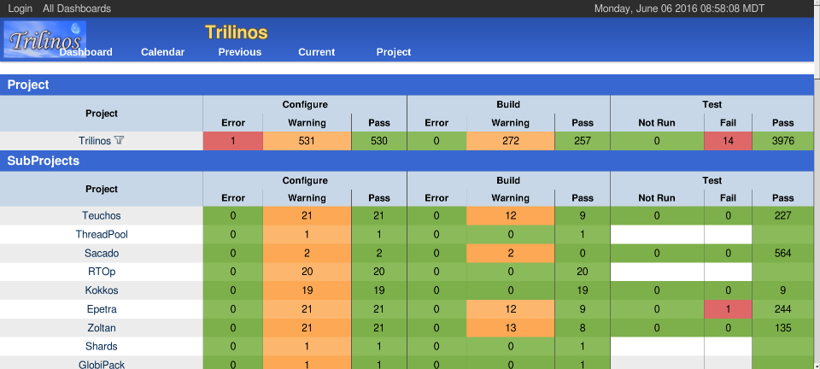
Example: Trilinos automated testing

Slide 19
Agenda
Tutorial evaluation form: http://bit.ly/sc17-eval
Time | Topic | Speaker
8:30am-8:45am | Why effective software practices are essential for CSE projects | David E. Bernholdt, ORNL
8:45am-9:15am | Introduction to software licensing | David E. Bernholdt, ORNL
9:15am-9:45am | Better (small) scientific software teams | Michael A. Heroux, SNL
9:45am-10:00am | Improving Reproducibility Through Better Software Practices | Michael A. Heroux, SNL
10:00am-10:30am | Break
10:30am-10:45am | Testing of HPC Scientific Software: Introduction | Alicia M. Klinvex, SNL
10:45am-11:15am | Verification | Anshu Dubey, ANL
11:15am-11:45am | Evaluating project testing needs | Anshu Dubey, ANL
11:45am-12:00pm | Code coverage demo and CI demo | Alicia M. Klinvex, SNL

