Slide 1
Verification
Presented at Better Scientific Software tutorial
SC17, Denver, Colorado
Anshu Dubey Argonne National Laboratory

Slide 2
License, citation and acknowledgements
License and Citation
This work is licensed under a Creative Commons Attribution 4.0 International License (CC BY 4.0).
Requested citation: Anshu Dubey, Verification, tutorial, in SC ‘17: International Conference for High Performance Computing, Networking, Storage and Analysis, Denver, Colorado, 2017. DOI: 10.6084/m9.figshare.5593345.
Acknowledgements
This work was supported by the U.S. Department of Energy Office of Science, Office of Advanced Scientific Computing Research (ASCR), and by the Exascale Computing Project (17-SC-20-SC), a collaborative effort of the U.S. Department of Energy Office of Science and the National Nuclear Security Administration.
This work was performed in part at the Argonne National Laboratory, which is managed by UChicago Argonne, LLC for the U.S. Department of Energy under Contract No. DE-AC02-06CH11357.

Slide 3
Scientific Software Verification
Challenges specific to scientific software

Slide 4
Verification
Code verification uses tests
It is much more than a collection of tests
It is the holistic process through which you ensure that
Your implementation shows expected behavior,
Your implementation is consistent with your model,
Science you are trying to do with the code can be done.

Slide 5
Simplified schematic of science through computation
Physical World
This is for simulations, but the philosophy applies to other computations too.
Model
Model
fidelity
Validation
Equations
Model
fidelity
Discretize
Many stages in the lifecycle have components that may themselves be under research => need modifications
Implementation
Difference equations
Verify accuracy
stability
Numerical solvers

Slide 6
CSE verification challenges
Floating point issues
Different results
On different platforms and runs
Ill-conditioning can magnify these small differences
Final solution may be different
Number of iterations may be different
Unit testing
Sometimes producing meaningful testable behavior too dependent upon other parts of the code
Definitions don’t always fit

Slide 7
CSE verification challenges
Integration testing may have hierarchy too
Particularly true of codes that allow composability in their configuration
Codes may incorporate some legacy components
Its own set of challenges
No existing tests of any granularities
Examples – multiphysics application codes that support multiple domains

Slide 8
Stages and types of verification
During initial code development
Accuracy and stability
Matching the algorithm to the model
Interoperability of algorithms
In later stages
While adding new major capabilities or modifying existing capabilities
Ongoing maintenance
Preparing for production

Slide 9
Stages and types of verification
If refactoring
Ensuring that behavior remains consistent and expected
All stages have a mix of automation and human-intervention
Note that the stages apply to the whole code as well as its components

Slide 10
Test Development
Development of tests and diagnostics goes hand-in-hand with code development
Non-trivial to devise good tests, but extremely important
Compare against simpler analytical or semi-analytical solutions
They can also form a basis for unit testing
In addition to testing for “correct” behavior, also test for stability, convergence, or other such desirable characteristics
Many of these tests go into the test-suite

Slide 11
Example from Flash
Grid ghost cell fill
Use some function to initialize domain
Two variables, in one only interior cells initialized, in the other ghost cells also initialized
Run ghost cell fill on the first variable – now both should be identical within known tolerance
Use redundant mechanisms

Slide 12
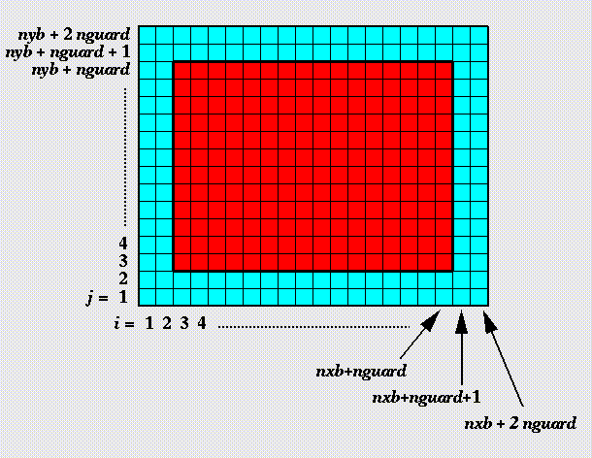
Against manufactured solution
Verification of guard cell fill
Use two variables A & B
Initialize A including guard cells and B excluding them
Apply guard cell fill to B

Slide 13
Example from Flash
Eos
Use initial conditions from a known problem
Apply eos in two different modes – at the end all variables should be consistent within tolerance
Hydrodynamics
Sedov blast problem has a known analytical solution
Runs with UG and AMR

Slide 14
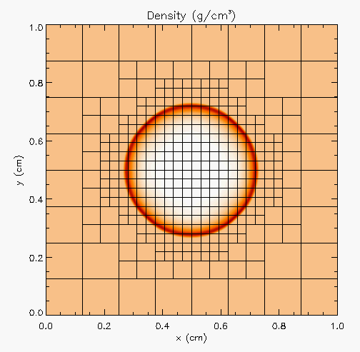
Against analytical solution
Sedov blast wave
High pressure at the center
Shock moves out spherically
FLASH with AMR and hydro
Known analytical solution
Though it exercises both mesh, hydro and eos, if mesh and eos are verified first, then this test verifies hydro

Slide 15
Building confidence
First two unit tests are stand-alone
The third test depends on Grid and Eos
Not all of Grid functionality it uses is unit tested
Flux correction in AMR
If Grid and Eos tests passed and Hydro failed
If UG version failed then fault is in hydro
If UG passed and AMR failed the fault is likely in flux correction

Slide 16
Agenda
Tutorial evaluation form: http://bit.ly/sc17-eval
Time | Topic | Speaker
8:30am-8:45am | Why effective software practices are essential for CSE projects | David E. Bernholdt, ORNL
8:45am-9:15am | Introduction to software licensing | David E. Bernholdt, ORNL
9:15am-9:45am | Better (small) scientific software teams | Michael A. Heroux, SNL
9:45am-10:00am | Improving Reproducibility Through Better Software Practices | Michael A. Heroux, SNL
10:00am-10:30am | Break
10:30am-10:45am | Testing of HPC Scientific Software: Introduction | Alicia M. Klinvex, SNL
10:45am-11:15am | Verification | Anshu Dubey, ANL
11:15am-11:45am | Evaluating project testing needs | Anshu Dubey, ANL
11:45am-12:00pm | Code coverage demo and CI demo | Alicia M. Klinvex, SNL

