Slide 1
Why effective software practices are essential for CSE projects
Presented at Better Scientific Software tutorial
ECP 2nd Annual Meeting, Knoxville, Tennessee
Anshu Dubey
Argonne National Laboratory

Slide 2
License, citation and acknowledgements
License and Citation
This work is licensed under a Creative Commons Attribution 4.0 International License (CC BY 4.0).
Requested citation:Anshu Dubey , Why effective software practices are essential for CSE projects, tutorial, in Exascale Computing Project 2nd Annual Meeting, Knoxville, Tennessee, 2018. DOI: TBA.
Acknowledgements
This work was supported by the U.S. Department of Energy Office of Science, Office of Advanced Scientific Computing Research (ASCR), and by the Exascale Computing Project (17-SC-20-SC), a collaborative effort of the U.S. Department of Energy Office of Science and the National Nuclear Security Administration.

Slide 3
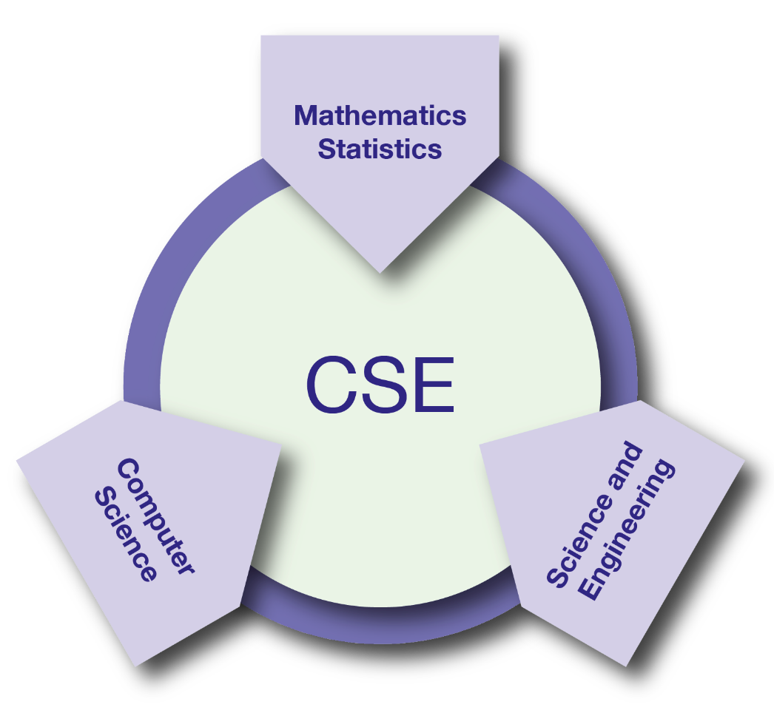
What is CSE?
Computational Science & Engineering (CSE): development and use of computational methods for scientific discovery
all branches of the sciences
engineering and technology
support of decision-making across a spectrum of societally important apps
CSE: essential driver of scientific and technological progress in conjunction with theory and experiment
Reference: Research and Education in Computational Science and Engineering, U. Rüde, K. Willcox, L.C. McInnes, H. De Sterck, et al., Oct 2016, https://arxiv.org/abs/1610.02608

Slide 4
Software is at the core of CSE
•
Software: foundation of sustained CSE collaboration and scientific progress

Slide 5
Heroic Programming
Usually a pejorative term, is used to describe the expenditure of huge amounts of (coding) effort by talented people to overcome shortcomings in process, project management, scheduling, architecture or any other shortfalls in the execution of a software development project in order to complete it. Heroic Programming is often the only course of action left when poor planning, insufficient funds, and impractical schedules leave a project stranded and unlikely to complete successfully.
From http://c2.com/cgi/wiki?HeroicProgramming
Science teams often resemble heroic programming
Many do not see anything wrong with that approach

Slide 6
What is wrong with heroic programming
Scientific results that could be obtained with heroic programming have run their course, because:
It is not possible for a single person to take on all these roles
Better scientific understanding
Math model
Different roles
and responsi-bilities
More complex software
Numerics
Verification
Performance

Slide 7
Other reasons
Accretion leads to unmanageable software
Increases cost of maintenance
Parts of software may become unusable over time
Inadequately verified software produces questionable results
Increases ramp-on time for new developers
Reduces software and science productivity due to technical debt
consequence of choices – quick and dirty incurs technical debt, collects interest which means more effort required to add features.

Slide 8
Increasing complexity of CSE software
•
Multiphysics and multiscale modeling
Coupling of data analytics
Disruptive changes in computer hardware
Requires algorithm/code refactoring
Importance of reproducibility
Science requirements are unfolding, evolving, not fully known a priori
Science through computing is only as good as the software that produces it.

Slide 9
Lifecycle
Modeling
Approximations
Discretizations
Numerics
Convergence
Stability
Implementation
Verification
Expected behavior
Validation
Experiment/observation

Slide 10
Challenges of CSE software
•
Technical
All parts of the cycle can be under research
Requirements change throughout the lifecycle as knowledge grows
Verification complicated by floating point representation
Real world is messy, so is the software
Sociological
Competing priorities and incentives
Limited resources
Perception of near-term overhead with deferred benefit
Need for interdisciplinary interactions

Slide 11
Taking stock: Understanding what you want from your CSE software and how to achieve it
•
•
•
•
•
Software architecture and process design
Managing complexity and avoiding technical debt (future saving)
Worthwhile to understand trade-offs
Issues to consider
The target of the software
Proof-of-concept
Discard once you’re done with it (or the student/postdoc leaves)
Long-term research tool that successive group members will extend
Others …
How important are performance, scalability, portability to you?
Buy vs. build: can you achieve your goals by contributing to exisiting software, or do you need to start from scratch?
What 3rd-party software are you willing to depend on?
Target should dictate the rigor of the design and development process
Considering resource constraints

Slide 12
Software process for CSE
•
Baseline
Desirable
Invest in extensible code design
Most uses need additions and/or customizations
Use version control and automated testing
Institute a rigorous verification and validation regime
Define coding and testing standards
Clear and well defined policies for
Auditing and maintenance
Distribution and contribution
Documentation
Provenance and reproducibility
Lifecycle management
Open development and frequent releases

Slide 13
Customize according to your needs
There is no “all or nothing”
Focus on improving productivity and sustainability rather than purity of process
Danger of being too dismissive too soon
Examine options with as little bias as possible
Fine balance between getting a buy-in from the team and imposing process on them
First reaction usually is resistance to change and suspicion of new processes
Many skeptics get converted when they see the benefit

Slide 14
Interdisciplinary Interactions
A partnership model that works
Science users treat the code as a research instrument that needs its own research
Developers and computer scientists interested in a product and the science being done with the code
Helps to have people with multidisciplinary training
Comparable resources and autonomy for the developers
And recognition of their intellectual contribution to scientific discovery
Careful balance between long term and short term objectives

Slide 15
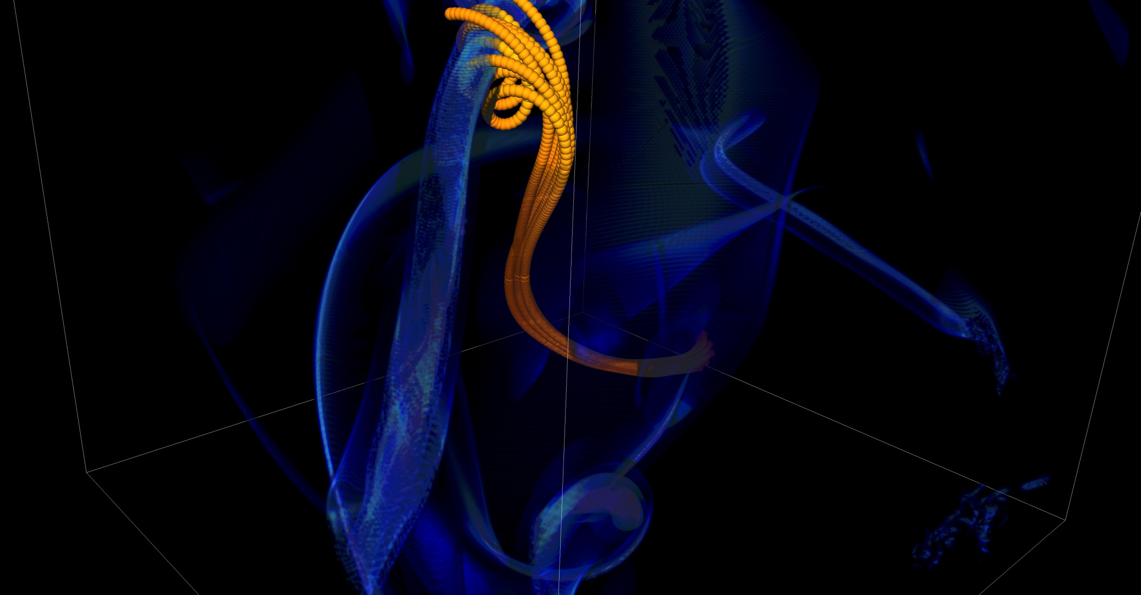
What can happen without a process
In 2005 BG/L was made available at short notice
Quick and dirty development of particles
Many in-flight corrections of defects
One was adding tags to track individual particles
Got many duplicated tags due to round-off
Had to develop post-processing tools to correctly identify trajectories
FLASH had a software process in place. It was tested regularly. This was one instance when the full process could not be applied because of time constraints. We got ready for the run in less than a month, the run went for 1.5 weeks, and it took over 6 months before we could trust the processed results.

Slide 16

Resources
Key:
Blue text: covered in this tutorial
Black text: pointers to other resources
Better Performance:
High-performance computing
Performance at LCFs
Performance portability
Better Skills:
Personal productivity and sustainability
Online learning
Better Planning:
Requirements
Design
Software interoperability
Performance
Planning
Skills
Better Collaboration:
Licensing
Strategies for more effective teams
Funding sources and programs
Projects and organizations
Software publishing and citation
Discussion forums, Q&A sites
Software Productivity & Sustainability
Better Development:
Documentation
Version control
Configuration and builds
Deployment
Issue tracking
Refactoring
Software engineering
Development tools
Collaboration
Development
Reliability
Better Reliability:
Testing
Continuous integration testing
Reproducibility
Debugging

Slide 17
IDEAS WhatIs and HowTo documents
Motivation: Software teams have a wide range of levels of maturity in SW engineering practices.
Resources:
‘What Is’ docs: 2-page characterizations of important topics for CSE software projects
‘How To’ docs: brief sketch of best practices
Emphasis on ``bite-sized'' topics enables CSE software teams to consider improvements at a small but impactful scale
Current topics:
What Is CSE Software Productivity?
What Is Software Configuration?
How to Configure Software
What Is Performance Portability?
How to Enable Performance Portability
What Is CSE Software Testing?
What Are Software Testing Practices?
How to Add and Improve Testing in a CSE Software Project
More topics under development
See: https://ideas-productivity.org/resources/howtos
What Is Good Documentation?
How to Write Good Documentation
What Are Interoperable Software Libraries?
What Is Version Control?
How to Do Version Control with Git
Impact: Provide baseline nomenclature and foundation for next steps in software productivity and software engineering for CSE teams.

Slide 18
Other Tutorials: Slides and video
Best Practices for HPC Software Developers
Argonne Training Program on Extreme-Scale Computing
On-going monthly webinar series
https://ideas-productivity.org/events/hpc-best-practices-webinars/
Topics to date:
What All Codes Should Do: Overview of Best Practices in HPC Software Development
Developing, Configuring, Building, and Deploying HPC Software
Distributed Version Control and Continuous Integration Testing
Testing and Documenting your Code
How the HPC Environment is Different from the Desktop (and Why)
Best Practices for I/O on HPC Systems
Basic Performance Analysis and Optimization
Python in HPC
Intermediate Git
Using the Roofline Model and Intel Advisor
Annual two-week short course
https://extremecomputingtraining.anl.gov/
Software Engineering and Community Codes track (2016) – 6 presentations
Software Productivity track (2017)
What All Codes Should Do: Overview of Best Practices in HPC Software Development
Git Introduction
Better (Small) Scientific Software Teams
Improving Reproducibility through Better Software Practices
Testing and Verification
Code Coverage and Continuous Integration
Software Lifecycle with an Example. Community Impact
An Introduction to Software Licensing

Slide 19
More resources
Software Carpentry: http://software-carpentry.org
Since 1998, Software Carpentry has been teaching researchers in science, engineering, medicine, and related disciplines the computing skills they need to get more done in less time and with less pain.
Lessons: https://software-carpentry.org/lessons/
freely reusable under the Creative Commons Attribution license
Software Sustainability Institute: http://www.software.ac.uk
UK national facility for cultivating and improving research software to support world-class research
Guides: https://www.software.ac.uk/resources/guides-everything
Computational Sci. Stack Exchange: https://SciComp.StackExchange.com
Question and answer site for scientists using computers to solve scientific problems

Slide 20
Agenda
Time | Topic | Speaker
1:30pm-2:15pm | Why effective software practices are essential for CSE projects | Anshu Dubey, ANL
2:15pm-2:45pm | Better (small) scientific software teams | Michael A. Heroux, SNL
2:45pm-3:00pm | Improving Reproducibility Through Better Software Practices | Michael A. Heroux, SNL
3:00pm-3:30pm | Break
3:30pm-4:15pm | Testing HPC Scientific Software: Introduction | Jared O’Neal, ANL
4:15pm-4:45pm | Verification, and Evaluating Project Testing Needs | Anshu Dubey, ANL
4:45am-5:00pm | Code Coverage and CI | Jared O’Neal, ANL

