Slide 1
Verification and Evaluating Project Needs
Presented at Better Scientific Software tutorial
ECP 2nd Annual Meeting, Knoxville, Tennessee
Anshu Dubey
Argonne National Laboratory

Slide 2
License, citation and acknowledgements
License and Citation
This work is licensed under a Creative Commons Attribution 4.0 International License (CC BY 4.0).
Requested citation: Anshu Dubey, Verification and Evaluating Project Needs, tutorial, in Exascale Computing Project 2nd Annual Meeting, Knoxville, Tennessee, 2018. DOI: TBA.
Acknowledgements
This work was supported by the U.S. Department of Energy Office of Science, Office of Advanced Scientific Computing Research (ASCR), and by the Exascale Computing Project (17-SC-20-SC), a collaborative effort of the U.S. Department of Energy Office of Science and the National Nuclear Security Administration.
This work was performed in part at the Argonne National Laboratory, which is managed by UChicago Argonne, LLC for the U.S. Department of Energy under Contract No. DE-AC02-06CH11357.

Slide 3
Scientific Software Verification
Challenges specific to scientific software

Slide 4
Verification
Code verification uses tests
It is much more than a collection of tests
It is the holistic process through which you ensure that
Your implementation shows expected behavior,
Your implementation is consistent with your model,
Science you are trying to do with the code can be done.

Slide 5
CSE verification challenges
Floating point issues
Different results
On different platforms and runs
Ill-conditioning can magnify these small differences
Final solution may be different
Number of iterations may be different
Unit testing
Sometimes producing meaningful testable behavior too dependent upon other parts of the code
Definitions don’t always fit

Slide 6
CSE verification challenges
Integration testing may have hierarchy too
Particularly true of codes that allow composability in their configuration
Codes may incorporate some legacy components
Its own set of challenges
No existing tests of any granularities
Examples – multiphysics application codes that support multiple domains

Slide 7
Stages and types of verification
During initial code development
Accuracy and stability
Matching the algorithm to the model
Interoperability of algorithms
In later stages
While adding new major capabilities or modifying existing capabilities
Ongoing maintenance
Preparing for production

Slide 8
Stages and types of verification
If refactoring
Ensuring that behavior remains consistent and expected
All stages have a mix of automation and human-intervention
Note that the stages apply to the whole code as well as its components

Slide 9
Test Development
Development of tests and diagnostics goes hand-in-hand with code development
Non-trivial to devise good tests, but extremely important
Compare against simpler analytical or semi-analytical solutions
They can also form a basis for unit testing
In addition to testing for “correct” behavior, also test for stability, convergence, or other such desirable characteristics
Many of these tests go into the test-suite

Slide 10
Example from Flash
Grid ghost cell fill
Use some function to initialize domain
Two variables, in one only interior cells initialized, in the other ghost cells also initialized
Run ghost cell fill on the first variable – now both should be identical within known tolerance
Use redundant mechanisms

Slide 11
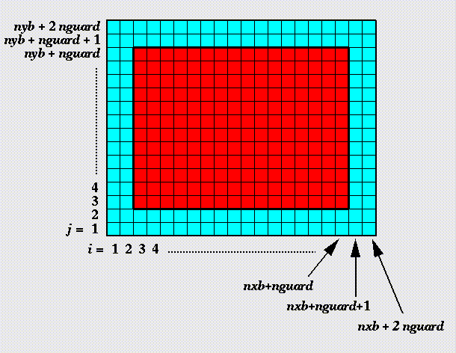
Against manufactured solution
Verification of guard cell fill
Use two variables A & B
Initialize A including guard cells and B excluding them
Apply guard cell fill to B

Slide 12
Example from Flash
EOS
Use initial conditions from a known problem
Apply EOS in two different modes – at the end all variables should be consistent within tolerance
Hydrodynamics
Sedov blast problem has a known analytical solution
Runs with UG and AMR

Slide 13
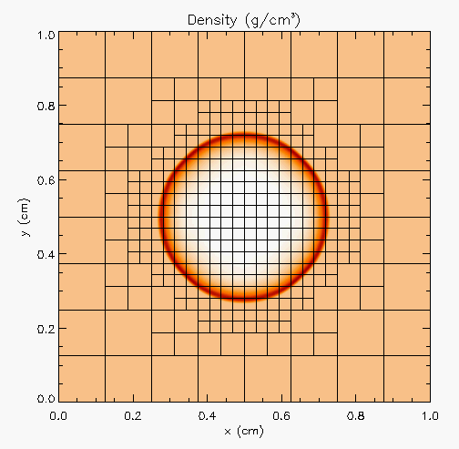
Against analytical solution
Sedov blast wave
High pressure at the center
Shock moves out spherically
FLASH with AMR and hydro
Known analytical solution
Though it exercises both mesh, hydro and eos, if mesh and EOS are verified first, then this test verifies hydro

Slide 14
Building confidence
First two unit tests are stand-alone
The third test depends on Grid and Eos
Not all of Grid functionality it uses is unit tested
Flux correction in AMR
If Grid and Eos tests passed and Hydro failed
If UG version failed then fault is in hydro
If UG passed and AMR failed the fault is likely in flux correction

Slide 15
How to evaluate project needs
And devise a testing regime

Slide 16
Why not always use the most stringent testing?
Effort spent in devising tests and testing regime are a tax on team resources
When the tax is too high…
Team cannot meet code-use objectives
When is the tax is too low…
Necessary oversight not provided
Defects in code sneak through

Slide 17
Evaluating project needs
Objectives: expected use of the code
Team: size and degree of heterogeneity
Lifecycle stage: new or production or refactoring
Lifetime: one off or ongoing production
Complexity: modules and their interactions

Slide 18
Commonalities
Unit testing is always good
It is never sufficient
Verification of expected behavior
Understanding the range of validity and applicability is always important
Especially for individual solvers

Slide 19
Development phase – adding on
Few more steps when adding new components to existing code
Know the existing components it interacts with
Verify its interoperability with those components
Verify that it does not inadvertently break some unconnected part of the code
May need addition of tests not just for the new component but also for some of the old components
This part is often overlooked to the detriment of the overall verification

Slide 20
Selection of tests
Important to aim for quick diagnosis of error
A mix of different granularities works well
Unit tests for isolating component or sub-component level faults
Integration tests with simple to complex configuration and system level
Restart tests
Rules of thumb
Simple
Enable quick pin-pointing
Full paper Dubey et al 2015

Slide 21
Approach
Build a matrix
Physics along rows
Infrastructure along columns
Alternative implementations, dimensions, geometry
Mark <i,j> if test covers corresponding features
Follow the order
All unit tests – including full module tests
Tests representing ongoing productions
Tests sensitive to perturbations
Most stringent tests for solvers
Least complex test to cover remaining spots

Slide 22
Example
A test on the same row indicates interoperability between corresponding physics
Similar logic would apply to tests on the same column for infrastructure
More goes on, but this is the primary methodology
Tests | Symbol
Sedov | SV
Cellular | CL
Poisson | PT
White Dwarf | WD

Slide 23
Challenges with legacy codes
Checking for coverage
Legacy codes can have many gotchas
Dead code
Redundant branches
Interactions between sections of the code may be unknown
Can be difficult to differentiate between just bad code, or bad code for a good reason
Nested conditionals
Code coverage tools are of limited help

Slide 24
An Approach
Isolate a small area of the code
Dump a useful state snapshot
Build a test driver
Start with only the files in the area
Link in dependencies
Copy if any customizations needed
Read in the state snapshot
Verify correctness
Always inject errors to verify that the test is working
Methodology developed for the ACME project, proving to be very useful

Slide 25
Agenda
Time | Topic | Speaker
1:30pm-2:15pm | Why effective software practices are essential for CSE projects | Anshu Dubey, ANL
2:15pm-2:45pm | Better (small) scientific software teams | Michael A. Heroux, SNL
2:45pm-3:00pm | Improving Reproducibility Through Better Software Practices | Michael A. Heroux, SNL
3:00pm-3:30pm | Break
3:30pm-4:15pm | Testing HPC Scientific Software: Introduction | Jared O’Neal, ANL
4:15pm-4:45pm | Verification, and Evaluating Project Testing Needs | Anshu Dubey, ANL
4:45am-5:00pm | Code Coverage and CI | Jared O’Neal, ANL

