Slide 1

Welcome to…
Anshu Dubey and Michael Heroux
Sunday 24th June 2018
Final version of tutorial slides:
Requested citation: Anshu Dubey, Michael Heroux, Better Scientific Software, tutorial, in ISC High Performance 2018
DOI:10.6084/m9.figshare.6452912

Slide 2
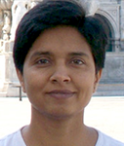
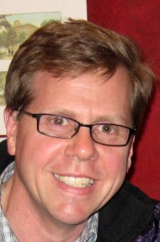


Tutorial Instructors
Anshu Dubey, ANL
Mike Heroux, SNL
Members of the IDEAS Scientific Software Productivity Project: www.ideas-productivity.org
Focus: Increasing CSE software productivity, quality, and sustainability
Anshu
Mike

Slide 3
License, citation and acknowledgements
License and Citation
This work is licensed under a Creative Commons Attribution 4.0 International License (CC BY 4.0).
Requested citation: Requested citation: Anshu Dubey, Michael Heroux, Better Scientific Software, tutorial, in ISC High Performance 2018 DOI:10.6084/m9.figshare.6452912
Acknowledgements
This work was supported by the U.S. Department of Energy Office of Science, Office of Advanced Scientific Computing Research (ASCR), and by the Exascale Computing Project (17-SC-20-SC), a collaborative effort of the U.S. Department of Energy Office of Science and the National Nuclear Security Administration.
This work was performed in part at Sandia National Laboratories. Sandia National Laboratories is a multi-mission laboratory managed and operated by National Technology and Engineering Solutions of Sandia, LLC., a wholly owned subsidiary of Honeywell International, Inc., for the U.S. Department of Energy’s National Nuclear Security Administration under contract DE-NA0003525. SAND NO SAND2017-5474 PE

Slide 4

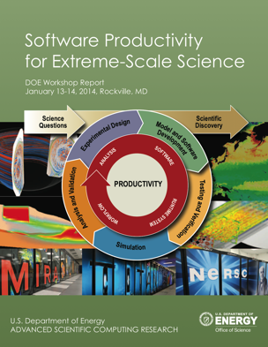
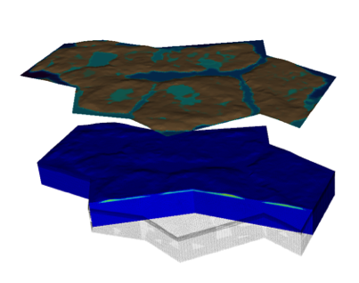


Interoperable Design of Extreme-scale Application Software (IDEAS)
Motivation
Enable increased scientific productivity, realizing the potential of extreme- scale computing, through a new interdisciplinary and agile approach to the scientific software ecosystem.
Project History
IDEAS began in 2014 as a DOE ASRC/BER partnership to improve application software productivity, quality, and sustainability. In 2017, the DOE Exascale Computing Project began supporting IDEAS to help application teams improve developer productivity and software sustainability while making major changes for exascale.
Impact on Applications & Programs
Terrestrial ecosystem use cases tied initial IDEAS activities to programs in DOE Biological and Environmental Research (BER). The Exascale Computing Project (ECP) supports a broad portfolio of applications furthering science, energy, national security, and economic competitiveness.
Objectives
Address confluence of trends in hardware and increasing demands for predictive multiscale, multiphysics simulations.
Respond to trend of continuous refactoring with efficient agile software engineering methodologies & improved software design.
Outreach and Community
Approach
Interdisciplinary multi-institutional team (ANL, LANL, LBNL, LLNL, ORNL, PNNL, SNL, U. Oregon) with broad experience in scientific software development
Close partnerships with applications teams ensures impact on science
Identification, documentation and dissemination of best practices for BER and ECP software teams and the broader community
Catalyzing software process improvements through tailored engagement with individual projects
Working to bend the curve of software development costs downwards
Use Cases: Terrestrial Modeling
Old Process
New Process
Software Productivity for Extreme-Scale Science
Cost
Methodologies for Software
Productivity
Extreme-Scale Scientific Software Development Kit (xSDK)
Start
Progress
Finish
www.ideas-productivity.org
Notes:
Qualitatively new approach based on making productivity the explicit and primary principle guiding our decisions and efforts.
Developing and demonstrating new approaches for producing, using, and supporting scientific software:
- Enhancing interoperability and performance portability of libraries and components
Establishing methodologies that facilitate delivery of software as reusable, interoperable components.
Right: Upper Colorado River System

Slide 5
Tutorial objectives
Overview of best practices in software engineering explicitly tailored for CSE
Why: Increase CSE software quality, sustainability, productivity
Better CSE software > better CSE research > broader CSE impact
Who: Practices relevant for projects of all sizes
emphasis on small teams, e.g., a faculty member and collaborating students
Approach:
Information, examples, exercises, pointers to other resources
Not to prescribe any set of practices as “must use”
Be informative about practices that have worked for some projects
Emphasis on adoption of practices that help productivity rather than put unsustainable burden
Customize as needed for each project

Slide 6
Agenda
Time | Topic | Speaker
2:00pm-2:30pm | Why Effective Software Practices are Essential for CSE Projects | Anshu Dubey, ANL
2:30pm-3:00pm | Introduction to Software Licensing | Michael A. Heroux, SNL
3:00am-3:30pm | Better (Small) Scientific Software Teams | Michael A. Heroux, SNL
3:30am-4:00pm | Improving Reproducibility Through Better Software Practices | Michael A. Heroux, SNL
4:00pm-4:30pm | Break
4:30pm-5:00pm | Testing HPC Scientific Software – Part 1 | Anshu Dubey, ANL
5:00pm-5:30pm | Testing HPC Scientific Software – Part 2 | Anshu Dubey, ANL
5:30pm-6:00pm | Code Coverage Hands-on and CI Demo | Anshu Dubey, ANL

Slide 7
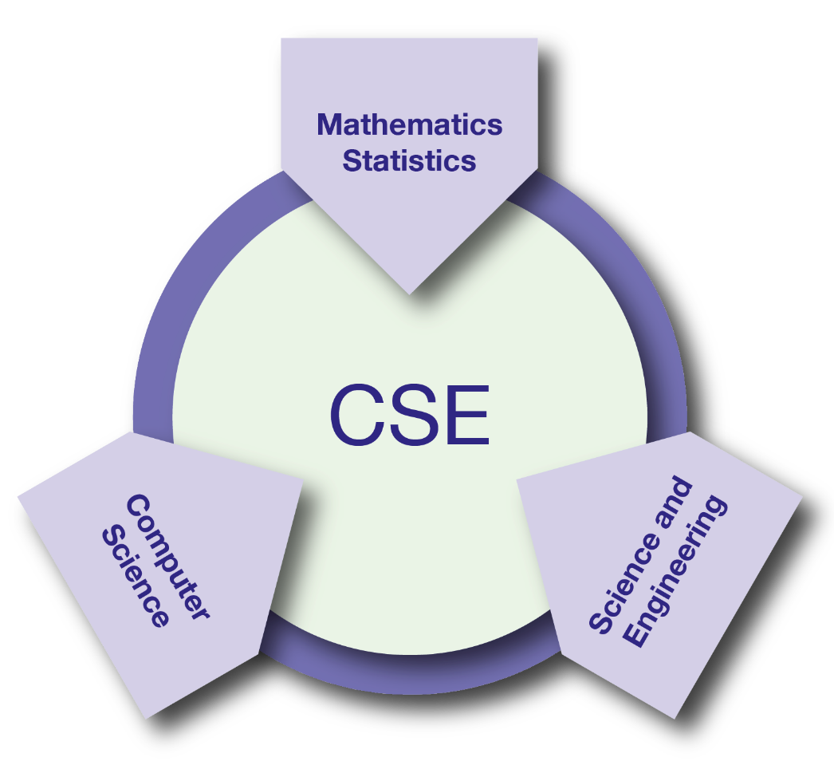
What is CSE?
Computational Science & Engineering (CSE): development and use of computational methods for scientific discovery
all branches of the sciences
engineering and technology
support of decision-making across a spectrum of societally important apps
CSE: essential driver of scientific and technological progress in conjunction with theory and experiment
Reference: Research and Education in Computational Science and Engineering, U. Rüde, K. Willcox, L.C. McInnes, H. De Sterck, et al., Oct 2016, https://arxiv.org/abs/1610.02608

Slide 8
Software is at the core of CSE
•
Software: foundation of sustained CSE collaboration and scientific progress

Slide 9
Heroic Programming
Usually a pejorative term, is used to describe the expenditure of huge amounts of (coding) effort by talented people to overcome shortcomings in process, project management, scheduling, architecture or any other shortfalls in the execution of a software development project in order to complete it. Heroic Programming is often the only course of action left when poor planning, insufficient funds, and impractical schedules leave a project stranded and unlikely to complete successfully.
From http://c2.com/cgi/wiki?HeroicProgramming
Science teams often resemble heroic programming
Many do not see anything wrong with that approach

Slide 10
What is wrong with heroic programming
Scientific results that could be obtained with heroic programming have run their course, because:
It is not possible for a single person to take on all these roles
Better scientific understanding
Math model
Different roles
and responsi-bilities
More complex software
Numerics
Verification
Performance

Slide 11
In High Performance Computing Science
Codes aiming for higher fidelity modeling
More complex codes, simulations and analysis
Numerous models, more moving parts that need to interoperate
Variety of expertise needed – the only tractable development model is through separation of concerns
It is more difficult to work on the same software in different roles without a software engineering process
Onset of higher platform heterogeneity
Requirements are unfolding, not known apriori
The only safeguard is investing in flexible design and robust software engineering process

Slide 12
Other reasons
Accretion leads to unmanageable software
Increases cost of maintenance
Parts of software may become unusable over time
Inadequately verified software produces questionable results
Increases ramp-on time for new developers
Reduces software and science productivity due to technical debt
consequence of choices – quick and dirty incurs technical debt, collects interest which means more effort required to add features.

Slide 13
Challenges
Technical
All parts of the cycle can be under research
Requirements change throughout the lifecycle as knowledge grows
Verification complicated by floating point representation
Real world is messy, so is the software
Sociological
Competing priorities and incentives
Limited resources
Perception of overhead without benefit
Need for interdisciplinary interactions

Slide 14
Taking stock: Understanding what you want from your CSE software and how to achieve it
•
•
•
•
•
Software architecture and process design
Managing complexity and avoiding technical debt (future saving)
Worthwhile to understand trade-offs
Issues to consider
The target of the software
Proof-of-concept
Discard once you’re done with it (or the student/postdoc leaves)
Long-term research tool that successive group members will extend
Others …
How important are performance, scalability, portability to you?
Buy vs. build: can you achieve your goals by contributing to exisiting software, or do you need to start from scratch?
What 3rd-party software are you willing to depend on?
Target should dictate the rigor of the design and development process
Considering resource constraints

Slide 15
Software process for CSE
•
Baseline
Desirable
Invest in extensible code design
Most uses need additions and/or customizations
Use version control and automated testing
Institute a rigorous verification and validation regime
Define coding and testing standards
Clear and well defined policies for
Auditing and maintenance
Distribution and contribution
Documentation
Provenance and reproducibility
Lifecycle management
Open development and frequent releases

Slide 16
Customize according to your needs
There is no “all or nothing”
Focus on improving productivity and sustainability rather than purity of process
Danger of being too dismissive too soon
Examine options with as little bias as possible
Fine balance between getting a buy-in from the team and imposing process on them
First reaction usually is resistance to change and suspicion of new processes
Many skeptics get converted when they see the benefit

Slide 17
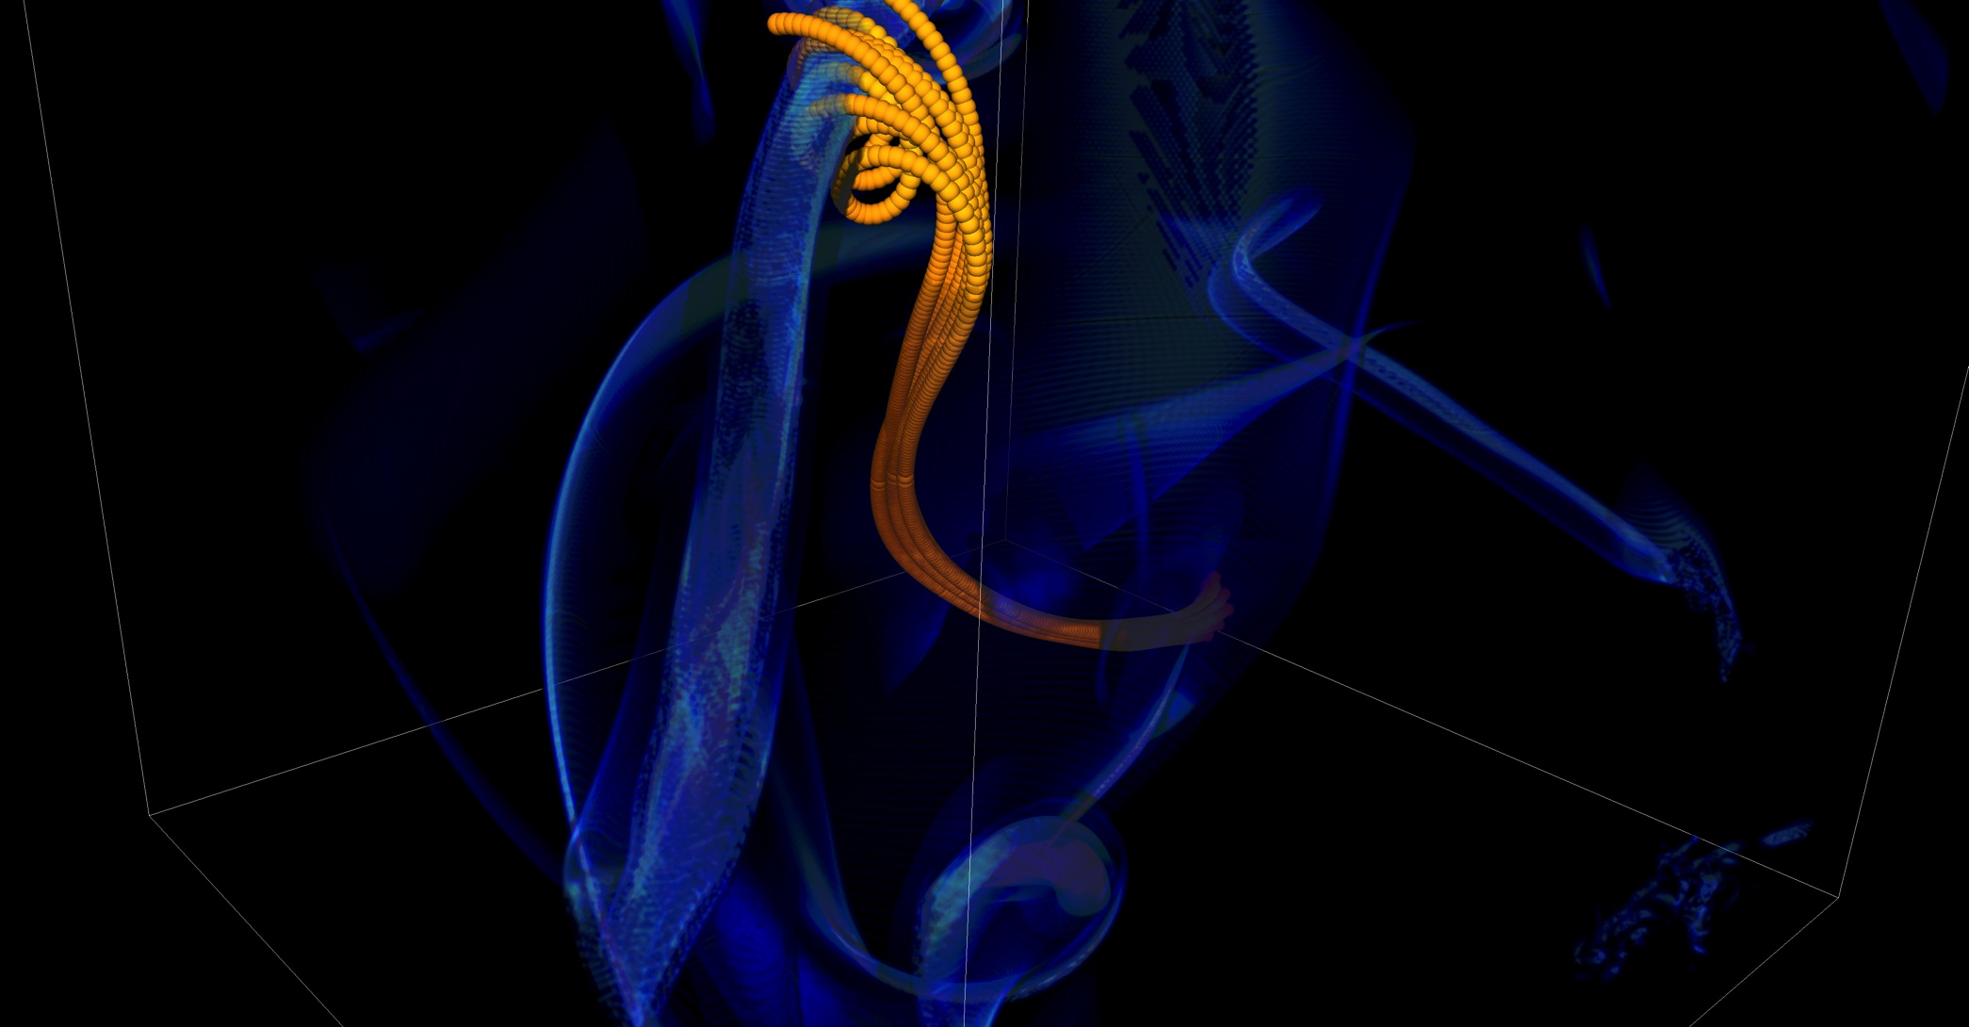
What can happen without software process FLASH experience
In 2005 BG/L was made available at short notice
Quick and dirty development of particles
Many in-flight corrections of defects
One was adding tags to track individual particles
Got many duplicated tags due to round-off
Had to develop post-processing tools to correctly identify trajectories
FLASH had a software process in place. It was tested regularly. This was one instance when the full process could not be applied because of time constraints. We got ready for the run in less than a month, the run went for 1.5 weeks, and it took over 6 months before we could trust the processed results.

Slide 18
Resources
Key:
Blue text: covered in this tutorial
Black text: pointers to other resources
Better Performance:
High-performance computing
Performance at LCFs
Performance portability
Better Skills:
Personal productivity and sustainability
Online learning
Better Planning:
Requirements
Design
Software interoperability
Performance
Planning
Skills
Better Collaboration:
Licensing
Strategies for more effective teams
Funding sources and programs
Projects and organizations
Software publishing and citation
Discussion forums, Q&A sites
Software Productivity & Sustainability
Better Development:
Documentation
Version control
Configuration and builds
Deployment
Issue tracking
Refactoring
Software engineering
Development tools
Collaboration
Development
Reliability
Better Reliability:
Testing
Continuous integration testing
Reproducibility
Debugging

Slide 19
IDEAS WhatIs and HowTo documents
Motivation: Software teams have a wide range of levels of maturity in SW engineering practices.
Resources:
‘What Is’ docs: 2-page characterizations of important topics for CSE software projects
‘How To’ docs: brief sketch of best practices
Emphasis on ``bite-sized'' topics enables CSE software teams to consider improvements at a small but impactful scale
Current topics:
What Is CSE Software Productivity?
What Is Software Configuration?
How to Configure Software
What Is Performance Portability?
How to Enable Performance Portability
What Is CSE Software Testing?
What Are Software Testing Practices?
How to Add and Improve Testing in a CSE Software Project
More topics under development
See: https://ideas-productivity.org/resources/howtos
What Is Good Documentation?
How to Write Good Documentation
What Are Interoperable Software Libraries?
What Is Version Control?
How to Do Version Control with Git
Impact: Provide baseline nomenclature and foundation for next steps in software productivity and software engineering for CSE teams.

Slide 20
Other Tutorials: Slides and video
Best Practices for HPC Software Developers
Argonne Training Program on Extreme-Scale Computing
On-going monthly webinar series
https://ideas-productivity.org/events/hpc-best-practices-webinars/
Selected Topics:
On-demand Learning for Better Scientific Software: How to Use Resources & Technology to Optimize your Productivity
Software Citation Today and Tomorrow
Distributed Version Control and Continuous Integration Testing
Testing and Documenting your Code
How the HPC Environment is Different from the Desktop (and Why)
Best Practices for I/O on HPC Systems
Basic Performance Analysis and Optimization
Jupyter and HPC: Current State and Future Roadmap
Using the Roofline Model and Intel Advisor
Annual two-week short course
https://extremecomputingtraining.anl.gov/
Software Engineering and Community Codes track (2016) – 6 presentations
Software Productivity track (2017)
What All Codes Should Do: Overview of Best Practices in HPC Software Development
Git Introduction
Better (Small) Scientific Software Teams
Improving Reproducibility through Better Software Practices
Testing and Verification
Code Coverage and Continuous Integration
Software Lifecycle with an Example. Community Impact
An Introduction to Software Licensing

Slide 21
More resources
Software Carpentry: http://software-carpentry.org
Since 1998, Software Carpentry has been teaching researchers in science, engineering, medicine, and related disciplines the computing skills they need to get more done in less time and with less pain.
Lessons: https://software-carpentry.org/lessons/
freely reusable under the Creative Commons Attribution license
Software Sustainability Institute: http://www.software.ac.uk
UK national facility for cultivating and improving research software to support world-class research
Guides: https://www.software.ac.uk/resources/guides-everything
Computational Sci. Stack Exchange: https://SciComp.StackExchange.com
Question and answer site for scientists using computers to solve scientific problems

Slide 22
Agenda
Dr. Louis Tao Center for Bioinformatics School of Life Sciences Peking University Dear Louis, I would like to invite you to visit the University of Chicago at some time during the period of August 6th - 14th this year. During your visit, I hope we will be able to start a collaboration on large-scale networks. I am looking forward to your visit. Yours sincerely, Anshu Dubey
Time | Topic | Speaker
2:00pm-2:30pm | Why Effective Software Practices are Essential for CSE Projects | Anshu Dubey, ANL
2:30pm-3:00pm | Introduction to Software Licensing | Michael A. Heroux, SNL
3:00am-3:30pm | Better (small) Scientific Software Teams | Michael A. Heroux, SNL
3:30am-4:00pm | Improving Reproducibility Through Better Software Practices | Michael A. Heroux, SNL
4:00pm-4:30pm | Break
4:30pm-5:00pm | Testing HPC Scientific Software – Part 1 | Anshu Dubey, ANL
5:00pm-5:30pm | Testing HPC Scientific Software – Part 2 | Anshu Dubey, ANL
5:30pm-6:00pm | Code Coverage Hands-on and CI Demo | Anshu Dubey, ANL

