Slide 1
Testing of HPC Scientific Software Part 2
Presented at Better Scientific Software tutorial
ISC18, Frankfurt, Germany
Anshu Dubey Computer Scientist, Argonne National Laboratory University of Chicago

Slide 2
License, citation and acknowledgements
License and Citation
This work is licensed under a Creative Commons Attribution 4.0 International License (CC BY 4.0).
Requested citation: Anshu Dubey, Testing of HPC Scientific Software: Part 2, tutorial, in ISC High Performance 2018: DOI: 10.6084/m9.figshare.6453020.
Acknowledgements
This work was supported by the U.S. Department of Energy Office of Science, Office of Advanced Scientific Computing Research (ASCR), and by the Exascale Computing Project (17-SC-20-SC), a collaborative effort of the U.S. Department of Energy Office of Science and the National Nuclear Security Administration.
This work was performed in part at the Argonne National Laboratory, which is managed by UChicago Argonne, LLC for the U.S. Department of Energy under Contract No. DE-AC02-06CH11357.

Slide 3
How to evaluate project needs
And devise a testing regime

Slide 4
Why not always use the most stringent testing?
Effort spent in devising tests and testing regime are a tax on team resources
When the tax is too high…
Team cannot meet code-use objectives
When is the tax is too low…
Necessary oversight not provided
Defects in code sneak through

Slide 5
Evaluating project needs
Objectives: expected use of the code
Team: size and degree of heterogeneity
Lifecycle stage: new or production or refactoring
Lifetime: one off or ongoing production
Complexity: modules and their interactions

Slide 6
Commonalities
Unit testing is always good
It is never sufficient
Verification of expected behavior
Understanding the range of validity and applicability is always important
Especially for individual solvers

Slide 7
Challenges with legacy codes
Checking for coverage
Legacy codes can have many gotchas
Dead code
Redundant branches
Interactions between sections of the code may be unknown
Can be difficult to differentiate between just bad code, or bad code for a good reason
Nested conditionals
Code coverage tools are of limited help

Slide 8
CSE specific verification challenges
Integration testing may have hierarchy too
Particularly true of codes that allow composability in their configuration
Codes may incorporate some legacy components
Its own set of challenges
No existing tests at any granularity
Examples – multiphysics application codes that support multiple domains

Slide 9
Selection of tests
Two purposes
Regression testing
May be long running
Provide comprehensive coverage
Continuous integration
Quick diagnosis of error
A mix of different granularities works well
Unit tests for isolating component or sub-component level faults
Integration tests with simple to complex configuration and system level
Restart tests
Rules of thumb
Simple
Enable quick pin-pointing

Slide 10
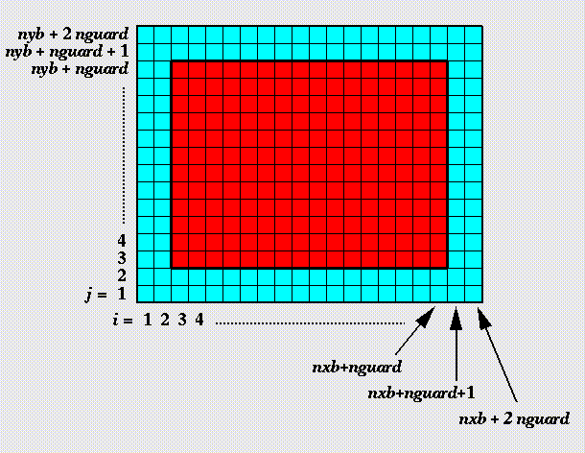
Example from Flash
Verification of guard cell fill
Use two variables A & B
Initialize A including guard cells and B excluding them
Apply guard cell fill to B
Eos
Use initial conditions from a known problem
Apply eos in two different modes – at the end all variables should be consistent within tolerance

Slide 11
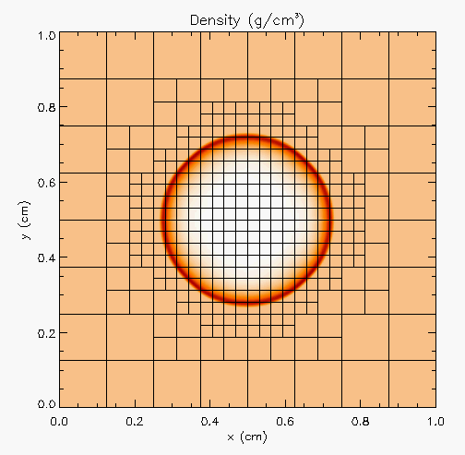
Against analytical solution
Sedov blast wave
High pressure at the center
Shock moves out spherically
FLASH with AMR and hydro
Known analytical solution
Though it exercises mesh, hydro and eos, if mesh and eos are verified first, then this test verifies hydro

Slide 12
Building confidence
First two unit tests are stand-alone
The third test depends on Grid and Eos
Not all of Grid functionality it uses is unit tested
Flux correction in AMR
If Grid and Eos tests passed and Hydro failed
If UG version failed then fault is in hydro
If UG passed and AMR failed the fault is likely in flux correction

Slide 13
Approach for Test Selection
Build a matrix
Physics along rows
Infrastructure along columns
Alternative implementations, dimensions, geometry
Mark <i,j> if test covers corresponding features
Follow the order
All unit tests – including full module tests
Tests representing ongoing productions
Tests sensitive to perturbations
Most stringent tests for solvers
Least complex test to cover remaining spots

Slide 14
Example
A test on the same row indicates interoperability between corresponding physics
Similar logic would apply to tests on the same column for infrastructure
More goes on, but this is the primary methodology
Tests | Symbol
Sedov | SV
Cellular | CL
Poisson | PT
White Dwarf | WD

Slide 15
Refactoring
Testing needs during code refactor

Slide 16
Considerations
Know bounds on acceptable behavior change
Know your error bounds
Bitwise reproduction of results unlikely after transition
Map from here to there
Check for coverage provided by existing tests
Develop new tests where there are gaps
Incorporate testing overheads into refactor cost estimates

Slide 17
An Approach
Isolate a small area of the code
Dump a useful state snapshot
Build a test driver
Start with only the files in the area
Link in dependencies
Copy if any customizations needed
Read in the state snapshot
Verify correctness
Always inject errors to verify that the test is working
Methodology developed for the ACME project, proving to be very useful

Slide 18
Agenda
Time | Topic | Speaker
2:00pm-2:30pm | Why Effective Software Practices are Essential for CSE Projects | Anshu Dubey, ANL
2:30pm-3:00pm | Introduction to Software Licensing | Michael A. Heroux, SNL
3:00am-3:30pm | Better (small) Scientific Software Teams | Michael A. Heroux, SNL
3:30am-4:00pm | Improving Reproducibility Through Better Software Practices | Michael A. Heroux, SNL
4:00pm-4:30pm | Break
4:30pm-5:00pm | Testing HPC Scientific Software – Part 1 | Anshu Dubey, ANL
5:00pm-5:30pm | Testing HPC Scientific Software – Part 2 | Anshu Dubey, ANL
5:30pm-6:00pm | Code Coverage Hands-on and CI Demo | Anshu Dubey, ANL

