Slide 1
Verification and Developing a Testing Regime
Presented to ATPESC 2018 Participants
Anshu Dubey
Computer Scientist, Mathematics and Computer Science Division
Q Center, St. Charles, IL (USA) Date 08/08/2018

Slide 2
License, citation, and acknowledgments
License and Citation
This work is licensed under a Creative Commons Attribution 4.0 International License (CC BY 4.0).
Requested citation: Anshu Dubey, Verification and developing a testing regime, tutorial, in Argonne Training Program on Extreme-Scale Computing (ATPESC) 2018. DOI: 10.6084/m9.figshare.6943091
Acknowledgements
This work was supported by the U.S. Department of Energy Office of Science, Office of Advanced Scientific Computing Research (ASCR), and by the Exascale Computing Project (17-SC-20-SC), a collaborative effort of the U.S. Department of Energy Office of Science and the National Nuclear Security Administration..
This work was performed in part at the Argonne National Laboratory, which is managed managed by UChicago Argonne, LLC for the U.S. Department of Energy under Contract No. DE-AC02-06CH11357

Slide 3
Verification
Code verification uses tests
It is much more than a collection of tests
It is the holistic process through which you ensure that
Your implementation shows expected behavior,
Your implementation is consistent with your model,
Science you are trying to do with the code can be done.

Slide 4
Stages and types of verification
During initial code development
Accuracy and stability
Matching the algorithm to the model
Interoperability of algorithms
In later stages
While adding new major capabilities or modifying existing capabilities
Ongoing maintenance
Preparing for production

Slide 5
Stages and types of verification
If refactoring
Ensuring that behavior remains consistent and expected
All stages have a mix of automation and human-intervention
Note that the stages apply to the whole code as well as its components

Slide 6
Challenge with Exploratory Software
Verification implies one knows the outcome
The outcome is achieved or not achieved
What if one doesn’t exactly know the outcome?
Software is meant to understand the expected outcome

Slide 7
Challenge with Scientific Software
Physical World
This is for simulations, but the philosophy applies to other computations too.
Model
Model
fidelity
Validation
Equations
Model
fidelity
Discretize
Many stages in the lifecycle have components that may themselves be under research => need modifications
Implementation
Difference equations
Verify accuracy
stability
Numerical solvers

Slide 8
Other specific verification challenges
Functionality coverage
Particularly true of codes that allow composability in their configuration
Codes may incorporate some legacy components
Its own set of challenges
No existing tests at any granularity
Examples – multiphysics application codes that support multiple domains

Slide 9
Challenges with legacy codes
Checking for coverage
Legacy codes can have many gotchas
Dead code
Redundant branches
Interactions between sections of the code may be unknown
Can be difficult to differentiate between just bad code, or bad code for a good reason
Nested conditionals
Code coverage tools are of limited help

Slide 10
Components of Verification
Testing at various granularity
Individual components
Interoperability of components
Convergence, stability and accuracy
Validation of individual components
Testing practices
Error bars
Necessary for differentiating between drift and round-off
Selection of tests for coverage

Slide 11
Testing
More on this later in Jared’s presentation

Slide 12
Regular Testing
Part of ongoing verification
Automating is helpful
Can be just a script
Or a testing harness
Essential for large code
Set up and run tests
Evaluate test results
Easy to execute a logical subset of tests
Pre-push
Nightly
Automation of test harness is critical for
Long-running test suites
Projects that support many platforms
Jenkins
C-dash
Custom
(FlashTest)

Slide 13
Good Testing Practices
Must have consistent policy on dealing with failed tests
Issue tracking
How quickly does it need to be fixed?
Who is responsible for fixing it?
Someone should be watching the test suite
When refactoring or adding new features, run a regression suite before checkin
Add new regression tests or modify existing ones for the new features
Code review before releasing test suite is useful
Another person may spot issues you didn’t
Incredibly cost-effective

Slide 14
Maintenance of a test suite
Testing regime is only useful if it is
Maintained
Tests and benchmarks periodically updated
Monitored regularly
Can be automated
Has rapid response to failure
Tests should pass most of the time

Slide 15
How common are bugs?
Programs do not acquire bugs as people acquire germs, by hanging around other buggy programs. Programmers must insert them.
- Harlan Mills
Bugs per 1000 lines of code (KLOC)
Industry average for delivered software
1-25 errors
Microsoft Applications Division
10-20 defects during in-house testing
0.5 in released product
Code Complete (Steven McConnell)

Slide 16
Why testing is important: the protein structures of Geoffrey Chang
Some inherited code flipped two columns of data, inverting an electron-density map
Resulted in an incorrect protein structure
Retracted 5 publications
One was cited 364 times
Many papers and grant applications conflicting with his results were rejected
He found and reported the error himself

Slide 17
Why testing is important: the 40 second flight of the Ariane 5
Ariane 5: a European orbital launch vehicle meant to lift 20 tons into low Earth orbit
Initial rocket went off course, started to disintegrate, then self-destructed less than a minute after launch
Seven variables were at risk of leading to an Operand Error (due to conversion of floating point to integer)
Four were protected
Investigation concluded insufficient test coverage as one of the causes for this accident
Resulted in a loss of $370,000,000.

Slide 18
Why testing is important: the Therac-25 accidents
Therac-25: a computer-controlled radiation therapy machine
Minimal software testing
Race condition in the code went undetected
Unlucky patients were struck with approximately 100 times the intended dose of radiation, ~ 15,000 rads
Error code indicated that no dose of radiation was given, so operator instructed machine to proceed
Recalled after six accidents resulting in death and serious injuries

Slide 19
Test Development
Development of tests and diagnostics goes hand-in-hand with code development
Non-trivial to devise good tests, but extremely important
Compare against simpler analytical or semi-analytical solutions
When faced with legacy codes with no existing tests
Isolate a small area of the code
Dump a useful state snapshot
Build a test driver
Start with only the files in the area
Link in dependencies
Copy if any customizations needed
Read in the state snapshot
Verify correctness
Always inject errors to verify that the test is working

Slide 20
Workarounds for Granularity
Real dependency
Mocked up
dependency
Approach the problem sideways
Components can be exercised against known simpler applications
Same applies to combination of components
Build a scaffolding of verification tests to gain confidence
Unit test
Unit test
Unit test

Slide 21
Unit test
Real dependency
Mocked up dependency
Unit test
Unit test
Unit test
Unit test

Slide 22
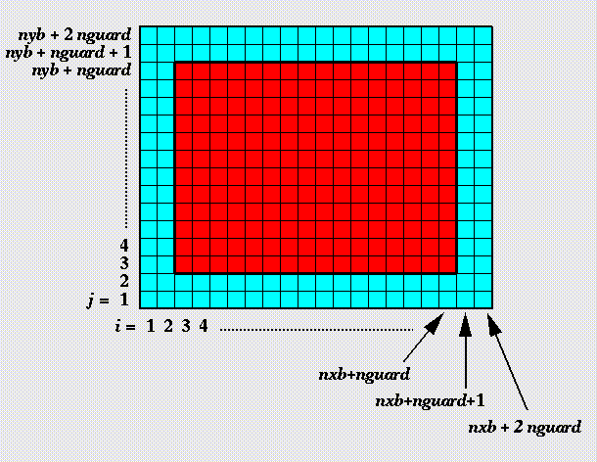
Example from Flash
Against manufactured solution
Grid ghost cell fill
Use a known analytical function to initialize domain
Use two variables A & B
Initialize A including guard cells and B excluding them
Apply guard cell fill to B
Works for uniform and adaptive mesh

Slide 23
Example from Flash Equation of State
Operates in three modes
Given density and internal energy get pressure
Given density and pressure get temperature
Given density of pressure get internal energy
Use initial conditions from a known problem
Apply EOS in two different modes – at the end all variables should be consistent within tolerance

Slide 24
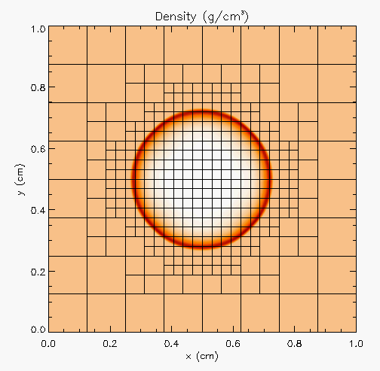
Example from FLASH, scaffolding
Sedov blast wave
High pressure at the center
Shock moves out spherically
FLASH with AMR and hydro
Known analytical solution
Though it exercises both mesh, hydro and eos, if mesh and eos are verified first, then this test verifies hydro

Slide 25
Building confidence
First two unit tests are stand-alone
The third test depends on Grid and Eos
Not all of Grid functionality it uses is unit tested
Flux correction in AMR
If Grid and Eos tests passed and Hydro failed
If UG version failed then fault is in hydro
If UG passed and AMR failed the fault is likely in flux correction

Slide 26
How to evaluate project needs
And devise a testing regime

Slide 27
Why not always use the most stringent testing?
Effort spent in devising tests and testing regime are a tax on team resources
When the tax is too high…
Team cannot meet code-use objectives
When is the tax is too low…
Necessary oversight not provided
Defects in code sneak through

Slide 28
Evaluating project needs
Objectives: expected use of the code
Team: size and degree of heterogeneity
Lifecycle stage: new or production or refactoring
Lifetime: one off or ongoing production
Complexity: modules and their interactions

Slide 29
Commonalities
Unit testing is always good
It is never sufficient
Verification of expected behavior
Understanding the range of validity and applicability is always important
Especially for individual solvers

Slide 30
Selection of tests
Two purposes
Regression testing
May be long running
Provide comprehensive coverage
Continuous integration
Quick diagnosis of error
A mix of different granularities works well
Unit tests for isolating component or sub-component level faults
Integration tests with simple to complex configuration and system level
Restart tests
Rules of thumb
Simple
Enable quick pin-pointing

Slide 31
Approach for Test Selection
Build a matrix
Physics along rows
Infrastructure along columns
Alternative implementations, dimensions, geometry
Mark <i,j> if test covers corresponding features
Follow the order
All unit tests – including full module tests
Tests representing ongoing productions
Tests sensitive to perturbations
Most stringent tests for solvers
Least complex test to cover remaining spots

Slide 32
Example
A test on the same row indicates interoperability between corresponding physics
Similar logic would apply to tests on the same column for infrastructure
More goes on, but this is the primary methodology
Tests | Symbol
Sedov | SV
Cellular | CL
Poisson | PT
White Dwarf | WD

Slide 33
Questions

