Slide 1
Typical Workflows, Definitions, and Examples
ATPESC 2018
Jared O’Neal
Mathematics and Computer Science Division
Argonne National Laboratory
Q Center, St. Charles, IL (USA) July 29 – August 10, 2018

Slide 2
Acknowledgements
Anshu Dubey
Klaus Weide
Saurabh Chawdhary
Iulian Grindeanu

Slide 3
Goals
Development teams would like to use version control to collaborate productively and ensure correct code
Understand challenges related to parallel code development via distributed version control
Understand extra dimensions of distributed version control & how to use them
Local vs. remote repositories
Branches
Issues, Pull Requests, & Code Reviews (next talk)
Exposure to workflows of different complexity
What to think about when evaluating different workflows
Motivate continuous integration

Slide 4
Distributed Version Control System (DVCS)
Two developers collaborating via Git
Local copies of master branch synched to origin
Each develops on local copy of master branch
All copies of master immediately diverge
How to integrate work on origin?
Notes:
Understand how having local and remote repositories helps and what challenges it brings – integration of independent work.
Introduction of divergence of work. Here divergence of local/remote branches rather than of two branches on the same repo.

Slide 5
DVCS Race Condition
Integration of independent work occurs when local repos interact with remote repo
Alice pushes her local commits to remote repo first
No integration conflicts
No risk
Alice’s local repo identical to remote repo
Notes:
First introduction of idea of conflict and need to resolve these quickly/easily without creating bugs.

Slide 6
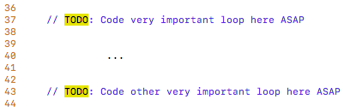
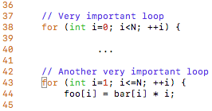
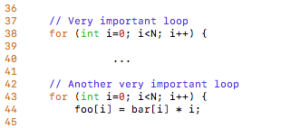
Integration Conflicts Happen
Bob’s push to remote repo is rejected
Alice updated code in commit D
Bob updated same code in commit E
Alice and Bob need to study conflict and decide on resolution at pull (time-consuming)
Possibility of introducing bug on master branch (risky)
loops.cpp (commit C)
loops.cpp (commit D)
loops.cpp (commit E)
Notes:
Git will not allow push because the contents of Bob’s repo is not a fast-forward situation. In other words, there is a non trivial divergence. Git recognizes that commits E, H, and J are not descendents of commits D, F, G, I.
The pull initiates a merge on the local repo, which can be aborted. The resolution could result in a merge commit. Best to avoid this conversation if possible, here, as it is overly complex. Wait for Feature branches to introduce merges and merge commits.

Slide 7
Our First Workflow
This process of collaborating via Git is called the Centralized Workflow
See Atlassian/BitBucket for more information
“Simple” to learn and “easy” to use
Leverages local vs. remote repo dimension
Integration in local repo when local repos interact with remote repo
What if you have many team members?
What if developers only push once a month?
What if team members works on different parts of the code?
Working directly on master
Notes:
Mention that simple and easy here do not imply that it is simple and easy for those just introduced to DVCS. Rather, it means relative to those workflows that will be introduced.
Many team members means that with a single pull I might have conflicts related to work by five different developers. I would need to work with each to resolve.
Only pushing once a month means that all repos could start to diverge significantly. Harder to resolve. Also, there work is hidden. I might be working on same code or I might want something that they have done.
Last point is lead in to next slide/branches. What if we want to leave master alone so that we can use it for science as it is updated and still develop in parallel.

Slide 8
Branches
Branches are independent lines of development
Use branches to protect master branch
Feature branches
Organize a new feature as a sequence of related commits in a branch
Branches are usually combined or merged
Develop on a branch, test on the branch, and merge into master
Integration occurs at merge commits
Notes:
All branches are based of a commit in the repo. As development occurs through commits, the independent line of development grows off of the
Introduction of merge commits. Graph show two long-lived feature branches and race condition.
For both branches we see a merge commit. For the first branch, the merge commit was simple as FeatureA and master did not diverge – everything in master is also in FeatureA.
However, when FeatureB is to be merged into master, there is a commit on master that is not on FeatureB => the two branches have diverged slightly. The VCA must study the divergence and determine if there were conflicting changes made.

Slide 9
Control Branch Complexity
Workflow policy is needed
Descriptive names or linked to issue tracking system
Where do branches start and end?
Can multiple people work on one branch?
Notes:
What if stuff was being developed by Dev1 and Dev2 decided to merge in a without communicating? Consider that case that stuff was just for tinkering and was not necessarily meant to ever be in master.
Don’t dwell much on this. Use it as an opportunity to trace the history of a branch from master to merge. Here, we get some, but not all of b. We also get all of stuff.

Slide 10
Feature Branches
Extend Centralized Workflow
Remote repo has commits A & B
Bob pulls remote to synchronize local repo to remote
Bob creates local feature branch based on commit B
Commit C pushed to remote repo
Alice pulls remote to synchronize local repo to remote
Alice creates local feature branch based on commit C
Both develop independently on local feature branches
Notes:
If we are using local-only feature branches, why is this an improvement? Why not just stick with the centralized and only push changes to remote when everything is good?
In this workflow, we are always doing fast-forward merges, which means that bad commits still end up in master.
One argument is that I can still maintain my local copy of master up to date and use it for work. Another argument is that I could do merge –no-ff so that I always get merge commits. This would isolate master.

Slide 11
Feature Branch Divergence
Alice integrates first without issue
Alice does fast-forward merge to local master
Alice deletes local feature branch
Alice pushes master to remote
Meanwhile, Bob pulls master from remote and finds Alice’s changes
Merge conflict between commits D and E
Notes:
Fast-forward merge means that there has been no divergence between the two branches. This can happen between two branches in a single repo or the same branch on two local repos.
Alice has fast-forward merge, which is simple to understand, has no merge conflicts. Bob would like the same.

Slide 12
Feature Race Condition
Integration occurs on Bob’s local repo
Bob laments not having fast-forward merge
Bob rebases local feature branch to latest commit on master
E based off of commit B
E’ based off of Alice’s commit I
E’ is E integrated with commits C, D, F, G, I
Merge conflict resolved by Bob & Alice on Bob’s local branch when converting commit E into E’
Can test on feature branch and merge easily and cleanly
Notes:
Leverages local vs. remote dimension
Not necessary to understand the details of rebase. Just the idea of rebasing to get fast-forward merge and that we get merge conflicts at rebase.

Slide 13
Feature Branches Summary
Multiple, parallel lines of development possible on single local repo
Easily maintain local master up-to-date and useable
Integration with rebase on local repo is safe and can be aborted
Testing before updating local and remote master branches
Rebase is advanced Git command
Rebase can cause complications and should be used carefully.
Hide actual workflow
History in repo is not represent actual development history
Less communication
Fewer back-ups using remote repo
Does it scale with team size? What if team integrates frequently?
Commits on master can be broken
See Atlassian/BitBucket for a richer Feature Branch Workflow
Notes:
This is what was used with FLASH5 repo at the beginning. Only 3 developers. Each worked on separate part of code => no merge conflicts.
However, rapid integration meant rebasing testing over and over before I could finally get my changes into master.
As lead in to next slide, point out that as we develop, some commits might leave code in a broken state. And with the schemes developed so far, those same commits end up on master. Therefore, users of the repo need to know which to use for science and which to avoid. While this can be done (e.g. commit messages or tags), we want something better.

Slide 14
More Branches
Branches with infinite lifetime
Base off of master branch
Exist in all copies of a repository
Each provides a distinct environment
Development vs. pre-production
For this example,
All feature branches start and end on master
Merge into development before merging into master
No integration happening
Notes:
Here each feature branch starts at master and ends at master. Before merging into master, it must be merged into development. Therefore, all changes made to master were first made to development. Therefore, development cannot diverge from master.
For the graphic, the workflow was simple. There is no possibility of a merge conflict. No real integration occurring since second branch is based off of first branch’s commit merge on master.

Slide 15
Challenges
Multiple feature branches developed in parallel
All commits in master are in development
Merge conflicts first exposed on development
Set workflow so that infinite branches don’t diverge

Slide 16
Current FLASH5 Workflow
Test-driven workflow
Feature branches start and end with master
All feature branches are merged into development for integration & manual testing
All feature branches are then merged into staged for full, automated testing
Notes:
Emphasize word current here. We started with Feature Branch Workflow and opted for something more complex. This presently works, but might not as team grows/code grows.
We started with little policy during initial exploration/prototyping feature branch
Master protected
Staged allows for extra layer of cleaning and testing
Feature branches start and end with master branch
Feature branches flow through levels => rules about environments
Development should contain everything in master and possibly more.
Staged should contain everything in master and possibly more.

Slide 17
More Branch Rules
Is staged really necessary?
Contains only changes intended for master
No integration means cleaner branch
Allows for extra stage of testing with more tests
Extra buffer for protecting master branch
Notes:
Race condition:
Dev1 is OK as first into staged and master. Intermediate dev2 is OK unless they are incompatible.
Dev2 was merged into staged without testing last dev1 commit on development!! However, tests on staged and passed => no need to go back.
Drawing shows two possible problems.
Is it OK that dev2 was merged into staged without full integration testing on development? Should we have a stronger policy that disallows this? What if we didn’t have staged and there was an incompatiblity?

Slide 18
Branch Rules
Why base feature branches off master?
Start from correct, verified commit
Clean and simple to learn/enforce
Isolate master from integration environment
Notes:
Someone had a good idea that they realized was bad only after it was merged into development. Another developer wanted a commit already in development, but not in master. So, they base their branch off of development. When they merge their branch into master, they bring in the bad idea, perhaps without knowing it.
Isolation means that they only way that we know what happens in the integration environment is through merges from feature branches. In this example, DEVELOPMENT HAS BEEN MERGED INTO MASTER!

Slide 19
Merge Conflicts
How are merge conflicts resolved in FLASH5 Workflow?
Merge conflict with master means merge conflict with staged and development
We want to avoid conflict resolution when merging into master
Directly on feature branch if resolution is there
One idea is to merge master into feature branch
Notes:
Development and staged contain master. Therefore, a merge conflict with master means a conflict with all three branches.
Downside is that it breaks the scheme that infinite branches don’t merge into other branches.
Downside is also that all new commits on master are now in your branch, which is unrelated to real development history and can make code reviews more challenging.

Slide 20
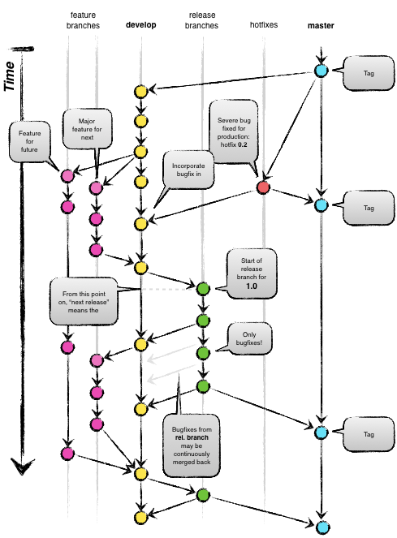

Git Flow
Full-featured workflow
Increased complexity
Designed for SW with official releases
Feature branches based off of develop
Git extensions to enforce policy
How are develop and master synchronized?
Where do merge conflicts occur and how are they resolved?

Slide 21
More Workflows
GitHub Flow (Scott Chacon)
No structured release schedule
Continuous deployment & continuous integration allows for simpler workflow
GitLab Flow

Slide 22
Conclusions
Version control is an amazing tool
Parallel and distributed working requires coordination and rules to be productive and produce correct code
Appropriately chosen workflows can ensure quality results and help debugging/verification while helping productivity
Adopt what is good for your team
Consider team culture and project challenges
Assess what is and isn’t feasible/acceptable
Start with simplest and add complexity where and when necessary

Slide 23
What do we want from a workflow?
Develop a clear set of polices that
results in correct code on a particular branch (usually master),
ensures that a team can develop in parallel and communicate well,
minimizes difficulties associated with parallel and distributed work, and
minimizes overhead associated with learning, following, and enforcing policies.

Slide 24
Resynch Feature and Master Branches
Merge master branch into feature branch to
Get new commits that are useful for feature (see also cherry pick)
Resolve a merge conflict
Branch longer lived than other branches
Disadvantages
Can complicate repository graph if done often
Pollute branch history, which can needlessly complicate code reviews
Notes:
Merge might pull in many commits not needed by branch and pollute the history (as seen by Pull Request for example). This could complicate a code review.

