Slide 1

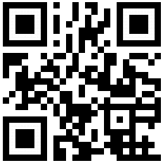
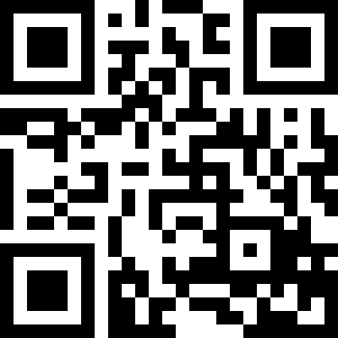
Welcome to…
David E. Bernholdt, Anshu Dubey, Michael Heroux, Jared O’Neal
8:30am-5:00pm, Monday 12 November 2018
Tutorial slides http://bit.ly/sc18-bssw-tutorial
Tutorial evaluation form http://bit.ly/sc18-eval
See slide 2 for license details and requested citation

Slide 2
License, Citation and Acknowledgements
License and Citation
This work is licensed under a Creative Commons Attribution 4.0 International License (CC BY 4.0).
Each module of this tutorial is available individually with its own citation and DOI. Details in each module. This module is DOI: 10.6084/m9.figshare.7309877
The requested citation the complete collection of modules representing this whole tutorial is: David E. Bernholdt, Anshu Dubey, Michael A. Heroux, and Jared O’Neal, Better Scientific Software tutorial, in SC ‘18: International Conference for High Performance Computing, Networking, Storage and Analysis, Dallas, Texas, 2018. DOI: 10.6084/m9.figshare.c.4293800
Acknowledgements
This work was supported by the U.S. Department of Energy Office of Science, Office of Advanced Scientific Computing Research (ASCR), and by the Exascale Computing Project (17-SC-20-SC), a collaborative effort of the U.S. Department of Energy Office of Science and the National Nuclear Security Administration.
This work was performed in part at the Argonne National Laboratory, which is managed managed by UChicago Argonne, LLC for the U.S. Department of Energy under Contract No. DE-AC02-06CH11357.
This work was performed in part at the Oak Ridge National Laboratory, which is managed by UT-Battelle, LLC for the U.S. Department of Energy under Contract No. DE-AC05-00OR22725.
This work was performed in part at Sandia National Laboratories. Sandia National Laboratories is a multi-mission laboratory managed and operated by National Technology and Engineering Solutions of Sandia, LLC., a wholly owned subsidiary of Honeywell International, Inc., for the U.S. Department of Energy’s National Nuclear Security Administration under contract DE-NA0003525. SAND NO SAND2017-5474 PE

Slide 3
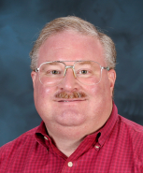
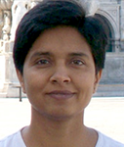
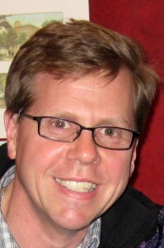
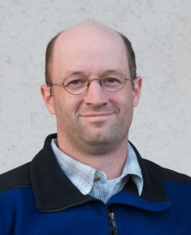



Tutorial Instructors
David Bernholdt, ORNL
Anshu Dubey, ANL
Mike Heroux, SNL
Jared O’Neal, ANL
Members of the IDEAS Productivity Project: http://ideas-productivity.org
Focus: Increasing CSE software productivity, quality, and sustainability
David
Anshu
Mike
Jared

Slide 4
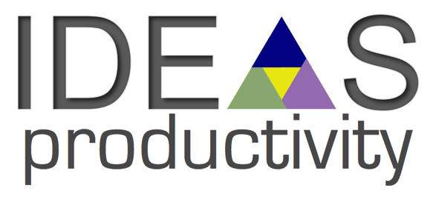
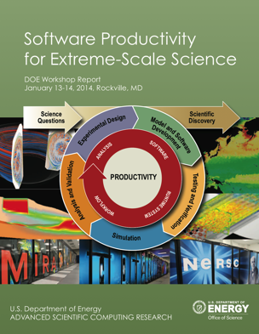
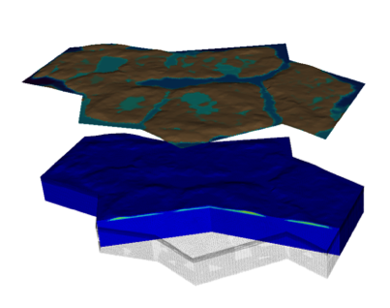


Interoperable Design of Extreme-scale Application Software (IDEAS)
Motivation
Enable increased scientific productivity, realizing the potential of extreme- scale computing, through a new interdisciplinary and agile approach to the scientific software ecosystem.
Project History
IDEAS began in 2014 as a DOE ASRC/BER partnership to improve application software productivity, quality, and sustainability. In 2017, the DOE Exascale Computing Project began supporting IDEAS to help application teams improve developer productivity and software sustainability while making major changes for exascale.
Impact on Applications & Programs
Terrestrial ecosystem use cases tied initial IDEAS activities to programs in DOE Biological and Environmental Research (BER). The Exascale Computing Project (ECP) supports a broad portfolio of applications furthering science, energy, national security, and economic competitiveness.
Objectives
Address confluence of trends in hardware and increasing demands for predictive multiscale, multiphysics simulations.
Respond to trend of continuous refactoring with efficient agile software engineering methodologies & improved software design.
Outreach and Community
Approach
Interdisciplinary multi-institutional team (ANL, LANL, LBNL, LLNL, ORNL, PNNL, SNL, U. Oregon) with broad experience in scientific software development
Close partnerships with applications teams ensures impact on science
Identification, documentation and dissemination of best practices for BER and ECP software teams and the broader community
Catalyzing software process improvements through tailored engagement with individual projects
Working to bend the curve of software development costs downwards
Use Cases: Terrestrial Modeling
Old Process
New Process
Software Productivity for Extreme-Scale Science
Cost
Methodologies for Software
Productivity
Extreme-Scale Scientific Software Development Kit (xSDK)
Start
Progress
Finish
ideas-productivity.org
Notes:
Qualitatively new approach based on making productivity the explicit and primary principle guiding our decisions and efforts.
Developing and demonstrating new approaches for producing, using, and supporting scientific software:
- Enhancing interoperability and performance portability of libraries and components
Establishing methodologies that facilitate delivery of software as reusable, interoperable components.
Right: Upper Colorado River System

Slide 5
Tutorial Objectives
Overview of best practices in software engineering explicitly tailored for CSE
Why: Increase CSE software quality, sustainability, productivity
Better CSE software > better CSE research > broader CSE impact
Who: Practices relevant for projects of all sizes
emphasis on small teams, e.g., a faculty member and collaborating students
Approach:
Useful information, examples, exercises, pointers to other resources
Not to prescribe any particular practices as “must use”
Be informative about practices that have worked for some projects
Emphasis on adoption of practices that help productivity rather than put unsustainable burden
Customize as needed for each project
Remember: your code will live longer than you expect. Prepare for it!

Slide 6
Agenda
Time | Module | Topic | Speaker
8:30am-8:40am | 00 | Introduction and Setup | David E. Bernholdt, ORNL
8:40am-9:00am | 01 | Overview of Best Practices in HPC Software Development | David E. Bernholdt, ORNL
9:00am-10:00am | 02 | Git Workflows | Jared O’Neal, ANL
10:00am-10:30am |  | Break
10:30am-11:40am | 03 | Better (Small) Scientific Software Teams | Michael A. Heroux, SNL
11:40am-12:00pm | 04 | Improving Reproducibility through Better Software Practices | Michael A. Heroux, SNL
12:00pm-1:30pm |  | Lunch (C1/2/3/4 Ballroom, 2nd floor)
1:30pm-2:15pm | 05 | An Introduction to Software Licensing | David E. Bernholdt, ORNL
2:15pm-2:55pm | 06 | Verification and Refactoring | Anshu Dubey, ANL
2:55pm-3:00pm | 07 | Code Coverage and Continuous Integration | Jared O’Neal, ANL
3:00-3:30pm |  | Break
3:30pm-3:40pm | 07 | Code Coverage and Continuous Integration (continued) | Jared O’Neal, ANL
3:40pm-5:00pm | 08 | Hands-on Activities | Jared O’Neal, ANL, and team

Slide 7
Who Are You?
Undergrad students
Graduate students
Postdocs
Faculty/staff
Manager
Other
Academia
National Laboratories
Government
Industry
Other
Domain scientist
Computer scientist
Applied mathematician
Other

Slide 8
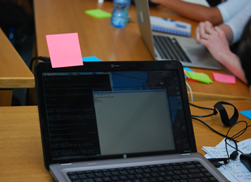
Sticky Notes
More on sticky note teaching https://github.com/gvwilson/sticky-note-teaching
We’re passing out two colored sticky notes to each of you
You can use these to signal us, especially during hands-on by sticking them to the top of your laptop screen like flags
Remember to “reset” (take the sticky down) once you’ve been helped or everyone has synced
Everything’s cool. Ready to proceed
I could use a little help
© North-West University, 2015

Slide 9
Setup for Hands-On Activities
A few things that you can multi-task on while the tutorial proceeds
GitHub account
First used in module 03 Teams
Travis CI account linked to your GitHub account if you would like to use hands-on time to create your own repository linked with Travis CI
First used in module 07 Coverage/CI or module 08 Hands-On
Optional: access to additional tools for a deeper dive in the Hands-On Activities
First used in module 08 Hands-On

Slide 10
Sign Up for a GitHub Account
Go to https://github.com/
Enter a username, your email address, and a password
Verify that you’re a real person
Select the free plan
Complete or skip the interests survey
Check your email and complete the verification
You’re ready to go!

Slide 11
Connect your GitHub Account to Travis CI
Go to https://travis-ci.com/
Click Sign Up with GitHub
Authorize Travis CI to access your GitHub account

Slide 12
Taking the Hands-On Elbows-Deep (Optional)
Depending on your interests, you will need access to a system with some or all of the following tools:
Could be local or remote
Git
Python and perl
A compiler suite (examples will be available in C++ and Fortran)
Gcov code coverage tool (part of GCC compiler suite)
Additional tools of possible interest, but not strictly necessary
Doxygen
Ruby, rake & FRUIT Fortran Unit Test Framework (talk to Jared if interested)
https://sourceforge.net/p/fortranxunit/wiki/Home/

Slide 13
Agenda
Tutorial evaluation form: http://bit.ly/sc18-eval
Time | Module | Topic | Speaker
8:30am-8:40am | 00 | Introduction and Setup | David E. Bernholdt, ORNL
8:40am-9:00am | 01 | Overview of Best Practices in HPC Software Development | David E. Bernholdt, ORNL
9:00am-10:00am | 02 | Git Workflows | Jared O’Neal, ANL
10:00am-10:30am |  | Break
10:30am-11:40am | 03 | Better (Small) Scientific Software Teams | Michael A. Heroux, SNL
11:40am-12:00pm | 04 | Improving Reproducibility through Better Software Practices | Michael A. Heroux, SNL
12:00pm-1:30pm |  | Lunch (C1/2/3/4 Ballroom, 2nd floor)
1:30pm-2:15pm | 05 | An Introduction to Software Licensing | David E. Bernholdt, ORNL
2:15pm-2:55pm | 06 | Verification and Refactoring | Anshu Dubey, ANL
2:55pm-3:00pm | 07 | Code Coverage and Continuous Integration | Jared O’Neal, ANL
3:00-3:30pm |  | Break
3:30pm-3:40pm | 07 | Code Coverage and Continuous Integration (continued) | Jared O’Neal, ANL
3:40pm-5:00pm | 08 | Hands-on Activities | Jared O’Neal, ANL, and team

